Slide 1
Teamwork and Group Success
“The way a team plays as a whole determines its success”
-Babe Ruth

Slide 2
What Types of teams are you on?
Pause for Discussion

Slide 3
What makes a good team?
Pause for Discussion

Slide 4
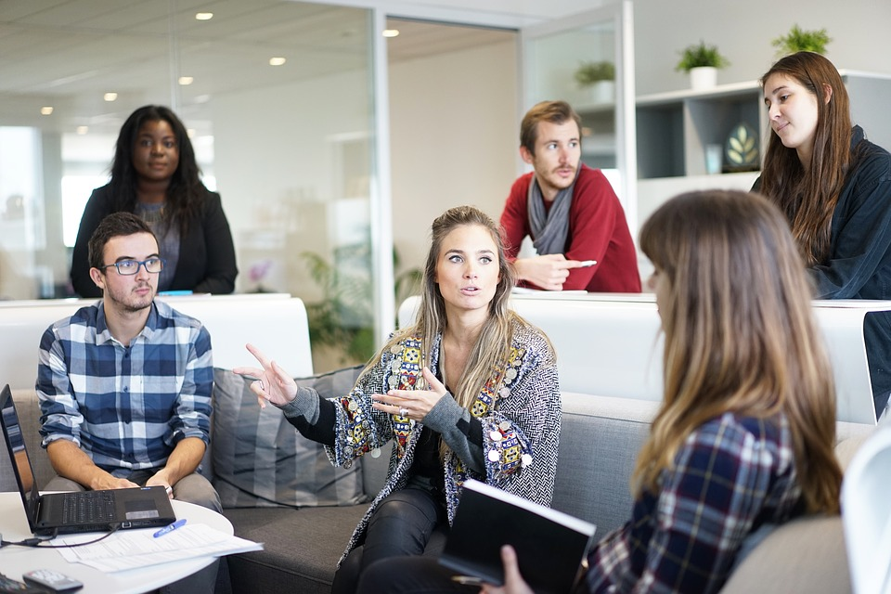
Communication
Listening
Listen more than you speak
Stay focused
Be a mirror
Speaking
Be clear
Balance aggressive/passive communication
Pay attention to your body language
Use “I” statements
Ask Questions
Talk in Person
Think before you speak
Source: Pixbay

Slide 5
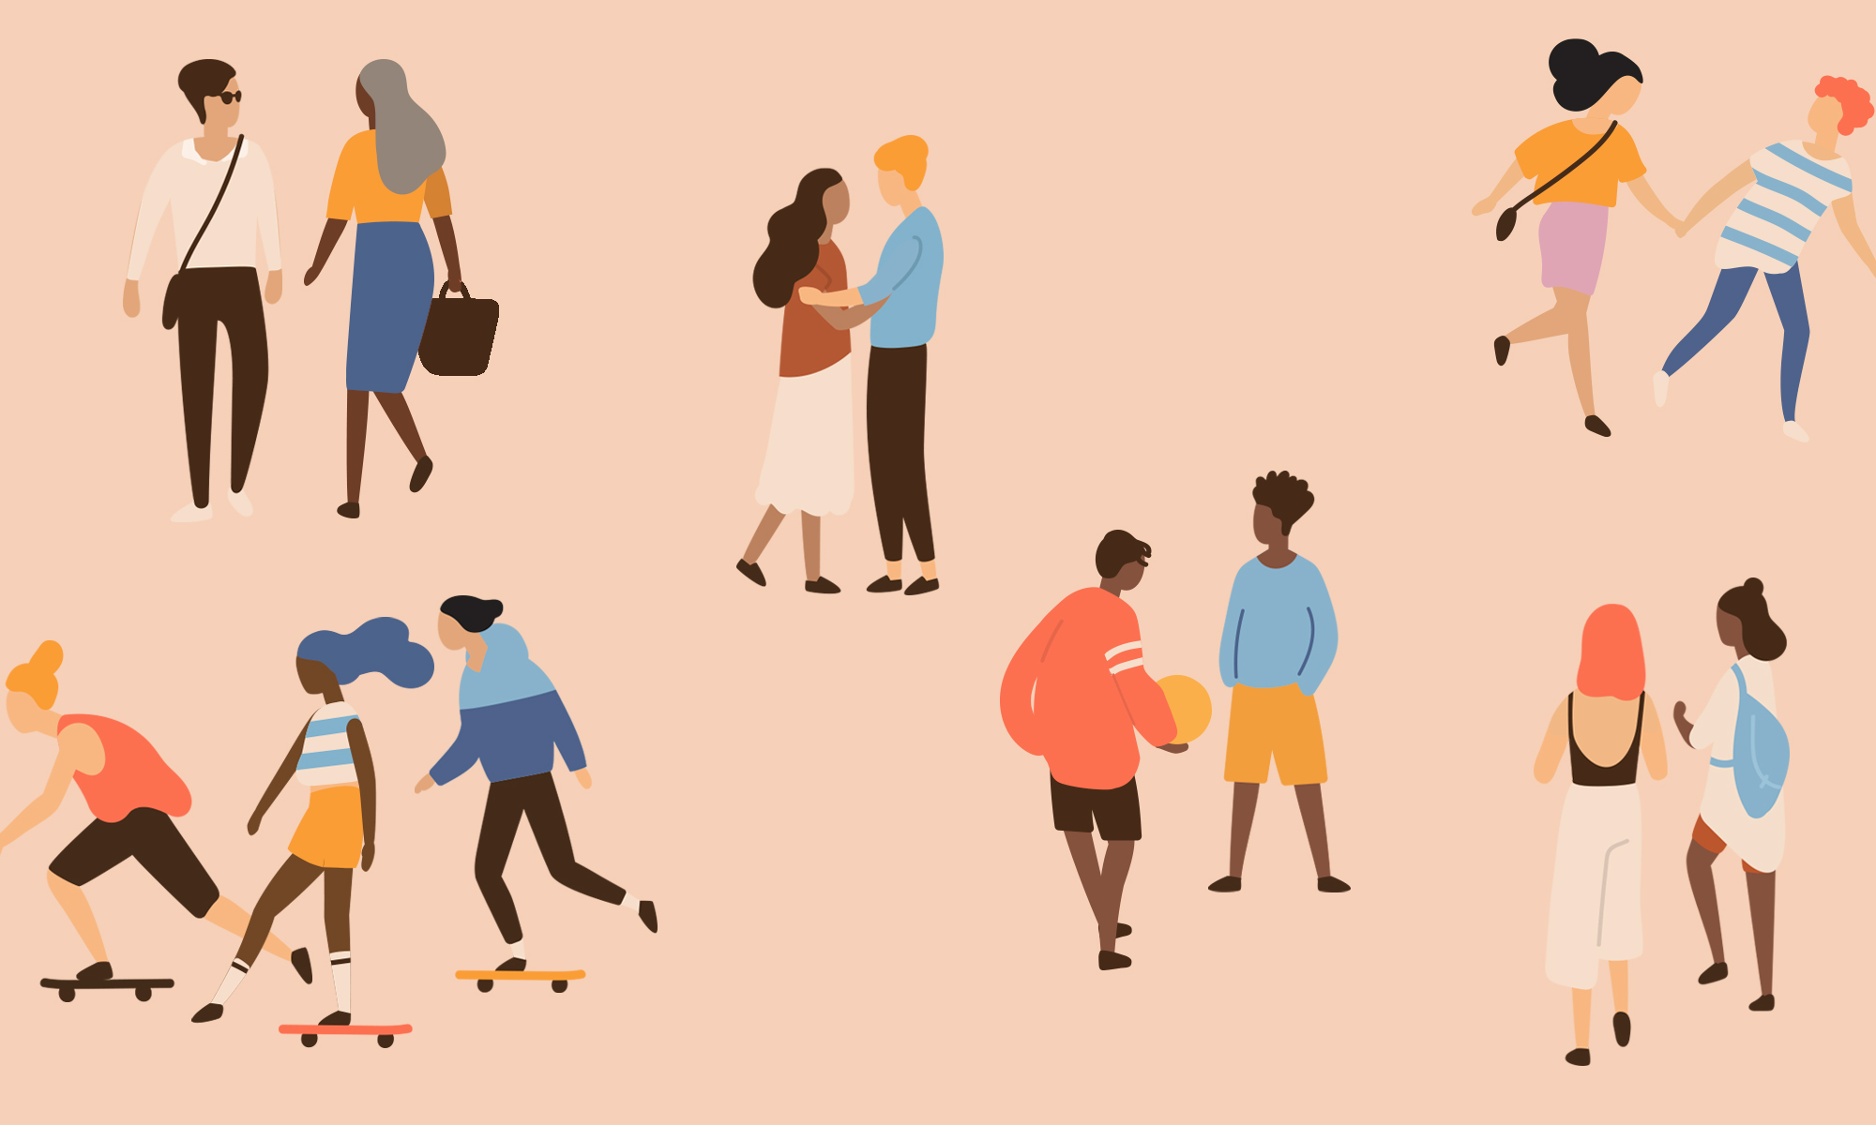
Respect
Respect builds feelings of trust, safety and wellbeing
Acknowledge what every member of the group brings to your team
Value everyone’s input
Respect Individual differences
Make decisions based on what’s right...not who you like
Address mistakes with kindness
Source: Pixbay

Slide 6
Cooperation
Learn to accept others as they are
It’s not your job to change people
Find common ground
Take turns
Offer suggestions
Give praise
Even when it’s tough!
Be empathetic
Be soft...but firm
Get along to get along
We don’t always enjoy working with certain people but we can compromise to complete the task
Source: Pixbay

Slide 7
Scenario #1: Leadership
Jenny is on a team for a group project with people she doesn’t know very well or have much in common with. Everyone is really quiet so it’s a struggle coming up with ideas or making decisions.
Jenny should follow everyone’s lead and remain quiet...eventually someone will do the work.
Do you agree or disagree?

Slide 8
Agree
Disagree

Slide 9
What did you pick and why?
Pause for Discussion

Slide 10
Scenario #2: Conflict Resolution
Michael wants to be a vegetarian and his parents and brothers won’t take him seriously. He has talked to them calmly about the many health and environmental benefits of not eating meat. When it’s time for dinner his mom is serving chicken, again.
Michael has had enough, he has tried the nice way and now he should lose his patience and scream at his parents.
Do you agree or disagree?

Slide 11
Agree
Disagree

Slide 12
What did you pick and why?
Pause for Discussion

Slide 13
Scenario #3: Accepting Responsibility
Kayla is the captain of the field hockey team. It has been a really busy week and she completely forgot that it was her day to bring the snacks before the game.
Kayla should blame her parents for not being prepared, besides she can’t even drive to the store. It’s not her fault.
Do you agree or disagree?

Slide 14
Agree
Disagree

Slide 15
What did you pick and why?
Pause for Discussion

Slide 16
Scenario #4: Respecting Differences
Jayden and his friends enjoy hanging out together and they all have different cultural backgrounds. At lunch Miguel is always getting teased for the different types of foods he brings from home. Jayden can see that even though the friends are joking it hurts Miguel’s feelings.
Jayden should just ignore the problem; besides if it really bothers Miguel he will probably say something about it.
Do you agree or disagree?

Slide 17
Agree
Disagree

Slide 18
What did you pick and why?
Pause for Discussion

Slide 19
Exit Ticket
What is one thing you can do today to improve your role as a teammate?
Source: giphy.com

