Slide 1
STRESS
Catherine Showalter Lineburg
Responses. Influences. Managing
6.1t, 6.2t, 6.3t

Slide 2
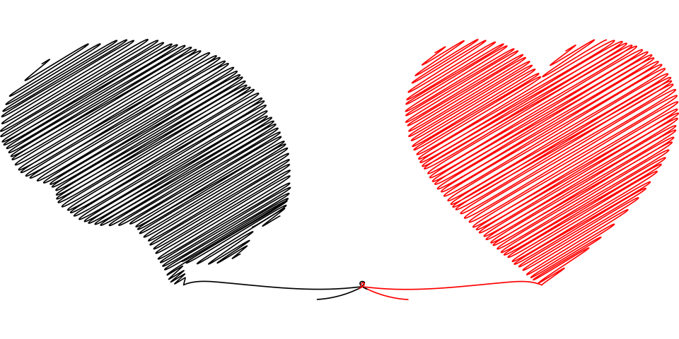
Observe the classroom for a few seconds
Please sit quietly
Listen
Close your eyes
Relax
Peaceful music

Slide 3
How do you feel?
Before coming in the classroom VS. How you feel after having a few quiet moments?

Slide 4
Learning Objectives
I can identify potential positive and negative responses to stress and criticism (6.1t)
I can analyze internal factors, such as responses to criticism or stress, which influence emotional and social health (6.2t)
I can create a plan to manage stress (6.3t)

Slide 5
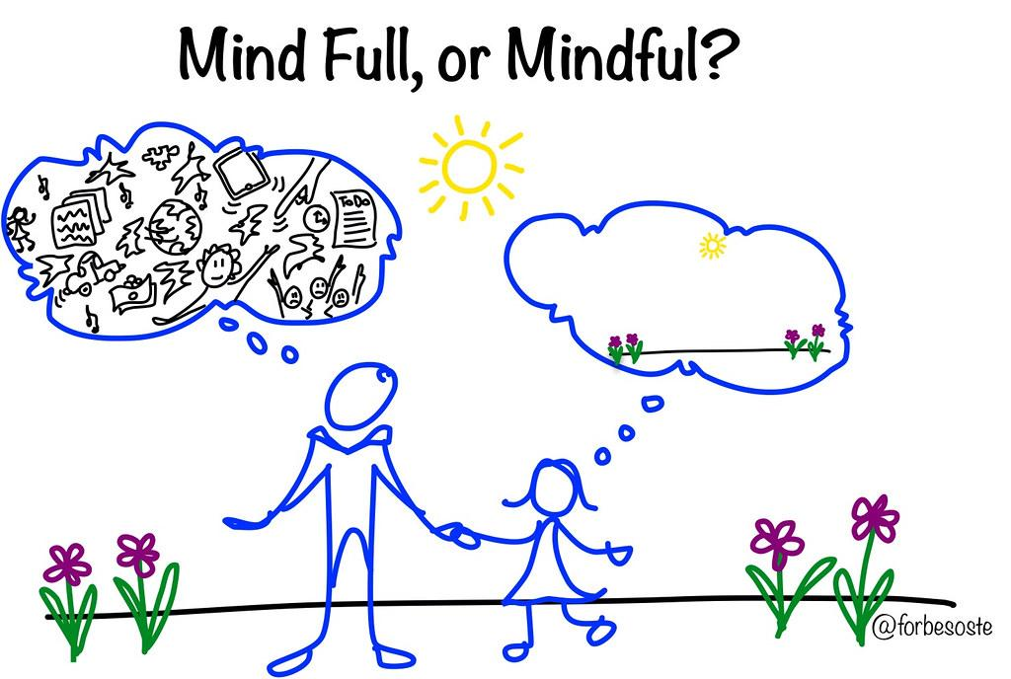
Introduction
What is the first thing that pops into your mind when you hear the word “stress?”
In your own words, how would you define “Stress?”
Key Terms
Internal Stressors
External Stressors
Eustress (positive stress)
Distress (negative Stress)
The Mason Jar

Slide 6
Stress Test Questions
Add the numbers on the Stress Test
Under 20— Low Stress, 21 to 30 — Medium Stress, 31 and up — High Stress

Slide 7
Why is identifying our stressors important?
Do you think ALL stress is bad for you? Explain.
Effects of Stress Worksheet

Slide 8
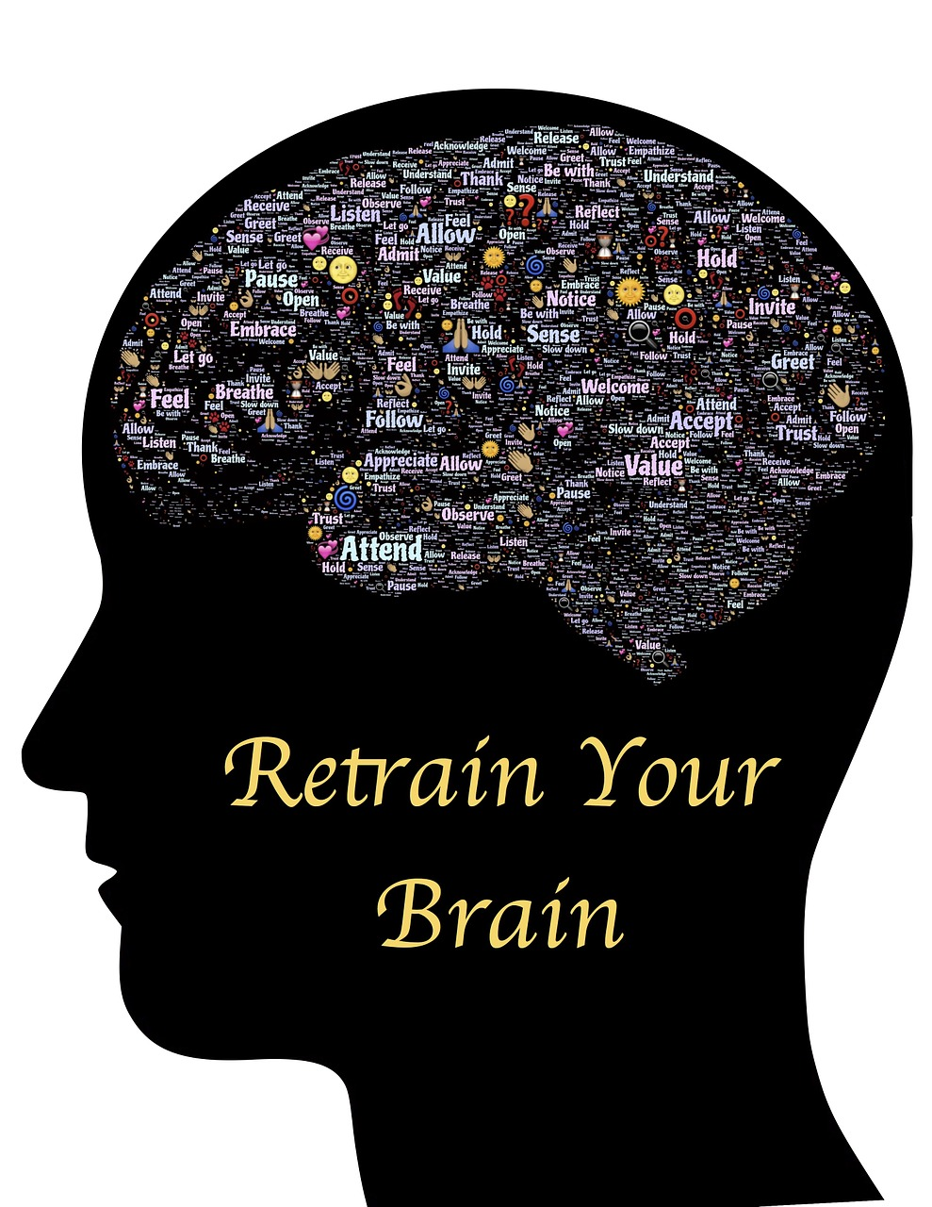
The Stop Practice
The STOP acronym stands for:
S: Stop. Whatever you’re doing, just pause momentarily.
T: Take a breath. Reconnect with your breath. The breath is an anchor to the present moment.
O: Observe. Notice what is happening. What is happening inside you, and outside of you? Where has your mind gone? What do you feel? What are you doing?
P: Proceed. Continue doing what you were doing. Or don’t: Use the information gained during this check-in to change course. Whatever you do, do it mindfully.
Mindful Practice(s)

Slide 9
Practice Yoga Poses
Red Light, Yellow Light, Green Light YOGA Activity
Heartbeat Exercise
Mindful Movement Activities

Slide 10
Closure
Revisit The Mindful Jar
Revisit Questions posed throughout the lesson.
Create a Plan to Manage Stress
Healthy Coping Worksheet
What is mindfulness?
The practice of of paying attention of noting whatever is happening in the moment with a gentle and open mind.

Slide 11
Extensions/Connections/Applications
Extensions/Connections/Applications
Draw a picture & Mindful practice
Watch and stop the video to participate. Mindful Exercise: Still, Quiet Place
Stop the video and have students in class to draw their happy place (just like the character in the video). (5-10 minutes) * Draw with computers or on paper.
Restart the video. Stop video when and close your eyes and “picture yourself” in your happy place. (3-5 minutes)
Finish watching the video.
How did you feel picturing yourself in this happy place? Was it difficult to “quiet” your thoughts?
Remind students that it takes consistent practice to be able to focus and still their minds.
Stress Buster Bingo
Heartbeat Exercise

Slide 12
Resources
Resources/References
Lesson activities are credits to the awesome resource links below that have been borrowed and copied to ensure the lesson supports student learning.
Health Smart
Kids Health
What is mindfulness?
Mindfulness Activities
Mindfulness STOP SKill
STRESSED OUT!
Youth Smart Stress Workbook
Yoga Games
Red Light, Green Light Yoga
Yoga Journal

