Slide 1
Body Image
Catherine Lineburg
Culture, Media, & Other Influences
6.2p & 6.3p Mental Wellness, Social & Emotional Skills

Slide 2
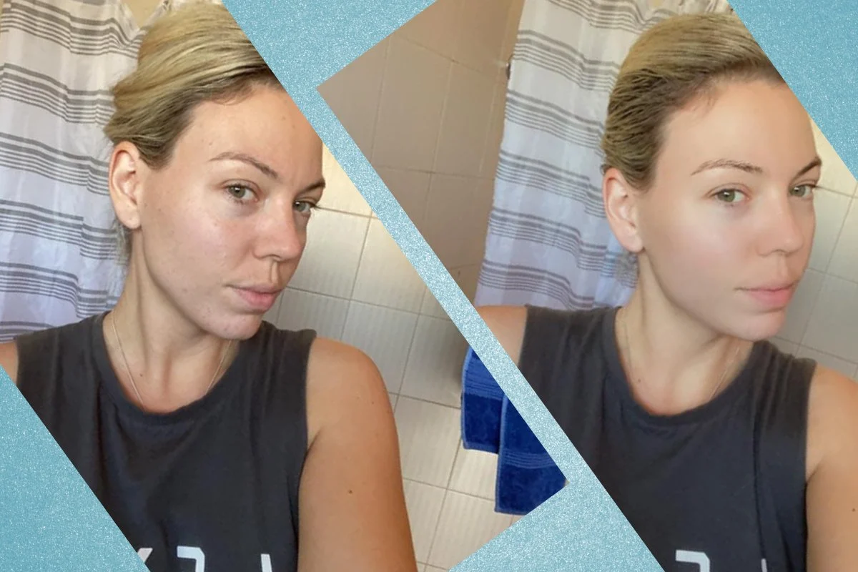
Learning Objective:
I can describe how culture, media, and other external factors influence perceptions about body image (6.2p).
I can analyze the influence of media on issues related to body image (6.3p).

Slide 3
Key Terms
Media: A way of communicating that reaches and affects a lot of people, including television, magazines, advertisements, movies, music videos, video games, and more
Diverse: Different, showing different points of view or coming from different backgrounds.
Self-esteem: Confidence in one's own worth or abilities; self-respect.

Slide 4
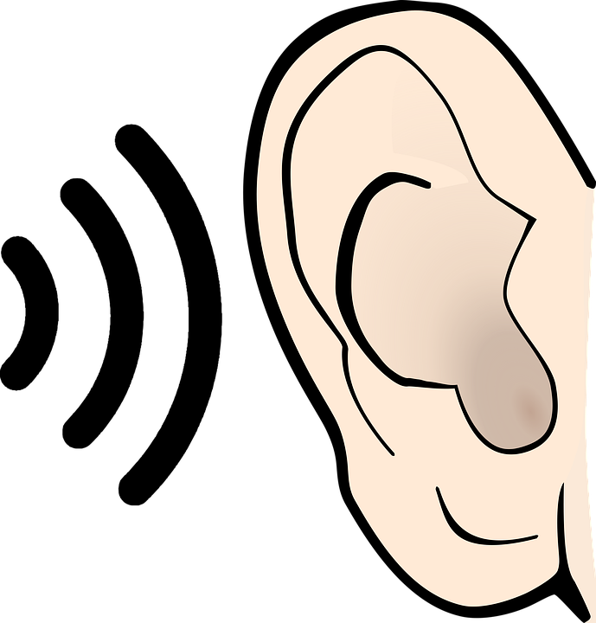
Introduction: Listen & Write
Lyrical Video of I Love Me
Listen to the lyrics of the song, I Love Me, by Meghan Trainor and LunchMoney Lewis.
Listen a second time and then write down lyrics or words you hear that describe a positive body image.

Slide 5
Listen & Watch
We will watch the live video showing the two singers extraordinaire.
Live performance, I Love Me
What was your first thought about Meghan Trainor and LunchMoney Lewis?
Think-Pair-Share: What influenced your thoughts about the two singers? What are the influences that impact our thoughts on body image?
Do you watch television? Play video games? Encourage students to share with each other and talk about what they like and don’t like about different kinds of media.

Slide 6
What else shapes the body images we have of ourselves? What can you/we add?
Friends
Family
Social Media
Television
Toys
Body Image is Shaped By...
Culture
Video games
Advertisements
Movies
Activity 1: Body Image is shaped by....

Slide 7
Activity 2:
Discuss the ways in which that category has shaped our ideas about body image and our perceptions about people who fall outside what is considered “normal” or attractive.

Slide 8
Activity 3:
Culture moderates the level of self-esteem in an individual because it contains certain aspects of their lives, such as their values and beliefs, which become the forefront of how one measures their worth. Self-esteem is a holistic concept, and it is not only impacted from within, but by one's surroundings as well.https://thesociologistdc.com/all-issues/a-cultural-look-on-the-adolescent-mind/
Watch and Discuss:
Reshaping Body Image
Are there any pop-culture celebrities that have changed body image over the last few years? Have pop-culture celebrities changed how we view our bodies in a better way? Or not? Explain.

Slide 9
Activity 4: Optional (Girls only)
What 18 different countries think the ideal women should look like?
How are ideas about body image different in other parts of the world? What do you think accounts for this?

Slide 10
Discussion:
How do you think that fixed ideas about body shape and size in U.S. culture influence you?
Do you think that bias against people because of their body size and shape is acceptable?
Discuss filters, photoshop, social media, magazines, advertisement posters, etc. that can give us all a distorted image of ourselves and our self-esteem.
Common Sense Media Lesson: Picture Perfect. Students learn how photos can be altered digitally. They will consider the creative upside of photo alteration, as well as its power to distort our perceptions of beauty and health.
Media's Impact On Kids
Photoshopping Real Women into Supermodels
Photoshop, Frank Ribery, Boys/Men
Students should list steps they could take to reduce the pressure they feel to look a certain way. WHY IS THIS IMPORTANT?

Slide 11
Closing:
Create a web:
Why I Love My WHOLE Self

Slide 12
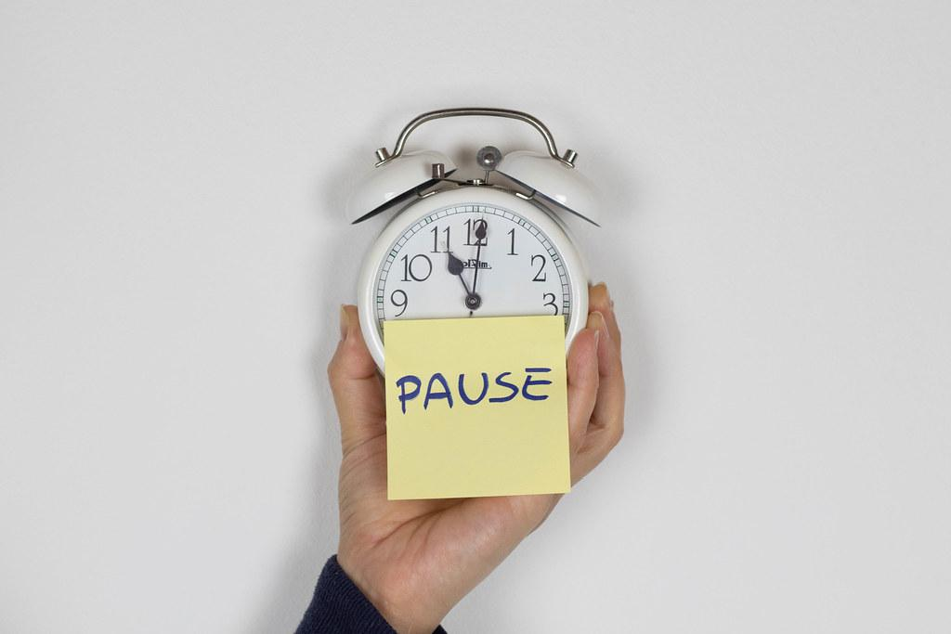
3-Minute Pause

Slide 13
Extensions and Resources
Extensions/Connections/Applications
Have student find a song (Appropriate song) and share the lyrics that make them feel beautiful
Have a student write a “I AM” poem and share it with the class.
Have the students find a quote that makes them feel good about themselves.
Have the students create a positive self-mantra they can repeat when they are feeling low about themselves.
Handouts
Various Body Image Handouts
Resources/References
Common Sense Education: Body Image
Learning for Justice: Body Image & The Media
I see you, you see me
Positive Body Image
Body Activism
Body Image Report and Data

