Slide 1
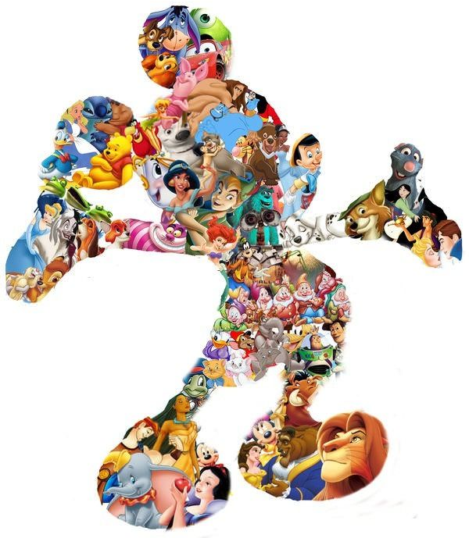
Compliment
a Character
What are compliments?
How can you tell it's a compliment?

Slide 2
Compliment a Character
What are compliments?
...are true
...are specific
...are positive

Slide 3
Compliment a Character
TRUE
It really happened.
An accurate statement.
SPECIFIC
Unique to the individual.
Shows you're paying attention.
POSITIVE
Kind, encouraging words
about who they are & makes them smile!

Slide 4
Compliment a Character
What does it feel like
when you get a compliment?
builds self-esteem
good
confident
weird
important
makes you happy
noticed

Slide 5

Compliment a Character
Graciously ACCEPT it.

