Slide 1
Substance Abuse: Opioids
“There is no segment of society that has been spared of the opioid crisis”
-Andrew Kolodny

Slide 2
What Comes to Mind When you hear the Word Opioid?
Pause for Discussion

Slide 3
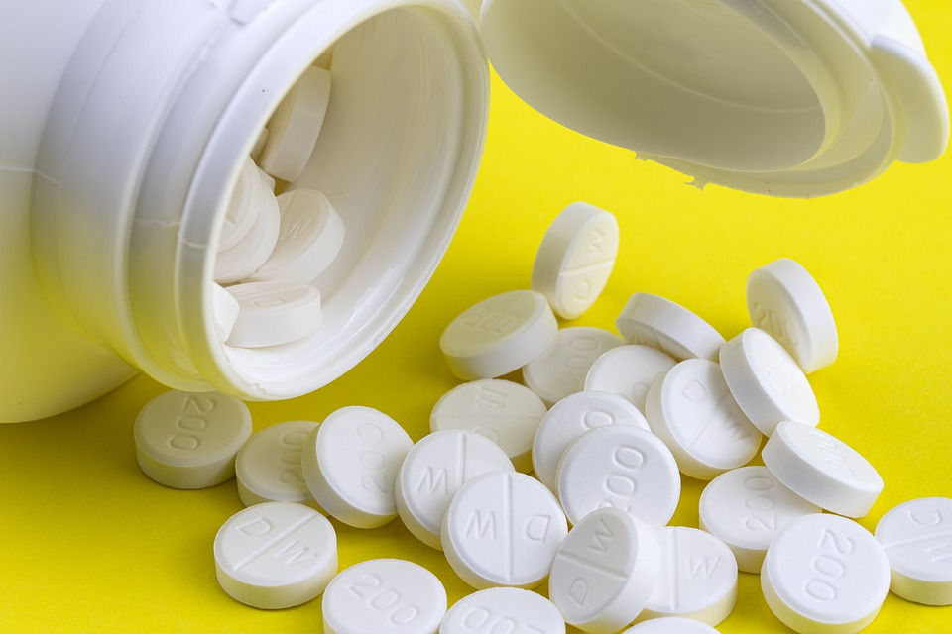
What are opioids?
Opioids are prescription drugs that are used to control pain
If used improperly they can cause dependance, addiction and overdose
The misuse of opioids has led to an epidemic in the United States where hundreds of people die daily and millions are fighting addiction

Slide 4

Examples of Opioids
Prescription Medications (when used incorrectly are illegal drugs)
  Oxycodone (OxyContin®)
  Hydrocodone (Vicodin®)
  Codeine
  Morphine
  Many others
Street Drugs (illegal drugs)
  Heroin
  Fentanyl
  Synthetic Drugs

Slide 5
What are the risks of taking opioids?
Side effects of opioids include sleepiness, itching, constipation or upset stomach
If taken longer than prescribed other risks can occur
  developing a tolerance (needing more opioid for the same pain relief)
  physical dependence (having symptoms of withdrawal when the opioid is stopped)
  addiction (when someone has very strong cravings and will continue to take an opioid even when it causes problems with health, relationships, and money)
Taking too much of an opioid or mixing it with other drugs and/or alcohol can lead to overdose and death

Slide 6

What happens when someone is addicted?
Someone addicted to opioids will want to get more when the prescription runs out
This can lead to inappropriate or risky behavior, such as lying to a health care provider to get a new prescription, buying opioids from a friend, stealing opioids from friends or family, or buying and using street drugs

Slide 7
Can I become addicted to opioids?
Most kids and teens who take opioids for a short time as instructed by a health care provider do not get addicted
For example, a teen who has surgery or a broken bone and takes an opioid as directed is very unlikely to become addicted
  Taking more of the medicine or taking it for longer than prescribed increases your chances of becoming addicted.
  Sharing this medicine with others puts them at risk for addiction or overdose. Do not share your medicine with anyone.

Slide 8
Where can I get help?
If you or a loved one has a substance abuse issue call SAMHSA's National Helpline at 1-800-662-HELP (4357)
This is free and confidential service is available in English and Spanish

Slide 9
Application: Opioid “Walk-About”
4 Corners Show What You Know
Group 1: What they are
Group 2: What they are NOT
Group 3: When are they legal
Group 4: When are they illegal

Slide 10

Exit Ticket
What is one thing you can do to limit your risk of becoming addicted to opioids?
Source: giphy.com

