Slide 1
Basic First Aid
“Safety doesn’t happen by accident”
-Unknown

Slide 2
Have you ever been in a situation that required first aid?
Pause for Discussion

Slide 3
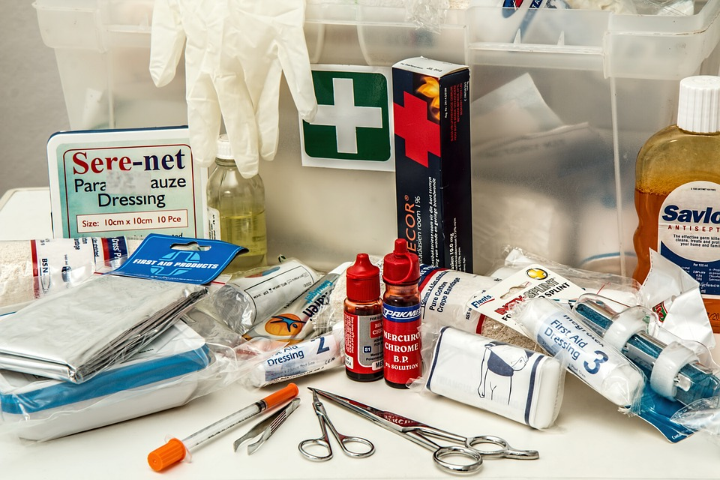
What is first aid?
First aid is immediate care given to someone who becomes injured or ill until regular medical care can be provided
The goal of first aid is to prevent further injury or even speed recovery by knowing what to do in an emergency
Knowing what NOT to do is equally as important
Source: Pixbay

Slide 4
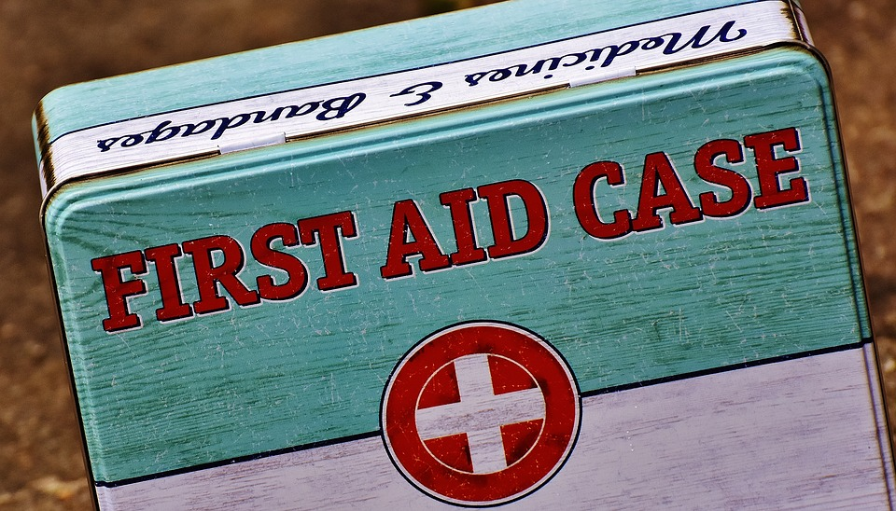
Minor Emergencies
Some injuries are not life threatening
  Cutting your fingertip and it bleeds
  Falling and scraping your knees while skateboarding
These injuries can be cleaned with soap and water and be wrapped or covered with a breathable bandage
Other minor injuries include insect stings and sunburn
Source: Pixbay

Slide 5
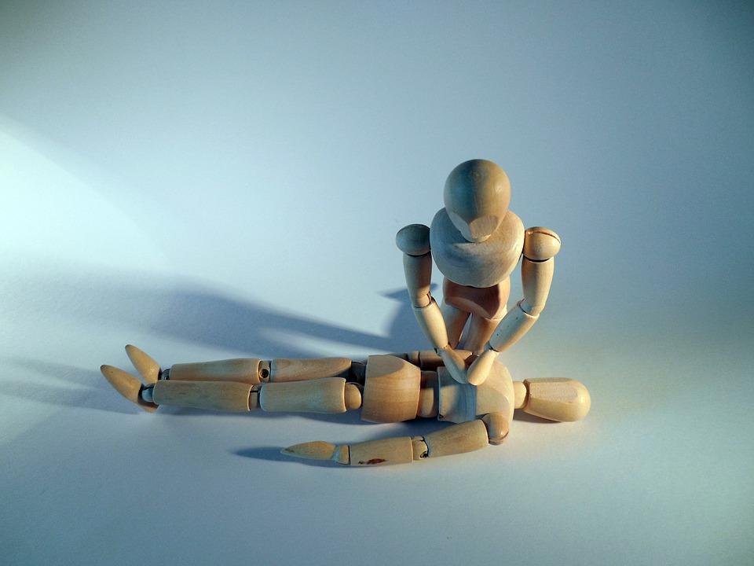
Major Emergencies
Some emergencies can be life threatening
  Someone has stopped breathing
  Someone is choking
  Someone has ingested poison
  Someone is severely burned
These situations require immediate help
  Check the scene and the victim
  Call 911
  Care for the person until help arrives
Source: Pixbay

Slide 6
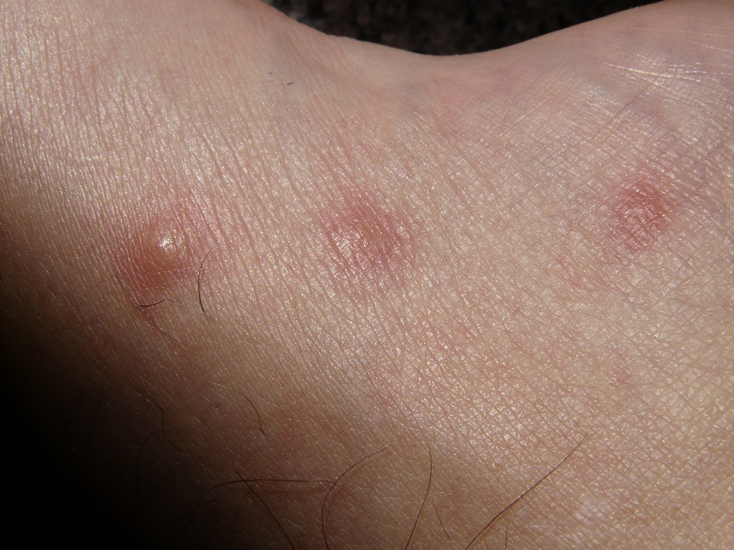
First Aid for Insect Bites
Remove the stinger by scraping it off with a firm, straight-edge object. Do not use tweezers
Wash the site thoroughly with mild soap and water
Apply ice (wrapped in a cloth) to the site for ten minutes to reduce pain and swelling
Continue to apply ice alternating ten minutes on and off
If an allergic person has been stung get medical help immediately
Source: Pixbay

Slide 7
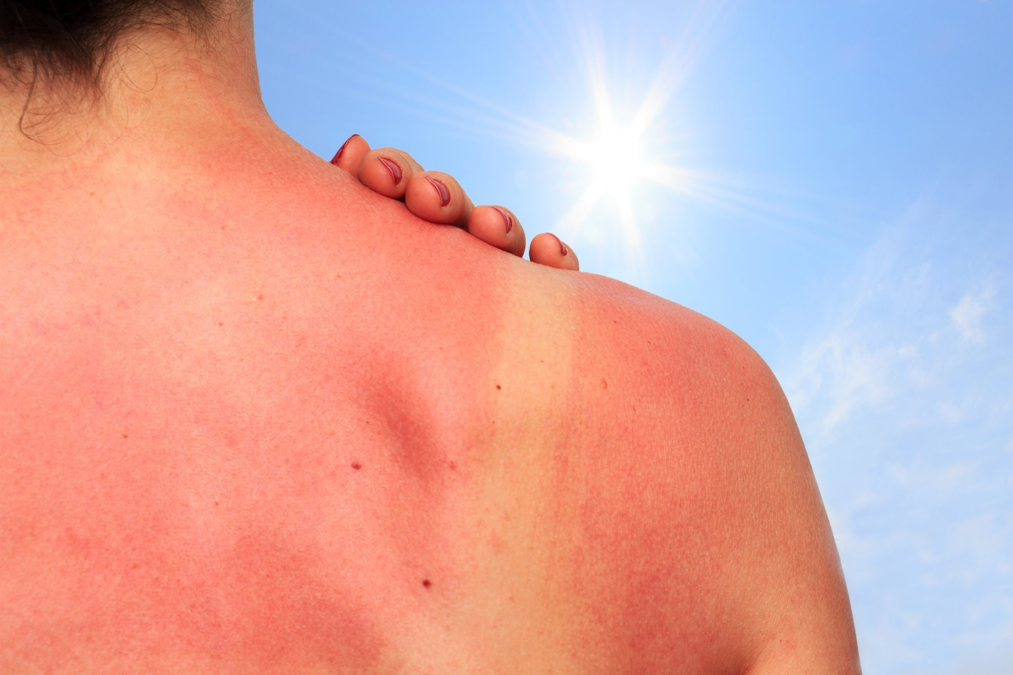
First aid for Sunburn
Take a cool bath or shower and apply a clean towel dampened with cool water
Apply an aloe vera moisturizing lotion multiple times daily
Leave blisters intact to speed healing and avoid infection
Talk to your doctor if the pain increases
Source: Pixbay

Slide 8
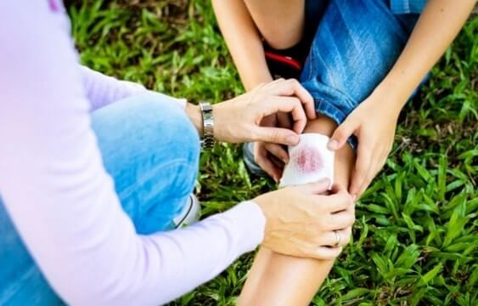
First Aid for Scrapes
Stop the bleeding by applying gentle pressure with a sterile bandage or clean cloth
Clean the wound by rinsing with clean water
Apply a thin layer of antibiotic cream or ointment to the wound
Cover the wound with an adhesive bandage or sterile gauze as it heals
  Change the wound covering twice daily and keep the wound clean
Source: Pixbay

Slide 9
First Aid for Bruises and Sprains
A bruise is when an impact breaks blood vessels below the surface of the skin
A sprain is when ligaments that hold joints in position are stretched or torn
A doctor should always evaluate serious sprains
Minor sprains can be treated using the PRICE method
  Protect the injured part by keeping it still
  Rest the affected joint for 24 to 48 hours
  Ice the injured area to reduce pain and swelling (remove ice every 15 to 20 minutes)
  Compress the injured area by wrapping it in an elastic bandage
  Elevate the injured area above the heart to reduce swelling

Slide 10
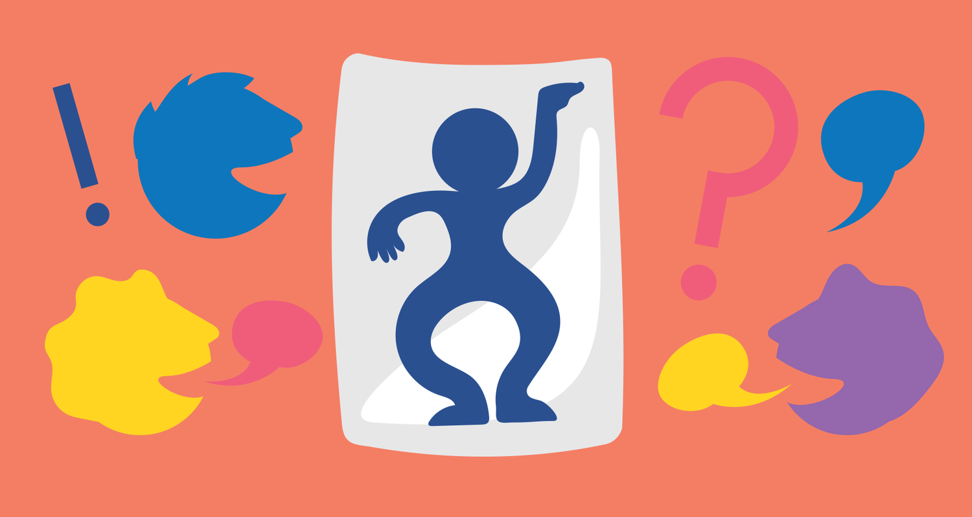
Application: First Aid Charades
Divide students into teams
Each team will take turns acting out a common injury
The first team to correctly guess the common first aid injury AND describe how to treat it gets a pont
The team with the most points wins
Source: Pixbay
Pause Now to Play

Slide 11

Exit Ticket
Why is it important to know basic first aid safety?
Source: giphy.com

