Slide 1
Nutrition:
Meal Planning
“Start where you are. Use what you have. Do what you can”
-Arthur Ashe

Slide 2
Think about the last meal you ate...
Pause for Discussion

Slide 3
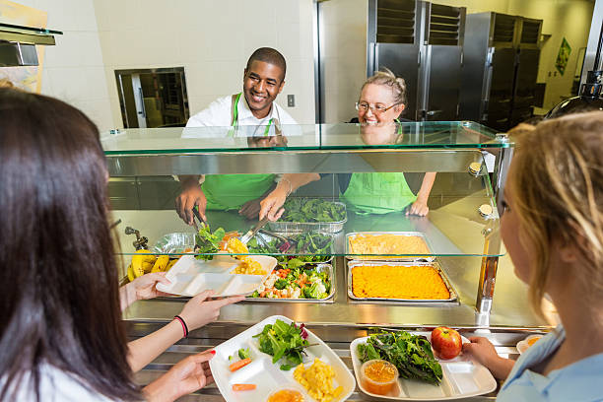
Many factors affect our food choices
  Family/Friends
  Convenience
  Culture
  Media
  Personal Preference
  Availability
When it’s time to eat how can you sort out all of the influences and choose foods to give your body the nutrients it needs?

Slide 4
Planning Healthful Meals
Use Myplate to guide your decision making
Choosing a balance of foods from all five food groups ensures that your body will get the nutrients it needs
When creating meals keep these terms in mind
  Variety: Choose foods from all five food groups
  Moderation: Keep your portion sizes reasonable and limit nutrients that can be harmful such as excessive fat, added sugar and excessive sodium
  Balance: Find the right balance between the amount of food you eat and your level of physical activity

Slide 5
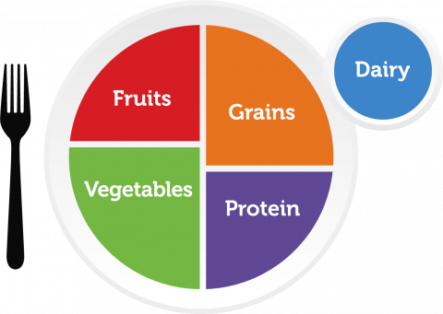
Meal Plan Creation
Create a one-day plan for meals, snacks and drinks
Use the MyPlate graphic to guide you
Make the plan reasonable (something you would actually eat)
You will be sharing these with your peers and voting on the best plan

Slide 6
Application: Speed Presentations
Sell your meal plan
You have 2 minutes to describe your plan to the person in front of you. When your time ends your partner will share their plan.
After both students have shared ONE student moves to the next person and you begin to explain your plan again.
Whole class vote for the best meal plan

Slide 7

Exit Ticket
How likely are you to plan your meals ahead for proper nutrition?
1 = I can do it!
2 = Maybe
3 = Not right now
Source: giphy.com

