Slide 1

YOUR BODY’S
NUTRIENT NEEDS

Slide 2
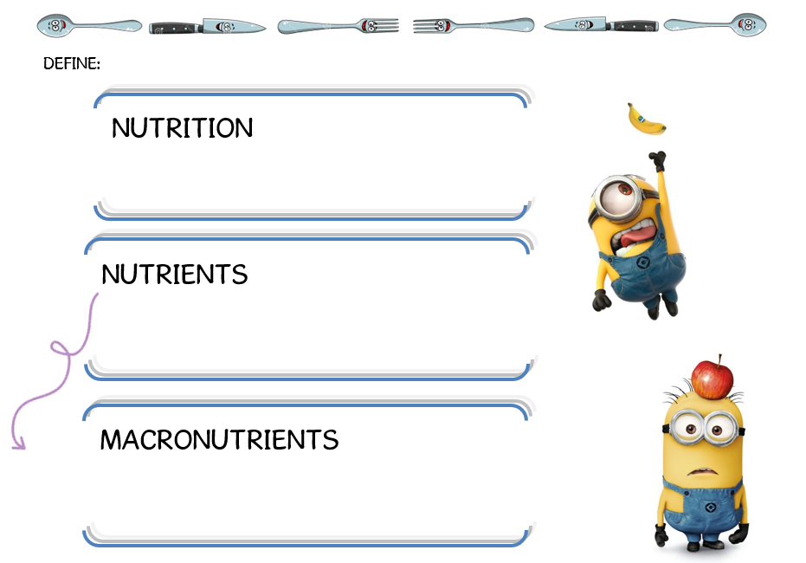
The process of taking in food and using it for energy.
Substances in food that help you function normally.
A type of food required in large amounts.

Slide 3
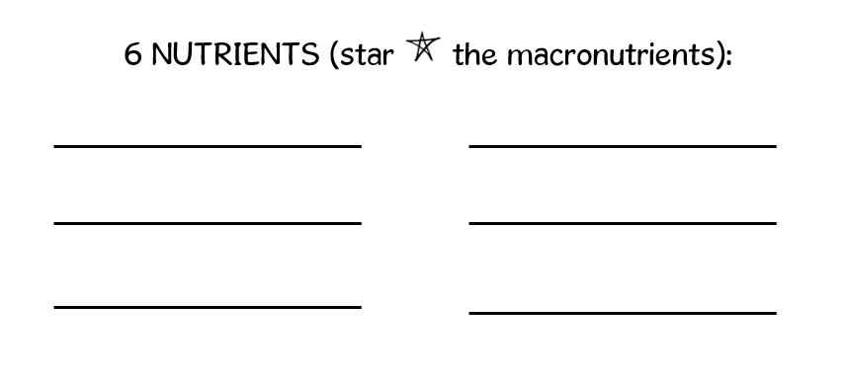

CARBOHYDRATES
VITAMINS
PROTEINS
MINERALS
FATS
WATER

Slide 4
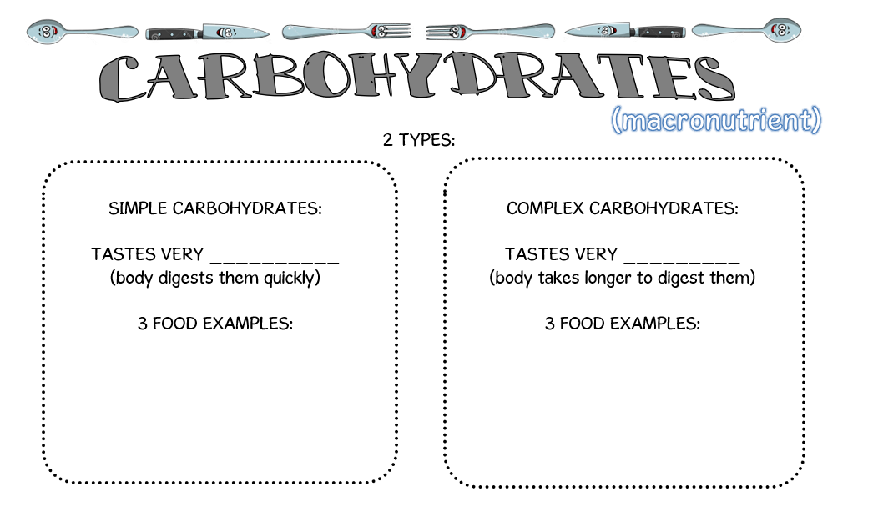
sugary
savory

Slide 5
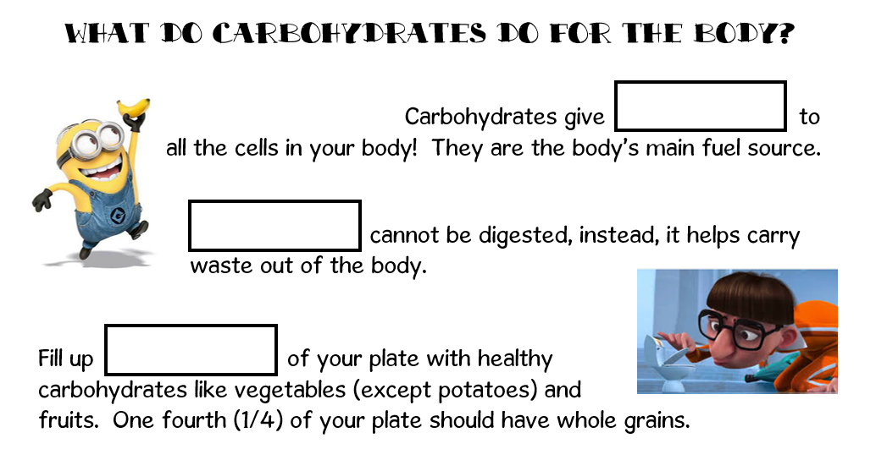
energy
Fiber
Half (1/2)

Slide 6
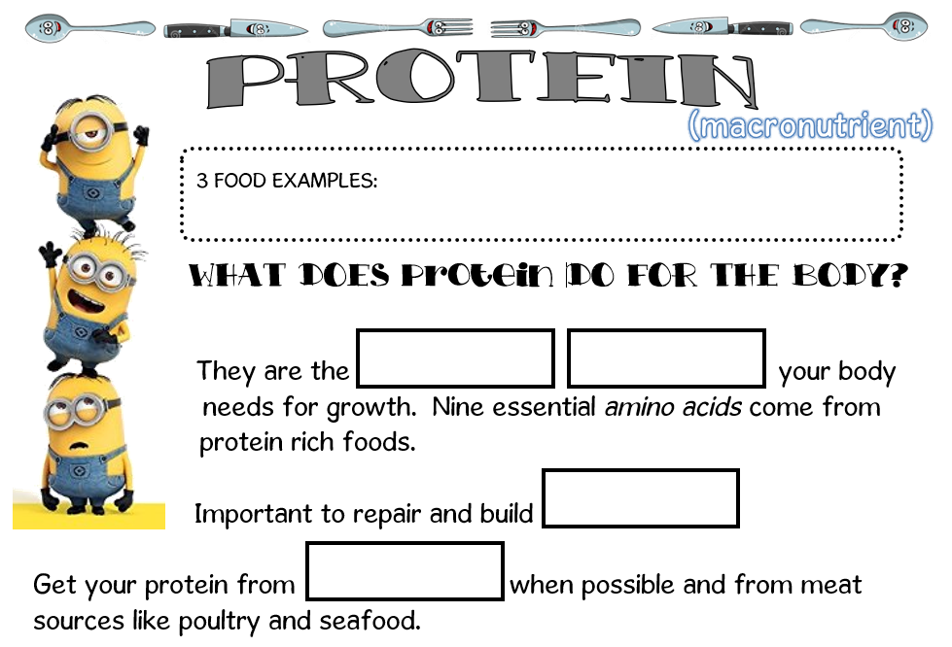
building
blocks
tissue
plants

Slide 7
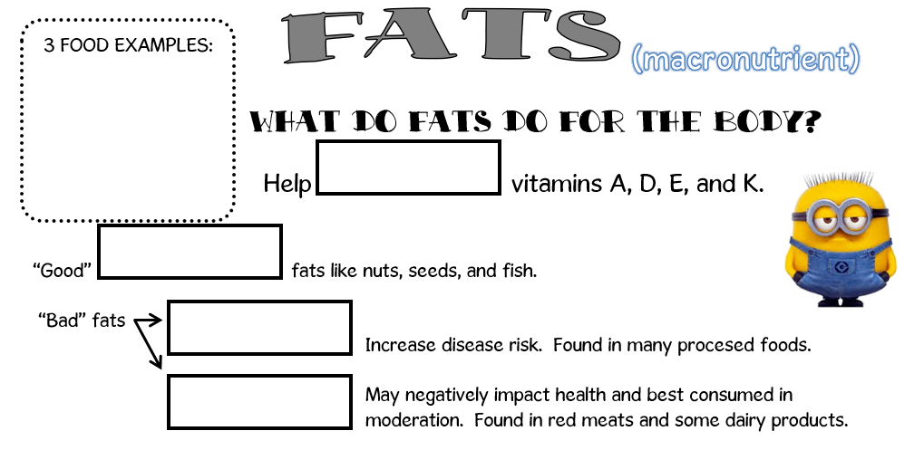
absorb
unsaturated
trans
saturated

Slide 8
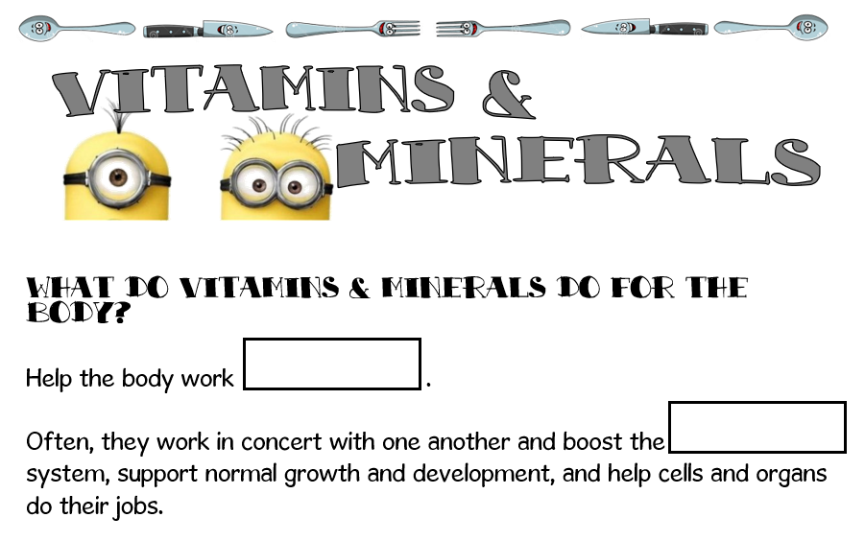
properly
immune

Slide 9
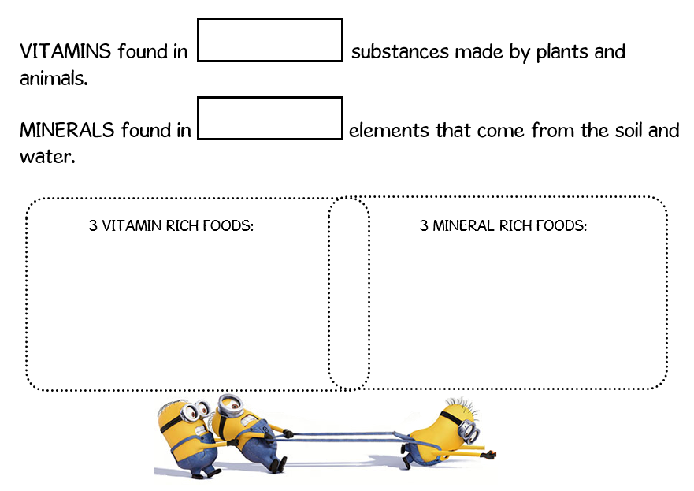
organic
inorganic

Slide 10
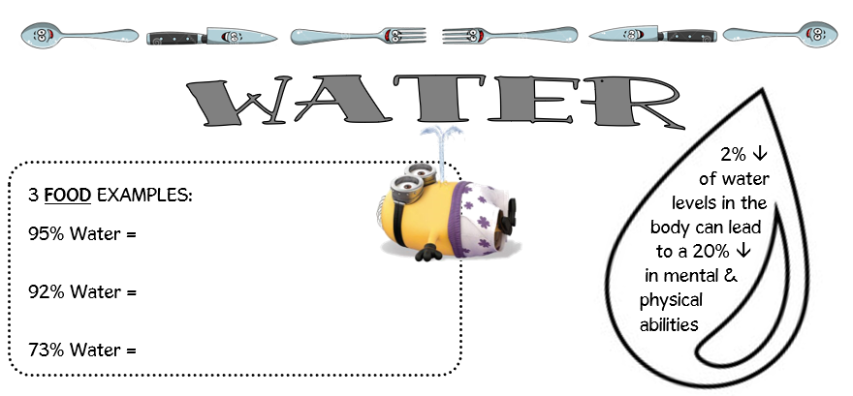
lettuce
watermelon
yogurt

Slide 11
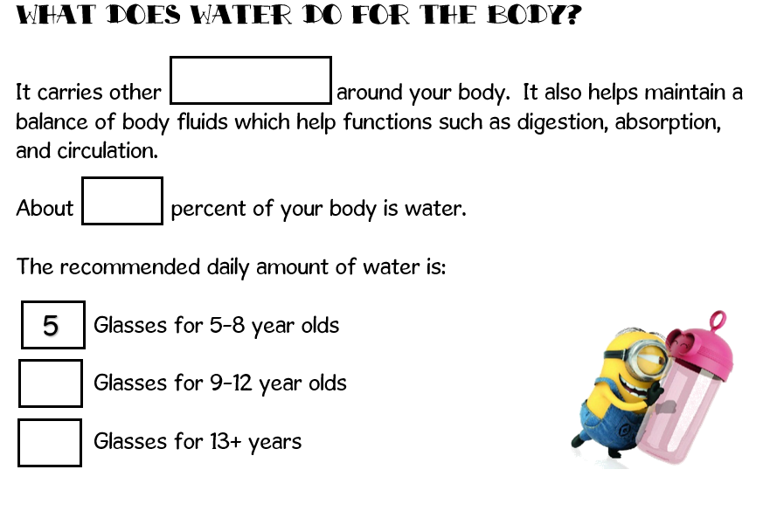
nutrients
60
7
9

