Slide 1
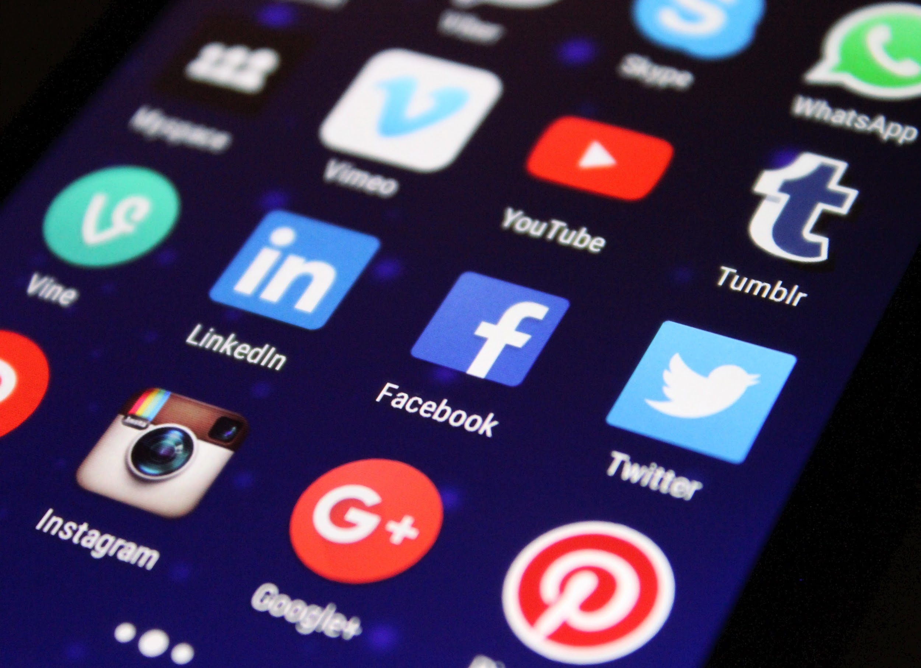
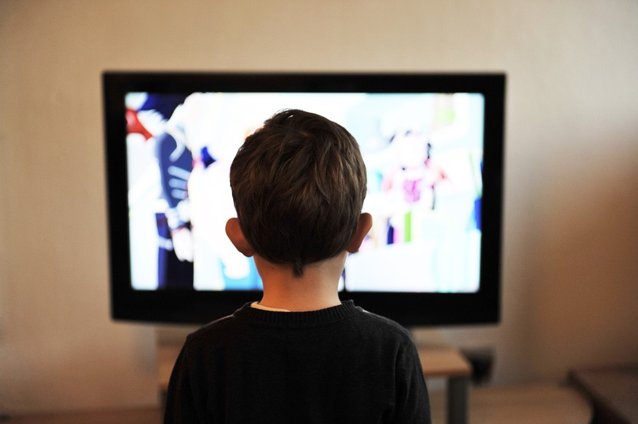
Media Messages

Slide 2
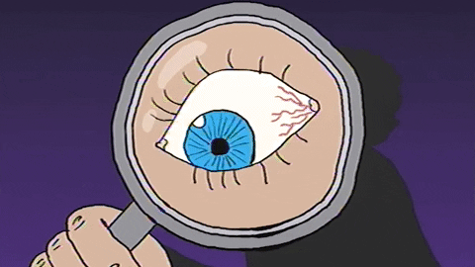
What is Media?
-A way to communicate with a large
number of people over a broad area.
Notes:
https://media.giphy.com/media/l1J3t19OefNssKKfm/giphy.gif
https://media.giphy.com/media/xTiIzrkmUZpP6kYF20/giphy.gif

Slide 3
What is Media Literacy?
“Media literacy is the ability to access, analyze, evaluate, create and communicate using information in all forms.” -Commonsense.org
Notes:
https://media.giphy.com/media/l1J9HWBKLp20YfNAY/giphy.gif

Slide 4
5 Essential Media Literacy Questions For Kids
Who created the message?
Why was the message made?
Who is paying $$$for it? Motives?
How is the message trying to get my attention?
Who is represented & who’s missing?
(Commonsense.org, 2019)

Slide 5
Show Brainpop Media Literacy Video (5:46 mins)
Notes:
Source: https://www.brainpop.com/english/studyandreadingskills/medialiteracy/

Slide 6
Brainpop Media Literacy Video Key Points:
Product Placement inside movies and shows
Scientific claims or statistics
Connecting products with celebrities or cute mascots
Sensationalism (stories in your news feed)
Social media
Data tracking by companies
Learn to read the messages that is what media literacy is all about.

Slide 8
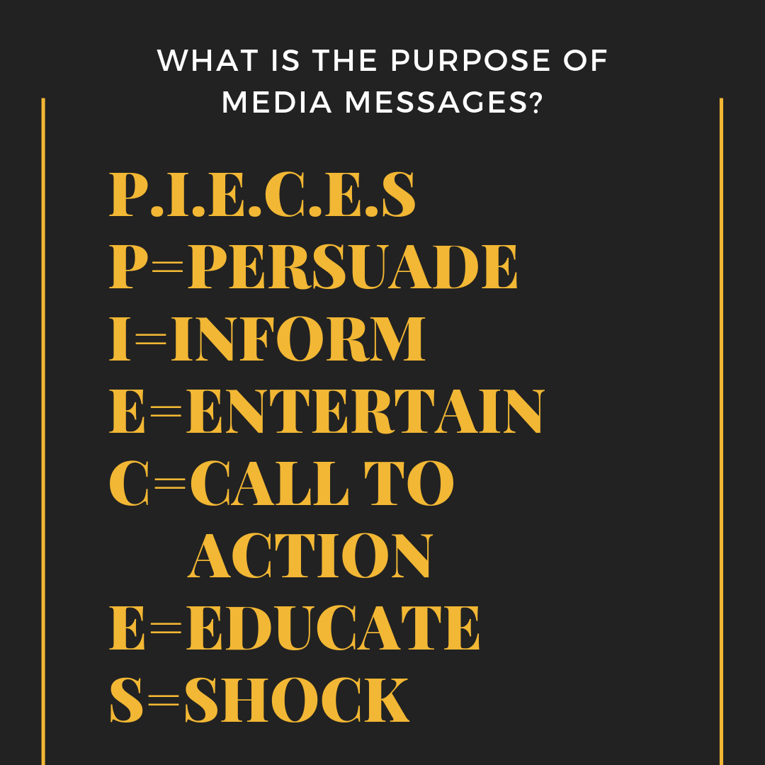

Slide 9
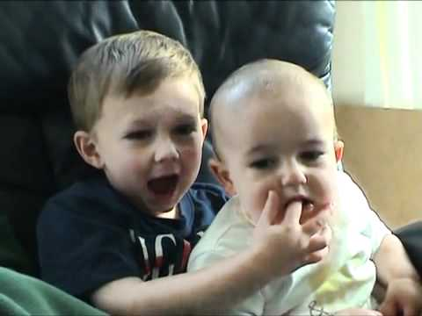
What Is Their Purpose? Motive? Agenda? To...
Inform?
Educate?
Entertain?
Persuade?
Shock?
Call to Action?
Notes:
https://www.youtube.com/watch?v=c2EOa-1InaA

Slide 10
What Is Their Purpose? Motive? Agenda? To...
Entertain
Many things may you watch on social media like YouTube is for likes and/or entertainment purposes
Notes:
https://www.youtube.com/watch?v=c2EOa-1InaA

Slide 11
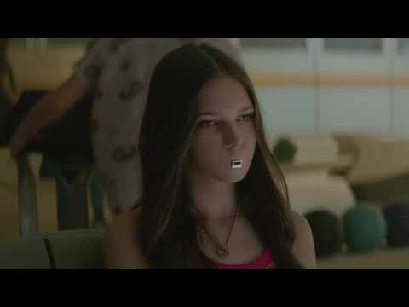
What Is Their Purpose? Motive? Agenda? To...
Inform?
Educate?
Entertain?
Persuade?
Shock?
Call to Action?

Slide 12
What Is Their Purpose? Motive? Agenda? To...
To Educate, Inform & Persuade
This is a public service announcement from the US Dept of Health & Human Services
Notes:
This PSA ad educates young people on the dangers of vaping/juuling and informs youth on the effects of nicotine on the brain.
Key Message: Don’t get hacked!
These messages from this PSA tries to persuade youth to make healthy decisions.
Guiding Questions:
Do you think the US Dept of Health and Human Services cares about your health?
https://therealcost.betobaccofree.hhs.gov/gm/hacked-ends.html
https://www.youtube.com/watch?time_continue=1&v=qbCyPBZYdWk

Slide 13
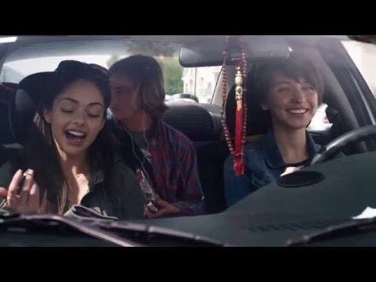
What Is Their Purpose? Motive? Agenda? To...
Inform?
Educate?
Entertain?
Persuade?
Shock?
Call to Action?

Slide 14
What Is Their Purpose? Motive? Agenda? To...
Shock
Secondary purpose: call to action, inform, persuade, educate
This PSA put out by the National Highway Traffic Safety Administration is meant to shock, persuade, inform, educate and call to action the dangers of distracted and driving

Slide 15
Techniques Used In Advertisement To Influence?
Sounds-
Sound effects, music, dialogue, catchy songs
Movement-
Actions, actors
Graphics-
Images and pictures
Colors-
Bright or dull

Slide 16
Propaganda
Messages
In Advertisements
Spreading of information to help or hurt a cause.
Appeals to emotions rather than intellect.
Telling only the side you want people to know.

Slide 17
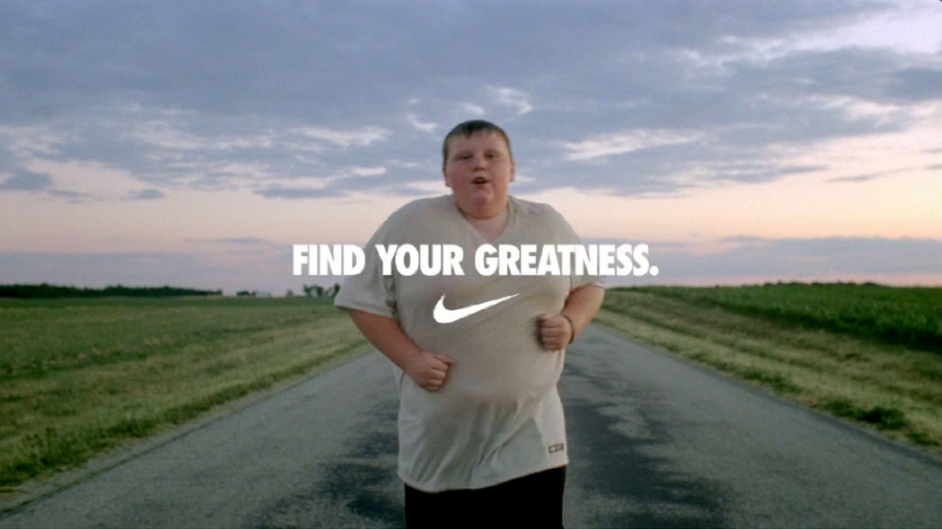
Glittering Generality
(Used in politics and advertising)
Is a vague statement that appeals to positive emotions but isn’t informative or enough to take action.

Slide 18
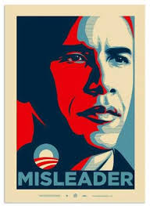
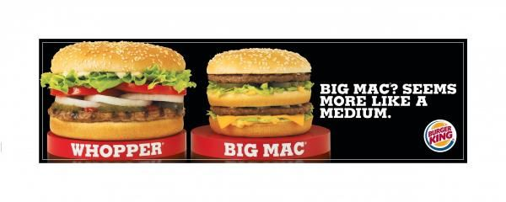
Name Calling
Trash talking another product or person.
Notes:
Sources:
http://www.notobacco.org/photos/large/photo02.jpg
https://thebsreport.files.wordpress.com/2009/09/barack-obama-liar1.jpg
https://images.huffingtonpost.com/2016-11-02-1478105136-3693466-ConMan-thumb.jpg
http://iblal.edublogs.org/files/2017/11/AAEAAQAAAAAAAAqbAAAAJDEwYzA3N2Y4LTZmNTYtNDFhMC1hYWMyLTcwN2YyMmMyYjJhMQ-x725np-1kv2gk8-540x190.jpg

Slide 19
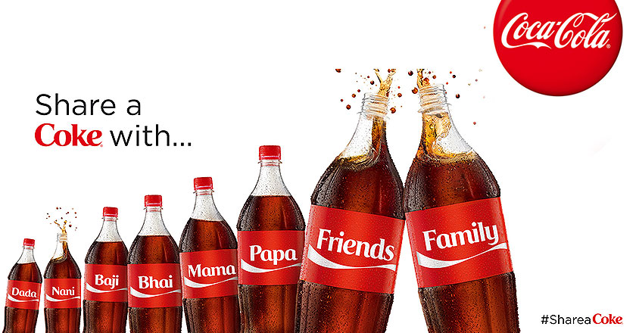
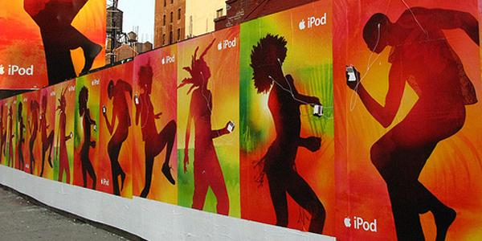
Repetition
repeated words or phrases, &/or repeated visuals

Slide 20
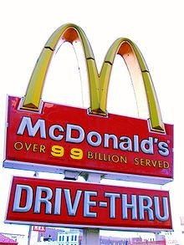
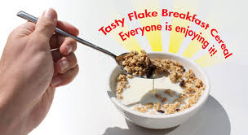
Bandwagon
Appeal to be part of the group
Notes:
https://sites.google.com/site/mstrong13579/_/rsrc/1468857537423/examples-of/220px-Harlem_Micky_Dz.jpg?height=400&width=361
https://encrypted-tbn0.gstatic.com/images?q=tbn:ANd9GcSV8mZXhvQa1OZy-Cu4YbZBSJbBJh8qj86Jxbfh-c6woCVXYjARjQ
https://propagandainsports.weebly.com/uploads/4/5/9/7/45979837/4339928_orig.png

Slide 21
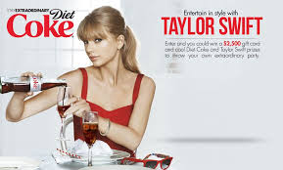
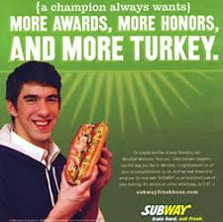
Testimonial
Expert or Famous Person
A person’s written or spoken statement extolling the virtue of a product or brand.

Slide 22
Propaganda Messages in Advertisements
Glittering Generality
Name Calling
Repetition
Bandwagon
Testimonial

Slide 23
Propaganda:
Glittering Generality
Mascot
Techniques:
Sound catchy phrase, graphics,
bright colors

Slide 24
Brand Name
Audience: Children
Propaganda: Glittery Generality
Mascot
Techniques Used: Sound:Catchy Phrase Graphics Bright Colors

