Slide 1
SEE WHAT YOU SAY
Communicating with care, kindness, and respect.

Slide 2
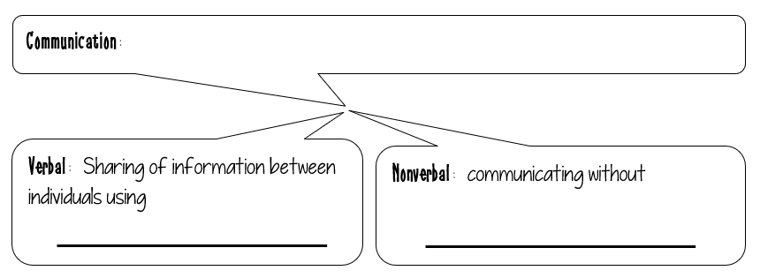
Exchange of information from one person to another.
spoken words/speech.
words.

Slide 3
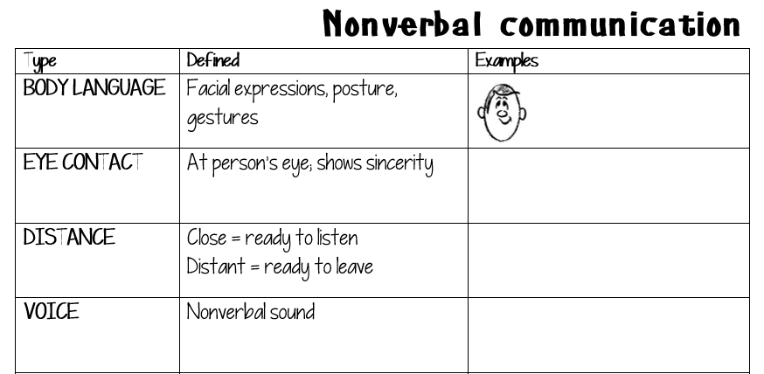
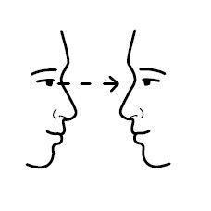
crossed arms tapping toes
Directly at eyes
Whisper and hear
Gasp or sigh

Slide 4
High five, shoulder hug
Uniform; stance on culture
Silence

Slide 6
