Slide 1
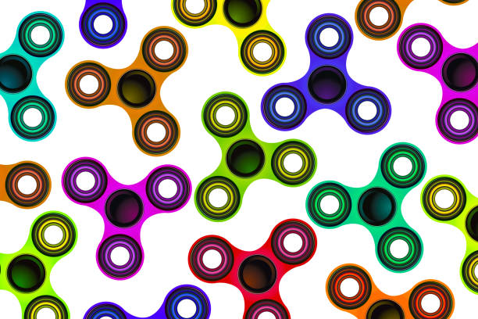
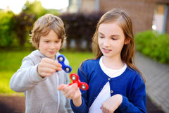
FIDGET SPINNER FRIENDS

Slide 2
What qualities make a good friend?
Trustworthy
Similar likes
Fun
Honest
Listens
Loyal
Dependable
Supportive

Slide 3
What qualities make a someone a ‘bully’?
Breaks rules
Violent
Angry
Controlling
Ignores
Rude
Lacks empathy
Impulsive

Slide 4
Positive Support? What is it? What does it look like?
Offer to help
Don’t judge in disagreement
Use encouraging words
Be respectful of others feelings
LISTEN

Slide 5
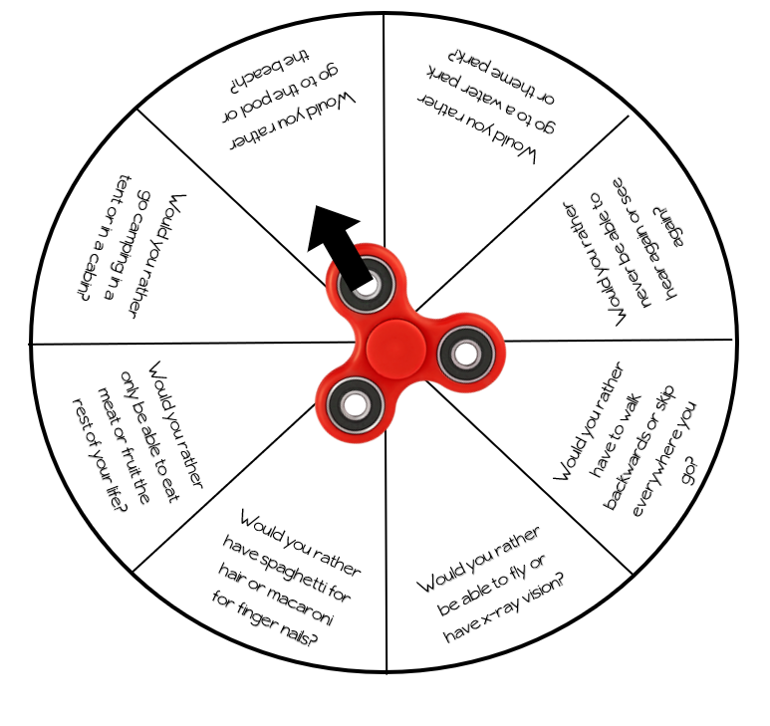

Slide 6
