Slide 1
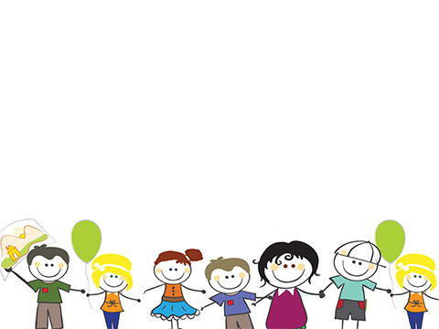
Family
Portraits

Slide 2
1. _____________________ is a basic unity of society; brought together by blood, marriage, adoption, or a desire for mutual support.
Family
2. Strong families
_____________________ each other by fulfilling physical, mental/emotional and social needs.
nurture

Slide 3
Your Family
Partner's Familyl
Same
1.
2.
3.
1.
2.
3.
1.
2.
3.

Slide 4
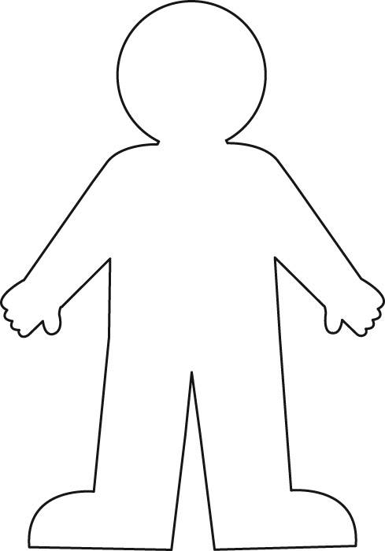
Family Portrait
What does your family look like?
Inside of the person you need to create a collage of your family by drawing or writing…
-means to you
-looks like
-represents
WHAT
FAMILY

Slide 5



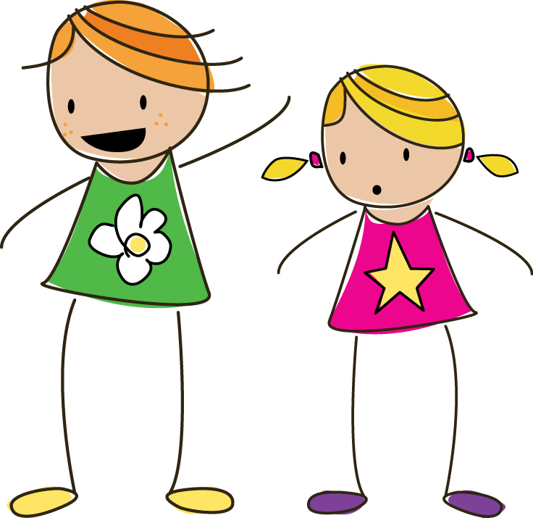
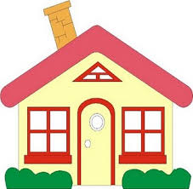
Family Portrait Must Haves:
AT Least:
+5 drawn color pictures
+8 words/phrases
+2 Name bottom right foot
=15 points
funny
care
hugs
Game night
comfort
I love you!
walks
fighting
Mrs. Adams

