Slide 1
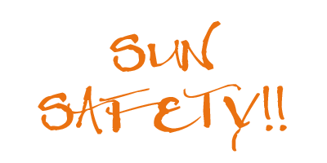
Sun Safety Lesson 1
Grade 5

Slide 2
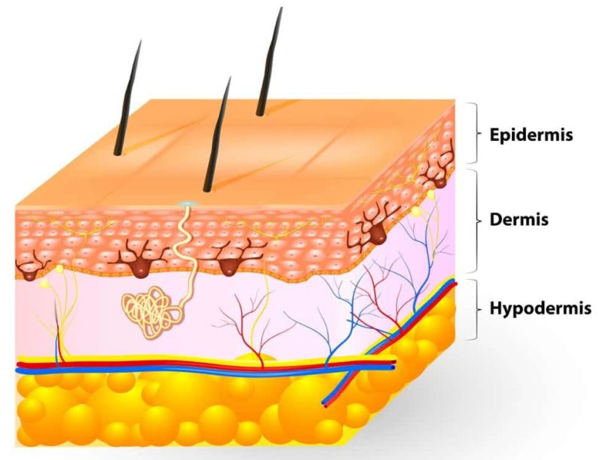
Lesson Objectives
Learning about your skin
What can happen if you don’t protect yourself from the sun.
How to be Sun Smart

Slide 3
How much do you already know about sun safety?
Question | True | False
1. A baseball cap is more protective than a wide-brimmed hat.
2. You can be sunburned in the winter.
3. The sun’s rays are strongest between 6 a.m. and 10 a.m. every day.
4. When you are in the shade, you are always protected from the sun’s rays.
5. All sunglasses protect your eyes against the sun’s rays.
6. Sunscreen is not needed on cloudy days.
7. The sun’s rays are most harmful when your shadow is shorter than you are.
8. You do not ever need to reapply sunscreen when you are outside.

Slide 4
Skin has three layers.
1. Epidermis—New skin cells are made here. It is also where is made. Melanin is what gives skin its color. Melanin protects skin from sun damage by reflecting and absorbing UV rays.

Slide 5
Skin has three layers.
2. Dermis—It has nerves that help you feel sensations. It’s also where sweat, oil, and goose bumps are made. It helps bring blood to your skin. It is also where hairs start.

Slide 6
Skin has three layers.
3. Subcutaneous—It connects the dermis to your muscles and bones and stores fat to help protect them from bumps and falls. It helps your blood vessels and nerve cells reach the rest of your body. This layer helps keep your body from getting too hot or cold.

Slide 7
Ultraviolet A Rays
UVA penetrates the skin more deeply than UVB and plays a major part in skin aging and wrinkling.
Tanning booths primarily emit UVA and emit doses of UVA 12 times that of the sun.

Slide 8
Ultraviolent B Rays
UVB rays have slightly more energy than UVA rays. They can damage the DNA in skin cells directly, and are the main rays that cause sunburns. They are also thought to cause most skin cancers.

Slide 9
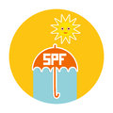
How can we protect ourselves?
Apply sunscreen with a Sun Protection Factor (SPF) of 30 or higher at least 30 minutes before you go outside. SPF 30 blocks 97% of UV rays.
The sun’s rays are most harmful when the sun is directly overhead between 10 a.m. and 4 p.m. Rays are strongest in the summer, but can also be harmful in the winter.

Slide 10
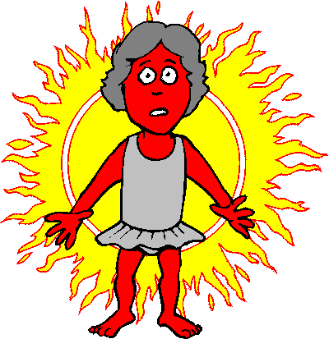
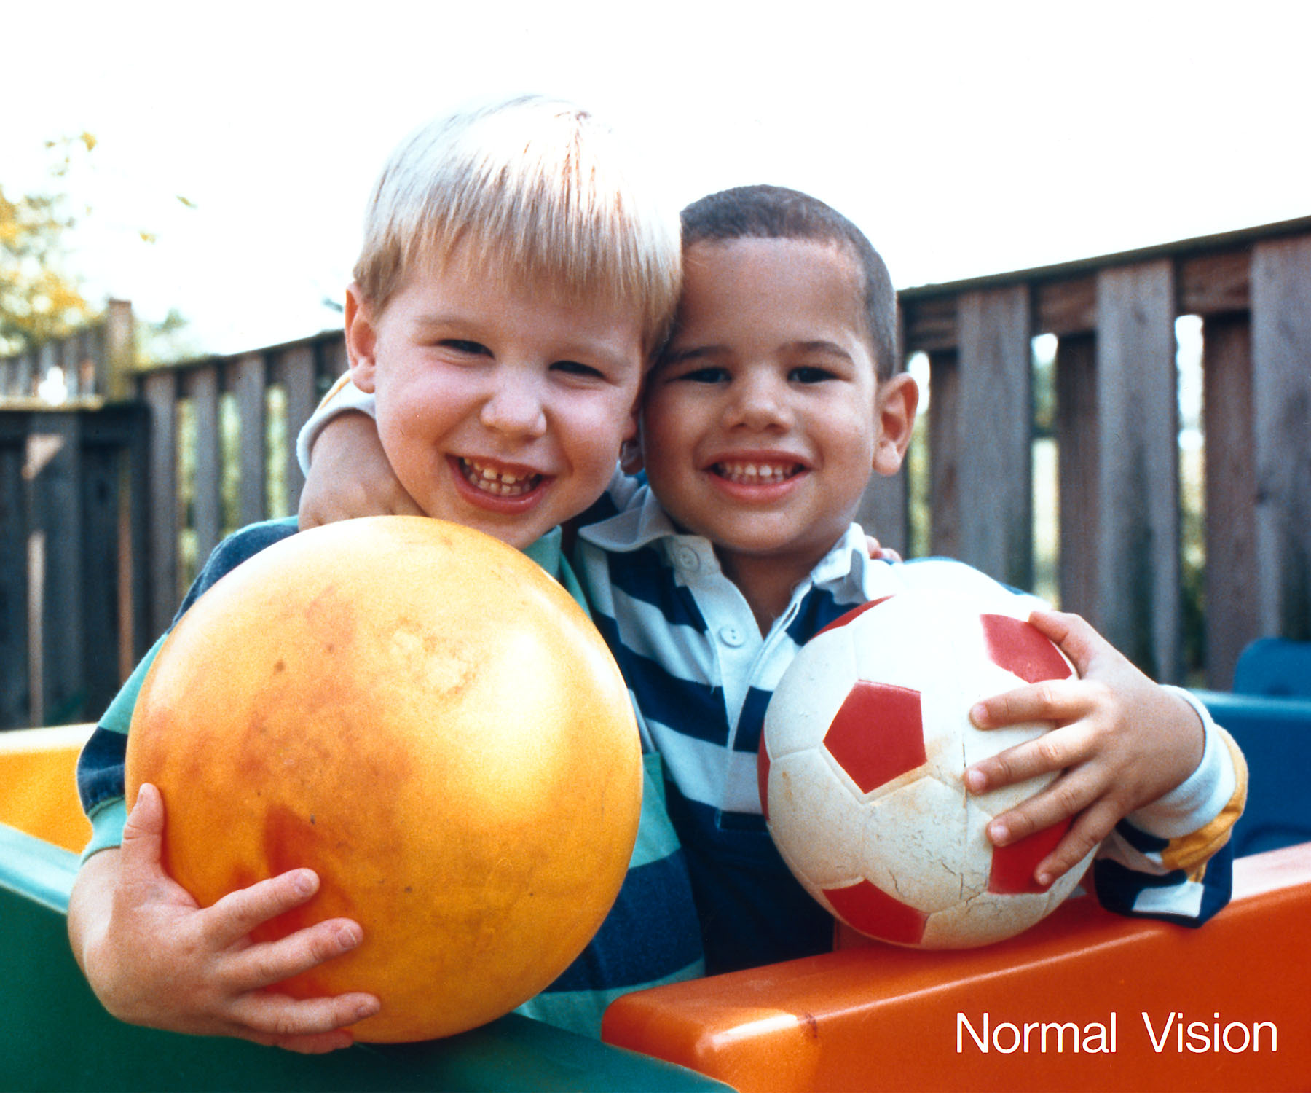
Health Risks of Unprotected Sun Exposure
Sunburn occurs when a person has been exposed to the ultraviolet rays of the sun for too long.
People with blond or red hair and have light colored skin and light-colored eyes, tend to get a sunburn more quickly because they have less melanin than someone with dark eyes and skin because they have more melanin.

Slide 11
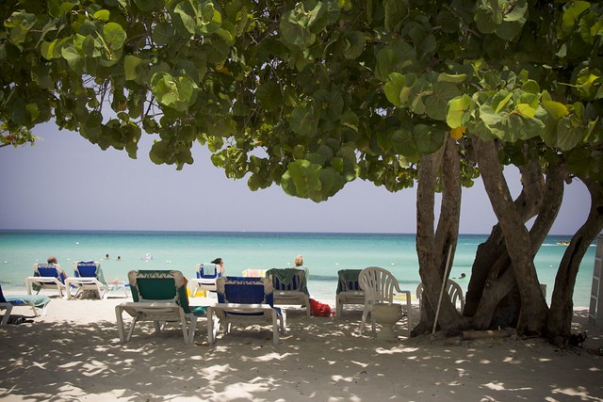
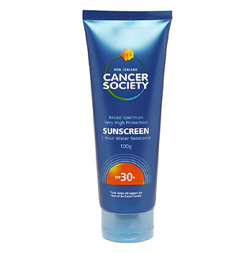
Sunscreen
The rays of the sun are strongest and most harmful between 10 a.m. and 4 p.m. The sun’s rays are strongest in the summer, but its rays can also be harmful in the winter. Always wear sunscreen with a sun protection factor (SPF) rating of 30 or higher. Apply 15-20 minutes before going into the sun and every two hours in the sun.
Take breaks from the sun by going indoors or move to shady areas.
The number rating on the sunscreen means how much longer you can stay in the sun without getting sunburned. Example SPF 30 means you can stay in the sun for 30 minutes without getting sunburned.

Slide 12
Sunscreen
Where to apply sunscreen
tops of your ears
the back of your neck
the part in your hair
your face
the tops of your feet.

Slide 13
Other ways to protect yourself
Wear clothing that you cannot see your hand through to block the sun's rays.
Wear a wide brim hat (Best) or a baseball cap (make sure your ears have sunscreen!)
Wear sunglasses that have UV protection.

Slide 14
How much do you know now about sun safety?
Question | True | False
1. A baseball cap is more protective than a wide-brimmed hat.
2. You can be sunburned in the winter.
3. The sun’s rays are strongest between 6 a.m. and 10 a.m. every day.
4. When you are in the shade, you are always protected from the sun’s rays.
5. All sunglasses protect your eyes against the sun’s rays.
6. Sunscreen is not needed on cloudy days.
7. The sun’s rays are most harmful when your shadow is shorter than you are.
8. You do not ever need to reapply sunscreen when you are outside.

Slide 15
Stay Sun Smart!

