Slide 1
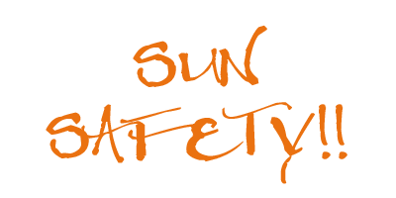
Sun Safety
Lesson 2
Grade 5

Slide 2
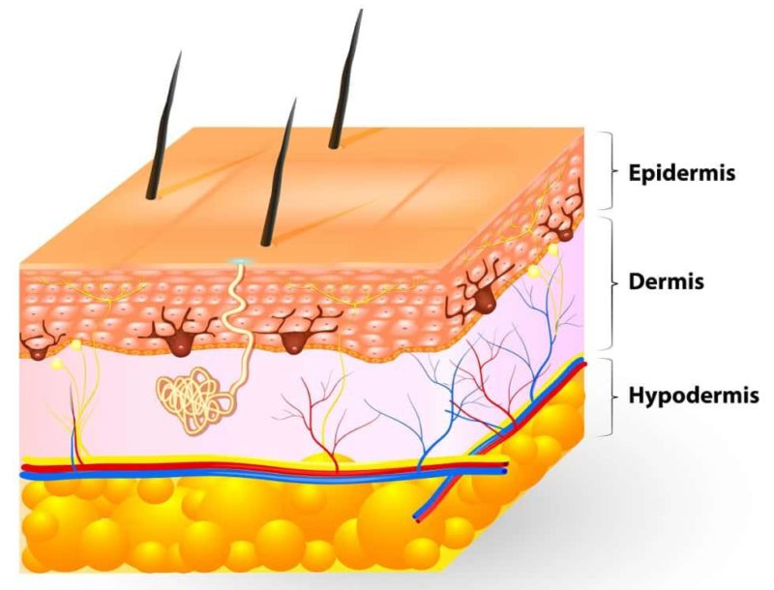

Lesson Objectives
Learning about your skin
What can happen if you don’t protect yourself from the sun.
How to be Sun Smart

Slide 3
Review sun safety
Question | True | False
1. A baseball cap is more protective than a wide-brimmed hat.
2. You can be sunburned in the winter.
3. The sun’s rays are strongest between 6 a.m. and 10 a.m. every day.
4. When you are in the shade, you are always protected from the sun’s rays.
5. All sunglasses protect your eyes against the sun’s rays.
6. Sunscreen is not needed on cloudy days.
7. The sun’s rays are most harmful when your shadow is shorter than you are.
8. You do not ever need to reapply sunscreen when you are outside.

Slide 4
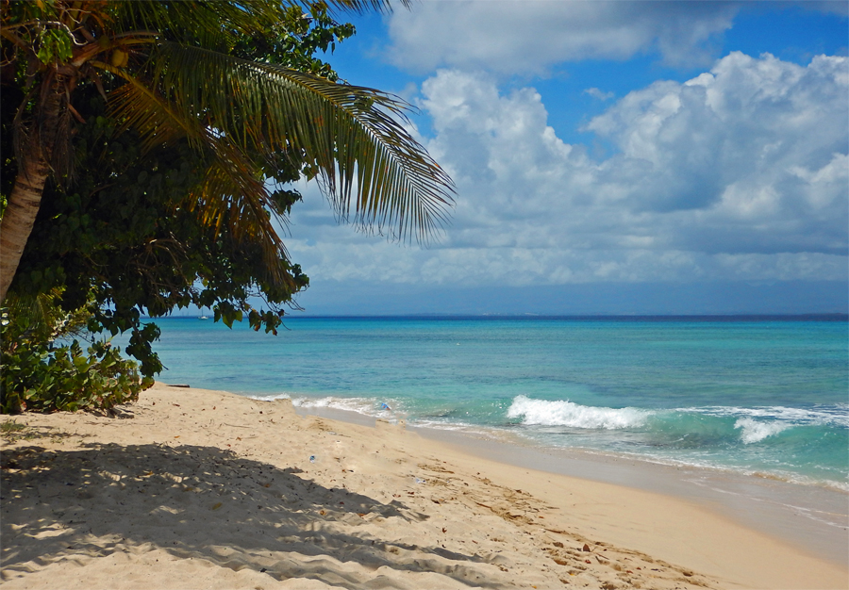
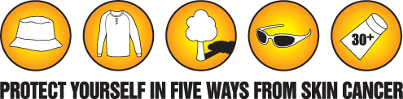
Prompt
Cara invited Carly and Simon to the beach with her family. They arrived at noon. There is a volleyball net and swings on the play ground. When they got there, they set up their blanket and picnic basket under a big, shady tree.
All three friends love to be active and swim. Cara and Simon followed the sun safety rules of Cara’s family (sunscreen, hats, sunglasses) but Carly didn’t want to. She never gets a sunburn so is not worried.
Your challenge role play is to convince Carly to use sun safety by explaining
Two risks of unprotected sun exposure
Seven sun safety strategies to use to protect herself from the UVA and UVB rays.

Slide 5
Stay Sun Smart!

