Slide 1
All About Me
Nutrition & Interpreting Food Labels
Let’s Learn About Health!
5th grade

Slide 2
What Should I do?
I have a family history of obesity, so I want to make sure I maintain a healthy weight today and as I age. The doctor told me that based on the amount of exercise that I do, I should be eating approximately 2,000 calories per day. I’m not sure exactly what this means. Can you help me?
What should I do to maintain a healthy weight as I age?

Slide 3
Calories In vs. Calories Burned
We need calories for energy, growth, and development. We burn calories all day long even when we are sleeping. We burn more calories when we exercise. To maintain a healthy weight, it is important for your calories in to be equal to calories burned. This will optimize energy while allowing one to maintain a healthy weight.
Calories In > Calories Burned = Weight Gain over time
Calories In = Calories Burned = Maintain Current Weight
Calories In < Calories Burned = Lose Weight over time

Slide 4
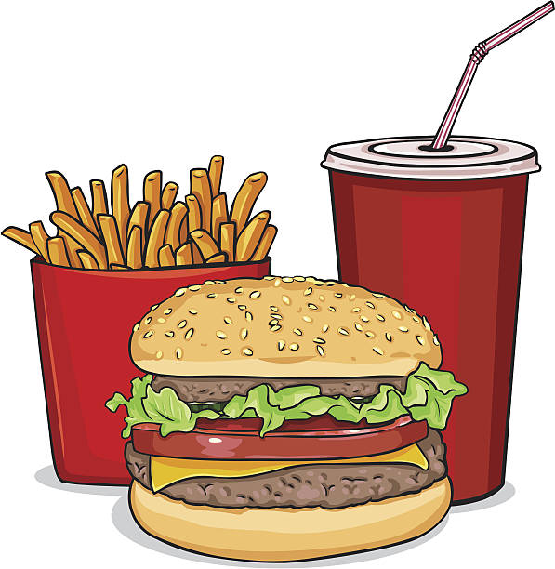
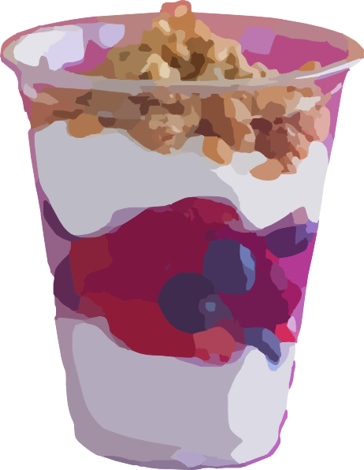
Eating in Moderation
Eating smaller meals throughout the day will help provide you constant energy throughout the day and help you eat in moderation.
OR

Slide 5
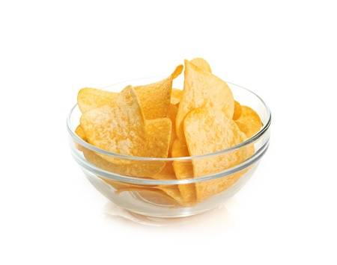
What Should I do?
I overheard my doctor tell my mom that I need approximately 1800 calories per day. I know that eating calories gives me energy. While I would prefer to eat 1800 calories of chips and cookies, my mom and dad have a very different idea of what types of food I should be eating. My mom tells me I can still eat chips but just in “moderation” or “an appropriate portion.” I don’t know much about portion sizes but the food label on the chips states “serving size 1 oz (about 11 chips).” I would like to eat a lot more than that.
What should I do?

Slide 6
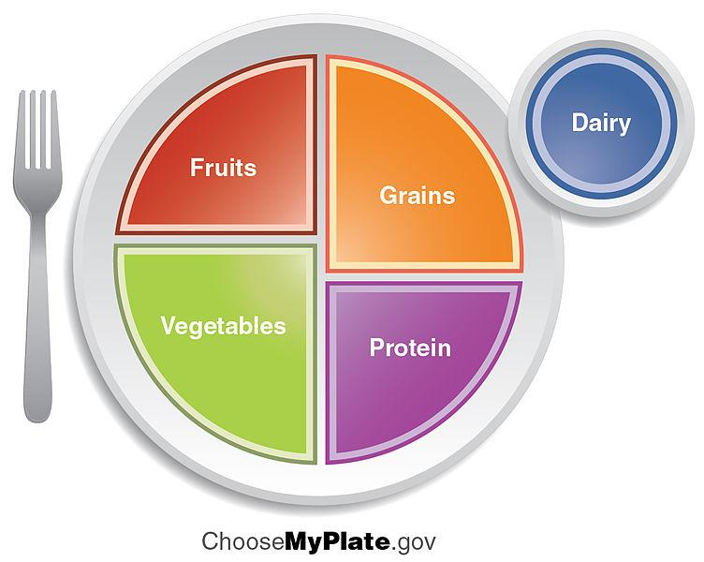
Moderation and Portion Size
Watch the video clip and think about the following questions:
https://www.youtube.com/watch?v=iSPKBQ2l8kI (Kid portion sizes)
Do you eat appropriate portion sizes of foods based on the amount of physical activity you do?
Do you portion your foods based on MyPlate?

Slide 7
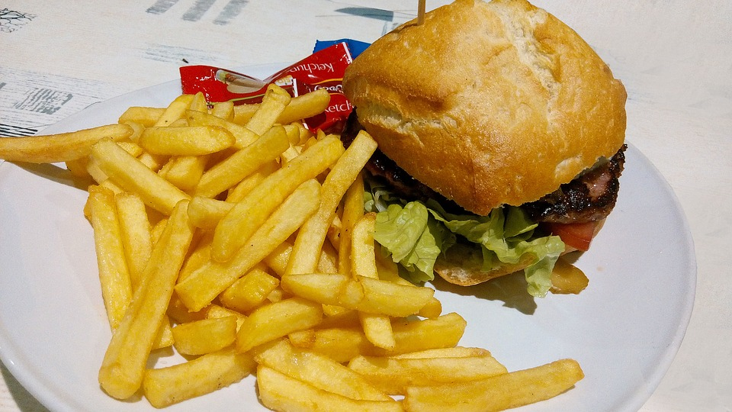
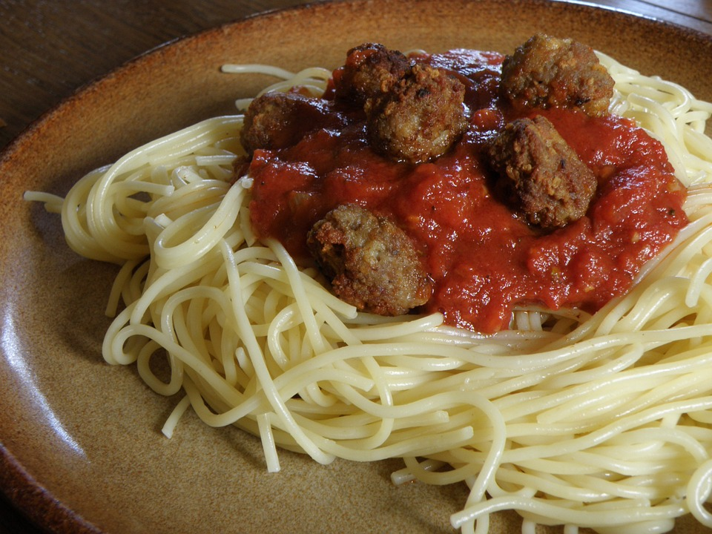
Can You Help Me?
Look at the following plates of food and decide how you would change them for the nutritional needs of a 5th grader, who does very little exercise.

Slide 8
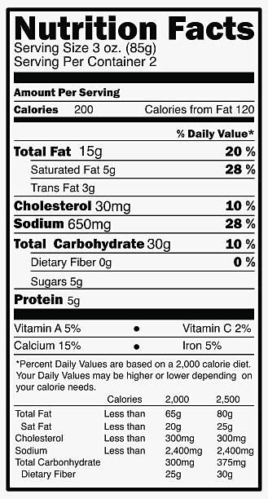
Interpreting Food Labels

Slide 9
New Food Labels
Let’s look at the new changes on the food labels.
https://www.fda.gov/downloads/food/labelingnutrition/ucm511646.pdf (The New and Improved Nutrition Facts Label)
What changes do you see?

Slide 10
Calories
To maintain a healthy weight, it is important for your calories in to be equal to calories burned. This will optimize energy while allowing you to maintain a healthy weight.
If you start to gain unhealthy weight, you may be taking in too many calories a day. Talk to your doctor about healthy eating habits.

Slide 11
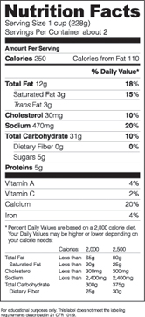
Look Closely...
For kids who exercise, extra calories may be needed for energy.
Which food has more calories?
VS.

Slide 12
Sugar
Watch the following video to learn more about sugar.
https://www.youtube.com/watch?v=m3AMzGd3-Z8 (The Effects of Sugar on the Brain)

Slide 13
What Should I do?
Now that I’m older, my mom and dad are beginning to give me more freedom to make choices about what foods and drinks I consume. Today, I’m at our neighborhood pool. It has a snack bar, so with the few dollars my mom gave me, I’m going to buy ice cream and soda. I know it is a lot of sugar. Is it too much sugar? Should I even care?
What should I do?

Slide 14
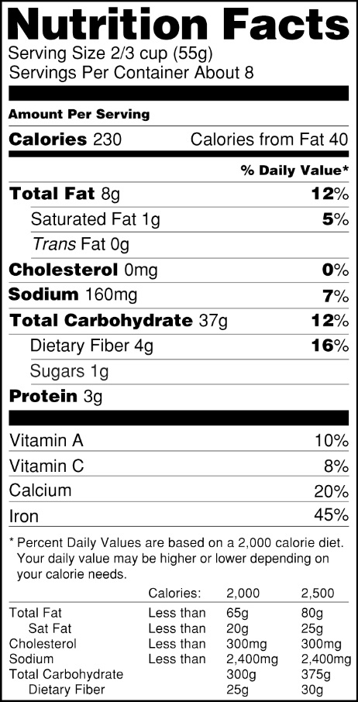
Too Much Sugar
Based on the U.S Food and Drug Association, a person should get no more than 50 g of added sugar a day. Too much sugar has been linked to obesity and diabetes. Let’s examine the sugar content of some of kids’ favorite foods.
Chick-fil-A Frosted lemonade= 63 grams
Chick-fil-A Cookies & Cream milkshake= 89 grams
Krispy Kreme original glazed donut = 10 grams
Can of Coke = 39 grams
Starburst (8 pieces) = 22 grams
Oreos (3 cookies) = 14 grams
Gatorade = 34 grams
Read food labels to determine sugar content!
Question: What could you do to decrease your sugar intake?

Slide 15
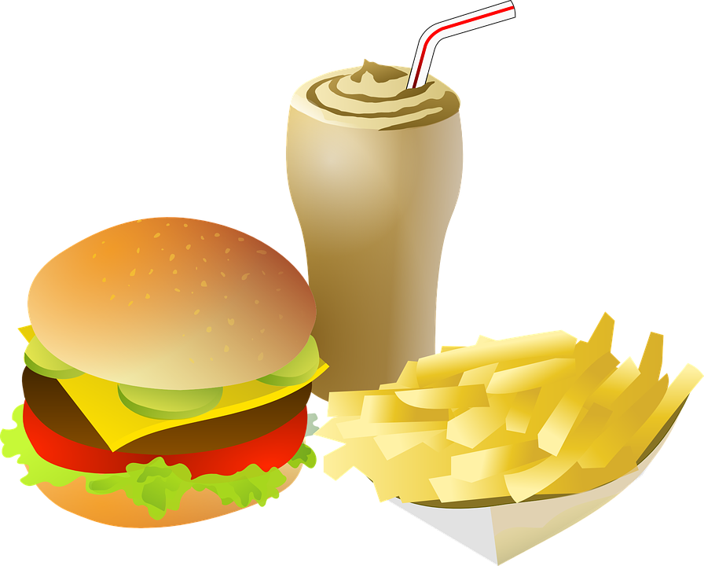
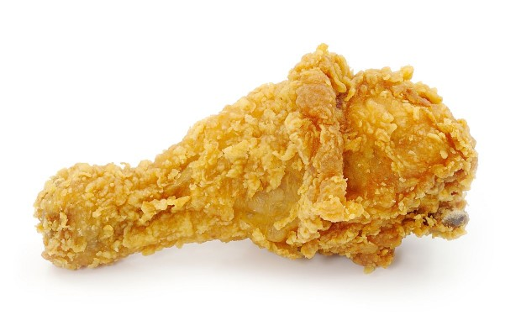
Saturated Fat and Trans Fat

Slide 16
Too Much Bad Fat
A diet high in saturated fat and trans fat increases a person’s risk of high cholesterol. On a 2,000 calorie diet, a person should have less than 20 grams of saturated fat a day and no trans fat. Let’s examine the fat content of some of kids’ favorite foods.
Chick-fil-A Chicken Sandwich= 4 g of saturated fat
Chick-fil-A Large Waffle Fries = 4 g of saturated fat
McDonald’s Big Mac = 10 g of saturated fat & 1 g of trans fat
Cinnabon Classic Roll= 17 g of saturated fat
Pizza Hut Pepperoni Pizza ( 1 slice)= 9 g of saturated fat
DQ Brownie Cookie Blizzard= 39 g of saturated fat & 1 g of trans fat
Read nutrition labels to determine fat content!
Question: What could you do to decrease your bad fat intake?

Slide 17
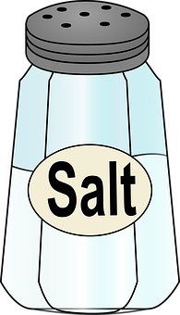
Sodium
Based on the U.S Food and Drug Association, a person should get no more than 2,400 mg of added sodium a day. Too much sodium has been linked to high blood pressure. Let’s examine the sodium content of some of kids’ favorite foods.
Doritos Nacho Cheese= 210 mg
McDonald’s Big Mac Burger= 950 mg
Five Guys regular fries = 960 mg
Wendy’s medium frosty = 292 mg
Read nutrition labels to determine sodium content!
Question: What could you do to decrease sodium intake?

Slide 18
Vitamins and Minerals
Vitamins and minerals are essential nutrients that perform hundreds of roles in your body from strengthening bones to boosting your immune system. Make sure the food you are eating is full of vitamins and minerals. Fruits and vegetables will contain lots of vitamins and minerals.
Orange= Vitamin C is 115%
Kale= Vitamin A is 133%
Read nutrition labels to determine vitamin and mineral content!
Questions:
What foods do you eat that are high in vitamins and minerals?
Which ones are low in vitamins and minerals?

Slide 19
Eating Healthy for a Lifetime
Read the following paragraph:
Food is everywhere, and food high in sugar and fat can be addicting. During your preteen and teen years, you are creating habits that may continue into adulthood. No food is off limit, but it is important to be aware of how much sugar and fat you consume and make an effort to eat nutrient dense foods including fruit, vegetables, dairy, whole grains, and lean proteins. Unexpected weight gain during puberty is normal and will affect both boys and girls. Don’t worry as your body is undergoing lots of changes. Developing healthy eating patterns today will set you up for a healthy adulthood, thus decreasing your risk of obesity and diseases. Eating healthy is not a diet but a way of life.
Think about the following questions:
What are 2 nutritional changes you could make to be a healthier person?
What is the difference between a diet and lifelong healthy weight management?

Slide 20
Let’s Move!
https://www.youtube.com/watch?v=BGZmiRSJnzY

Slide 21
The End
Take Care of Your Health!

