Slide 1
A GUIDE TO FOOD LABELS AND INGREDIENTS ON PRODUCTS WE CONSUME!

Slide 2
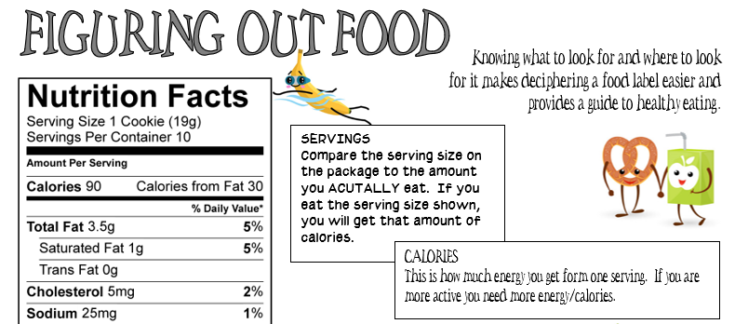
SERVINGS: Always check here first.
If you eat more than that, you’re taking in more calories, fat, and sugar than what is listed.
If you ate all 10 cookies you would consume ________ calories!
CALORIES: The amount you take in on a daily basis varies depending on age, gender, height and activity level.
On average teenage boys require about ________ calories while teenage girls require ________ calories/day.

Slide 3
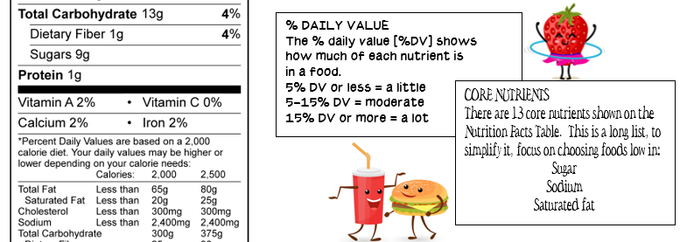
% DAILY VALUE: If the label states 2% calcium, it means that one serving provides 2% of the calcium you need each day. This %’s are based on a _______________ calorie diet.
CORE NUTRIENTS: Pay attention to the ‘bad ones’ - sugar, sodium, and saturated fat. Too much of these are bad for your health. SUGAR no more than 30 grams a day, SODIUM less than 2,300mg/day. SATURATED FAT less than 13g/day.

Slide 4
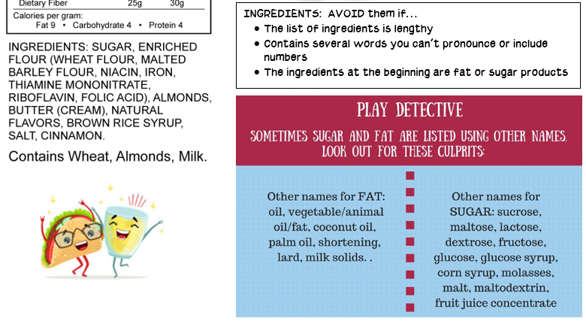
INGREDIENTS: There are several red flags to watch out for when looking at ingredients…
Several words you can’t easily identify or pronounce.
High-fructose corn syrup or other added sugars.
The FIRST ingredient isn’t a whole, recognizable food.
Hydrogenated oils; highly processed causing increase in trans fat.

Slide 5
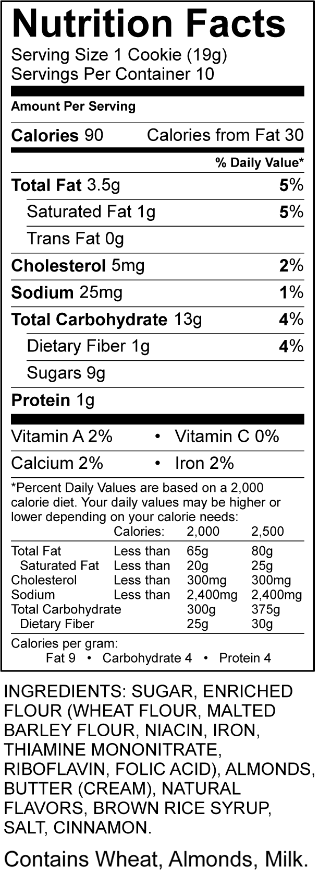
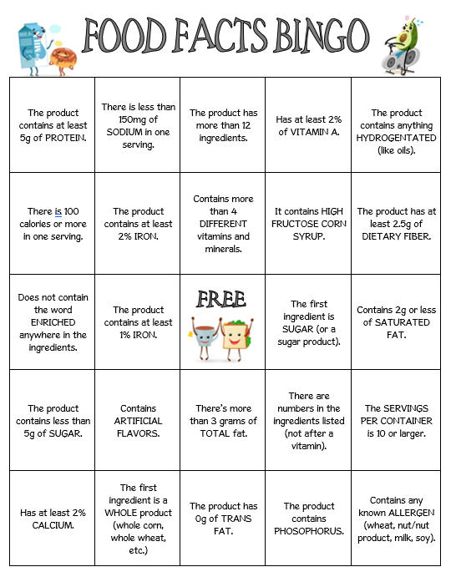
Directions:
Based on your provided label, mark off all of the squares that apply to your product.
For example, this product contains less than 150mg of sodium so that square is X’d off.

