Slide 1

The benefits of physical activity and play.

Slide 2
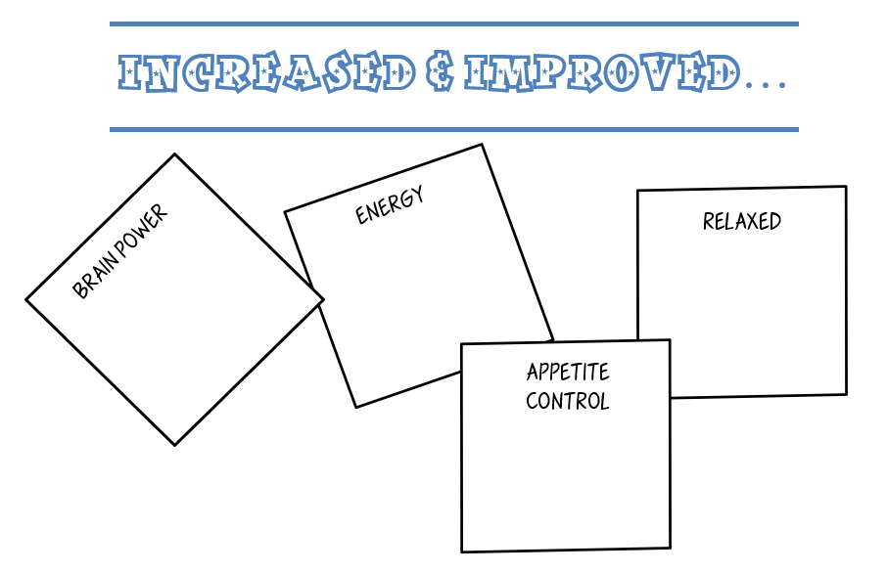
Relieves stress.
ability to concentrate & learn.
Blood flow & 0₂
Hunger hormone decreases.

Slide 3
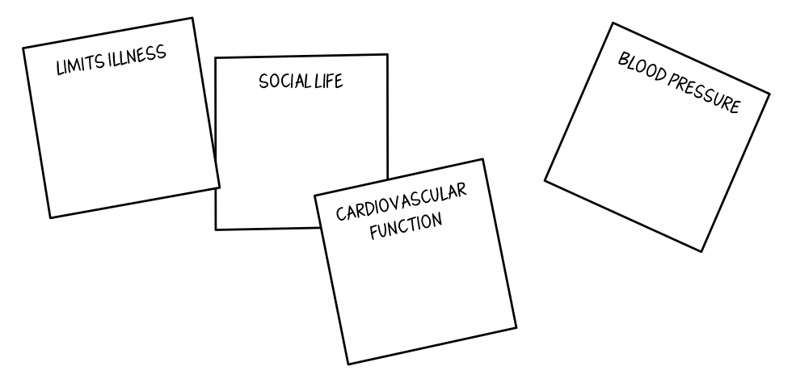
Boosts immune system.
Self-image/
Self-confidence
Lowers blood pressure.
Strengthens heart muscle.

Slide 4
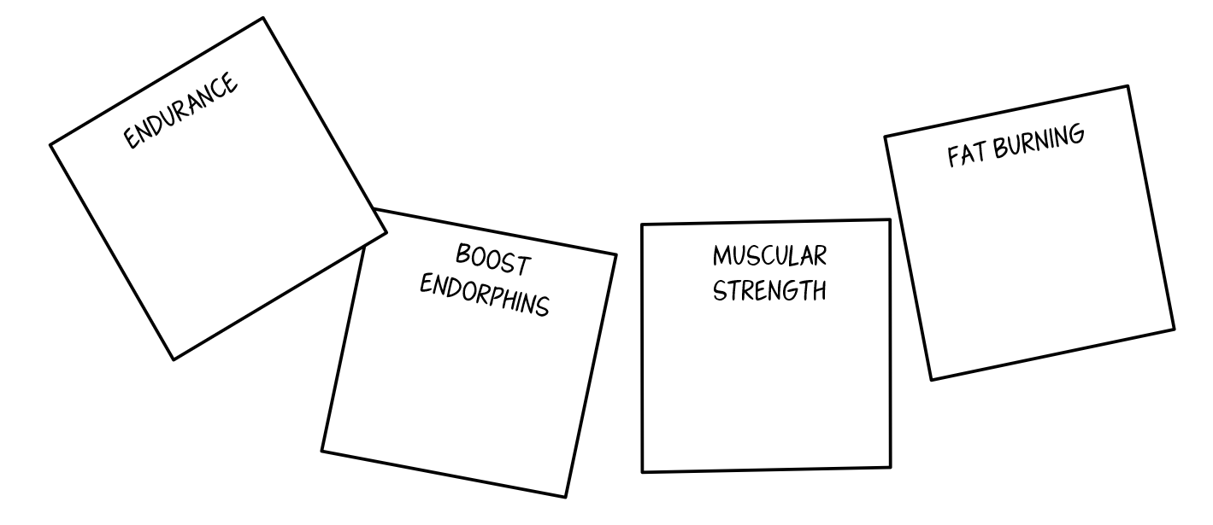
More you do, more you’ll be able to do.
Decreases body fat.
Happy; better outlook on life.
Toned body.

Slide 5
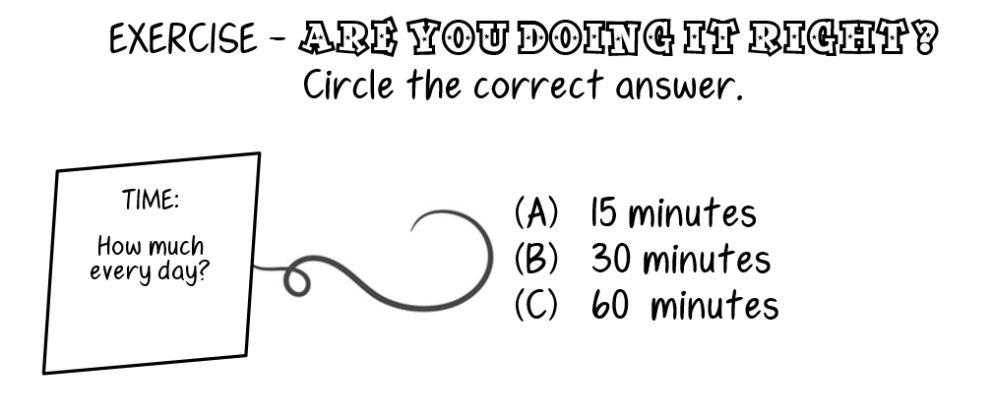

Slide 6
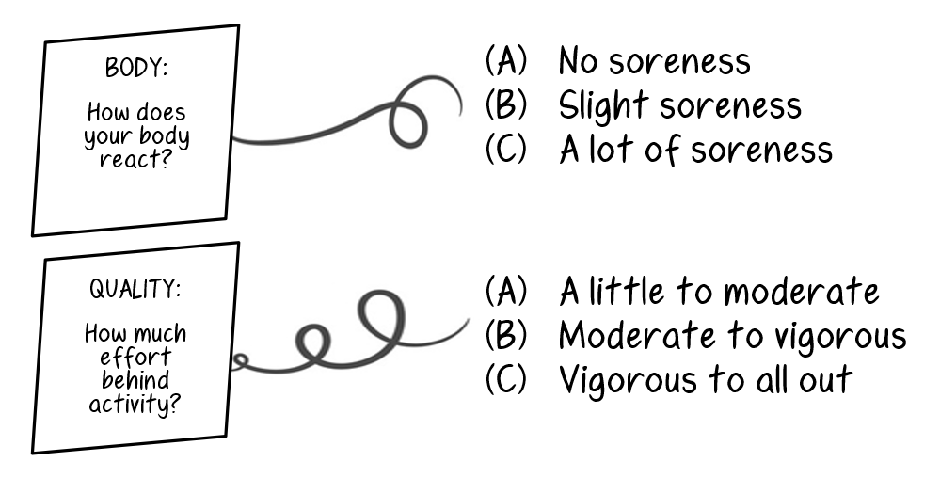

Slide 7
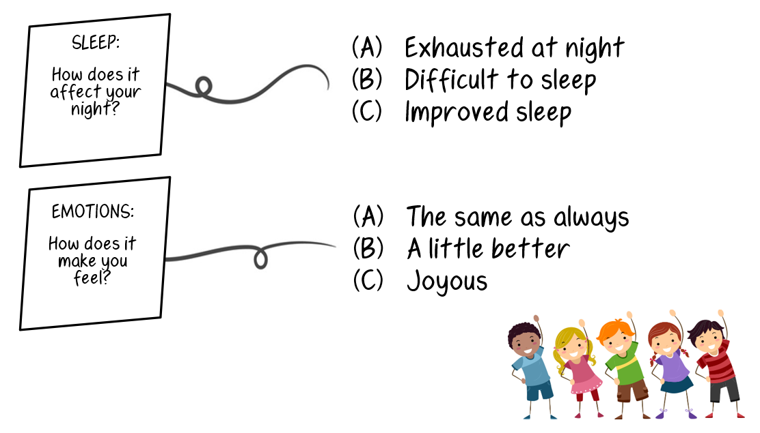

Slide 8

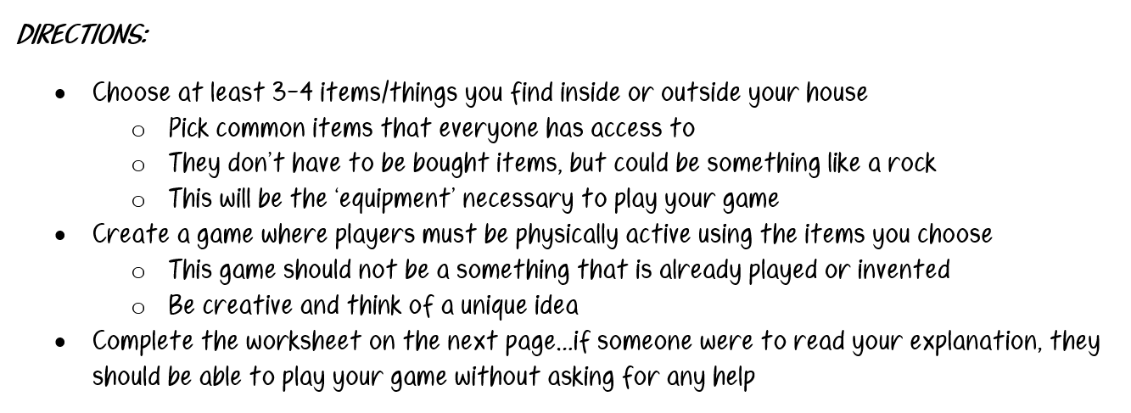

Slide 9
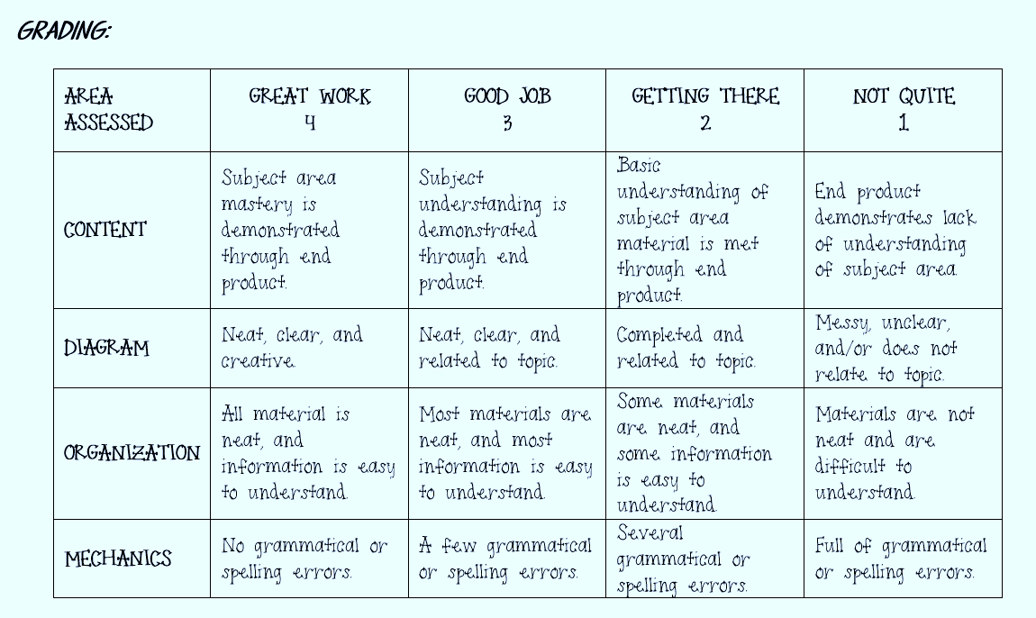

Slide 10

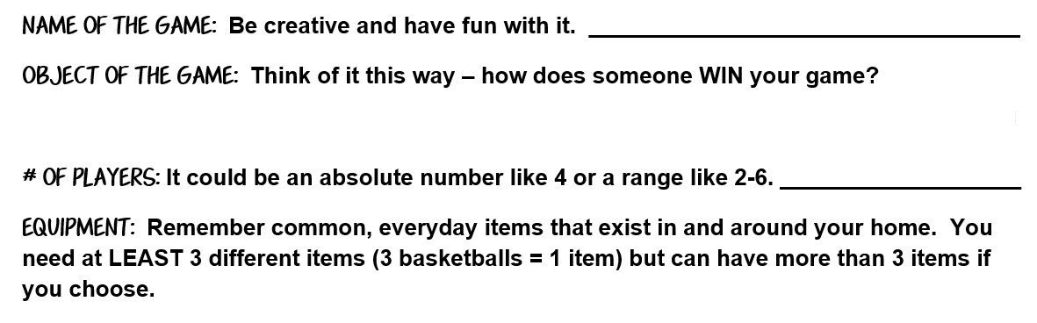

Slide 11
