Slide 1

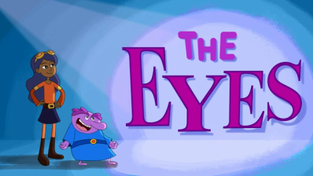
The EYE
YE
VIDEO

Slide 2
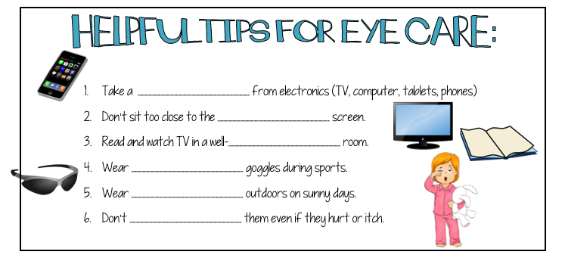
The EYE
YE
break
t.v.
lit
safety
sunglasses
rub

Slide 3



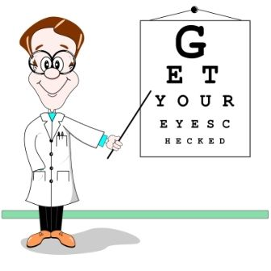

The EYE
YE
Can see objects far away
Close objects are blurry
Can see objects close by
Distant objects are blurry
Misshaped cornea or lens

Slide 4

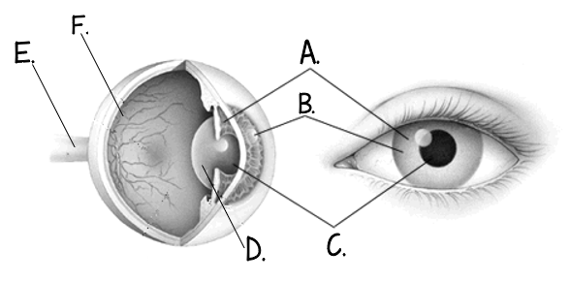
The EYE
YE
RETINA
OPTIC
IRIS
CORNEA
PUPIL
LENS

Slide 5
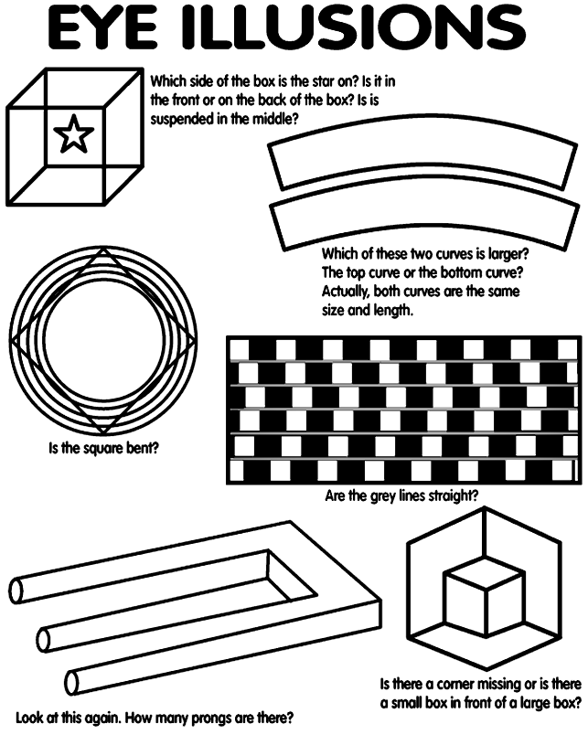
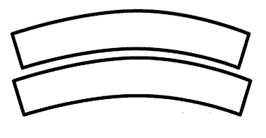
1. Is the square STRAIGHT or BENT? (circle one)
2. Which of these two curves are larger A or B or NEITHER?
A.
B.

Slide 6
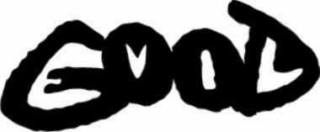
3. What 2 words do you see?
4. Which side of the box is the star on?

Slide 7
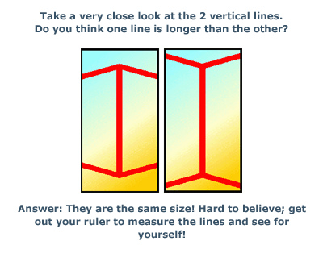
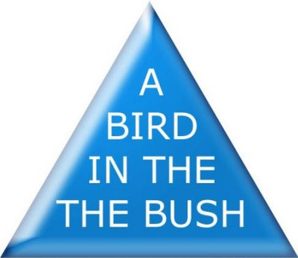
5. Which line in the middle is longer A or B or NEITHER?
A.
B.
6. Read the words in the triangle out loud. What is wrong with eh sentence?

Slide 8
6
7. How many F’s are in the passage?
f
f
Finished files are the result
of years of scientific study
combined with the experience
of years…
f
f
f
f
8. Try reading this paragraph out loud. Could you do it? YES or NO
Aoccdrnig to rscheearch at Cmabrigde uinervtisy, it deosn’t mttaer waht oredr the ltteers in a wrod are, the olny iprmoetnt tihng is taht the frist and lsat ltteres are at the rghit pclae. The rset can be a tatol mses and you can sitll raed it wouthit a porbelm. Tihs is bcuseae we do not raed ervey lteter by it slef but the wrod as a wlohe.

Slide 9

HIDE
AND
SEEK
9. What is the hidden message in this image?

Slide 10
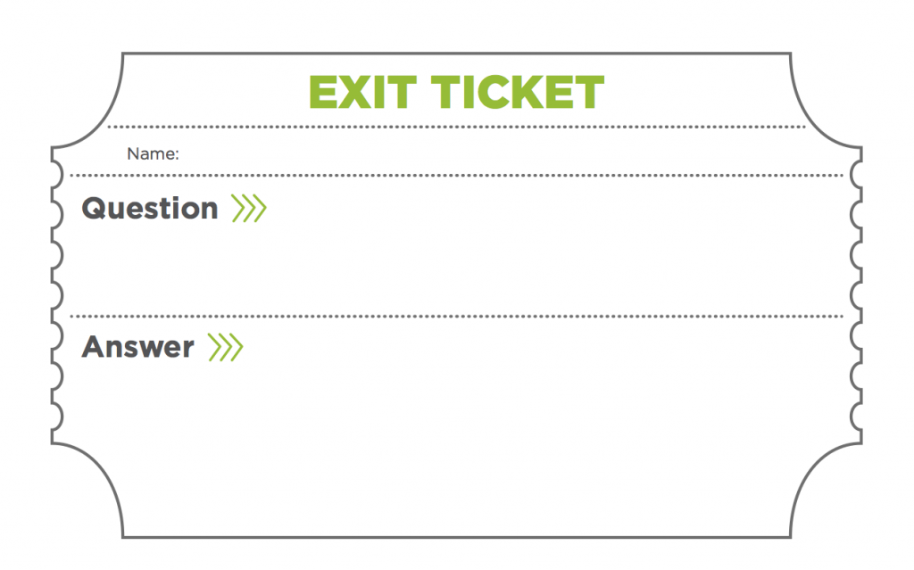
What are 3 ways you can prevent vision loss and take care of your eyes?

