Slide 1
PERSONAL
HEALTH
TEETH and
GUMS
VIDEO

Slide 2
1. HYGIENE:
ACTIONS YOU TAKE TO MAINTAIN YOUR HEALTH
TEETH &
GUMS
2. PLAQUE:
3. FLUORIDE:
FILM, CONTAINING BACTERIA THAT GROWS ON TEETH
SUBSTANCE FIGHTS TOOTH DECAY

Slide 3
TEETH &
GUMS
4. Your teeth and gums are important because they:
a.
b.
c.
d. GUMS keep teeth in place
You can prevent tooth and gum problems by:
e.
f.
g.
Chew food
Speech/talk
brush
Shape mouth
floss
Eat right

Slide 4
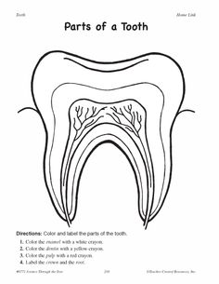
PARTS OF A TOOTH
DENTIN – PULP – NECK – ROOT – ENAMEL - CROWN
A.
ENAMEL
1.
CROWN
DENTIN
2.
B.
NECK
PULP
3.
C.
ROOT

Slide 5
VIDEO

Slide 6
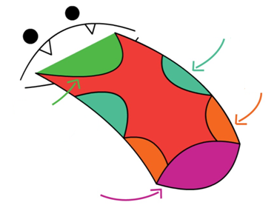
TASTE BUDS
2.
SOUR
both sides of tongue
3.
SALT
BITTER
1.
SWEET
4.

Slide 7
TASTE BUDS
10,000
5. You have about ___________________ (number) taste buds on your tongue and they are replaced about every ________ (number) weeks.
7. Your tongue touches the top of your mouth to make the letter sounds ‘K’ and _______.
8. Your ___________________ also helps you taste food as you chew and swallow food.
9. You should ___________________ tongue everyday just like your teeth to keep them healthy.
2
G
NOSE
BRUSH

Slide 8
TASTE BUDS
There is also a “5th” taste called UMAMI, what does this mean? _______________
What’s the difference between TASTE AND FLAVOR?
Flavor =
Taste =
yummy
Taste & Smell
Taste buds

Slide 9
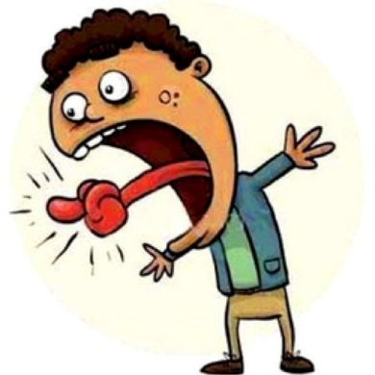
A.) A big black bug blew big blue bubbles.
Read it as fast as you can.
Read it 3 times in a row without stumbling.

Slide 10
DIRECTIONS: Create your own tongue twister using the helpful starters below.
Remember it should be difficult to say and the sentence should make sense.
1. Choose a main topic you’d like to write about (examples could be an animal, a favorite food, or a sport, or anything else you like):
_______________________________________________
2. What letter does your word start with from #1 (this is what you’ll repeat in the rest of your tongue twister)?
________
skunk
s

Slide 11
Make a list of 8 words that start with that letter and relate to your topic (also try rhyming some of the words):
Now arrange your topic and words into a complete sentence (AT LEAST 5 WORDS). Use this space below to brainstorm different arrangements and sentences.
skunk stump stink stunk
smelly stand slump stood
A skunk stood on a stump
and thunk the stump stunk.

Slide 12
REQUIREMENTS:
Your name AND topic in upper right hand corner
LARGE color drawing of tongue twister
Your WRITTEN tongue twister
~ Spelled correctly
~ Legible

Slide 13
A skunk stood
on a stump
and thunk
the stump stunk.
But the stump thunk the skunk stunk.

