Slide 1
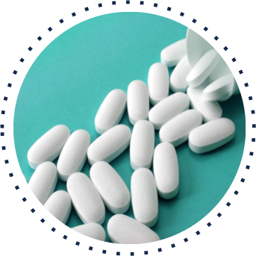
Analyzing Influences - Opioids
How culture influences behaviors about opioids.

Slide 2
Over view of the lesson
Skill of Analyzing Influences
Vocabulary review
Pre-test
Class activity - Endorphins and Opioids
Class activity-Analyzing Influences-Mica
Review

Slide 3
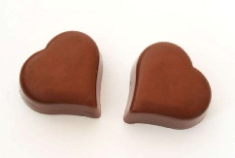
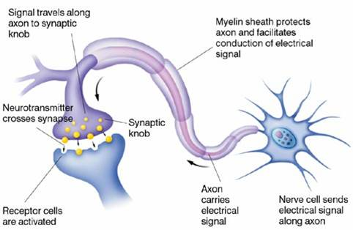
What do you already know about opioids?
1. T F Endorphins are released in your body when you laugh, eat chocolate, or exercise.
2. T F Endorphins send messages to your brain that your body is enjoying something.
3. T F Endorphins are neurotransmitters.
4. T F Nerve endings have receptors for specific neurotransmitters.
5. T F Opioids such as heroin, oxycodone, and morphine all come from a plant.
6. T F Tolerance means you need more and more of a drug to get the same feeling.

Slide 4
What do you already know about opioids?
7. T F Tolerance means you need more and more of a drug to get the same feeling.
8. T F Opioids are addicting. (Your body needs the drug to feel normal)
9. Opioids relieve pain and make us feel good.
10. T F Our culture does not contribute to opioid abuse.
11. T F If a person suddenly stops taking an opioid, the body is happy and has no reaction.
13. T F Your body is healthier when opioids are used according to a prescription and not misused.

Slide 5
Endorphins
When you exercise, laugh, eat certain foods, your nervous system releases “feel good” chemicals called endorphins.
Endorphins transmit messages across nerve endings to the brain to reduce pain.
Notes:
When you exercise, laugh, eat certain foods, your nervous system releases “feel good” chemicals called _________________. (Endorphins)
Endorphins transmit messages across nerve endings to the brain to ___________. (reduce pain.)

Slide 6
Opioids are drugs that work on the nervous system to reduce pain signals reaching the brain.
Some opioids come from the opium poppy plant. Others are made in laboratories.
Common opioids include heroin and prescription drugs like morphine, oxycodone, and hydrocodone.
Notes:
Instructor Notes: Click to reveal the image and then each bullet point of text, and discuss each with students before moving on to the next one.
When people take opioid drugs, they experience a euphoric rush because these drugs also affect the brain regions involved in reward. Some people may misuse opioids because they want to intensify their experience by taking the drug in ways other than those prescribed. Some people don’t use opioids to control pain. They use opioids because it gives them a relaxed, “high” feeling.

Slide 7
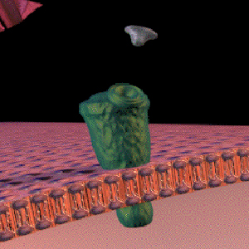
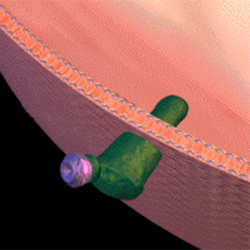
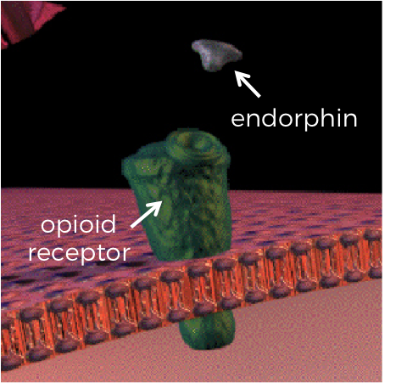
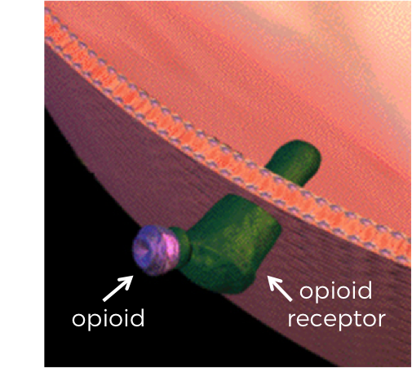
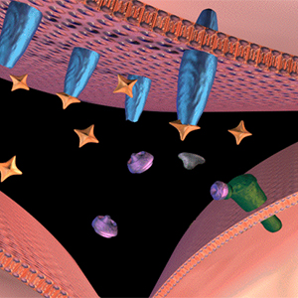
The brain cannot tell the difference!
endorphin
opioid receptor
opioid receptor
opioid
Notes:
Instructor Notes: Present students will this analogy: neurotransmitters are like “keys” that fit certain “locks” in the brain. Different keys fit different locks. Because the shapes of opioids and endorphins are similar, opioids are able to fit into “locks” intended for endorphins.
Click to display the images and ask students a series of questions to guide their inquiry:
What do you notice about the shape of each “key”—i.e., the natural endorphin and an opioid like morphine? (Circle the bottom section of each—i.e., the section that fits into the endorphin receptors. They are similar.)
The endorphin receptor is the “lock” from the analogy. What type of “lock” does each key fit into? (Both natural endorphins and opioid receptors fit into endorphin receptors.)
What conclusion can you draw from this relationship? (The brain cannot tell the difference between natural endorphins and opioids.)
After students have drawn their own conclusions, explain that opioids mimic the action of endorphins by fitting in the same locks (binding to endorphin receptor sites in the brain). This affects feelings of pain as well as a person’s overall emotional state. However, endorphins are not harmful or addictive like opioid drugs are. Endorphins come from positive activities such as exercising, laughing, and eating certain foods. Click the slide to display the text (“The brain cannot tell the difference!”).

Slide 8
Endorphin
When you exercise, laugh, eat certain foods, your nervous system releases “feel good” chemicals called endorphins.
Endorphins transmit “feel good” messages to the brain.

Slide 9
Class activity –Endorphins and Opioids
What is the danger?
Notes:
Ask for different volunteers.
Place the Axon, Dendrite, and Synapse posters behind the students.
Give one child a receptor card and the other an opioid card
Show how the pieces fit together and continue the “feel good” message to the brain.

Slide 10
What did we learn about endorphin and opioid transmission?
The nerve receptors cannot tell the difference between the “feel good” endorphin and the opioid.

Slide 11
What did we learn about opioid transmission?
Are opioids a healthy or unhealthy way to feel good?
Why are opioids a dangerous way to feel good?
This Photo by Unknown Author is licensed under CC BY-SA

Slide 12
What did we learn about endorphin transmission?
Is exercise, laughing and certain foods a healthy or unhealthy way to feel good?
Why are these activities a safe way to feel good?
This Photo by Unknown Author is licensed under CC BY-SA

Slide 13
How does our culture contribute to the misuse of opioids? How are opioids misused?
Read Micha’s story to answer these questions.
Notes:
Micha
While watching television, Micha often sees advertisements for different drugs. There is a drug for asthma, headaches, stomach aches, and pain relief! It seems normal to use a drug to relieve any discomfort. Micha’s friends also use drugs for asthma, ADHD, colds, and flu. One friend has an Epipen to use when he has an allergic reaction.
Micha’s older sister Ella broke her leg in track and was in a lot of pain. The doctor prescribed oxycodone, an opioid, and Ella said it was like magic. The pain went away!
Oxys! Micha recognized that word from listening to the older kids at the bus stop. They take left over prescriptions from their parent’s medicine cabinet and share them for fun!
Micha remembered his health teacher telling the class that a prescription is personal. It is made for a person’s age and size. Mrs. Rodriquez said it is dangerous for a child to take a pill prescribed for an adult or to take opioids if you are not in pain.
Suddenly, Micha realized that taking drugs can be dangerous if they are not used the way they are prescribed. Those television advertisements made the drugs look safe!
Questions:
How was Micha influenced by the American culture?
How were the opioids in the story misused?
Was the influence healthy or not healthy?
If the influence was not healthy, what should he do?

Slide 14
Class activity
With a peer, read the questions below the Micha prompt.
Use your sticky notes to answer.
Place your notes on the newsprint under the question.
Write the class reflection on the worksheet.

Slide 15
Symptoms of opioid use

Slide 16
Stages of addiction
Notes:
Instructor Notes: Present slides 18 to 23 one at a time. Pause after each slide so that students can identify whether it shows a symptom of opioid misuse or withdrawal and identify the body system affected (nervous, respiratory, digestive, or skeletal).

Slide 17
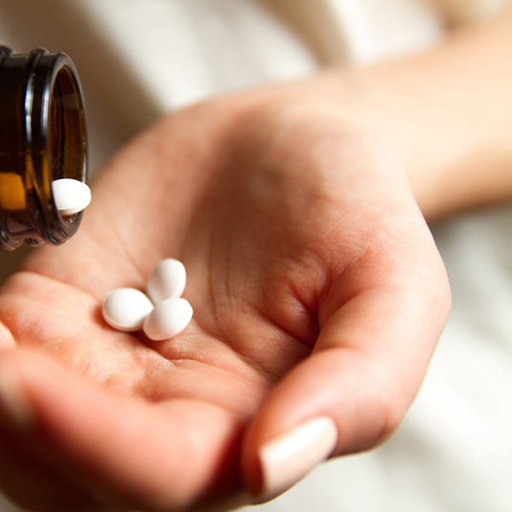
This is an example of tolerance – A person needs more of the drug to get the same feeling. Can result in addiction
Notes:
Instructor Notes: Pause after this slide so that students can identify whether it shows a symptom of opioid misuse or withdrawal and identify the body system affected (nervous, respiratory, digestive, or skeletal).

Slide 18
Addiction
The body has to have the drug to feel normal

Slide 19
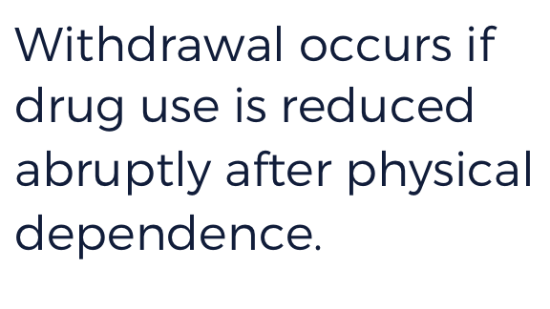
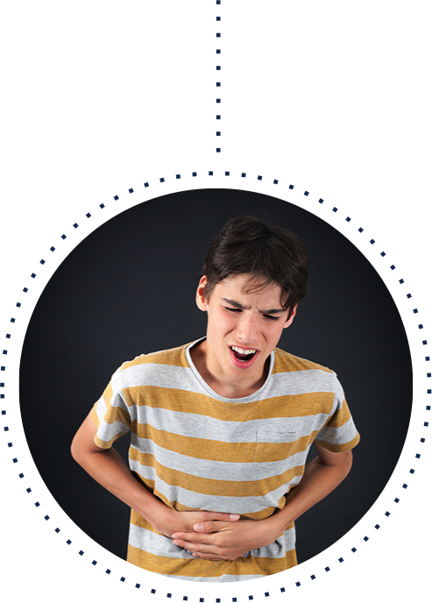
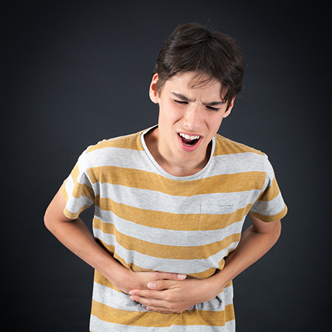
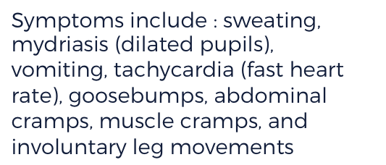
Symptoms include : sweating, mydriasis (dilated pupils), vomiting, tachycardia (fast heart rate), goosebumps, abdominal cramps, muscle cramps, and involuntary leg movements
Notes:
Instructor Notes: Ask students if they have any routines (like brushing their teeth every morning) and how their bodies would feel if this routine were interrupted. Click to display the definition of withdrawal. Then, click to display the image and ask students to describe what they see.

Slide 20
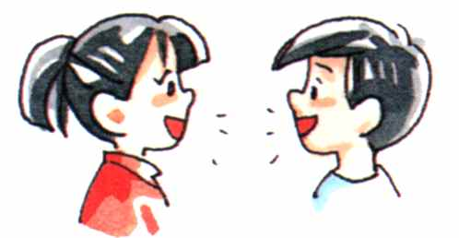
Describe three healthy behaviors such as non-drug endorphins and how they effect personal health.
Turn and Talk

Slide 21
Let’s review Use your white boards to answer these questions.
Notes:
1.

Slide 22
Let’s Review
T F It is not impossible for nerve receptors to tell the difference between a “feel good” endorphin such as chocolate or an opioid.
T F Using opioids with a doctor’s prescription is a healthy way to manage pain.
Write one way our culture contributes to opioid abuse.
Write down one reason why not using opioids is good for your body.

