Slide 1
Ecigarettes
The structure, the health hazards, the influence of advertisements

Slide 2
Over view of the lesson
Skill of Analyzing Influences
Vocabulary review
Structure of an ecigarette
Effects of ecigarettes on the body
Dangers of smoking an ecigarette
Influence of the media on smoking behavior
Review

Slide 3
Structure and health hazards of an ecigarette
Notes:
Mouthpiece
The user inhales through the detachable mouthpiece. Health hazard: Sharing an ecigarette may spread germs in the mouth or lungs.
Cartridge
Contains liquid nicotine, flavors attractive to teens (bubble gum, chocolate, gummy bear) and the vaporizing agents glycerol and propylene glycol. Health hazard: nicotine is an addictive drug, flavors attract young smokers and make the activity seem harmless, effects of propylene glycol vapor is unknown. Propylene glycol is a syrupy synthetic liquid added to food, cosmetics, and certain medicines to absorb water.
Sensor
Detects when a user inhales.
Lithium Battery
Rechargeable battery that powers the ecigarette. Health hazard: In a few rare cases, the battery overheats and causes a fire when being recharged.
Atomizer
Warms the liquids in the cartridge to boiling to create the vapor.
Control Button
The user pushes the button to turn on the ecigarette.
Vapor
The user inhales vapor and exhales a cloud that appears smoky due to the heating of glycerol, propylene glycol. Health hazard: The user inhales the vapor that contains nicotine and other dissolved substances .
Light
This light at the end of the ecigarette glows when the user inhales

Slide 4
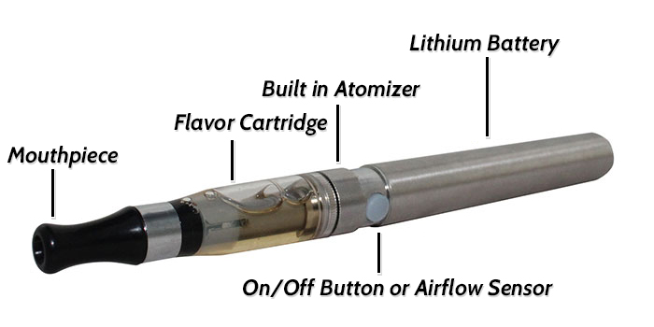
Class activity
Sort the descriptors by placing them over the parts of the ecigarette

Slide 5
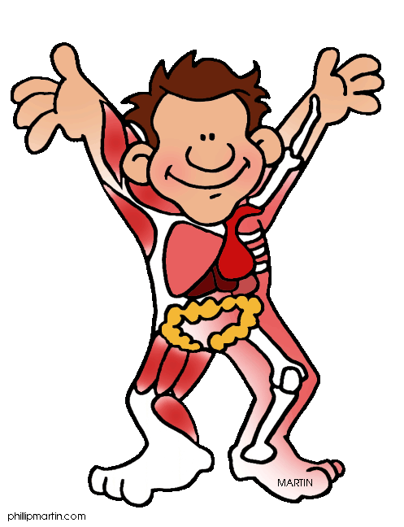
Effects of ecigarettes on the body.

Slide 6
Effects of ecigarettes on the body
Brain: The Nicotine in the vapor releases feel-good chemicals in the brain, causing long lasting chemical changes and addiction.
Behavior: Nicotine can lead to smoking cigarettes or marijuana.
Heart: The Nicotine in the vapor causes heart rate and blood pressure go up, making your heart work harder to get blood and oxygen to cells. Can lead to higher risk of heart attack and stroke.
Lungs: The Nicotine in the vapor can cause rapid, shallow breathing and permanent lung damage. Some ecigarettes contain flavorings that may lead to lung disease.
Burns: The rechargeable lithium battery that powers the ecigarette may overheat and cause a fire when being recharged.(Nemours)
Nicotine: Nicotine is an addictive drug. Ecigarette flavors attract young smokers and make the activity seem harmless, effects of propylene glycol vapor is unknown. (Nemours)
Poisoning: If the liquid nicotine is drunk, it can poison you. From 2013 to 2015, there was a 1500% increase in children under 6 poisoned by nicotine in ecigarettes.

Slide 7
Analyze the influence of ecigarette advertisement directed to females
https://www.youtube.com/watch?v=z9fj0nxzj4I-Ad
Using your red, yellow, or green squares, answer these questions. (Red-no, Yellow-not sure, Green-yes)
Is the advertisement an internal or external influence?
Does the advertisement promote healthy behavior?
Does this advertisement promote safe behavior?
Does this advertisement promote legal behavior?
Does this advertisement promote behavior that follows the guidelines of responsible adults, such as your parents or guardian?
Does this advertisement promote behavior that demonstrates good character? (Meeks, 2011)
Notes:
https://www.youtube.com/watch?v=El8V5PtLoB4
Vapor Couture Electronic Cigarettes – 1 minute 15 seconds
https://www.youtube.com/watch?v=oQelKE-aBNg
Blu E Cigarette - Stephen Dorff- 1 minute

Slide 8
Analyze the influence of ecigarette advertisements
https://www.youtube.com/watch?v=sv6MH_ADIGM
Using your red, yellow, or green squares, answer these questions. (Red-no, Yellow-not sure, Green-yes)
Does the advertisement promote healthy behavior?
Does the advertisement give any indication that ecigarettes can be addicting?
Does this advertisement promote safe behavior?
Does this advertisement promote legal behavior?
Does this advertisement promote behavior that follows the guidelines of responsible adults, such as your parents or guardian?
Does this advertisement promote behavior that demonstrates good character? (Meeks, 2011)
What is a good strategy to use when being influenced by an advertisement that is selling an unhealthy product? (Ask yourself the above questions)

Slide 9
Reflective questions
1. Describe one way to prevent injury and health problems that result from smoking ecigarettes?
2. Explain how advertisements for ecigarettes influence thoughts, feelings, and health behaviors?

