Slide 1
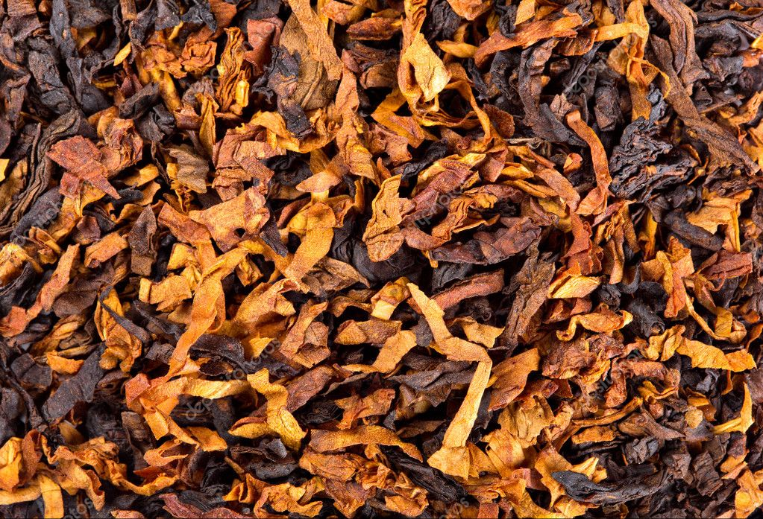
TOBACCO YUCKS

Slide 2
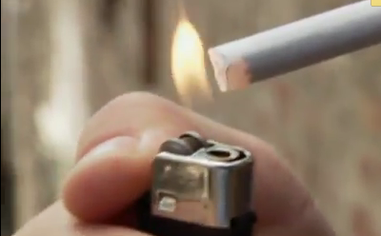
Effects on the body
Myth or Fact

Slide 3
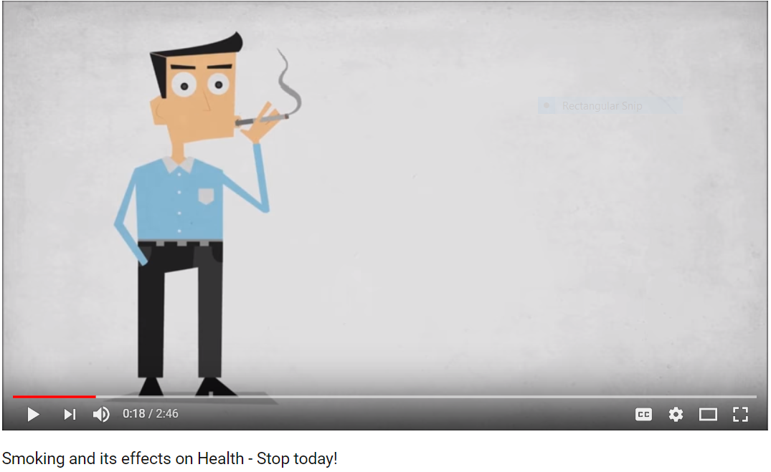
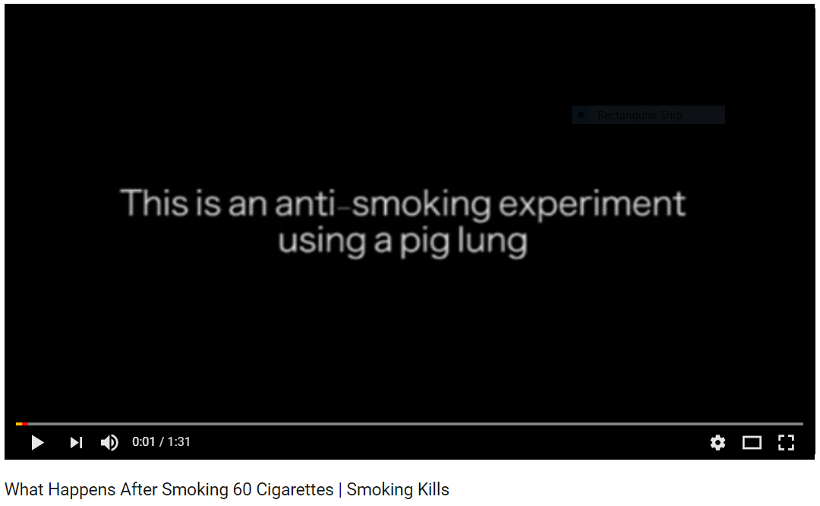
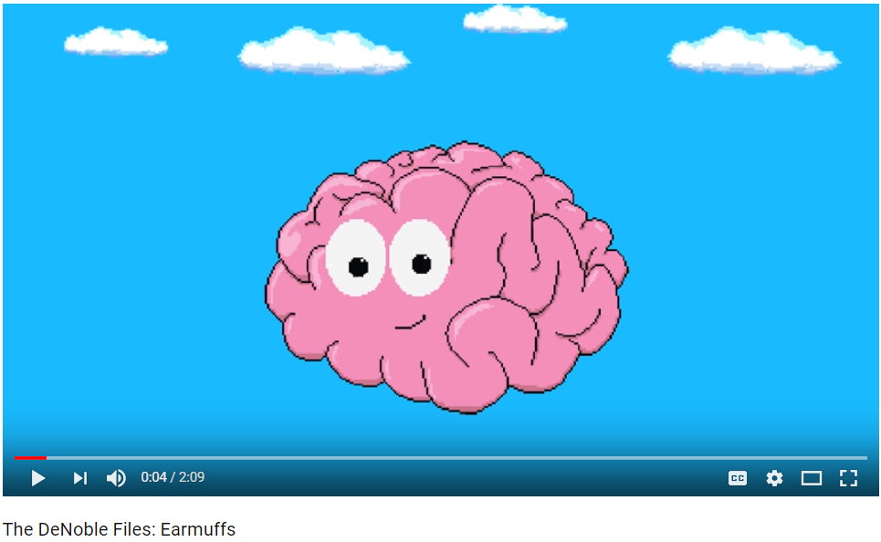
Lungs
Health?!?
Addiction

Slide 4
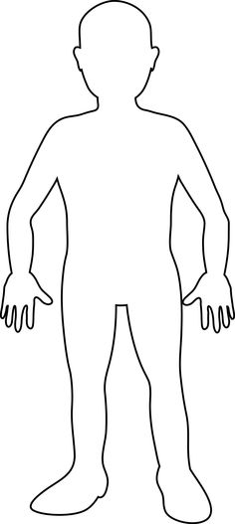
NEGATIVE SIDE EFFECTS
1. BRAIN
2. HAIR -
3. EYES -
4. EARS -
5. MOUTH -
6. TEETH -
7. THROAT -
8. SKIN -
9. MUSCLES -
10. BLOOD VESSELS -
11. LUNGS -
12. HEART -
13. FINGERS -
14. STOMACH -
Nose -
16. Clothing -
ADDICTION
LOSS, THINNING
BLINDNESS
HEARING LOSS
LOSS OF TASTE, BAD BREATH
YELLOW/BROWN, CAVATIES
CANCER
WRINKLES, SPOTS
DETERIORATE
LOWER CIRCULATION
CANCER, EMPHYSEMA
HEART ATTACK
YELLOW, BURN
CANCER, LOSS OF APPETITE
LOSS OF SMELL
BURN MARKS, SMELL

Slide 5
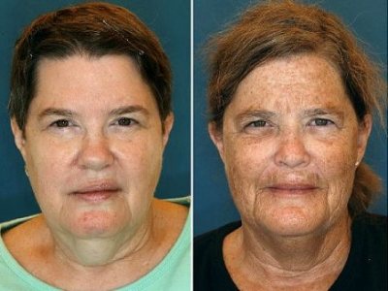
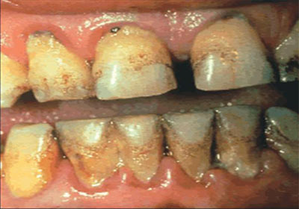
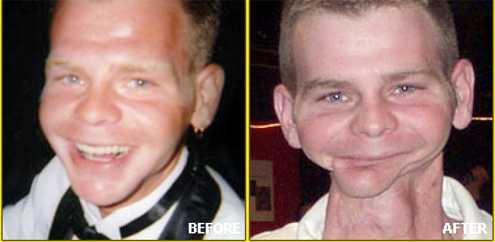
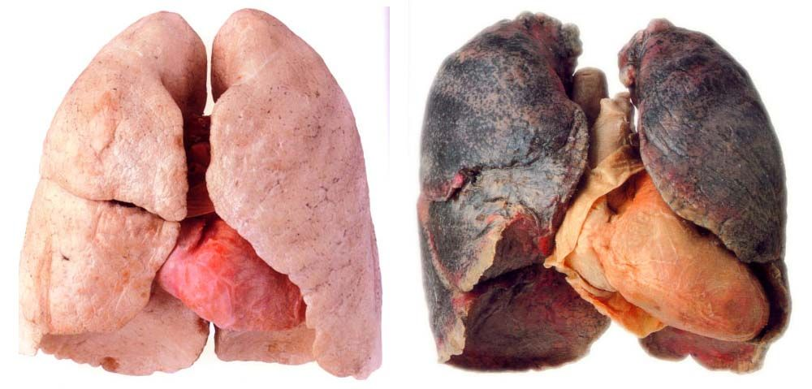

Slide 6
Tobacco Yucks PROJECT
PROJECT REQUIREMENTS & RUBRIC |  | POINTS | CHECK
DRAWING | Your drawing should be large, of a person or cartoon and should be of the whole body. | 10
2. LABELS | Label each body part negatively affected by tobacco use. Use the previous page for all of the labels needed. | 5
3. DESCRIPTION | Next to each label, explain what happens to this body part if someone used tobacco products. (Ex: Ears=hearing loss) | 10
4. DESIGN | Make it neat, colorful, and interesting to look at. | 5
5. TITLE | Give your poster a catchy title or name. | 3
6. STUDENT NAMES | Place student name(s) on the bottom right hand corner. | 2
Total Points: 35

Slide 7
