Slide 1


Analyzing Influences
Benefits of not using marijuana, identifying pressures to use/not use marijuana, and how to handle the pressure in a healthy way.

Slide 2
Over view of the lesson
Skill of Analyzing Influences
Vocabulary review
Pre-test
Class activity-Graphic organizer-Effects on the body
Class activity-Peer influences
Review

Slide 3
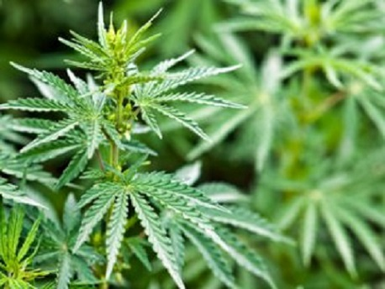
What do you know about marijuana?
  T F Marijuana cigarette is made from the crushed leaves of the cannabis plant.
  T F THC in marijuana affects your physical health.
  T F Riding your bike after smoking marijuana is safe.
  4. T F Because marijuana may cause depression or anxiety, it effects emotional development.
Notes:
1. Marijuana cigarette is made from the crushed leaves of the cannabis plant. When smoked it has a strong odor that may stay on your clothes. (T)
2. THC in marijuana affects your physical health. (T) (lungs - chronic cough, bronchitis - decreased blood pressure, decreased ability to fight off infections)
3. Riding your bike after smoking marijuana is safe. (F- THC effects coordination, your senses, and perception of time)
4. Because marijuana may cause depression or anxiety, it effects emotional development. (T)
5. Using marijuana will not affect your ability to do well in school. (F-THC effects caring about school, concentration, thought, and memory.) (Nemours, 2018)
6. If your friends are users and you use with them, your social health will not be affected. (F- THC may give you feelings of pleasure but the effects interfere in interpersonal relationships.)
7. In Massachusetts, people with certain diseases can get a prescription for marijuana. (T)

Slide 4

What do you know about marijuana?
  5. T F Using marijuana will not affect your ability to do well in school.
  6. T F If your friends are users and you use with them, your social health will not be affected.
  7. T F In Massachusetts, people with certain diseases can get a prescription for marijuana.
Notes:
1. Marijuana cigarette is made from the crushed leaves of the cannabis plant. (T)
2. THC in marijuana affects your physical health. (T) (lungs - chronic cough, bronchitis - decreased blood pressure, decreased ability to fight off infections)
3. Riding your bike after smoking marijuana is safe. (F- THC effects coordination, your senses, and perception of time)
4. Because marijuana may cause depression or anxiety, it effects emotional development. (T)
5. Using marijuana will not affect your ability to do well in school. (F-THC effects concentration, thought, and memory.) (Nemours, 2018)
6. If your friends are users and you use with them, your social health will not be affected. (F- THC may give you feelings of pleasure but the effects interfere in interpersonal relationships.)
7. In Massachusetts, people with certain diseases can get a prescription for marijuana. (T)

Slide 5
How does marijuana effect your body?
Effects of marijuana
Physical effects
Social effects
Intellectual effects
Emotional effects
Use the Venn diagram to identify the effects of marijuana on physical, social, intellectual, and emotional health.

Slide 6

Identifying peer influences
Healthy? Unhealthy? What to do?

Slide 7
Review
1. Identify examples of the emotional, intellectual, physical, and social health of children who do not use marijuana.
2. Identify how peers influence healthy and unhealthy behaviors relating to marijuana.

