Slide 1
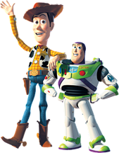
CONFLICT RESOLUTION
1. ____________________ are disagreements in ideas, beliefs, or interests.
2. ___________________ the use of physical force to harm someone.
3.___________________
a group whose members often use violence in a criminal way.
Conflict
Violence
Gang

Slide 2
CONFLICT RESOLUTION
CONFLICTS
4. Prejudice
5. Tolerance
6. Compromise
7. Negotiation
8. Peer Mediation
CAUSE
RESOLUTION
4. ___________ is an opinion or fear formed without having facts or firsthand knowledge.
6. ________________ each side gives up something.
7. ________________ the process of talking about a conflict and deciding how to reach a compromise.
8. ________________
specially trained students listen to both sides and help them reach a solution.
PREVENTION
5. ___________ is the ability to accept other people as they are.

Slide 3
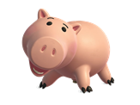
CONFLICT RESOLUTION
Try to T.A.L.K. about it
T. __________________________
A._______________________________________
L._______________________________________
K._______________________________________
Take a time out
Allow each person to tell their side
Let each person ask questions
Keep brainstorming to find a good solution

Slide 6
3. What gets wetter and wetter as it dries?

Slide 7
4. What color represents happiness?

