Slide 1
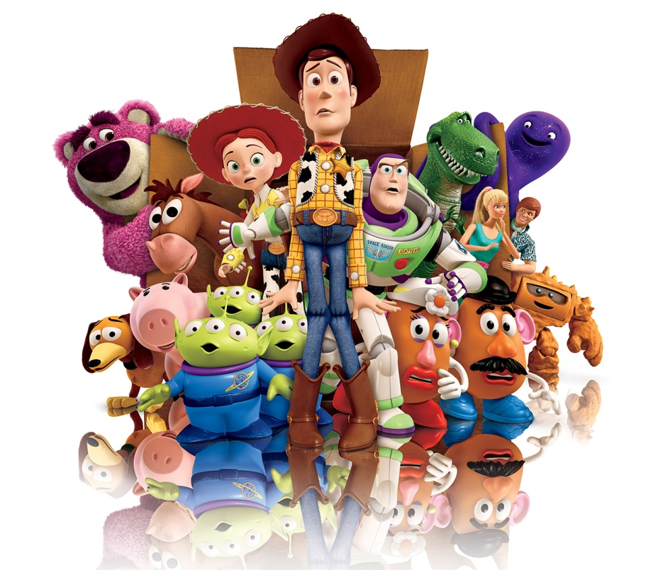
COMMUNICATION SKILLS

Slide 2
Communication skills
1.___________________ is the clear exchange of ideas and information.
Communication
2. RELATIONSHIP is defined as a ____________________________________________________________________________.
3. ___________ _______________ refers to facial expressions, eye contact, gestures, and posture.
Body
language
connection
with
another
person

Slide 3

Communication skills
Telephone activity
So what’s the point?
Speaking ~ Listening ~ Direct Source Rumors ~ Miscommunication Misunderstanding

Slide 4
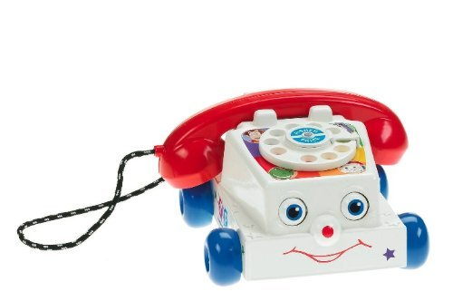
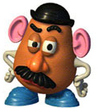
Communication skills
SENDING - SPEAKING | RECEIVING - LISTENING
4. Think, then _______________. | 5. _______________ actively.
6. Use “_____” messages. | 7. Ask _______________.
8. Make clear statements. | 9. _______________ thoughts & feelings.
10. Be _______________ with thoughts & feelings. | 11. Use appropriate __________ _______________.
12. Use appropriate body language. | 13. Wait your _______________
speak
listen
I
questions
mirror
honest
body
language
turn

Slide 5
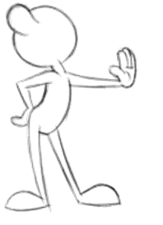
Communication skills
BODY LANGUAGE
Ex: rejection
DIRECTIONS:
Next to each picture, write 1-2 words ONLY describing what emotion they are showing with their body language.

Slide 6



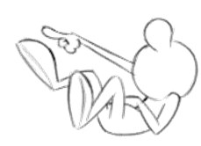



Slide 7
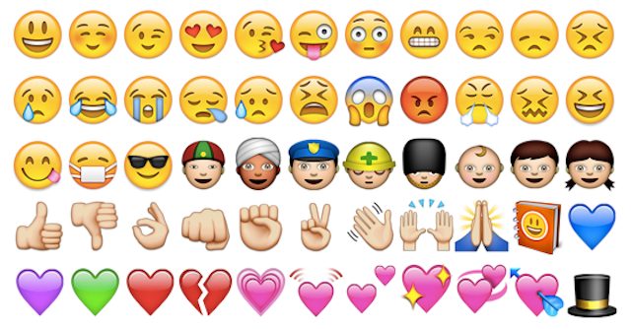
Technology ‘body language

