Slide 1
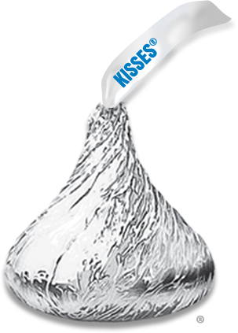
Circle
Of
Control
with a Kiss

Slide 2
Look
Smell
Pull the paper out
Unwrap
Bite the tip off
Place it on the corner of desk

Slide 3
Your choice...
Eat the Hershey Kiss NOW or save it for LATER

Slide 4
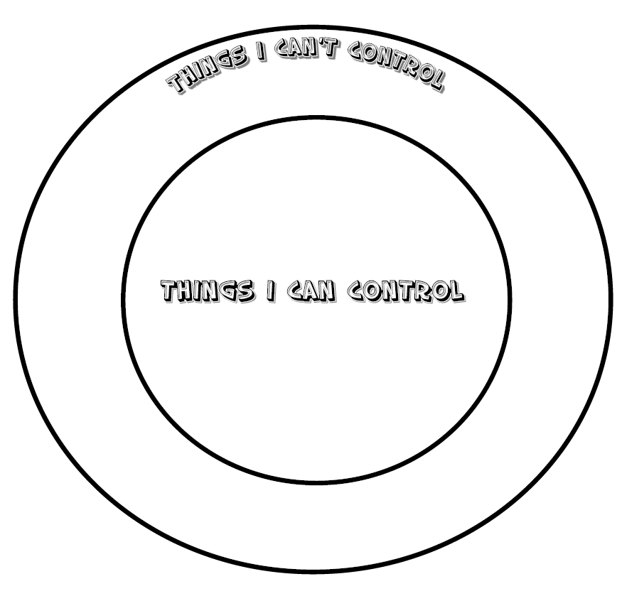
Circle of Control
Outside circle write things you CAN'T CONTROL
friends' happiness
helping someone
Inside circle write things you CAN CONTROL

Slide 5
Circle of Control
My behavior
What do you have CONTROL of...?
My effort
My thoughts
My attitude
My choices
My words
My body

Slide 6
Circle of Control
Others actions
What are some things you CAN'T CONTROL...?
Others mistakes
Others words
Other's actions
Others ideas

Slide 7
Circle of Control
What did you notice about the 2 lists?
My behavior
Others actions
My effort
Others mistakes
My thoughts
My attitude
Others words
My choices
Other's actions
My words
My body
Others ideas

Slide 8
Your choice...
Eat the Hershey Kiss NOW or save it for LATER

Slide 9
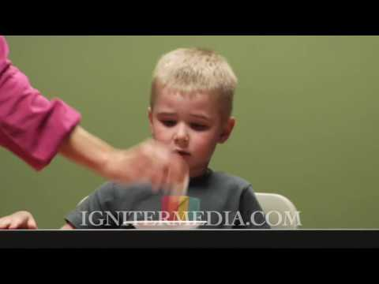
Marshmallow Test https://youtu.be/QX_oy9614HQ

