Slide 1
Nutrition
Trans Fat and Saturated Fat
Mrs. Rose-Roth

Slide 2
Trans Fat
What are trans Fat?
Trans fats are a form of unsaturated fat associated with a number of negative health effects. Artificial trans fat is created during hydrogenation, which converts liquid vegetable oils into semi-solid artially hydrogenated oil. Trans fat can also be found naturally in meat and dairy.
There two types of Trans fat
Naturally-occurring trans fats are produced in the gut of some animals and foods made from these animals (e.g., milk and meat products) may contain small quantities of these fats.
Artificial trans fats (or trans fatty acids) are created in an industrial process that adds hydrogen to liquid vegetable oils to make them more solid.

Slide 3
Example of trans Fat
Trans fat in your food
Baked goods, such as cakes, cookies and pies.
Shortening.
Microwave popcorn.
Frozen pizza.
Refrigerated dough, such as biscuits and rolls.
Fried foods, including french fries, doughnuts and fried chicken.
Nondairy coffee creamer.
Stick margarine.

Slide 4
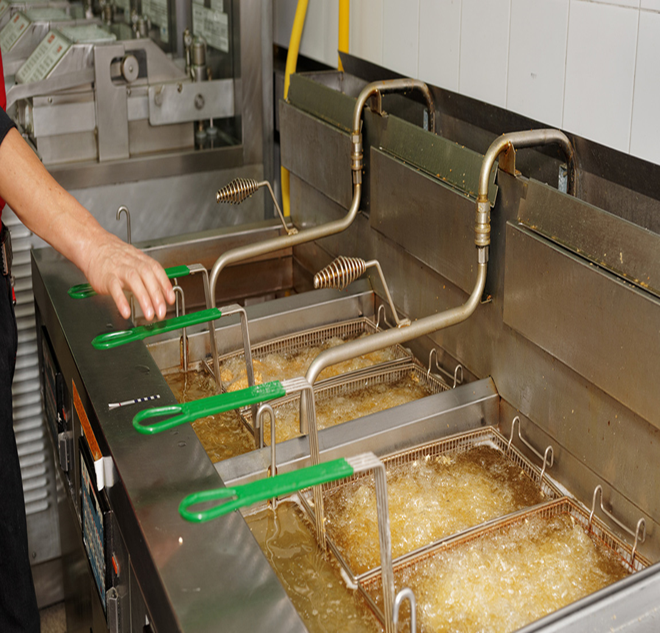
Trans Fat

Slide 5
Video on trans Fat
Play video
https://youtu.be/y0h4qZR9Q18
What is trans fat – is trans fat bad for you?

Slide 6
What are Saturated fat?
Saturated fats are found mostly in meat and animal products. They help packaged foods stay fresh longer and give baked goods a smooth texture. Saturated fats may increase the risk of heart disease and stroke because they raise the “bad” LDL cholesterol in the blood.
Saturated fat is found in:
butter, ghee, suet, lard, coconut oil and palm oil.
Cakes, biscuits, fatty cuts of meat, sausages.
bacon., cured meats like salami, chorizo and pancetta, cheese.

Slide 7
Saturated fat
Play video
https://youtu.be/9x4rnR8Tsu4-
What is saturated fat?

Slide 8
How does Trans Fat affect you health
Trans fats raise your bad (LDL) cholesterol levels and lower your good (HDL) cholesterol levels. Eating trans fats increases your risk of developing heart disease and stroke. It’s also associated with a higher risk of developing type 2 diabetes.

Slide 9
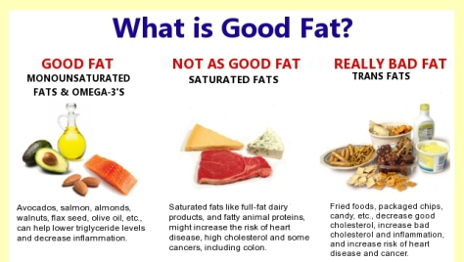

Slide 10
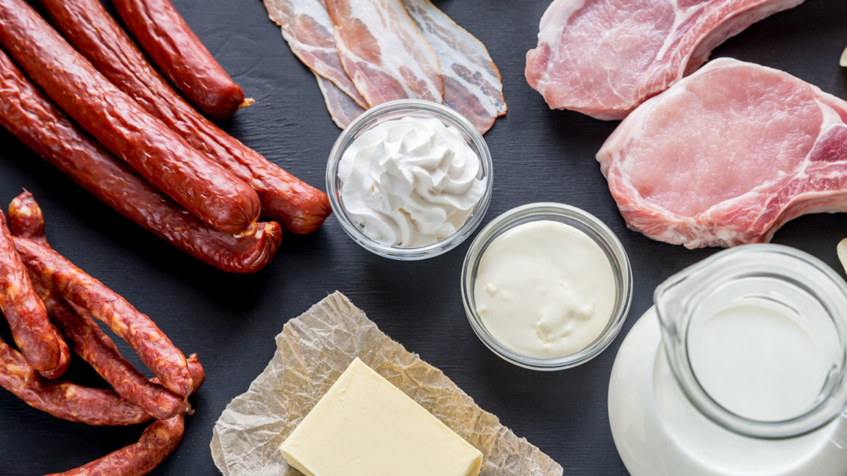
Saturated fat

Slide 11
