Slide 1
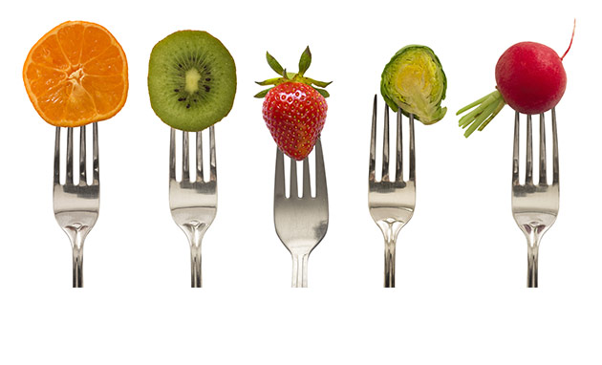
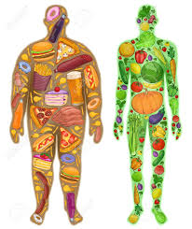
Nutrition
Tanner Roos (@MrRoosPE)
Jaryd Prince (@JPrincePhysed)
Kathy Szabo (@MrsSzaboPE).
OPEN: Online Physical Education Network

Slide 2
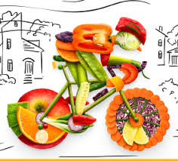
Energy
Recognizes that food provides energy for physical activity.

Slide 3

The Nutrition Rap: “Eat Real Food Baby”
The Scholarly Rapper, Andy Horne
https://youtu.be/eV21p_sepgU

Slide 4
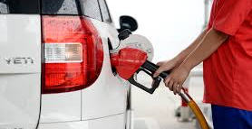
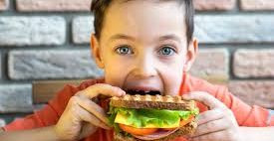
Recognizes that food provides energy for physical activity
Food is the fuel we need to do the things we want to do.
Calories from food = energy (like gas in a car)
Food is Energy In

Slide 5
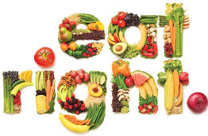
Essential Questions
What are the five food groups?
What foods give us energy?
What foods take away energy?

Slide 6
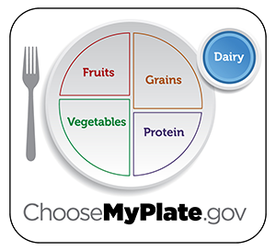
What are the five food groups?

Slide 7
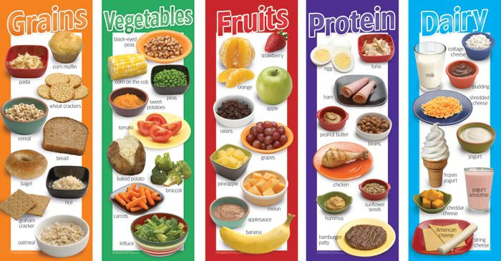
What types of foods give us energy?

Slide 8
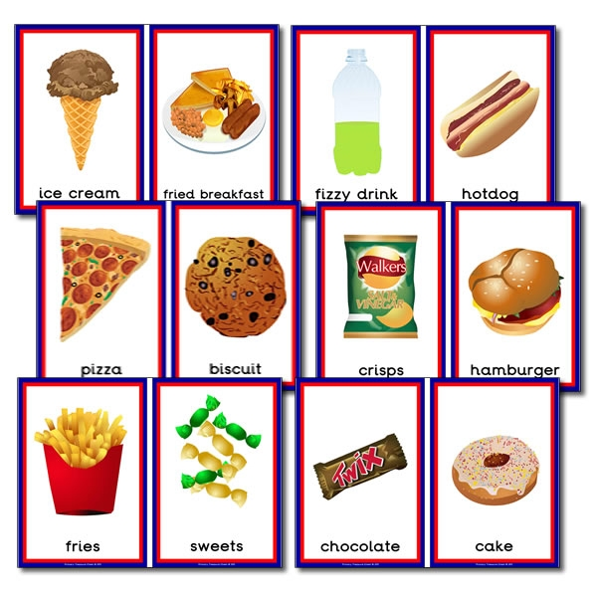
What types of foods take away energy?

Slide 9
Activity
Say a healthy and an unhealthy food to a partner.
See if your partner can guess which food gives energy for physical activity.
Together name the 5 food groups.
Repeat with a new partner.

Slide 10
Goal Setting
I know the names of the five food groups;
_______ , _______ , _______ , _______ and _______ .
My healthy eating goal is ___________ .
What will you do differently
to reach your goal?

Slide 11
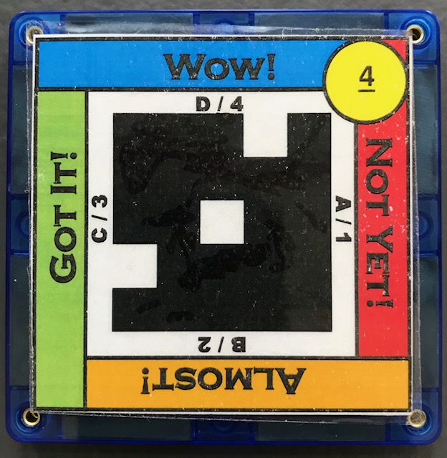
What food takes away our energy?
Food provides energy for physical activity.
1: Chocolate
2: Bananas
3: Yogurt
4: Carrots

Slide 12
Healthy vs Unhealthy
Differentiate between healthy and unhealthy foods.

Slide 13
Essential Questions
What foods are healthy?
What would make foods unhealthy?

Slide 14
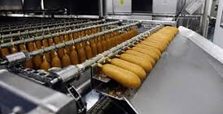
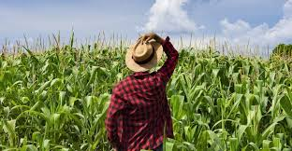
Differentiates between healthy and unhealthy Foods
Food provides nutrients and calories that we need to move and grow.
Food from farms, not from factories

Slide 15
What makes foods unhealthy?
Calories that are not filling
Low in nutrients
Higher in sugar
Too much sodium/ salt
Many saturated and trans fats

Slide 16
Activity
Find a partner.
Name a food group, see if your partner can name a healthy food from that group.
Repeat this until they have done this for each of the five food groups.
Let your partner have a turn.
Repeat with a new partner.

Slide 17
Activity
Find a partner.
Discuss what makes a food unhealthy.
Ask other groups for help if you can’t remember.
Repeat with a new partner.

Slide 18
What would make foods unhealthy?
Differentiate between healthy and unhealthy foods.
1: Many saturated and trans fats
2: Higher in sugar
3: Calories that are not filling
4: All of the above

Slide 19
Balance
Recognize the “good health balance” of good nutrition and physical activity.

Slide 20
Recognize the “good health balance” of good nutrition and physical activity
How much we eat needs to be in balance with how much we move and grow.
Need energy and nutrients from food for growth and activity

Slide 21
Essential Questions
How do you build a healthy My Plate?
How many minutes of exercise per day is recommended?
How does Eating Healthy + Exercise = Good Health Balance?

Slide 22
How do you build a healthy My Plate?

Slide 23
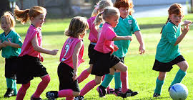
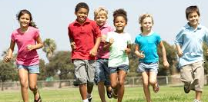
How many minutes and days of exercise is recommended?
60 minutes
7 days a week

Slide 24
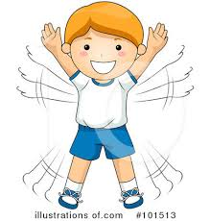
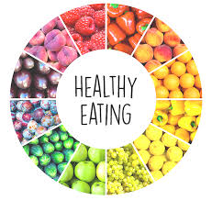
How does
Exercise +
Eating Healthy = Good Health
Balance?
Exercise:
controls weight, fights health conditions and diseases, improves mood, helps improve sleep
Eating Healthy:
controls weight, eat less, reduces stress, age better, live longer

Slide 25
Activity
How much exercise is recommended?
Why is eating healthy and exercise important for a “Good Health Balance”
What can people do to make sure they are achieving a “Good Health Balance”
Repeat with a new partner.

Slide 26
Activity
Find a partner.
Tell your partner the five food groups.
Ask your partner which food groups should take up more of the plate, and which should take less.
Repeat with a new partner.

Slide 27
Goal Setting
I know a good healthy balance includes _______ and _______ .
My goal to reach the “good
health balance” is ___________ .
What will you do differently to reach your goal?

Slide 28
What is the “good health balance”?
Recognize the “good health balance” of good nutrition and physical activity.
1: Exercising 60 minutes each day.
2: Using “My Plate” to determine the recommended portions from all five food groups.
3: Eating healthy and exercising daily.
4: Drinking enough water to stay properly hydrated.

Slide 29
Physical Activity
Identifies foods that are beneficial for before and after physical activity.

Slide 30
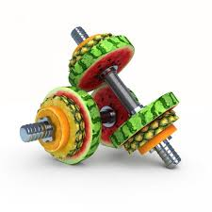
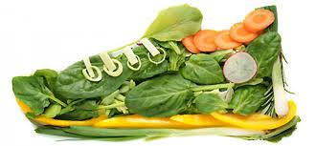
Identify foods that are beneficial for before and after physical activity
Focus activity snacks on fresh fruits and vegetables with water.
This combination hydrates the body, quickly provides energy needed, and is easy for the stomach to digest (comfortably).

Slide 31
Essential Questions
How do you build a healthy My Plate?
What foods would be a good choice for energy before and after physical activity?
What foods would be a bad choice for energy before and after physical activity?

Slide 32
How do you build a healthy My Plate?

Slide 33
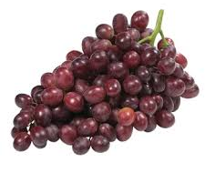
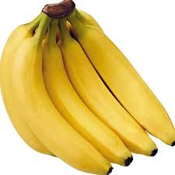
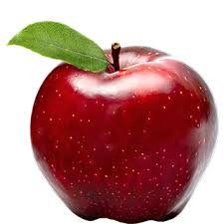
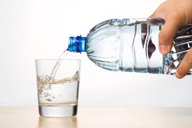
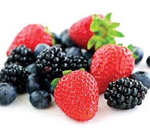
Fruits and water would be a good choices for adding energy before and after physical activity.

Slide 34
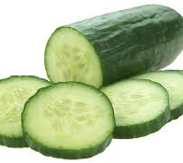
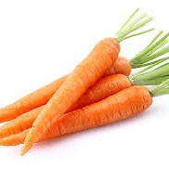
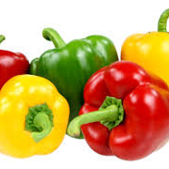
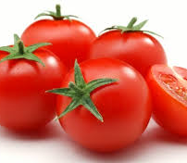
Most vegetables and water would be a good choices for adding energy before and after physical activity.

Slide 35
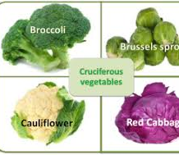
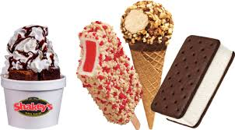
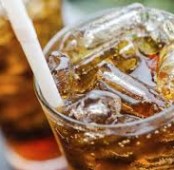
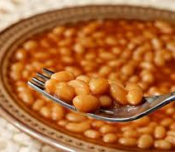
BAD Food choices before and after physical activity.
Beans
Cruciferous Veggies
Dairy Products
Fried or Fatty Foods
Carbonated Beverages
Desserts
Spicy Food

Slide 36
Activity
Find a partner.
Tell your partner 3 foods that would be beneficial before or after physical activity.
Your partner will tell you 3 foods that would not be beneficial before or after physical activity.
Repeat with a new partner.

Slide 37
Activity
Find a partner.
Tell your partner the five food groups.
Ask your partner which food groups should take up more of the plate, and which should take less.
Repeat with a new partner.

Slide 38
Goal Setting
I know I should be eating _______ to gain energy before and after physical activities.
My goal to gain energy before and after physical activity is ___________ .
What will you do differently
to reach your goal?

Slide 39
What types of foods are not good for before and after physical activities?
Identify foods that are beneficial for before and after physical activity.
1: Desserts (cake, ice cream, cookies)
2: Fruits (banana, apple, mango)
3: Vegetables (carrot, red pepper, tomato)
4: Water

Slide 40
Hydration
Discusses the importance of hydration and hydration choices relative to physical activities.

Slide 41

Hydration Rap
The Scholarly Rapper, Andy Horne
https://youtu.be/kcfGCds4u_Q

Slide 42
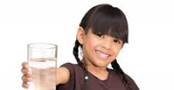
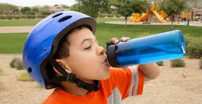
Discusses the importance of hydration and hydration choices relative to physical activities
Water is the best way to hydrate.
Sports drinks can help if you sweat a lot for more than an hour.
More hydration is needed when you sweat a lot and in hot temperatures.

Slide 43
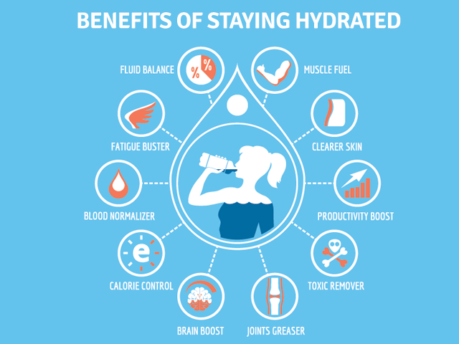
Essential Questions
Why are hydration and hydration choices important relative to physical activities?
How can you tell if you are hydrated enough?
How much water should you drink each day?

Slide 44
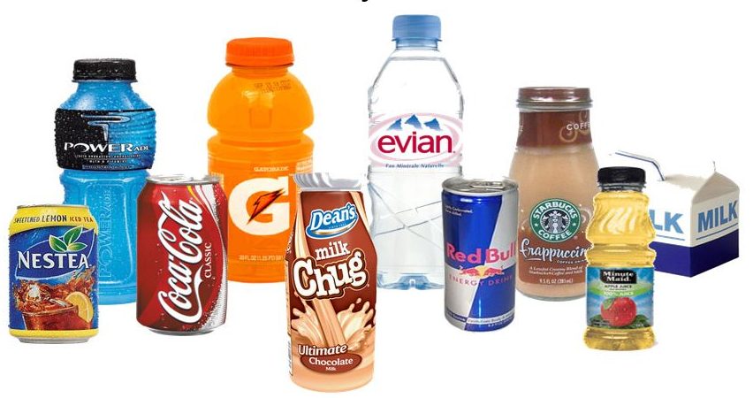
Why are hydration and hydration choices important relative to physical activities?
Whether you’re a serious athlete or simply exercise for recreation, it’s important to stay hydrated. Good hydration means getting the right amount of water before, during, and after exercise. Water regulates your body temperature and lubricates your joints. It helps transport nutrients to give you energy and keep you healthy. If you’re not hydrated, your body can’t perform at its highest level. You may feel tired, have muscle cramps, dizziness, or other serious symptoms.

Slide 45
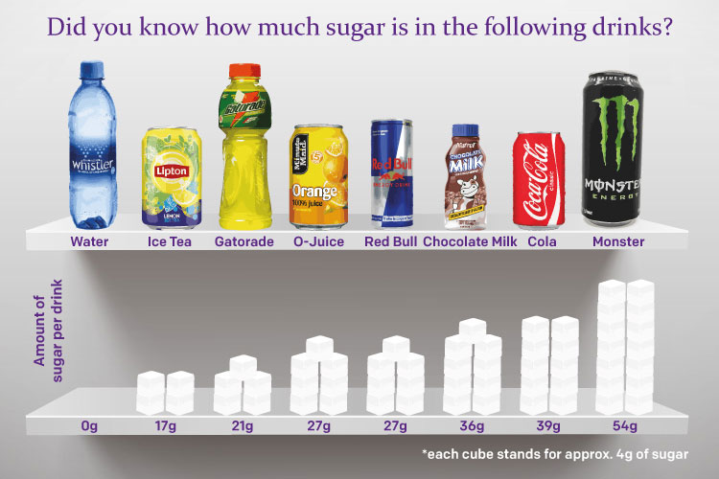
Why is it important to choose sugar free drinks when participating in sports?
You may get some added vitamins and electrolytes from sports drinks, but the high sugar content goes right through your system to cause an energy crash later on.

Slide 46
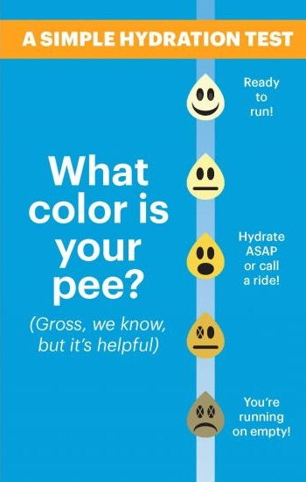
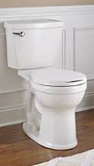
How can you tell if you are hydrated enough?

Slide 47
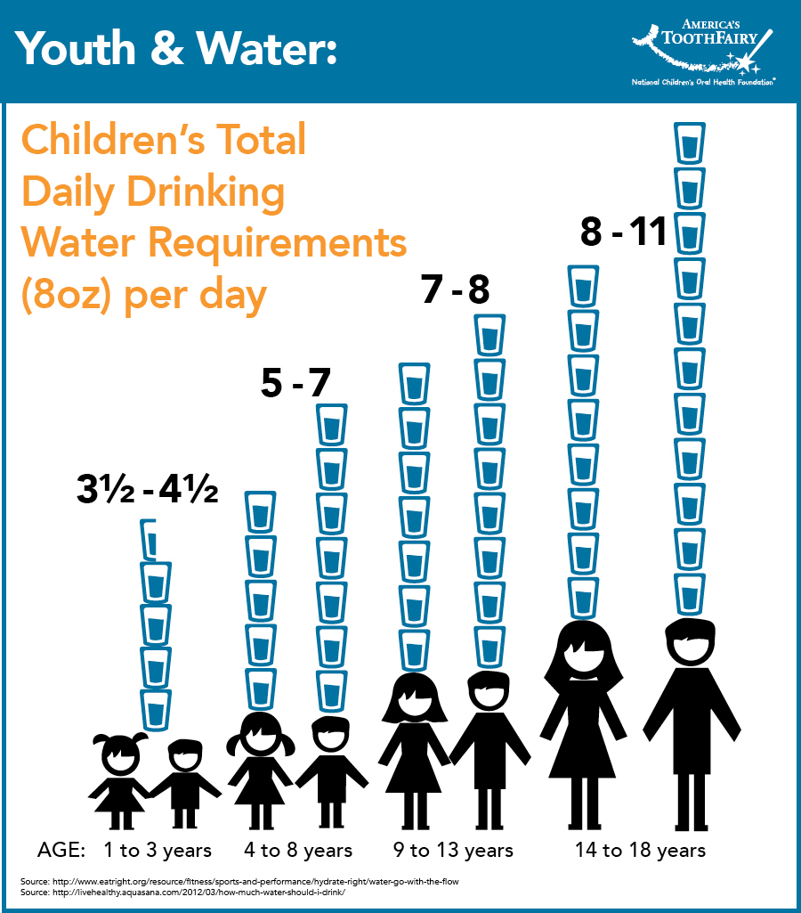
How much water should you drink each day?

Slide 48
Activity
Ask a partner how many 8 oz. cups of water they should drink each day.
What are the benefits that might happen if someone is hydrated properly?
How can someone tell if they are properly hydrated.
Repeat with a new partner.

Slide 49
Goal Setting
I currently drink about _______ cups of water a day.
I know I should be drinking _______ cups of water a day.
My water drinking goal is ___________ .
What will you do differently to reach your goal?

Slide 50
How can you tell if you are properly hydrated?
Discusses the importance of hydration and hydration choices relative to physical activities.
1: You’re urine is a dark color.
2: You’re urine is a light color.
3: You are not thirsty right now.
4: You need to use the restroom.

Slide 51
Food Choices
Analyzes the impact of food choices relative to physical activity, youth sports & personal health.

Slide 52
Analyzes the impact of food choices relative to physical activity, youth sports & personal health
Choose healthy foods and correct portion sizes from each food group
Proper food choices allow the body to perform optimally
Body uses nutrients and energy to be at its best

Slide 53
Essential Questions
What are portion sizes, and why are they important when choosing foods?
What food choices are good or bad choices for adding energy before or after physical activity?
Why is it important to choose sugar free drinks when participating in sports?

Slide 54
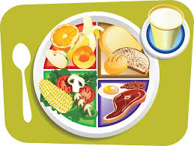
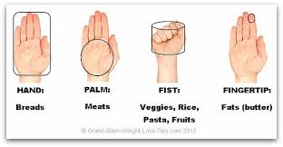
What are portion sizes, and why are they important when choosing foods?
Larger food servings not only provide more calories but also encourage people to eat more and to underestimate how much they are eating.
https://www.theatlantic.com/health/archive/2012/02/the-importance-of-portion-control/253580/
Hand =
Breads
Palm =
Meats
Fist =
Vegies, Rice, Pasta, Fruit
Fats =
Butter

Slide 55
Fruits and water would be a good choices for adding energy before and after physical activity.

Slide 56
Vegetables and water would be a good choices for adding energy before and after physical activity.

Slide 57
BAD Food choices before and after physical activity.
Beans
Cruciferous Veggies
Dairy Products
Fried or Fatty Foods
Carbonated Beverages
Desserts
Spicy Food

Slide 58
Activity
Find a partner.
Partner ONE asks how much (name a food) would be an appropriate portion.
Partner TWO responds by saying the food group and the portion size.
Repeat with a new partner.
Hand =
Breads
Palm =
Protein/ Meat
Fist =
Vegies,
Rice,
Pasta, Fruit
Tip =
Fats/
Butter

Slide 59
Activity
Why is it important to choose sugar free drinks when participating in sports?
Name food choices that would add energy if eaten before or after physical activity.
Name a bad food choice if it was before or after physical activity.
Repeat with a new partner.

Slide 60
Goal Setting
I know my hand can help me remember portion sizes. The proper portion size for each food group is approximately _______ .
My portion size goal is ___________ .
What will you do differently
to reach your goal?

Slide 61
Which of these was not a recommended portion size?
Analyze the impact of food choices relative to physical activity, youth sports & personal health.
1: Hand: Breads
2: Palm: Protein / Meats
3: Fist: Fruit, Vegetable, Rice, Pasta
4: Finger Tip: Dairy Products

