Slide 1
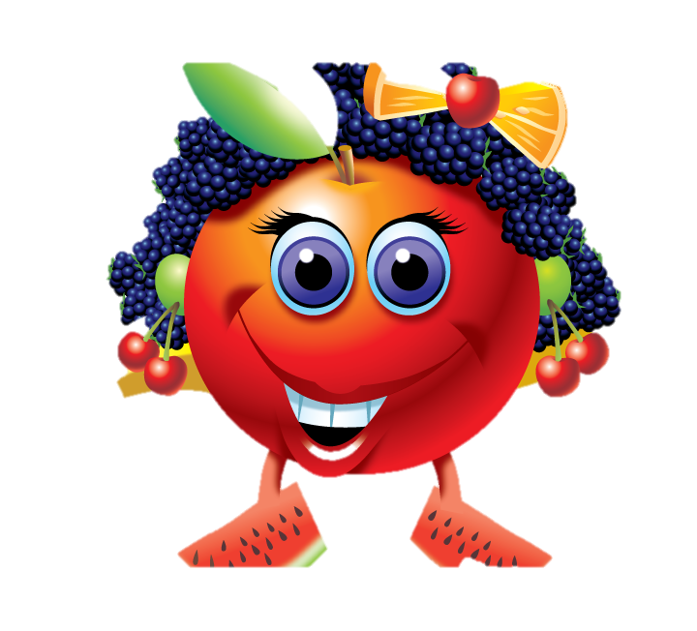
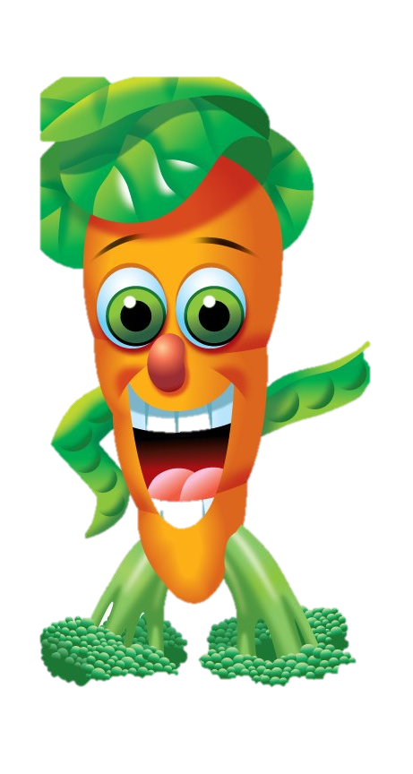
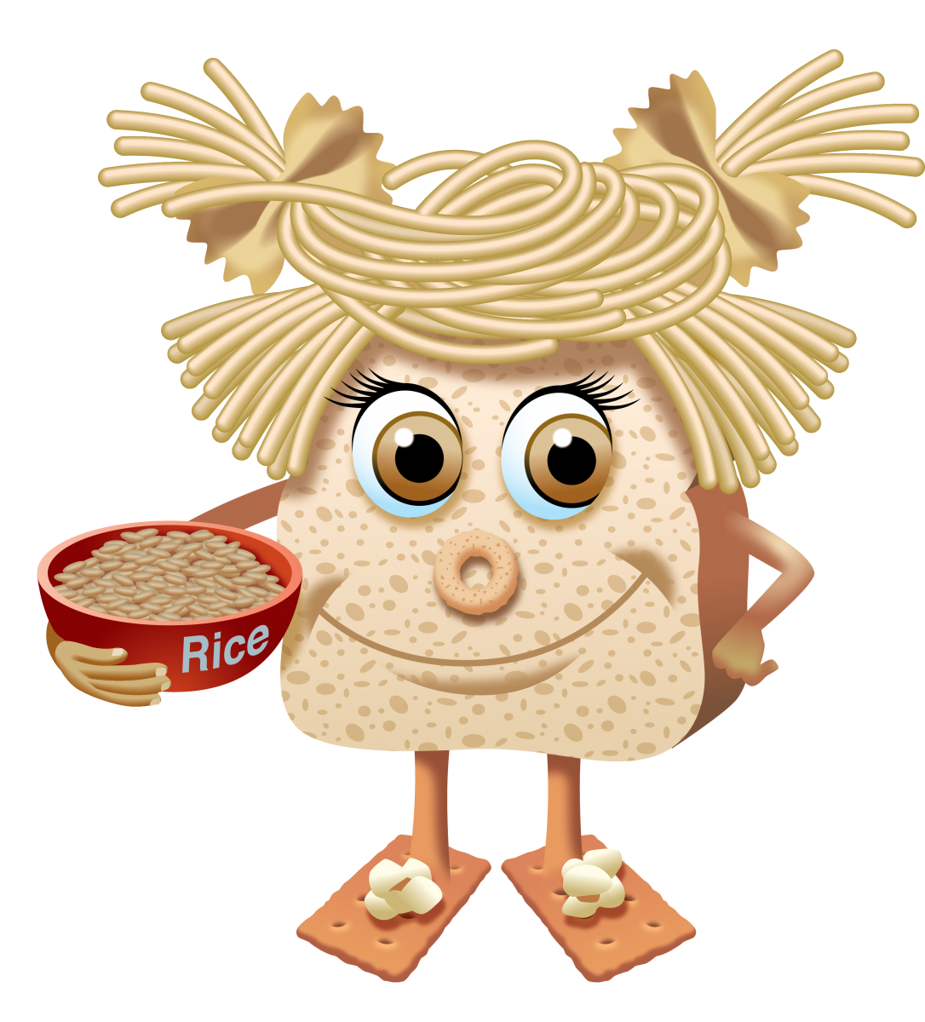
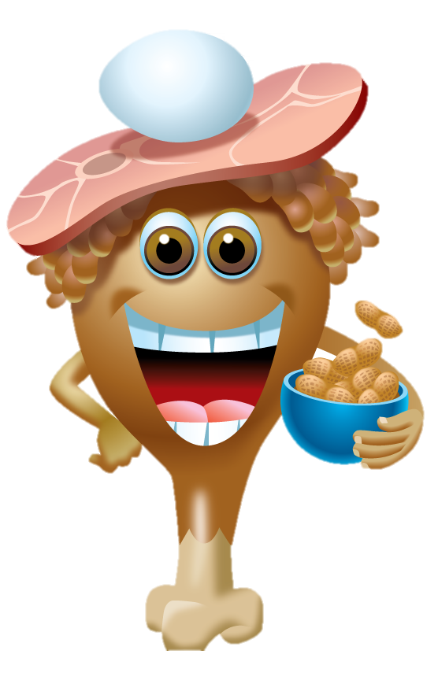
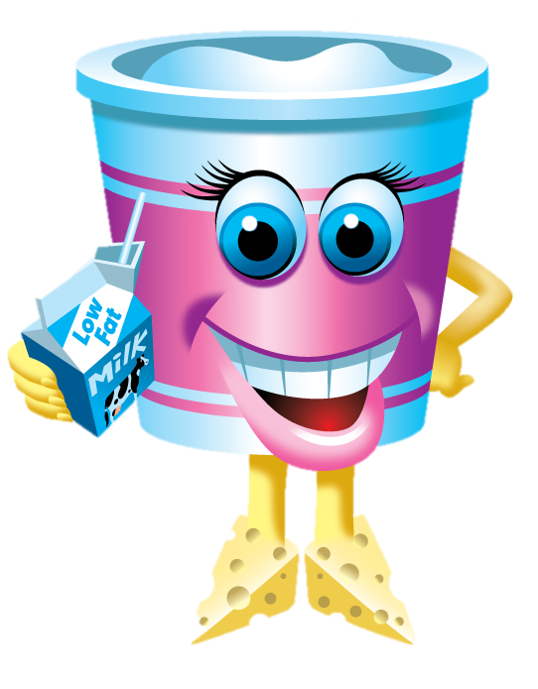
FOOD GUIDES...

Slide 2
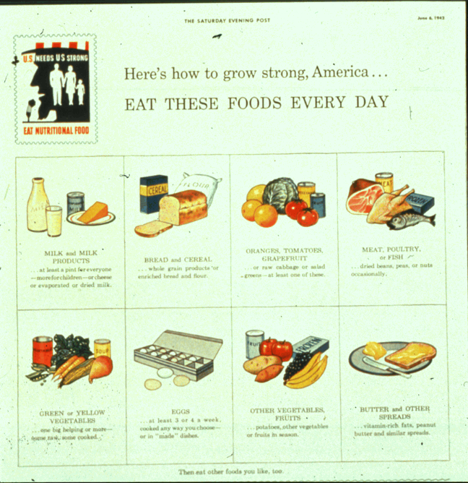
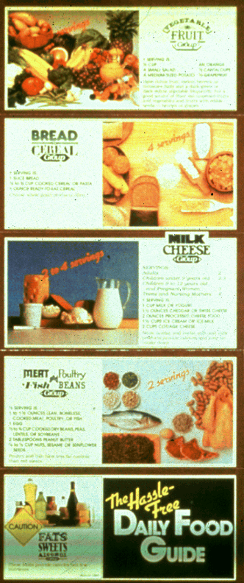
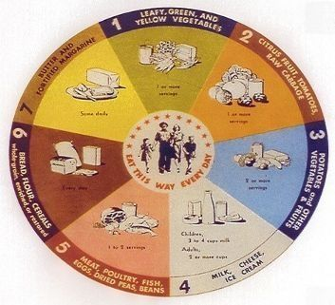
1970
1979
1940

Slide 3
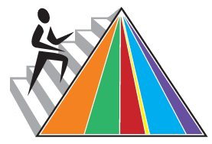
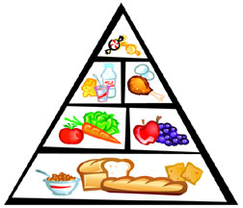
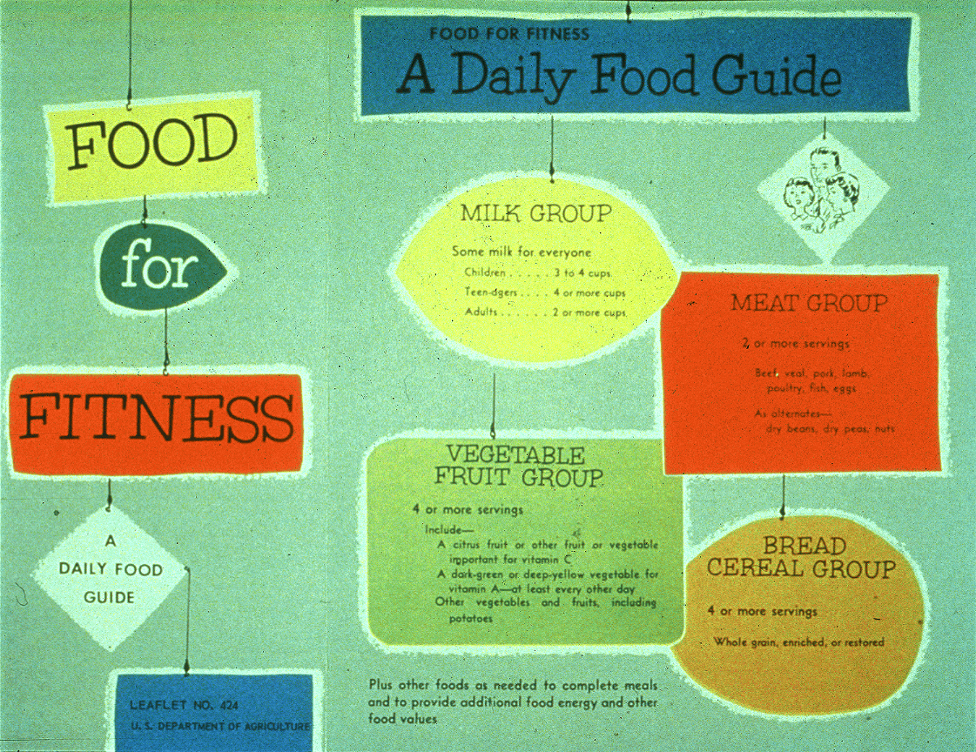
1984
2005
1992
1956
2011

Slide 4
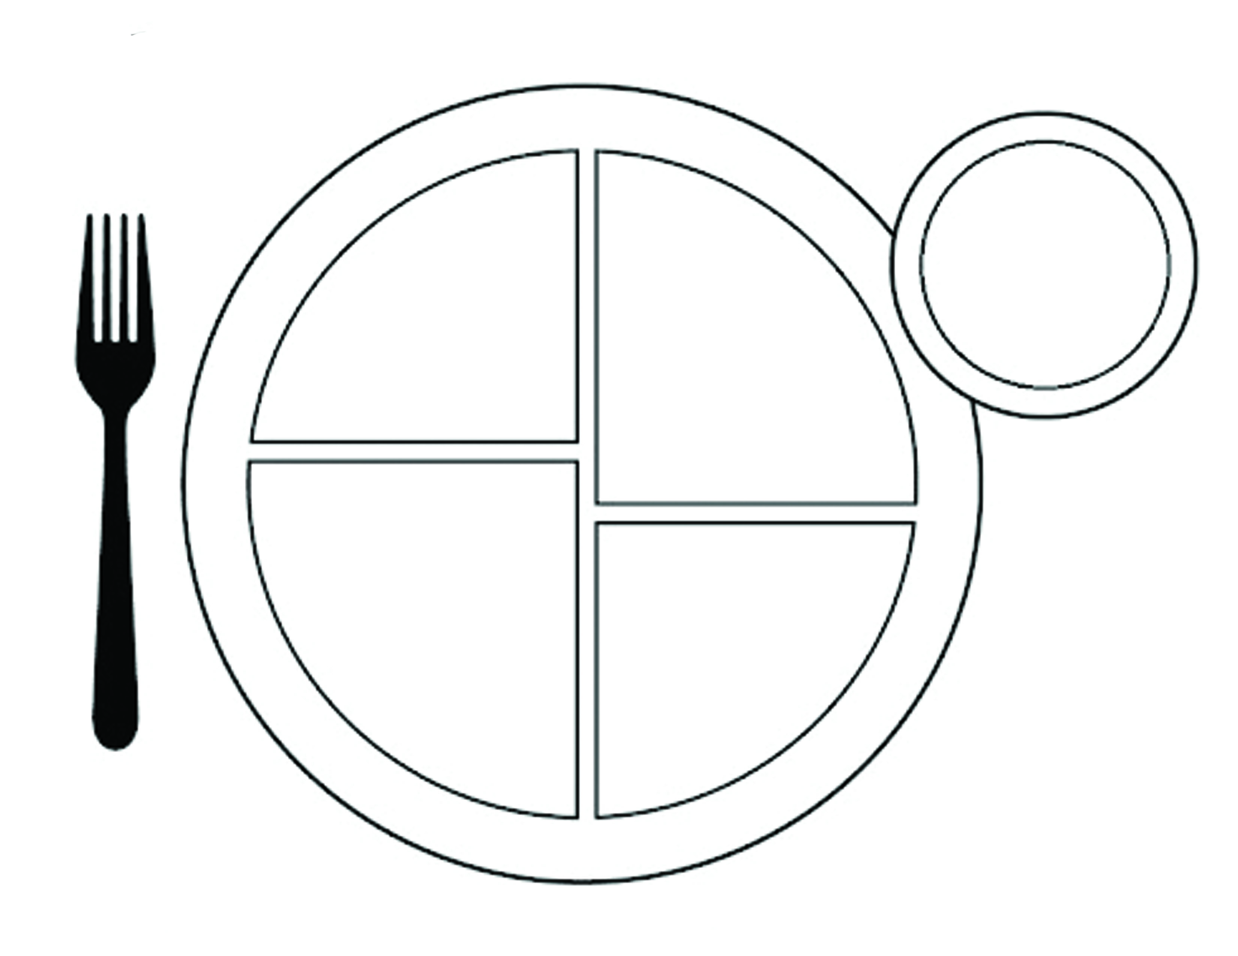
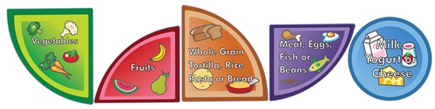
DAIRY
FRUITS
GRAINS
VEGETABLES
PROTIEN
5 food groups

Slide 5
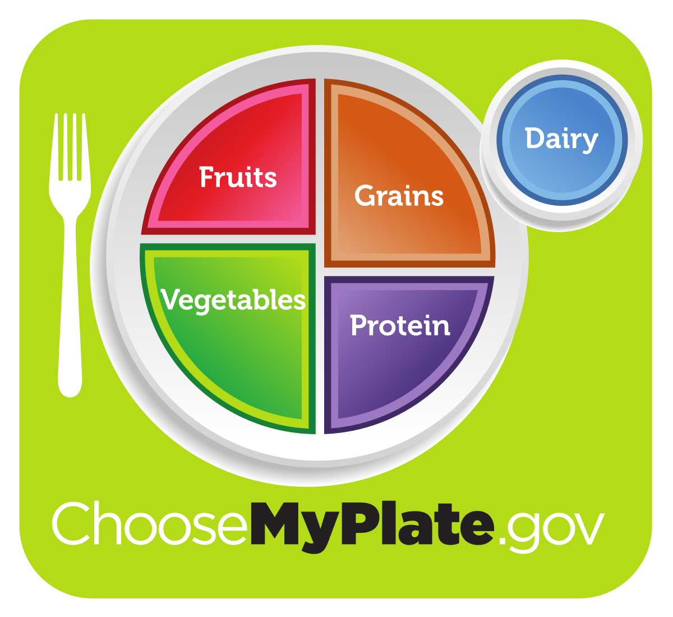
Why did they change this to a plate instead of the food groups they used in the past?
A plate shows what you eat
off of and better
represents portion size.

Slide 6
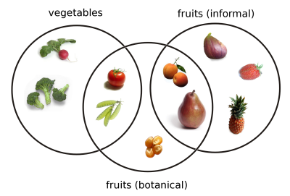
FRUIT
What makes a fruit a
and a vegetable a
VEGETABLE ?
A fruit is a seed-
bearing structure, whereas vegetables are all other plant parts, such as roots, leaves and stems.

Slide 7
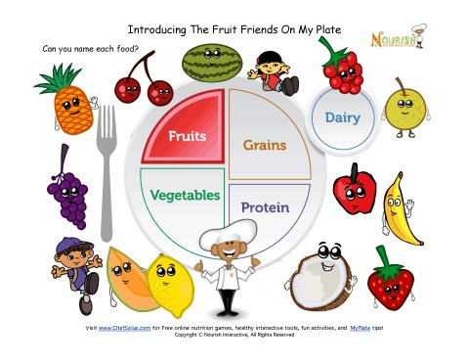
Healthier fruit = bitter taste, less sweet

Slide 8
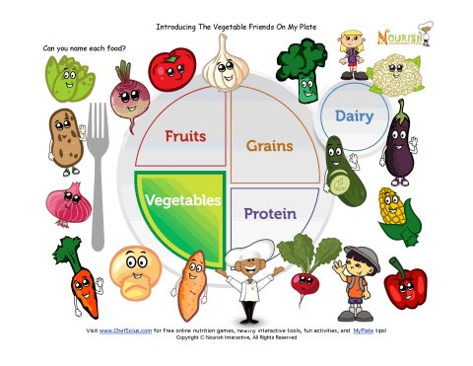
Healthier veggie = green

Slide 9
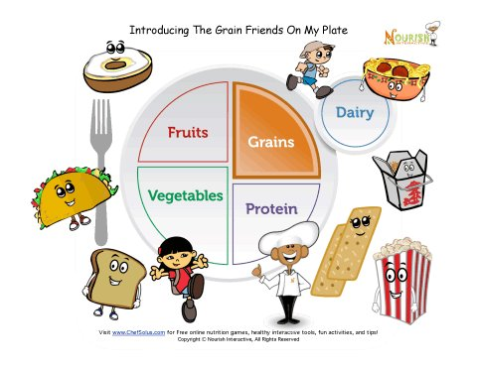
Healthier grain = WHOLE or darker brown

Slide 10
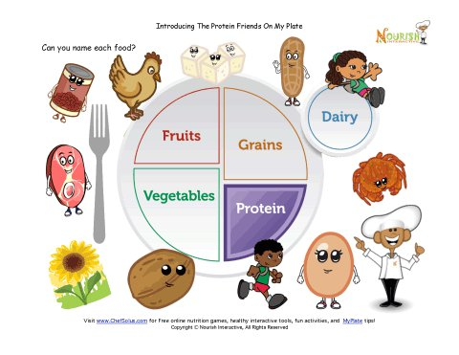
Healthier protein = whiter in color

Slide 11
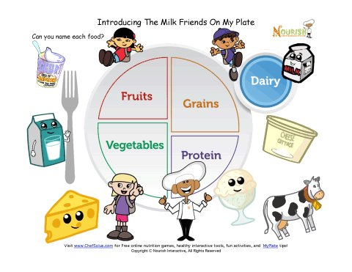
Healthier dairy = bland taste

Slide 12

YOU ARE WHAT YOU EAT
DIRECTIONS: Have you heard of the saying “You Are What You Eat”? If you looked just like what you ate, how would you look? To find out, make a list of your favorite foods. List AT LEAST 6 foods! Next to each food also write the food group category it is a part of. On a piece of scrap paper draw a rough draft showing your body made from these foods
6 FAVORITE FOODS:
1. _________________
2. _________________
3. _________________
4. _________________
5. _________________
6. _________________
FOOD GROUP CATEGORY:
1. _________________
2. _________________
3. _________________
4. _________________
5. _________________
6. _________________
Noodles
Grain
Cheerios
Grain
French Toast
Grain
Is this a
well-balanced
diet?
Rice
Grain
Crackers
Grain
Popcorn
Grain

Slide 13
YOU ARE WHAT YOU EAT
Label all 6 foods
In parenthesis place the food group (ex: grains)
Place your name on bottom right
Draw all 6 foods with color
In a few sentences explain if what you eat is a well-balanced meal.
Noodles
This is not well-balanced because there are no foods from any other category. These foods are also not healthier grains like whole wheat bread.
(Grains)
French Toast
(Grains)
Rice
Cheerios
(Grains)
(Grains)
Popcorn
(Vegetables)
Crackers
(Grains)
Mrs. Adams

