Slide 1
NONCOMMUNICABLE DISEASES
Diseases
Diseases
Diseases

Slide 2
Complete the information on your notes
There are 3 main causes of
noncommunicable diseases:
1. Poor health habits – examples include…
a. Lack of physical activity
b. ___________________________________
c. ___________________________________
2. Person’s ______________________ - like living where there is smog/pollution.
3. __________________ - passed from parent to child.
BEING OVERWEIGHT
POOR EATING HABITS
ENVIRONMENT
INHERITED

Slide 3
5 MOST COMMON NONCOMMUNICABLE DISEASES
Heart Disease
Cancer
Allergies
Asthma
Diabetes

Slide 4
Complete the information in your notes
Heart Disease
1. Chronic:
LONG LASTING

Slide 6
High Blood Pressure

Slide 7
Complete the information in your notes
2. _________________ _________________ is the #1 cause of death in the U.S.
HEART
DISEASE
3. _____________________ of blood vessels. Happens when the heart has a hard time doing its job.
4. _________________ blood pressure. Happens when the heart is forced to work extra hard.
NARROWING
Caused by:
HIGH

Slide 8
Complete the information in your notes
5. List 3 heart healthy habits:
A. _______________________________________________
B. _______________________________________________
C. _______________________________________________
STAY PHYSICALLY ACTIVE
MAINTAIN A HEALTHY WEIGHT
DON’T USE TOBACCO
6. How can heart disease be treated?
MEDICATION LOWERS BLOOD PRESSURE

Slide 9
Cancer explained

Slide 10
Complete the information in your notes
Cancer
CANCER
DISEASE CAUSED BY
ABNORMAL CELLS THAT
GROW OUT OF CONTROL
TUMOR
2. ___________________ or mass of abnormal cells are either:
BENIGN
A. Noncancerous or _______________ means they do not spread.
B. Cancerous or _____________________ means they do spread.
MALIGNANT

Slide 11
Complete the information in your notes
Fill-in ‘CAUTION’ the 7 warning signs that someone should seek medical help
C
hanges in bladder habits
.
SORE THROAT THAT DOES NOT HEAL
A
List the 4 ways to treat cancer:
1.
2.
3.
4.
U
NUSUAL BLEEDING
T
HICKENING OR LUMP
SURGERY
I
NDIGESTION OR DIFFICULTY
SWALLOWING
RADIATION
O
CHEMOTHERAPY
BVIOUS CHANGES IN WART
N
AGGING COUGH
BIOLOGIC

Slide 12
Allergies explained

Slide 13
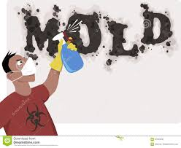
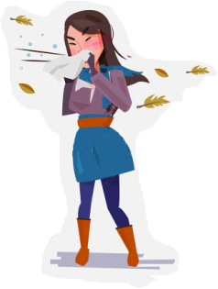
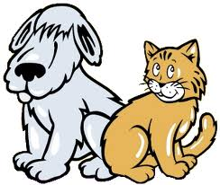
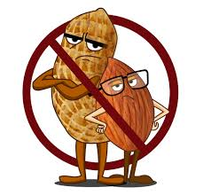
Complete the information in your notes
Allergies
1. Define Allergy
BODY’S SENSITIVITY
TO CERTAIN SUBSTANCES
List 5 more possible allergens:
1. Dander from animal fur
2.
3.
4.
5.
6.
DUST MITES
POLLEN
Bee stings &
medication
GRASS
MOLDS
FOODS

Slide 14
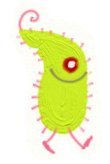
Complete the information in your notes
Asthma Video
Asthma
1. Define ASTHMA
AIRWAYS BECOME
IRRITATED AND SWOLLEN
6. INHALER:
OPENS
UP
THE
AIRWAYS
2.
3.
4.
5.
ALLERGENS
Ashtma can be
triggered by:
PHYSICAL ACTIVITY
COLD/DAMP AIR
AIR POLLUTION

Slide 15
Complete the information in your notes
7. Define Diabetes
Diabetes
DISEASE PREVENTS THE BODY FROM USING SUGAR PROPERLY
8. _____________________ is a hormone (or chemical) that normally moves sugars into cells.
9. Explain the difference between Type 1 Diabetes and Type 2 Diabetes:
10. What is the treatment for diabetes?
INSULIN
Diabetes Video
BORN WITH TYPE 1
MEDICATION

