Slide 1
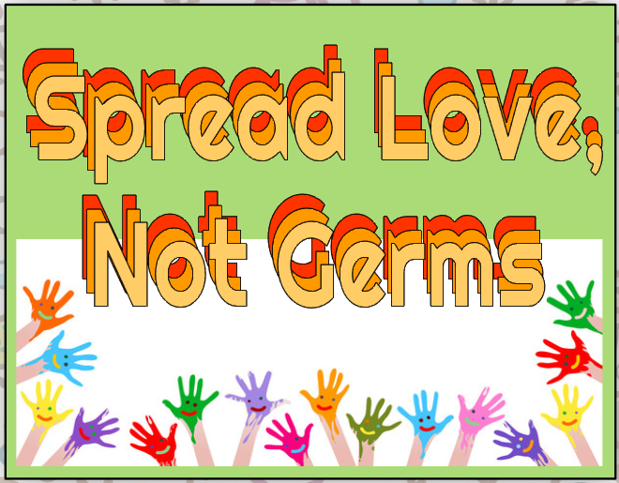

Slide 2
Spread Love, Not Germs
DISEASE
1. Condition that affects the mind &/or body
COMMUNICABLE DISEASE
2. Diseases that can spread

Slide 3
Spread Love, Not Germs
NONCOMMUNICABLE DISEASE
3. Diseases that DO NOT spread
PATHOGEN (also called a germ)
4. An organism that causes a communicable disease

Slide 4

PATHOGENS ARE ALSO
CALLED:
THERE ARE
FOUR TYPES
  5. Viruses
  6. Bacteria
  7. Protozoa
  8. Fungi
ALL PATHOGENS ARE COMMUNICABLE DISEASES; OR THEY CAN SPREAD EASILY.

Slide 5

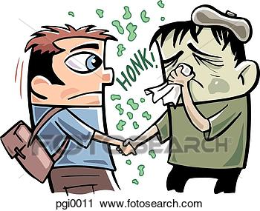
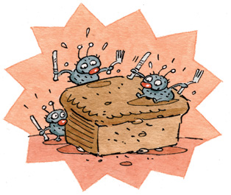
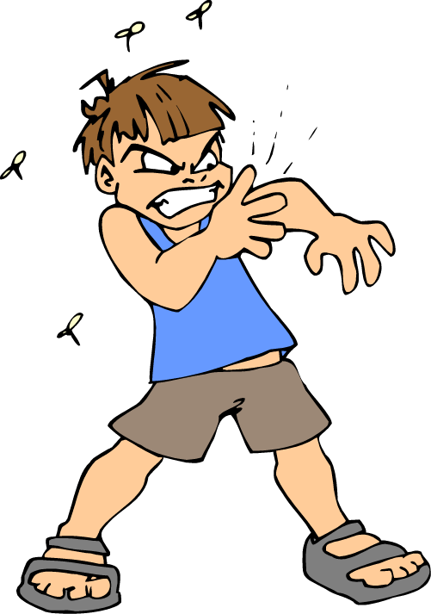
Spread Love, Not Germs
PATHOGENS ARE SPREAD IN 4 WAYS:
10. DIRECT physical contact
11. INDIRECT contact passing
through the air.
12. EATING or drinking
contaminated foods.
13. BITE by animal or insects.

Slide 6
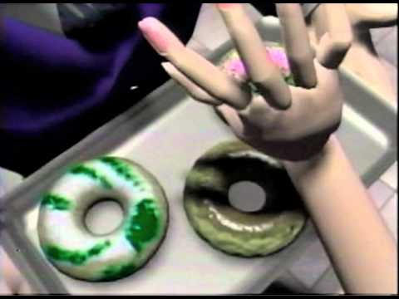

Slide 7
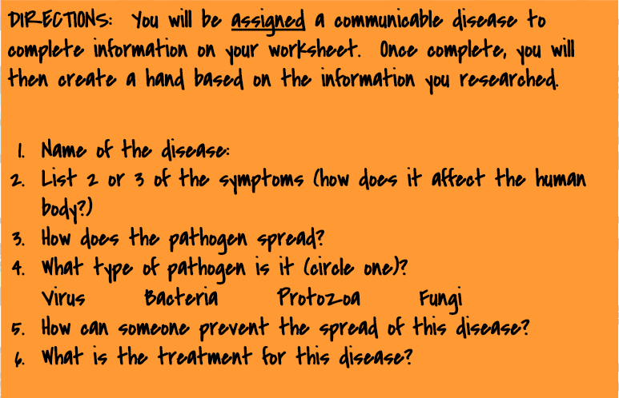
Spread Love, Not Germs

Slide 8
