Slide 1
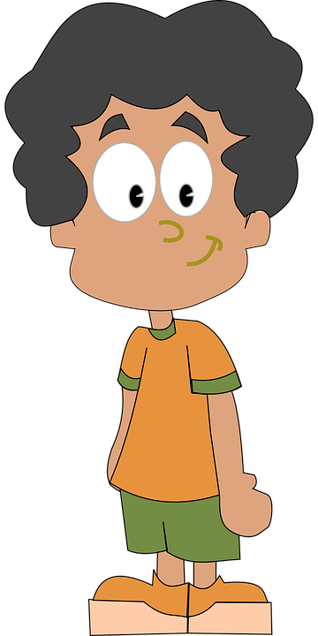
All About Me
Immune System and Germs
Let’s Learn About Health!
4th Grade

Slide 2
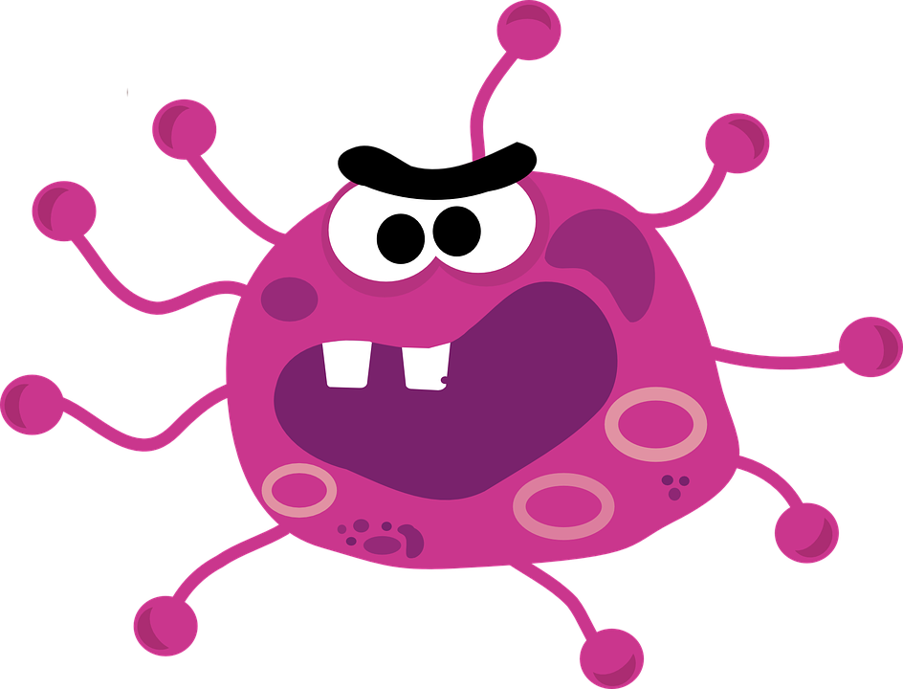
Glo Germ Activity
http://www.instructables.com/id/Teach-a-Glo-Germ-Lesson-for-Improved-Hand-Washing-/

Slide 3
The Immune System
Watch the following video clip to learn more about the functions of the immune system.
https://www.youtube.com/watch?v=24IYt5Z3eC4
Summarize how the immune system works and major structures of the immune system.

Slide 4
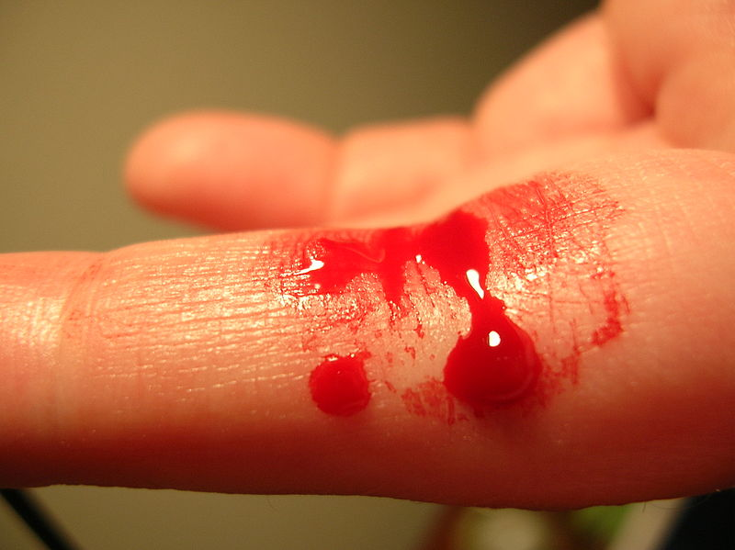
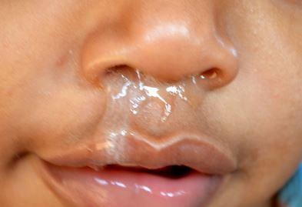
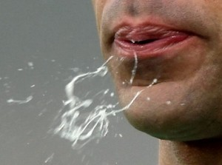
Body Fluids & Germs
Virus
Parasites
Bacteria
Virus
Bacteria Virus
Virus
Parasites

Slide 5
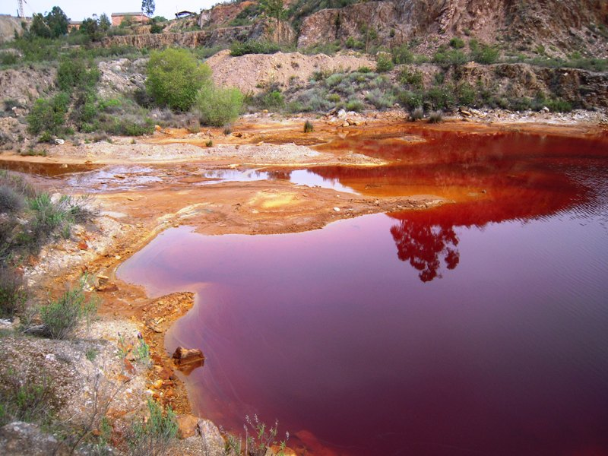
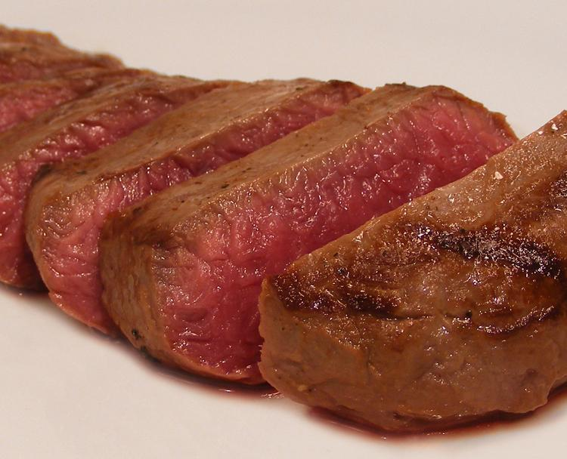
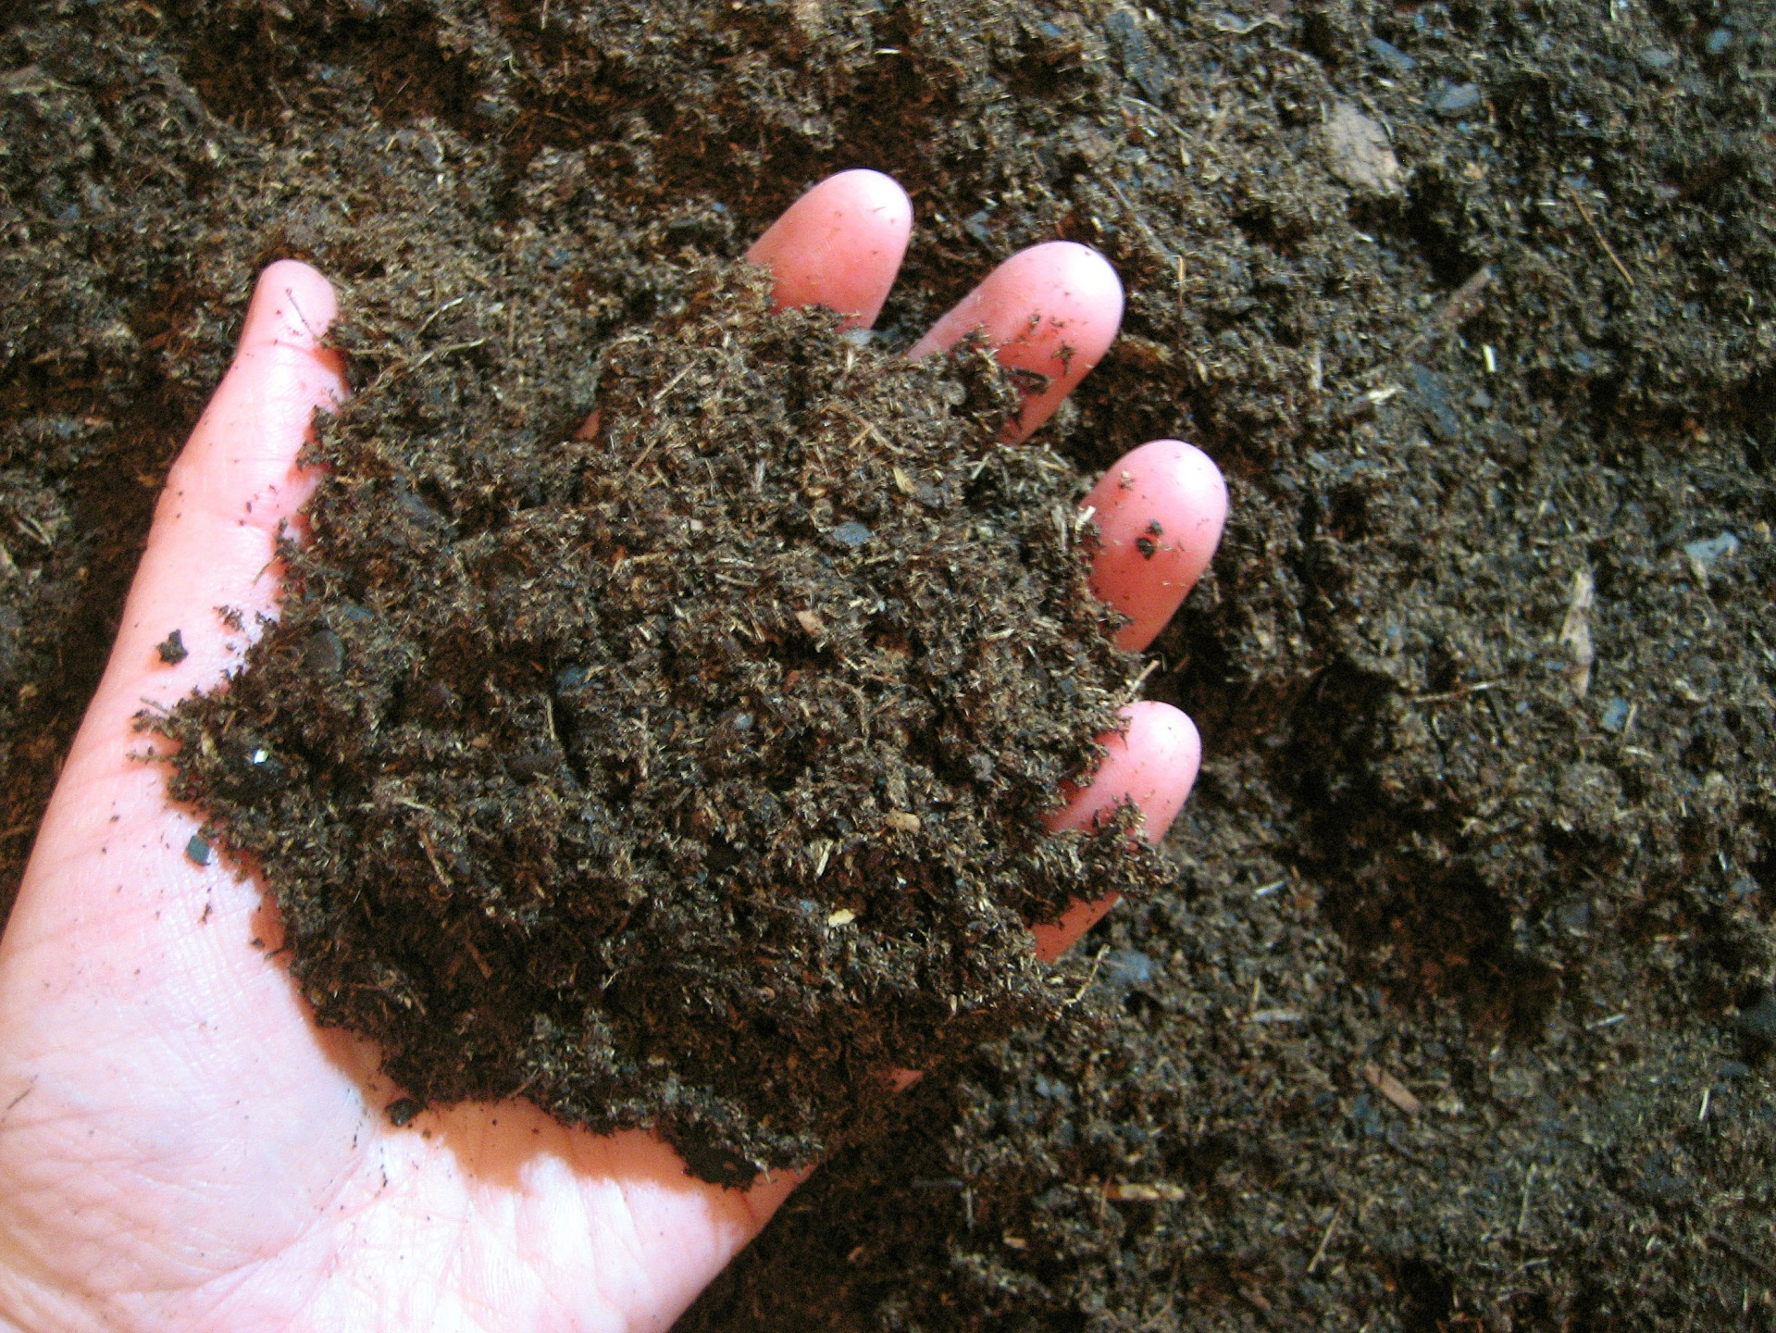
More Germs...
Parasites
Fungi
Parasites
Parasites
Fungi
Contaminated water
Contaminated meat
Soil
Air
https://www.youtube.com/watch?v=DYKADcR34Y8&list=PLsZfgFysGWT5DcIhvQPk0rtgv7zX5INPO

Slide 6
What Should I do?
Hi. I’m Mary. My best friend Sarah is sick again with a bad cold and sore throat. Her mom said we can’t play outside, so we will do an art project instead. Sarah sneezes into her hands and uses the red marker. I patiently wait for her to finish then I use the red marker. After using the red marker, I see that my thumb nail is too long, and think about biting it.
Should I bite my nail?
Two days later, I wake up with a sore throat .
Follow the path of the germ from Sarah to Mary to explain how Mary got sick.
https://www.youtube.com/watch?v=b09luE7z2qY

Slide 7
What Should I do?
After I finish my homework, I go outside to meet my friends to scooter in the cul-de-sac. Jones and I are riding when he falls down. I run over to help him get up. He seems fine, and we are back to scootering when I notice blood on my hand. Jones is bleeding, but he has already wiped it on his shirt and is riding again. I look back at my hand with the blood on it.
What should I do?

Slide 8
Can You Help Me?
Last week, they opened a new bounce house nearby intended for older kids. Mom says it is cold and flu season, and I need to wait another month to go. While mom thinks it may be crawling with germs, I could take measures to prevent getting sick. If I knew what to do, I may be able to convince her to let me go. Can you help me?
What could I do to prevent the spread of germs?

Slide 9
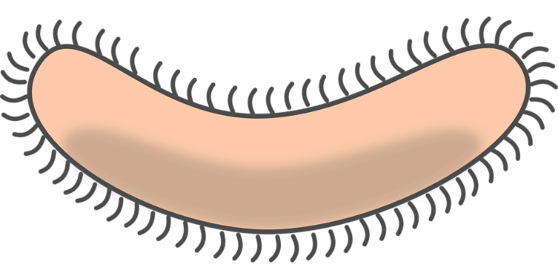
How to Prevent the Spread of Germs
Watch the following video clip and think about what you do to prevent the spread of germs.
https://www.youtube.com/watch?v=YBGsoimPXZg
Prevention:
Build your immune system by eating lots of fruits and vegetables, exercise, and getting lots of sleep
Wash your hands regularly
Prevent the spread of germs by coughing or sneezing into your elbow or “sneeze pocket”
Cover your wounds
Get vaccines/immunizations

Slide 10
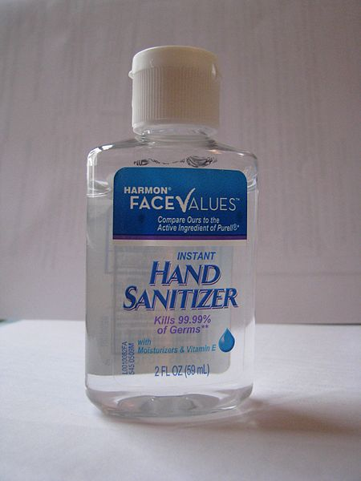
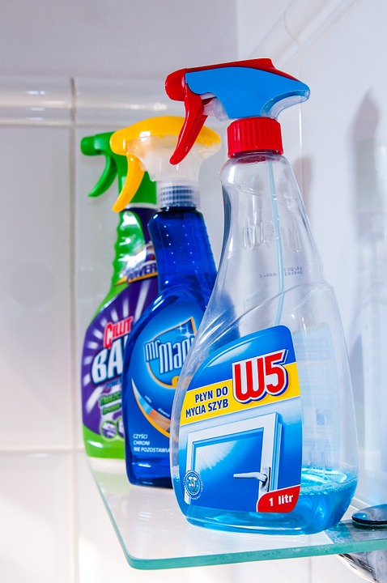
How to Prevent the Spread of Germs
How do these things prevent the spread of germs?

Slide 11
Let’s Move!
https://www.youtube.com/watch?v=_MfYYr_TBkQ

Slide 12
The End
Take Care of Your Health!

