Slide 1
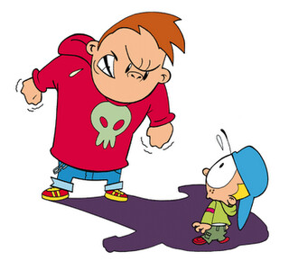
Refusal
“I SAY NO”
SKILL STEPS

Slide 2
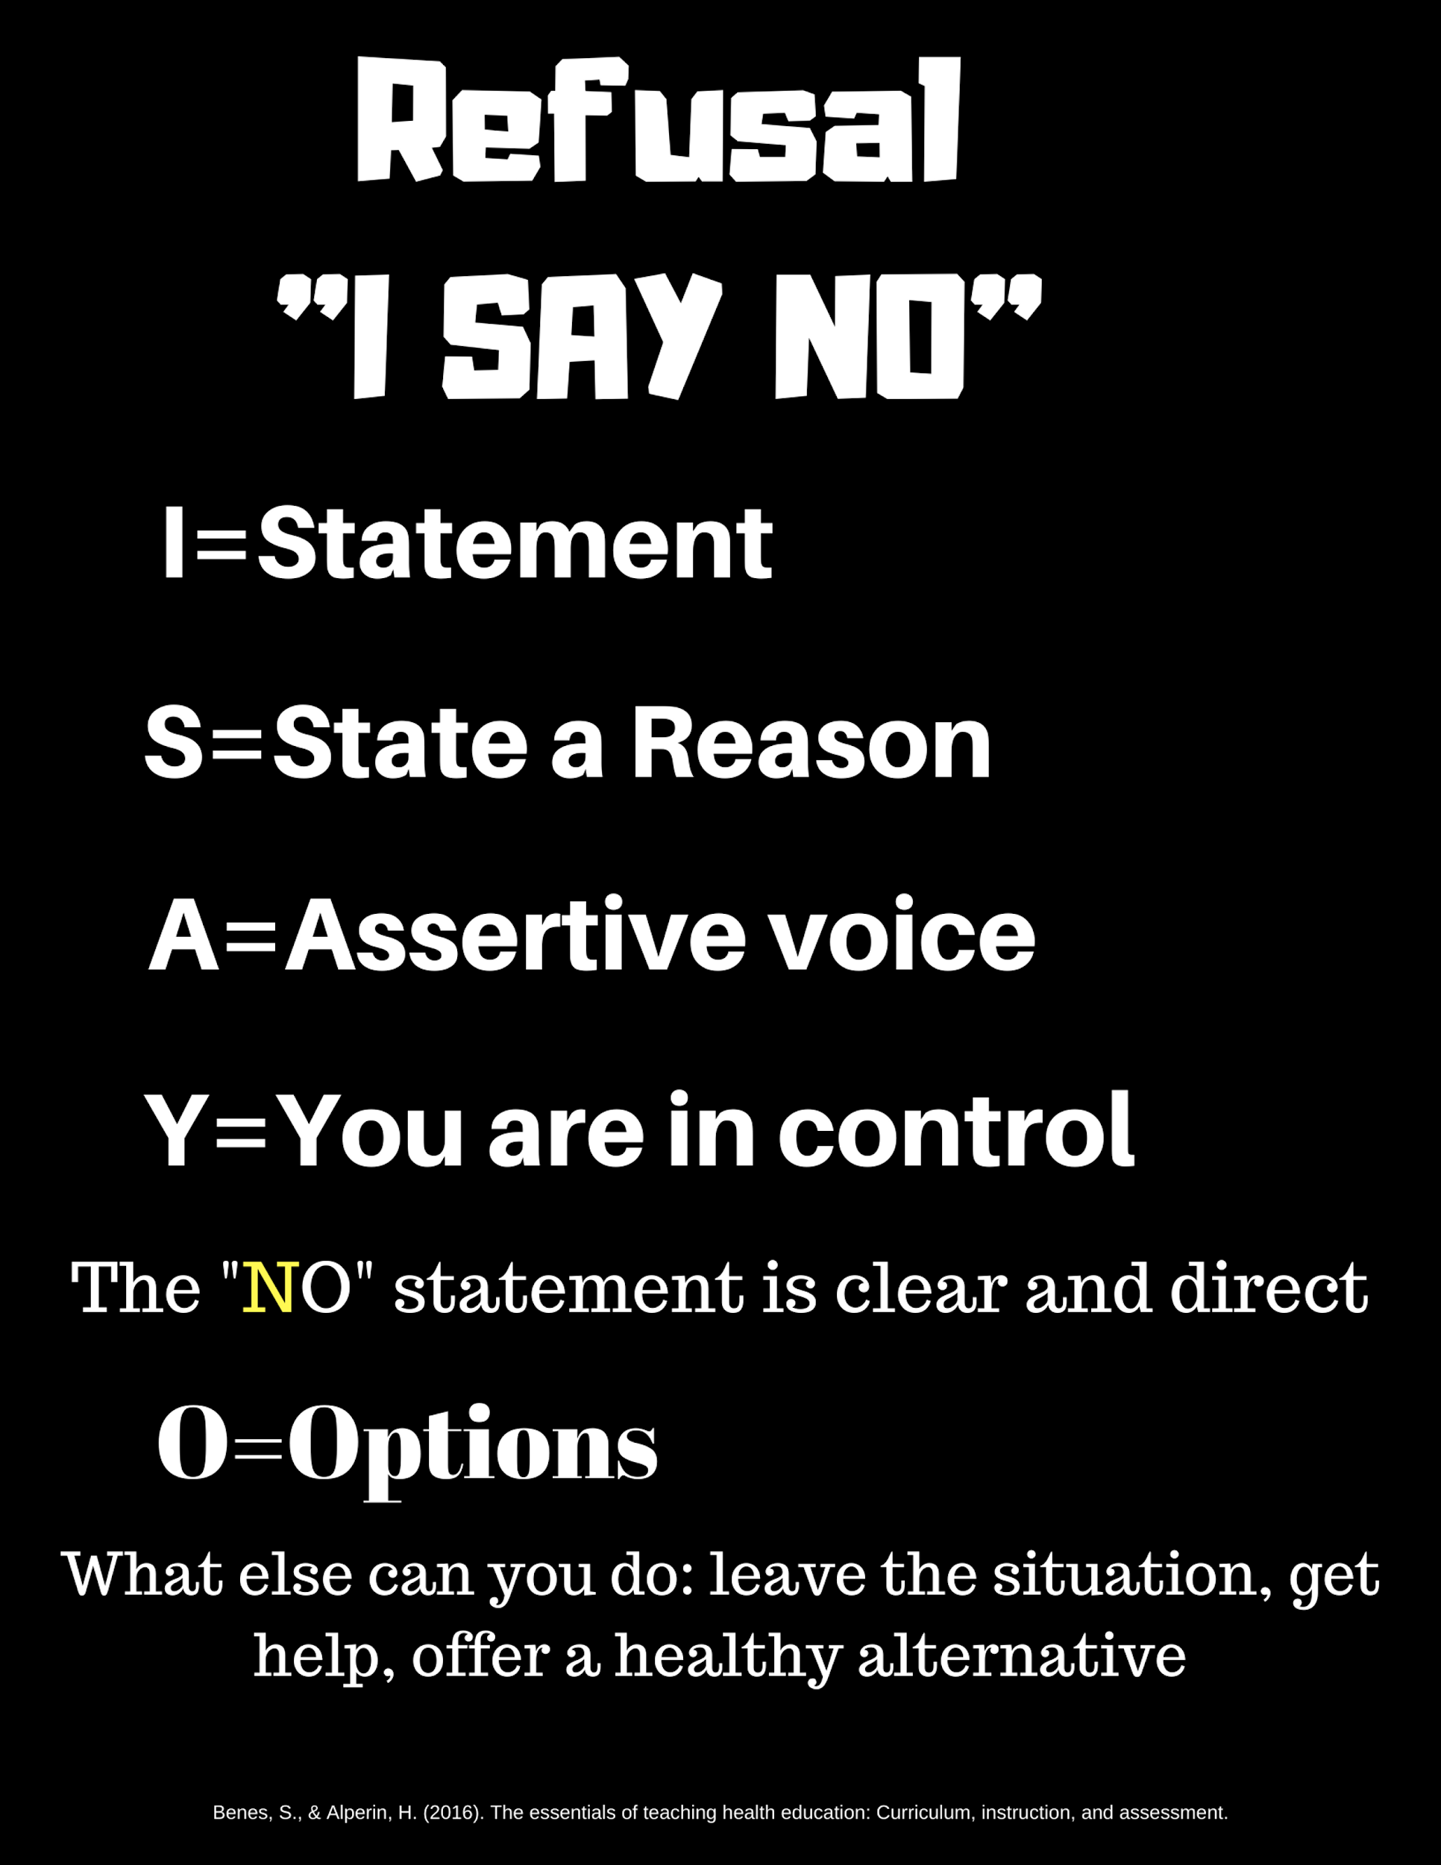

Slide 3
“I”
STATEMENT

Slide 4
“S”
STATE A REASON

Slide 5
“A”
ASSERTIVE VOICE

Slide 6
“Y”
YOU ARE IN CONTROL

Slide 7
“NO”
CLEAR & DIRECT

Slide 8
“O”
OPTIONS

Slide 9
I STATEMENT”
“I didn’t like it when you hit me when playing tag.”

Slide 10
STATE A REASON
“If I get caught my parents would be really mad at me.”

Slide 11

ASSERTIVE VOICE”

Slide 12


YOU ARE IN CONTROL”
Confident posture
Looks the person in the eyes

Slide 13
NO”
Is clear & direct

Slide 14
OPTIONS”
What else can you do ?
  Leave the situation
  Get help
  Offer a healthy alternative
Notes:
Benes, S., & Alperin, H. (2016). The essentials of teaching health education: Curriculum, instruction, and assessment.

