Slide 1
Conflict Resolution

Slide 2

What is conflict?

Slide 3
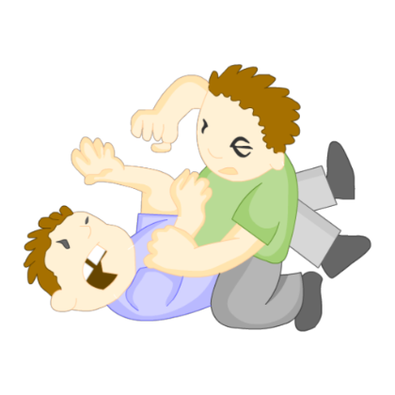
Conflict Is
A disagreement with someone.
Sometimes a conflict can lead to an argument or fight.

Slide 4
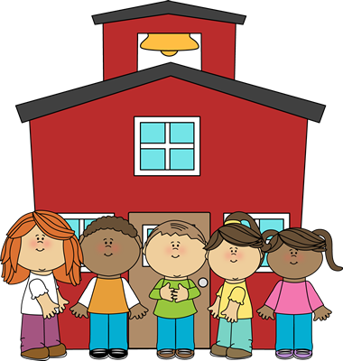
You might have a conflict at school.

Slide 5
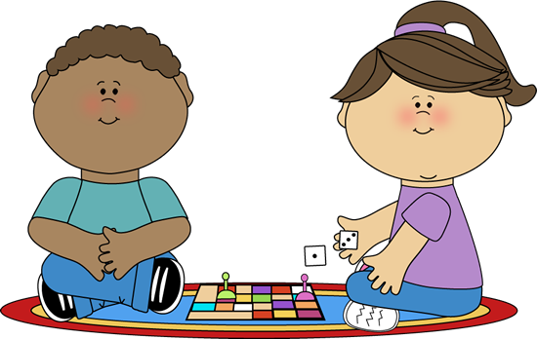
You might have a conflict while playing a game.

Slide 6
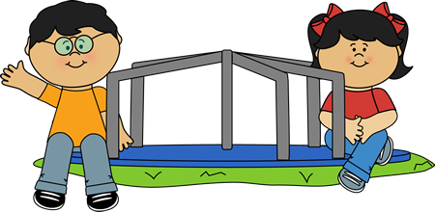
Maybe at recess.

Slide 7
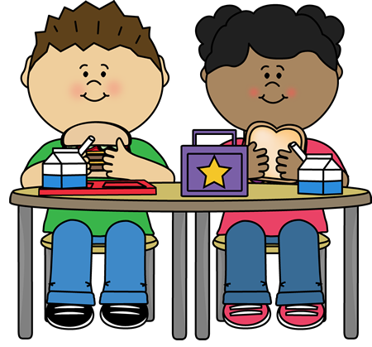
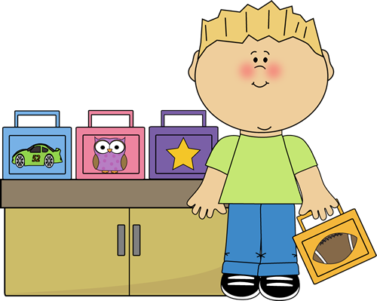
It could happen at lunch.

Slide 8
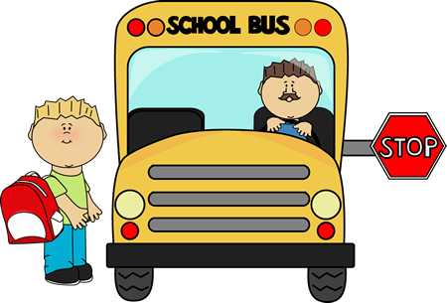
Even on the bus!

Slide 9
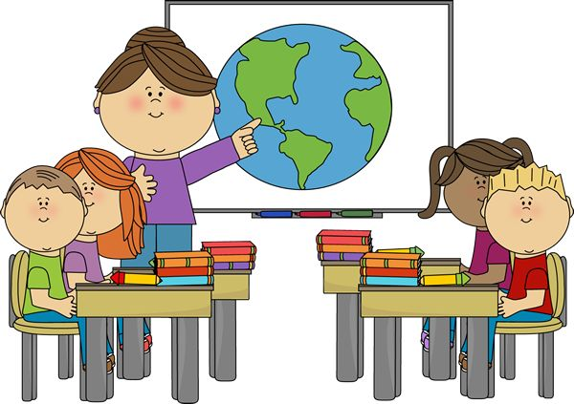

It could even happen in the classroom.

Slide 10
Can you think of other places you could have a conflict?

Slide 11

What is Conflict Resolution?

Slide 12
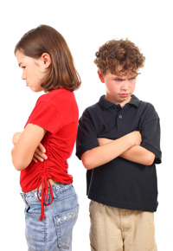
Conflict resolution is a way for 2 or more people to find a peaceful solution or
answer to a disagreement or conflict…

Slide 13
How can you resolve a conflict?

Slide 14
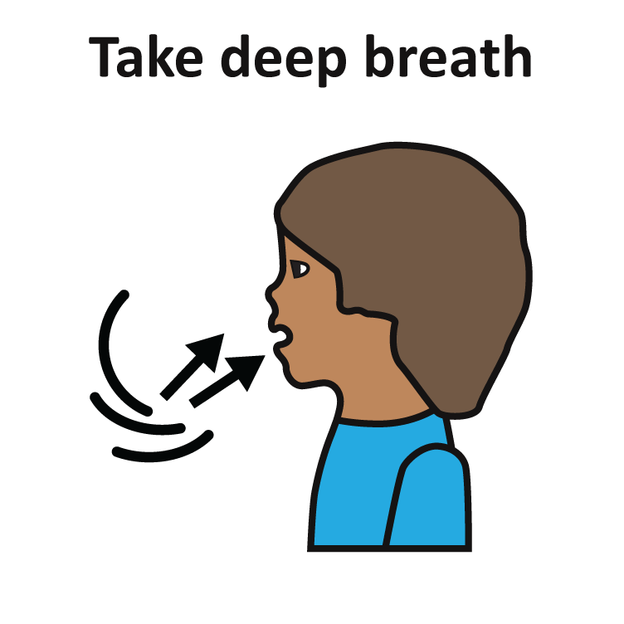
1. Stop and take a deep breath

Slide 15
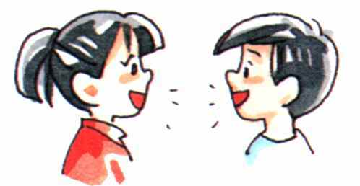
2. Listen to each other and talk it out.

Slide 16
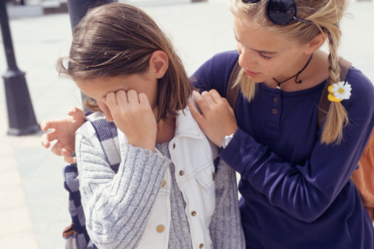
3. Try to understand how
the other person feels.

Slide 17
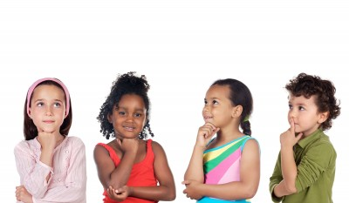
4. Think of different ways to solve the problem…

Slide 18
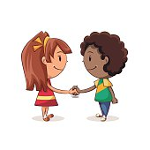
5. Agree on a plan!

Slide 19
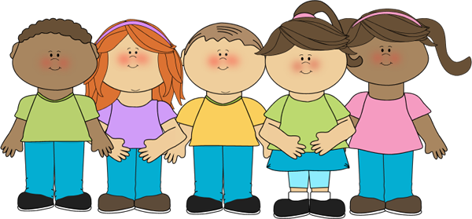
Learning to solve conflicts peacefully will help you and your friends have a healthy relationship!

