Slide 1
All About Me
Media Influence
Let’s Learn About Health!
2nd Grade

Slide 2
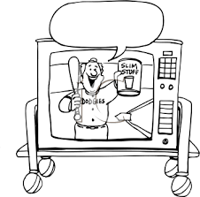
Commercials

Slide 3
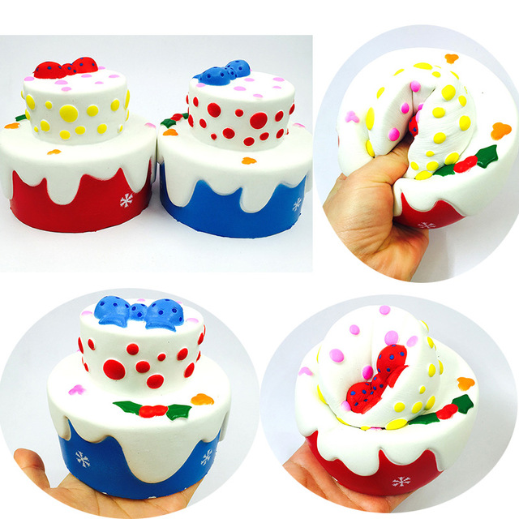
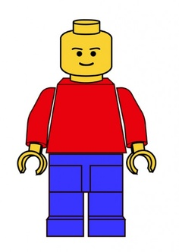
What Do You See?
Do you own any of these things?

Slide 4
Commercials
I totally want this. It looks so cool.
How do commercials influence people to buy things?
Watch the following commercials and think about how commercials influence you.
https://www.youtube.com/watch?v=f761pyolPkE
https://www.youtube.com/watch?v=Yy6xAP3jPxE
https://www.youtube.com/watch?v=hDbeBqYZtUA

Slide 5
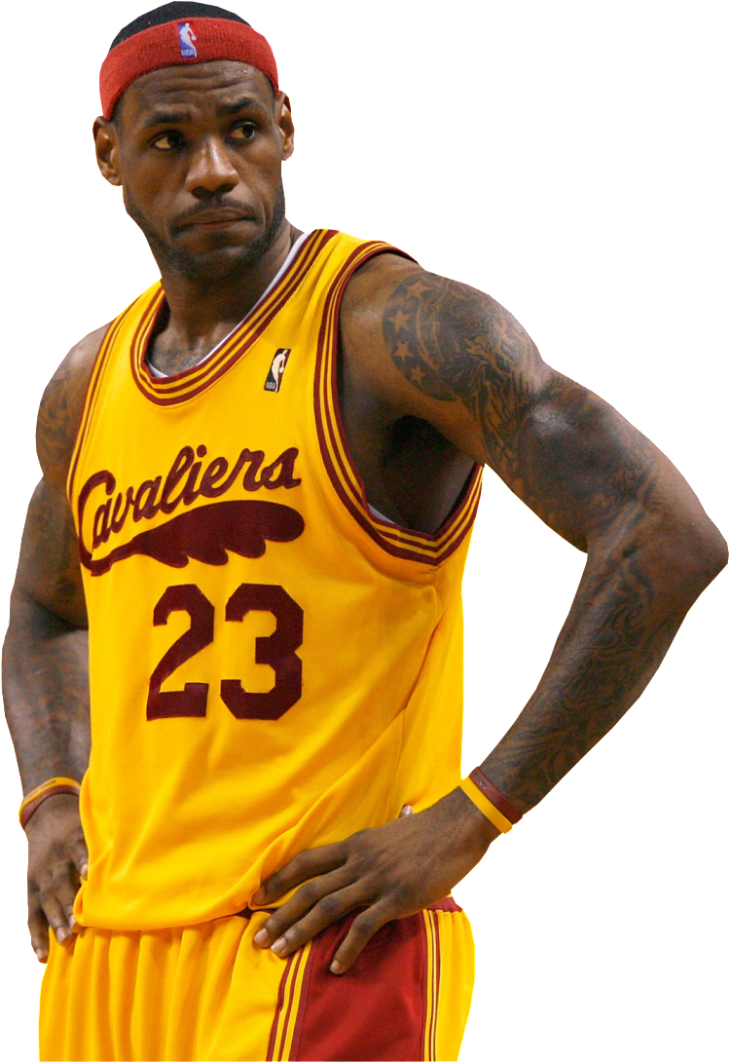
Famous people
&
TV characters

Slide 6
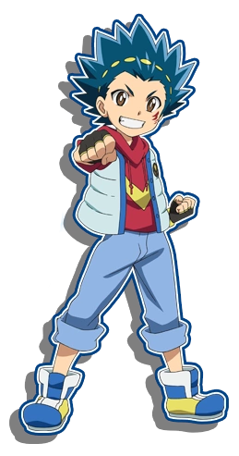
What Do You See?

Slide 7
Have You Ever...
Changed the way you dress because your favorite character dressed a certain way
Changed your hair to match your favorite character
Changed the way you walk, talk, or treat people to match your favorite character
Is this influence positive or negative or neutral?

Slide 8
The Negative Influences of Media

Slide 9
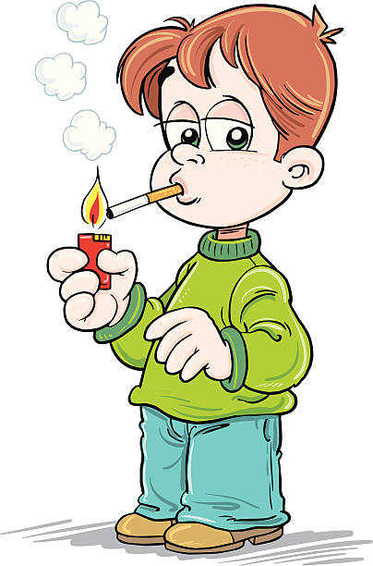
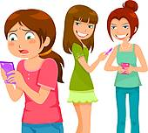
Think...
Think about the commercials, shows, movies, music videos that people watch on television. How could media negatively influence behaviors? Give examples.

Slide 10
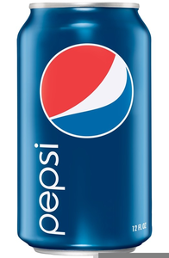
Commercials
Watch the following commercial and decide if it is a positive or negative influence on a child.
https://www.youtube.com/watch?v=po0jY4WvCIc
What other commercials do you see related to food and drink. Are they encouraging healthy choices?

Slide 11
Be You!
It is hard to escape the influence of the media, but it is important to recognize how it affects you. Be careful not to be a victim of the negative influences.

Slide 12
Let’s Move!
https://www.youtube.com/watch?v=9ccFDG4WY8Y

Slide 13
The End
Take Care of Your Health

