Slide 1
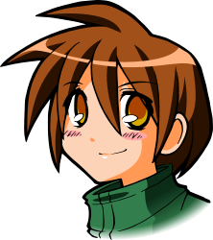
All About Me
Healthy Relationships and Violence Prevention
Let’s Learn About Health!
2nd Grade

Slide 2

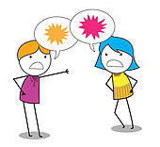
Conflict

Slide 3
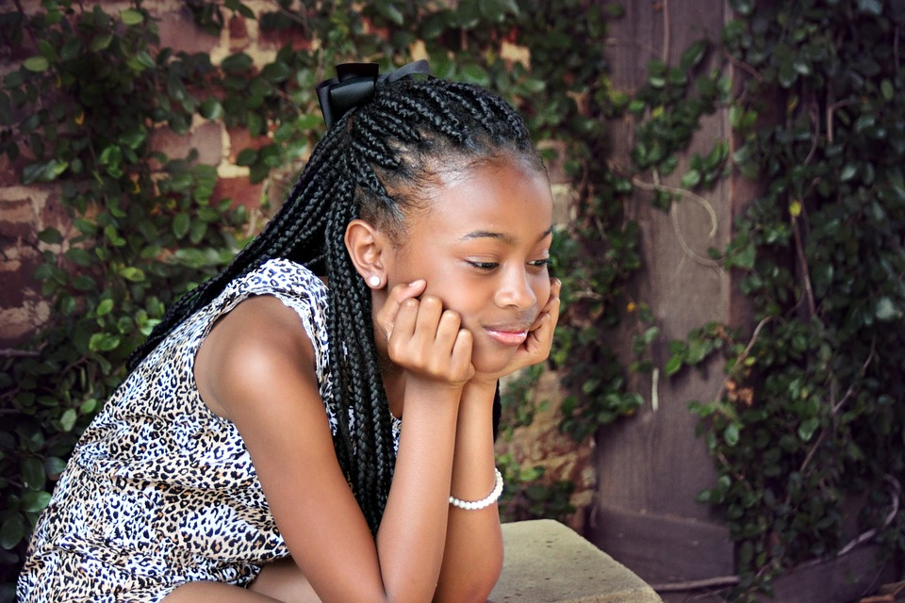
What Should I do?
At school, I always hang out with Madison on the playground at recess. Lately, she has been hanging out with someone else. I thought we were best friends. In the past, I’ve ignored her for a couple of days, and she normally starts hanging out with me again. Rather than ignoring her and staying mad for the next couple of days, what should I do to deal with this conflict?

Slide 4
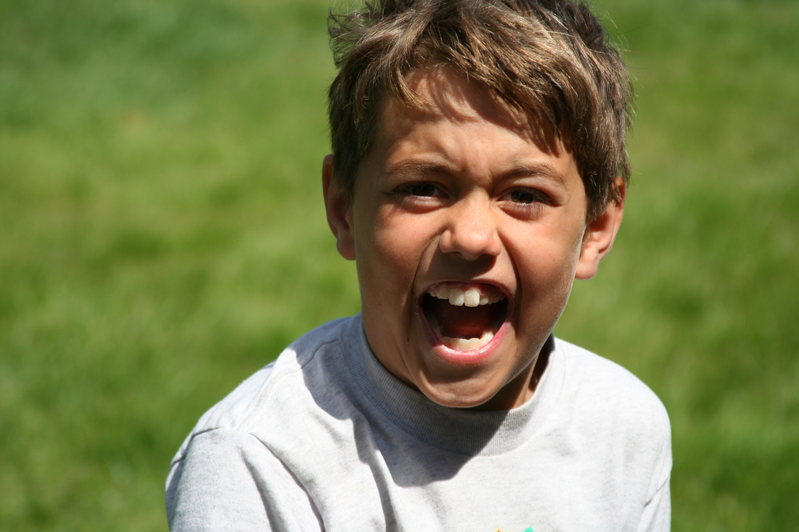
What Should I do?
Playing football is my favorite thing to do during recess. Today, some kids from another class join our game. While running for a touchdown, a kid on the other team yells, “I tagged him.” I’m furious. He did not tag me. I turn to yell back…
What should I do to deal with this conflict?

Slide 5
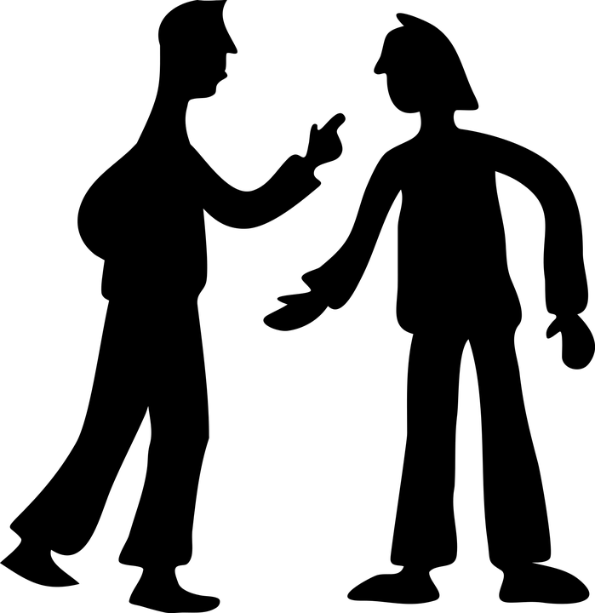


Conflict Resolution
Think of a time that you experience conflict with a friend or classmate.
How did you handle the situation?
Did you….
1. Stay calm and positive
2. Talk about the problem and work together to find a solution
3. Listen to each other’s point of view
4. Compromise

Slide 6

Let’s Practice...
Imagine that you are working on an art project and you need the red colored pencil. The student beside you has been using for 15 minutes, and you are tired of waiting. Use the skills of conflict resolution to solve the problem.
1. Stay calm and positive
2. Talk about the problem and work together to find a solution
3. Listen to each other’s point of view
4. Compromise

Slide 7
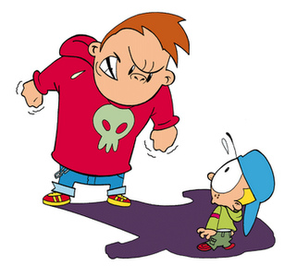
Teasing
&
Bullying

Slide 8

Teasing & Bullying
What is the difference between teasing and bullying?
How does it feel to be teased?
How does it feel to be bullied?

Slide 9
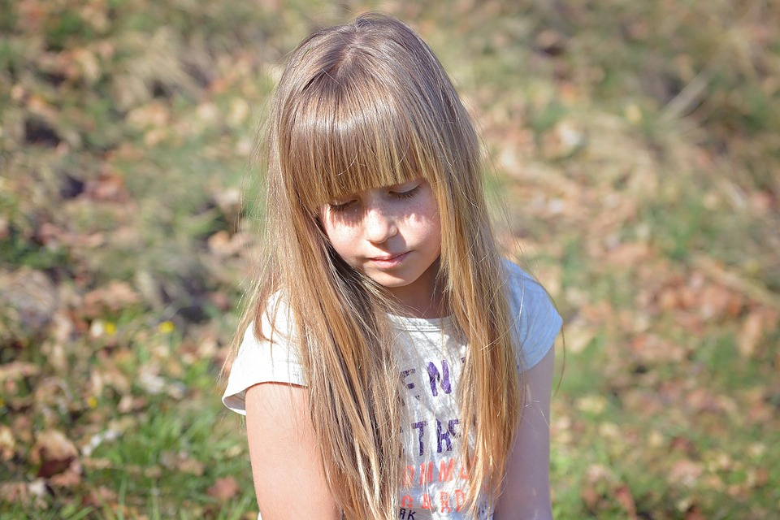
What Should I do?
During recess, we have lots of free time to run and play. Jayla is back in school after three days of having lice. She is the one who gave it to four other people in our class.
Jayla comes running up to me wanting to play. Sam yells, “She has lice. Don’t play with her.” Cara yells, “Don’t even touch her or you will get lice too.” I look at Jayla and notice she is about to cry.
What should I do?

Slide 10
How Does it Feel and How to Respond
Tell an Adult
Speak Up
Be Assertive
Walk Away
https://www.youtube.com/watch?v=PI-VKatg1Zk

Slide 11
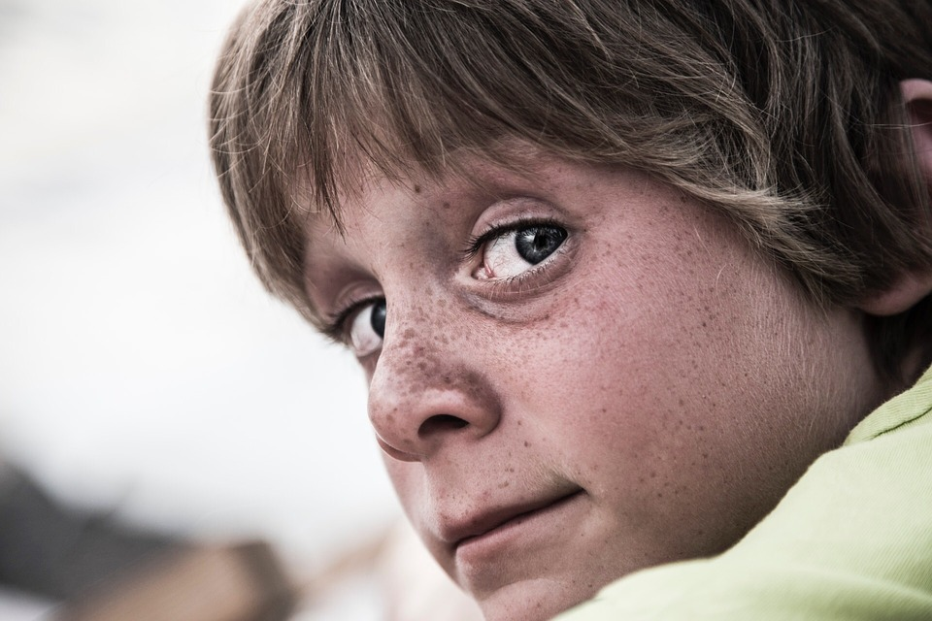
What Should I do?
At recess, I love to play basketball. We are all about the same skill level, so it is a really competitive game. Today, Cara asks to join. Mark quickly replies, “You are too slow and not that good at basketball.” The other boys laugh. I don’t laugh with the other boys. I kind of feel bad for her, but I agree with the boys that she is not that good at basketball. Unfortunately, Cara often tries to join a group, but people exclude her.
What should I do?

Slide 12
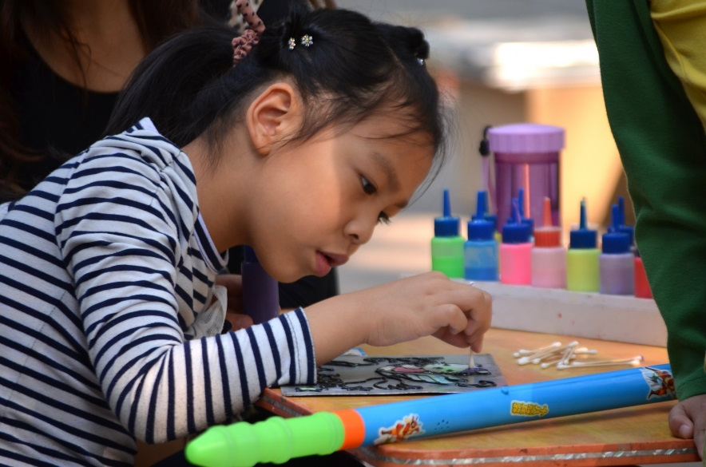
What Should I do?
Art is the best part of my school day. I love to paint! Today, I’m working on a picture when I see Anne talking with three other girls. She looks sad while the other girls are laughing. I stop to listen to their conversation. I hear the three girls saying mean remarks about how Anne looks and dresses. Anne puts her head down and continues to work on her art piece. They are bullying her!
What should I do?

Slide 13
Bullying
Walk Away
Watch the following video clip and think about the following questions:
Why is it wrong to tease others?
What should you do if you are bullied?
What can you do if you see that someone else is being bullied?
https://www.youtube.com/watch?v=P_b5YpJAAPk
Speak Up
Be Assertive
Tell an Adult
Support the Victim

Slide 14

Bully-Free School

Slide 15
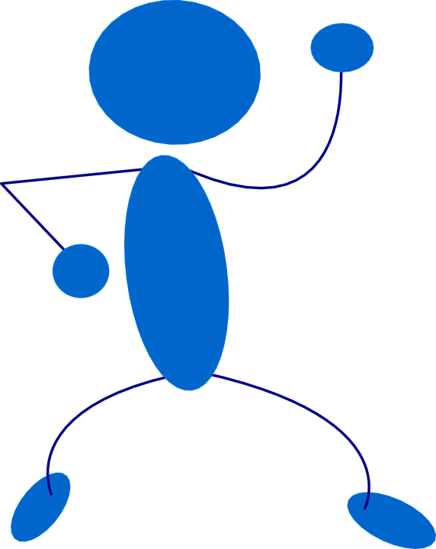
Let’s Move!
https://www.youtube.com/watch?v=neGpgxcJdY8

Slide 16
The End
Take Care of Your Health

