Slide 1
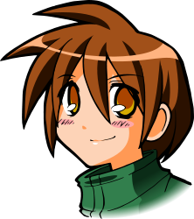
All About Me
Self-Image
Let’s Learn About Health!
2nd Grade

Slide 2
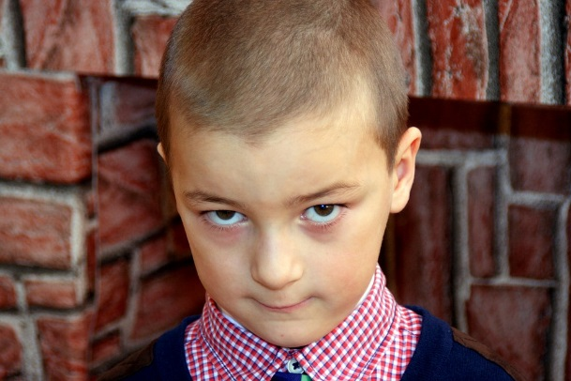
What Should I do?
I don’t always feel like I fit in. I have awesome qualities but not ones I always like to show at school. Rather than being athletic, I’m artistic. Rather than being outgoing, I’m quiet. Rather than dressing in cool, athletic clothes, I prefer church clothes. I’m not big and strong but rather small and thin. My unique qualities that make up me seem so different than the students around me.
My favorite time of the school day is recess. My teacher lets me take my drawing pad outside and draw by myself. I like being alone and having quiet time. It makes me happy. However, I wonder what the other students think of me. Maybe today, I should play tag and try to “fit in.”
What should I do?

Slide 3
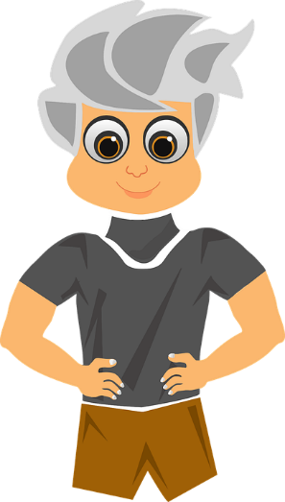
I am Me!
Watch the following video and think about your unique personal characteristics that define you:
https://www.youtube.com/watch?v=Dv0YSvtmACk (I Like Myself)
What unique characteristics do you have that define you?
Do you allow your unique qualities to shine or do you try to hide them?

Slide 4
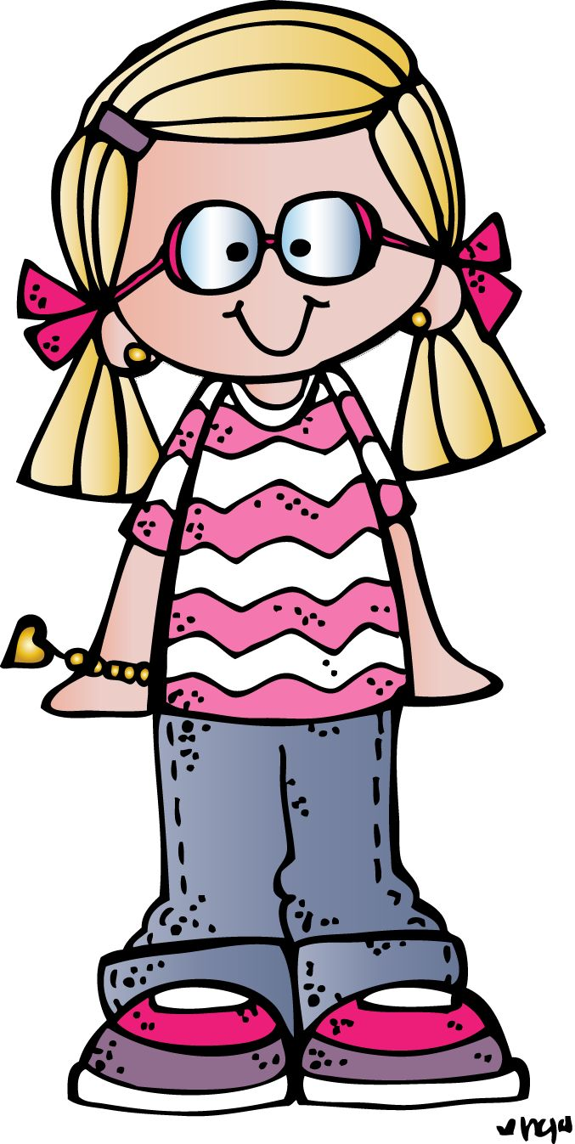
Self-Image
Self-Image is how you see yourself. It includes your abilities, personality, and appearance.

Slide 5
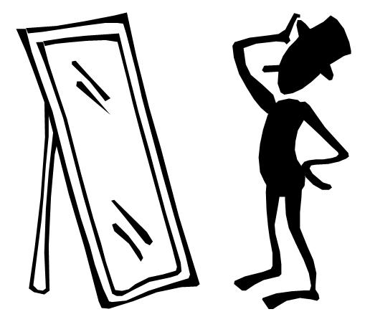
It’s Your Turn...
On your paper, list words that describe you.
How do you see yourself?
Think of one quality you want to share with the class.

Slide 6
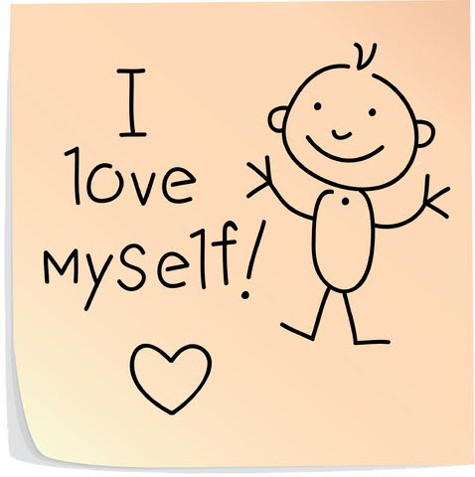
It’s Your Turn...
Think of one you want to share with the class.
On your paper, write what your internal voice is saying?
What words are you telling yourself?
I’m not good enough...
I can do it...
I like my….

Slide 7
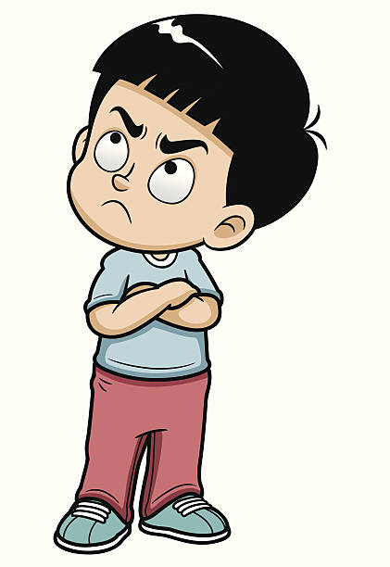
Can You Help Me?
I’m not good at math and my reading level is way below my classmates. While my teacher likes to remind me to do my best and try hard, my inner voice is telling me that I am stupid. The class is about to start another math worksheet and I feel like I want to quit. How do I change my inner voice that is telling me I can’t do it?
Can you help me?

Slide 8
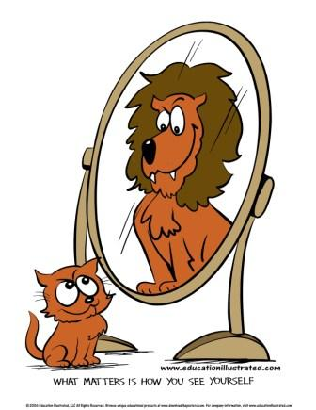
How to Improve Your Self-Image
Try to stop negative thoughts.
Focus on the positive.
Accept your flaws
Don’t bully yourself
Treat yourself kindly
Give yourself a break
Focus on the things you CAN do, not on what you can’t.
Can you think of examples for each strategy?

Slide 9
It’s Your Turn...
On your paper, make a list of the things you CAN do.
Think of one you want to share with the class.

Slide 10
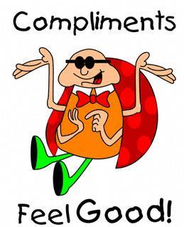
It’s Your Turn...
Treat yourself kindly. Don’t bully yourself. On your paper, write three or more compliments to yourself.

Slide 11
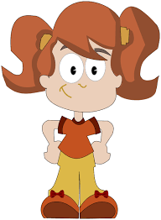
Goal: Positive Self-Image
Your goal is to have a positive self-image, which can influence future success.
How can a positive self-image help you reach your goals?

Slide 12
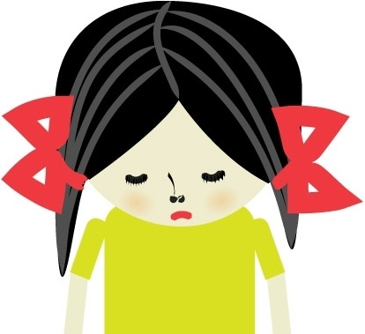
What Should I Do?
I’m the kid that does not do anything right. I’ve tried really hard to feel good about myself and tell myself positive things. But, it is not working. What should I do?

Slide 13
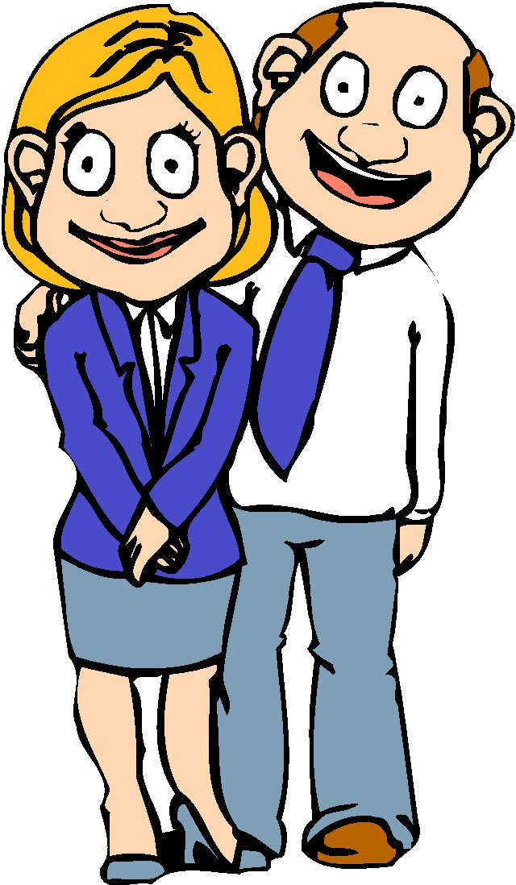
We Can Help!
Talk to your parents, guardians, teachers, or a trusted adult, and tell them how you are feeling.

Slide 14
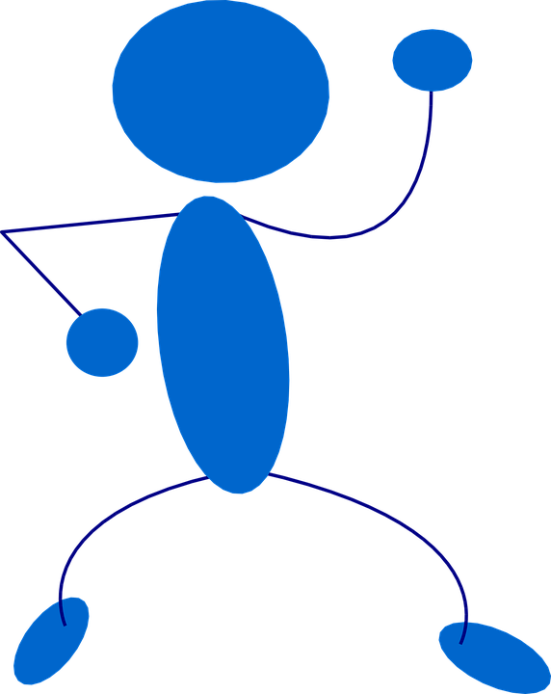
Let’s Move!
https://www.youtube.com/watch?v=9ccFDG4WY8Y

Slide 15
The End
Take Care of Your Health

