Slide 1
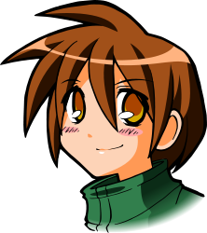
All About Me
Loss, Grief, and Disappointment
Let’s Learn About Health!
2nd Grade

Slide 2
Loss & Grief

Slide 3
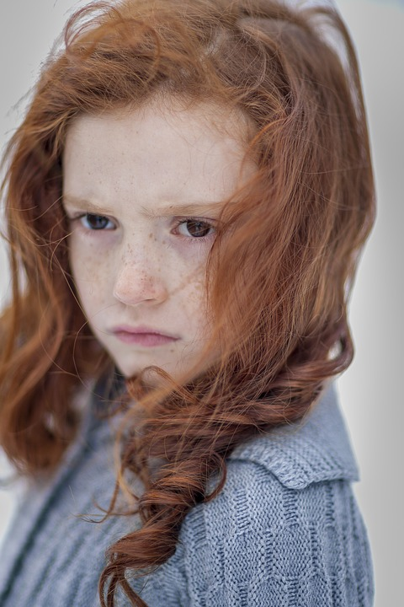
What Should I Do?
When I think about my dog Skittles, sadness overwhelms me. Skittles died two weeks ago, and I still get so sad when I think about her. I sometimes cry when no one is looking at me.
What am I feeling?
What should I do to cope with these feelings?

Slide 4
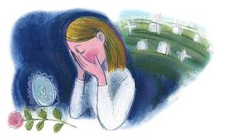
What is Grief?
What does it look like?
What does it feel like?

Slide 5
Feelings of Grief and Loss
Find activities you enjoy
Listen to the story Gentle Willow and think about the following questions:
https://www.youtube.com/watch?v=5OGqZRaP5oc&t=7s
Have you ever experienced grief?
What or who did you lose?
What did it feel like?
How did you cope with these feelings of sadness?
Talk to a trusted adult about your feelings

Slide 6
Disappointment

Slide 7
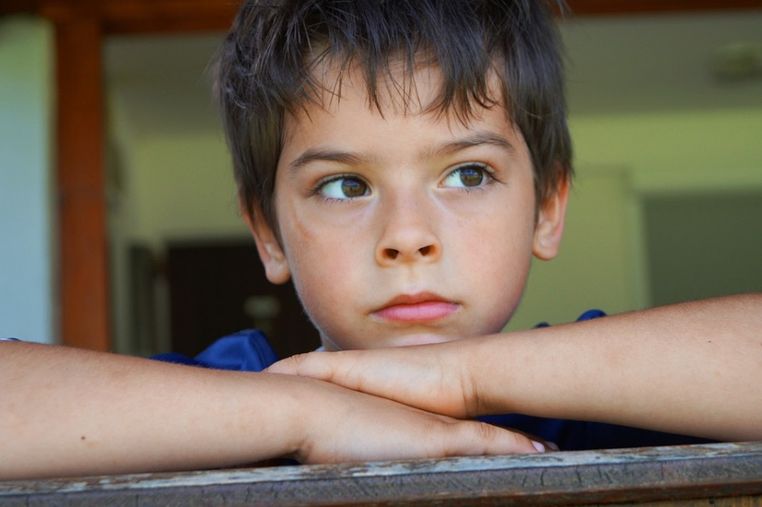
What Should I do?
Sometimes I wish I could run faster, read better, and beat my brother in soccer. Today, I feel like I can’t do anything right. Dad says I’m perfect just the way I am, but I don’t feel perfect. Today, I feel like a failure and disappointment in myself. Getting angry at myself and little brother does not make me feel any better.
What is he feeling?
What should I do to cope with these feelings?

Slide 8
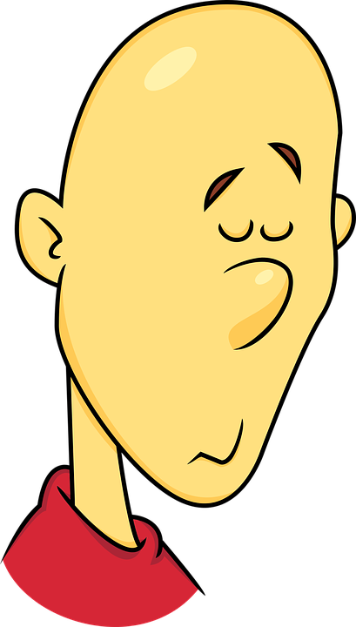
What is disappointment?
What causes you to feel disappointed?
What does disappointment feel like?

Slide 9
Positive Coping Strategies
What are positive ways to cope with disappointment and failure?
https://www.youtube.com/watch?v=oIlIVFBBbNw
Look for the positive
Do something positive (play, draw, dance)
Talk about your feeling
http://www.values.com/inspirational-stories-tv-spots/99-the-greatest

Slide 10
Write a Letter...
Think about a time in your life where you felt loss, grief, or disappointment. It is really important to express these feeling to a parent, guardian, or trusted adult. Practice expressing your feeling by writing a letter to a parent, guardian, or trusted adult. Include the following in your letter:
Describe the event that made you feel loss, grief, or disappointment
Describe how this event made you feel

Slide 11
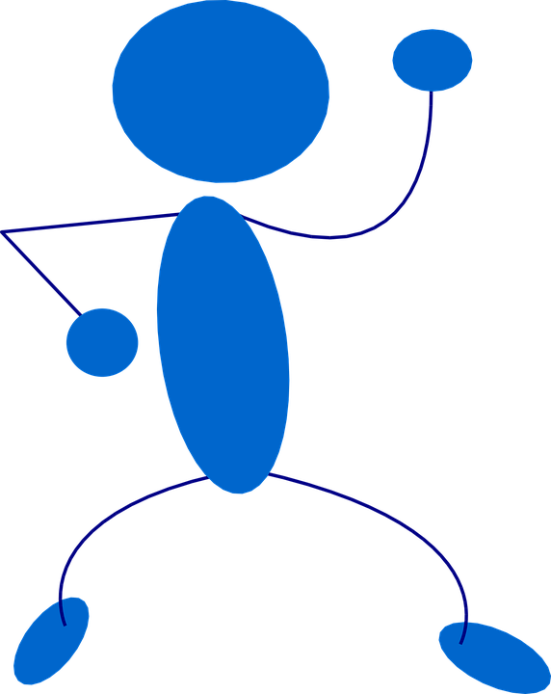
Let’s Move!
https://www.youtube.com/watch?v=rlmCYe8bZfc

Slide 12
The End
Take Care of Your Health

