Slide 1
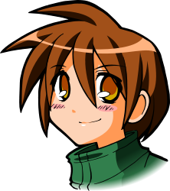
All About Me
Safety and Injury Prevention
Let’s Learn About Health!
2nd Grade

Slide 2
Personal Safety

Slide 3
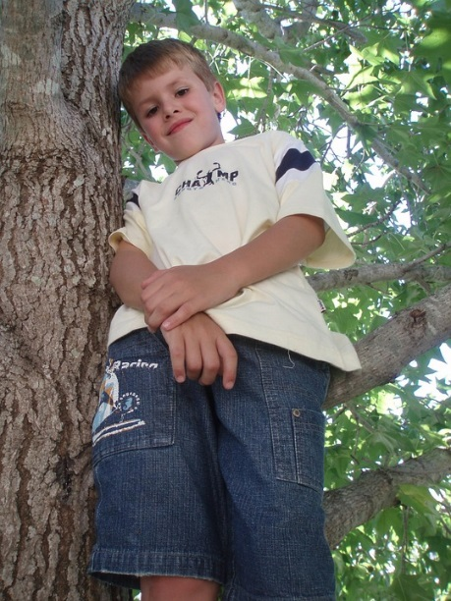
What Should I do?
I love summer! My friends and I love to explore the woods behind my house. I’m allowed to climb the trees as long as I stay on the low branches.
Today, my friends and I found a great new climbing tree. I started climbing when I heard my friend call, “I dare you to climb higher.” I look higher and most of the branches look strong enough to climb.
What should I do?

Slide 4
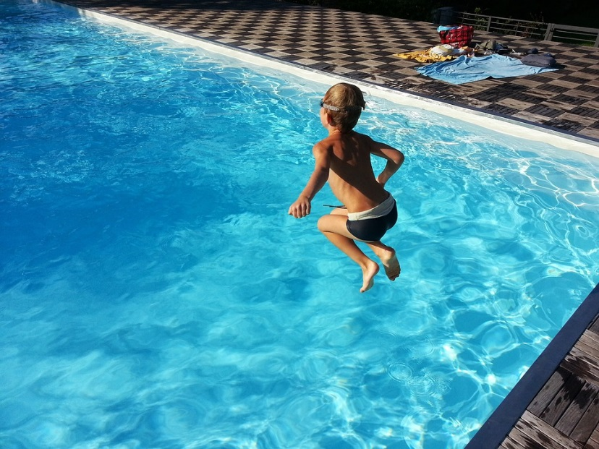
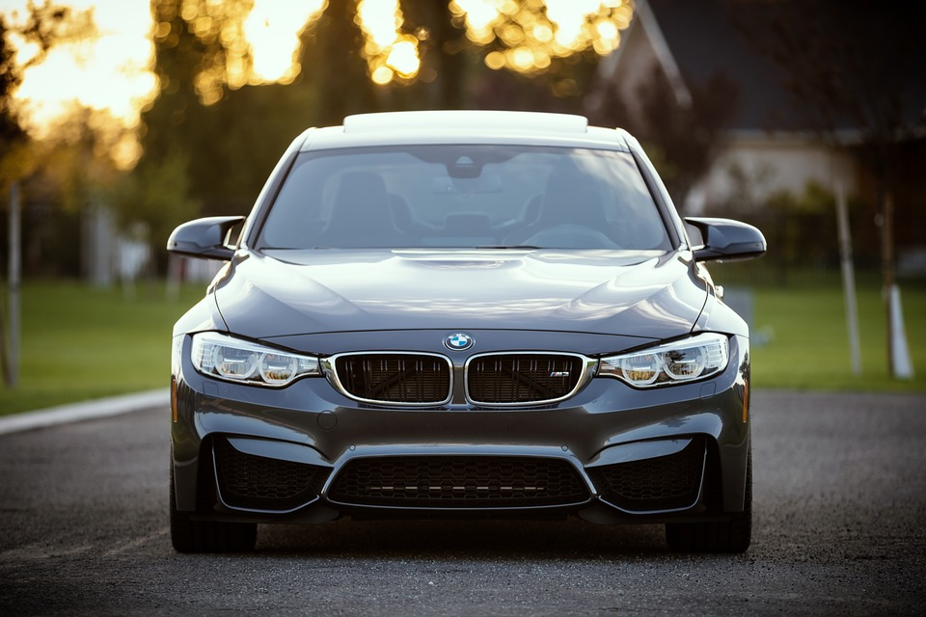
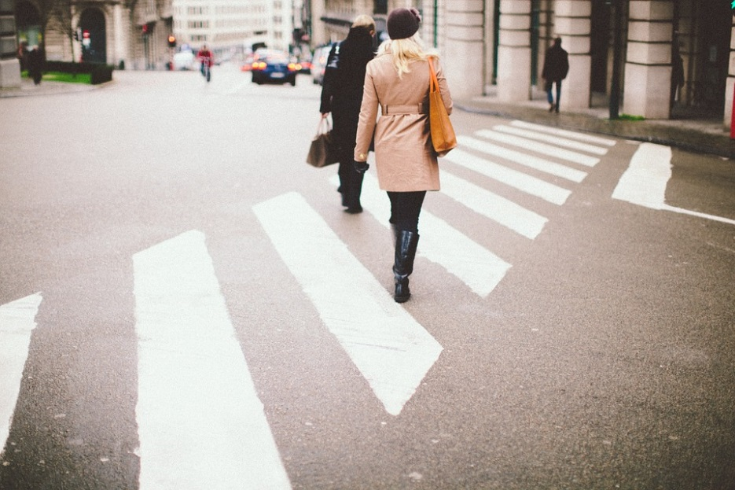
Stay Safe
Look at the following pictures and decide how you could be safe in that situation:

Slide 5
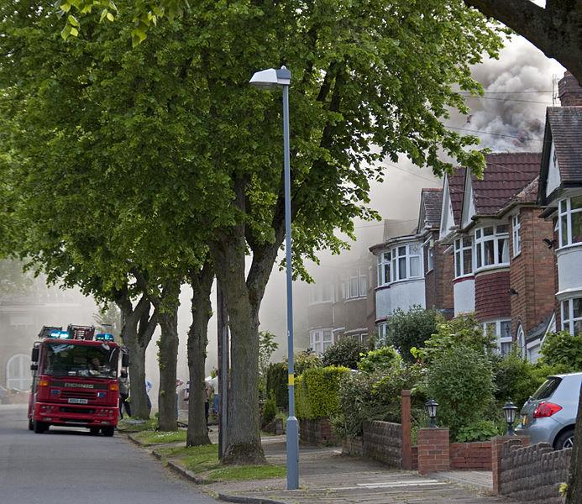
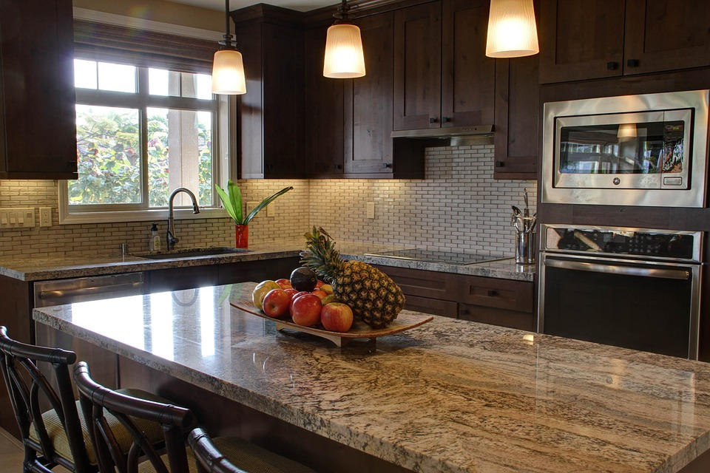
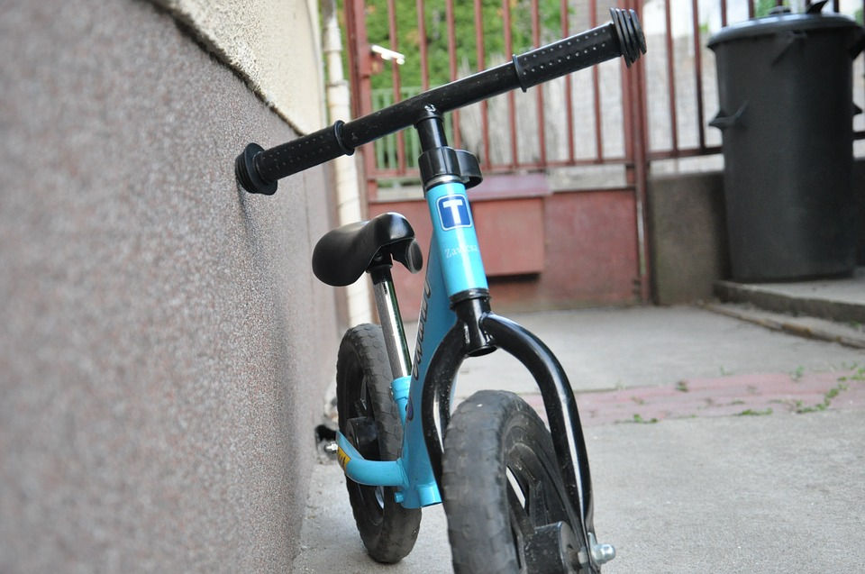
Stay Safe
Look at the following pictures and decide how you could be safe in that situation:

Slide 6
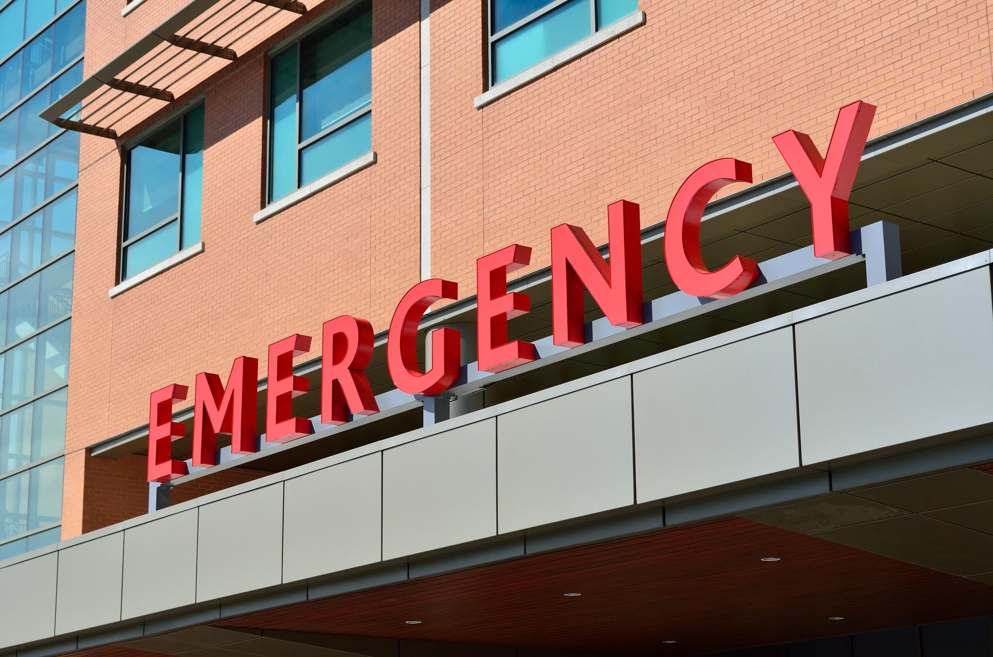
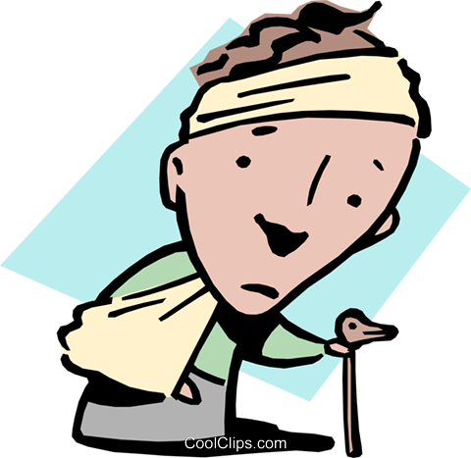
Why is Safety Important?

Slide 7
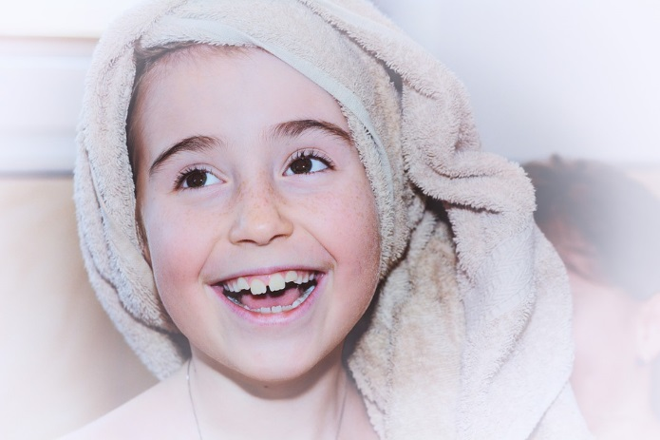
What Should I do?
My doctor told me that I have to take a multivitamin everyday and eat more fruits and vegetables to be healthier. My dad bought me gummy vitamins, which taste really good! I also have to take my allergy medicine, which I don’t mind because it tastes like cherry pie. Every morning, my mom gives me a vitamin and allergy medicine before she goes to work.
Tonight, my parents have to work late, so grandma is watching me. Grandma forgot that mom already gave me a vitamin and my allergy medicine, and she offers me more. We didn’t have any dessert tonight, so it would be a treat.
What should I do?

Slide 8
Medicines: Take it or Not?
Read the following scenarios and decide if it would be appropriate or inappropriate to take the medicine:
1. Sammy has a cough and his mom offers him medicine. Should he take it?
2. Mary finds medicine in her mom’s purse. Should she try it?
3. Eve finds a pill on the floor. It could be a Smartie, but she is not sure. Should she eat it?
4. Alex discovers the top off his allergy medicine. His mom forgot to give it to him this morning. Should he pour it himself and drink it?
https://www.youtube.com/watch?v=9OK6_OdWxTA&list=PLchGnon8rw_SdK5dXd62ZvHxsvN16HS17&index=3

Slide 9
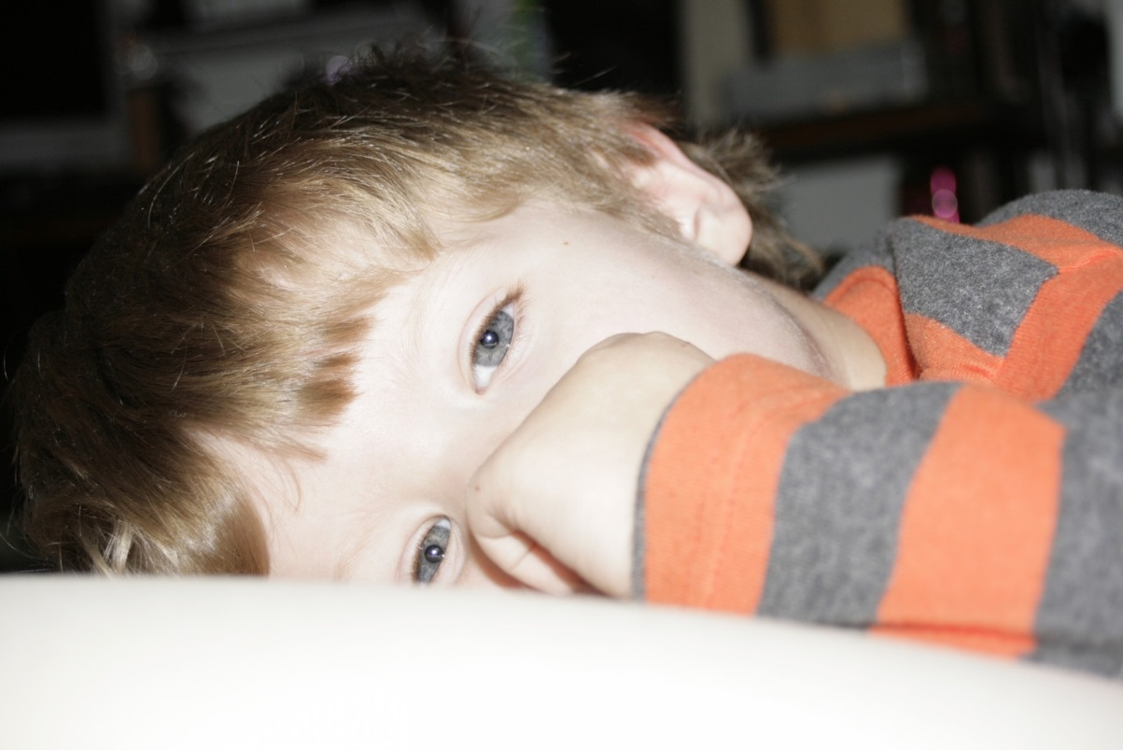
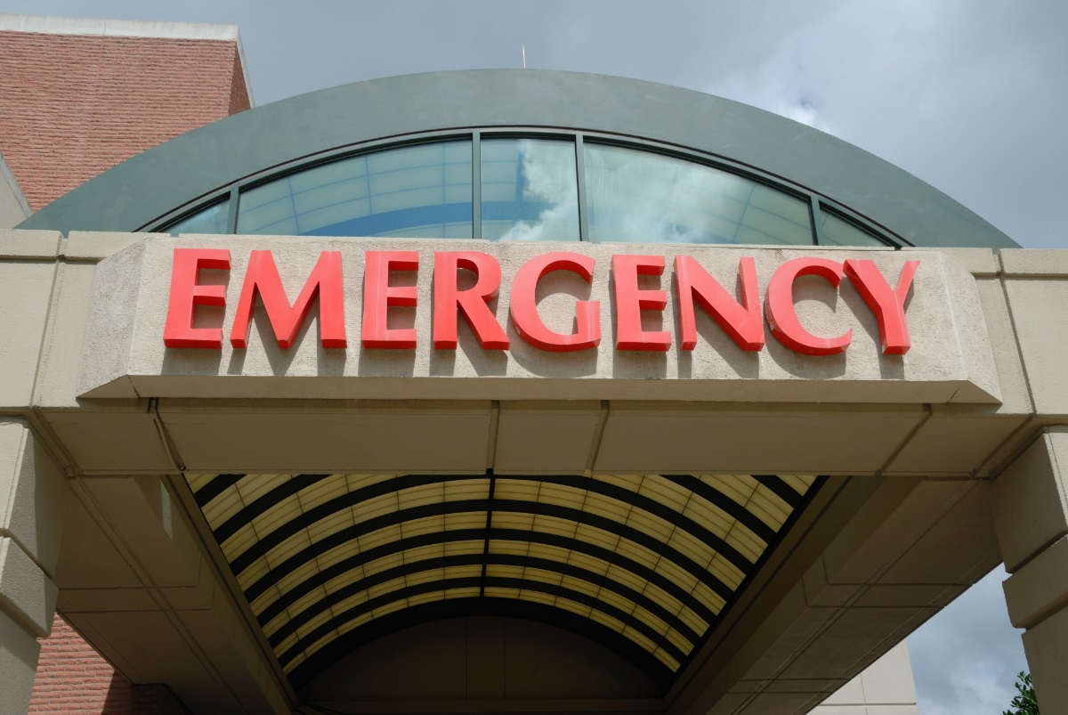
What if…
What if I take a medicine or use a drug that I am not suppose to….
Sick
Sicker

Slide 10
Taking Medicine
Only take medicine if your parent or a trusted adult gives it to you

Slide 11
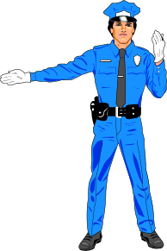
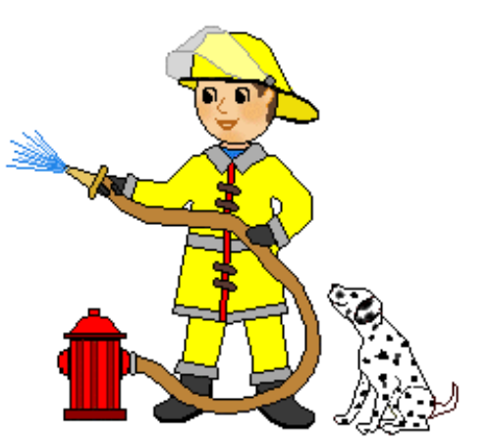
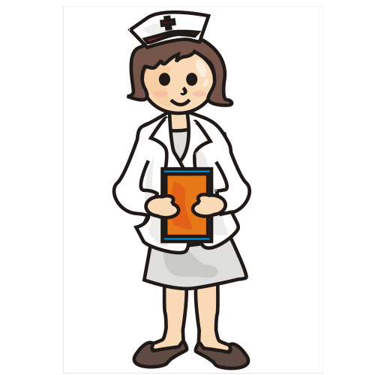
Who Can Help Me Stay Safe?
Look at the following pictures and decide how this person can help you.
Who else helps you stay safe?

Slide 12
Let’s Keep Thinking...

Slide 13
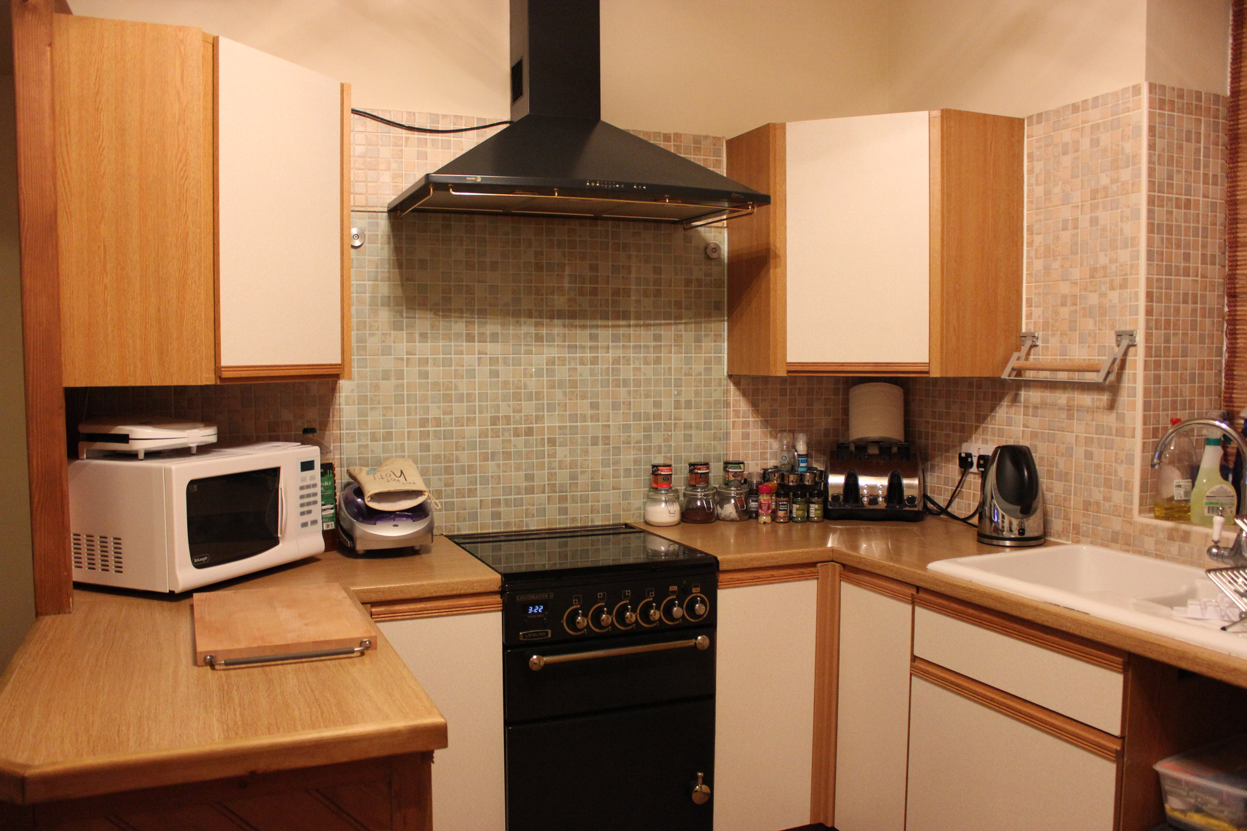
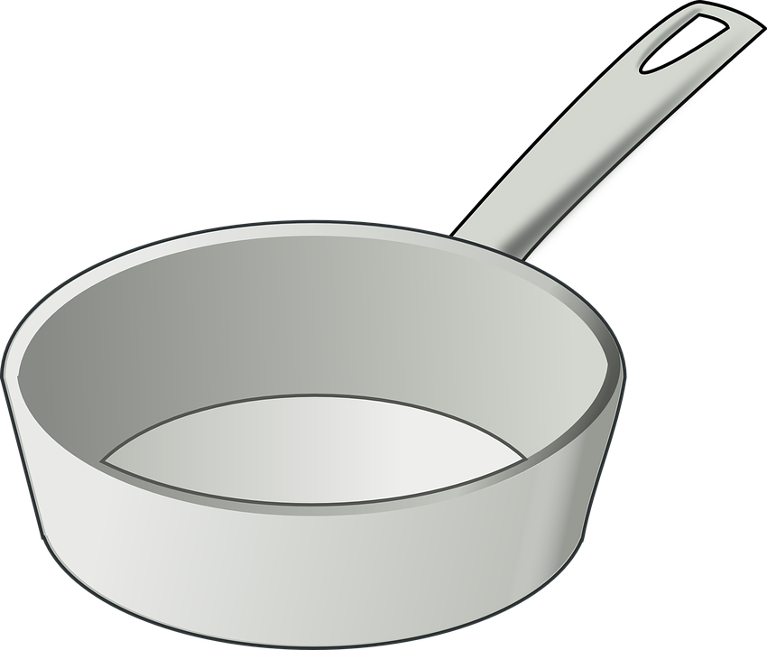
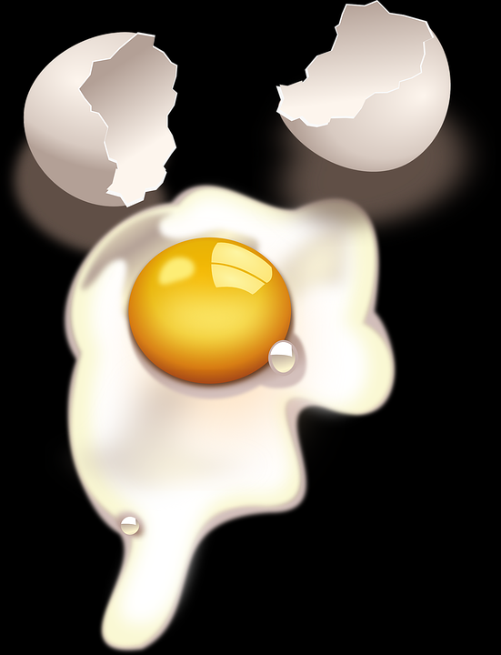
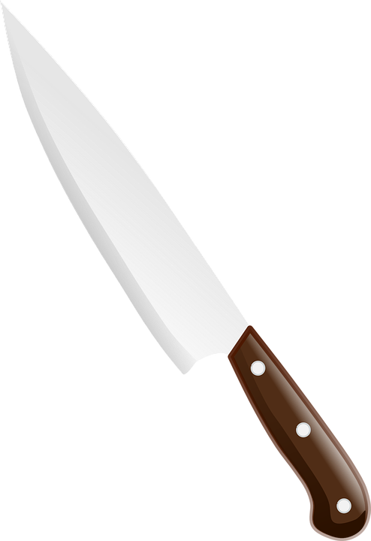
Look Closely...
I love cooking and my grandma often lets me help with food preparation. Look at the kitchen and help me stay safe. While cooking, what should I do to stay safe?

Slide 14
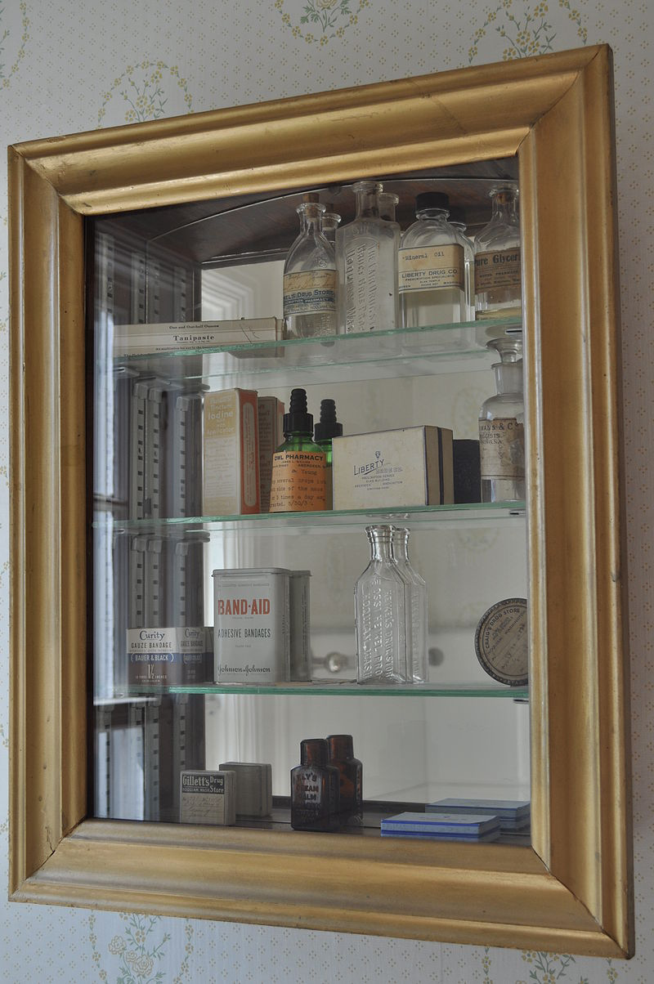
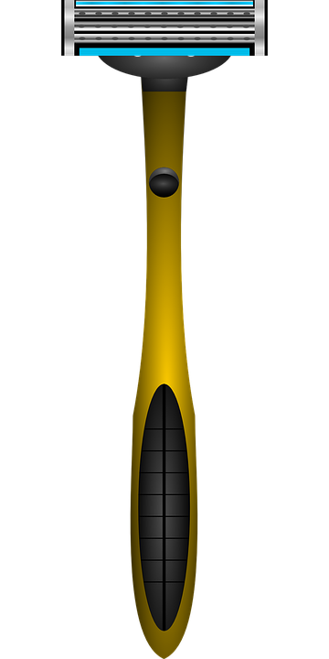
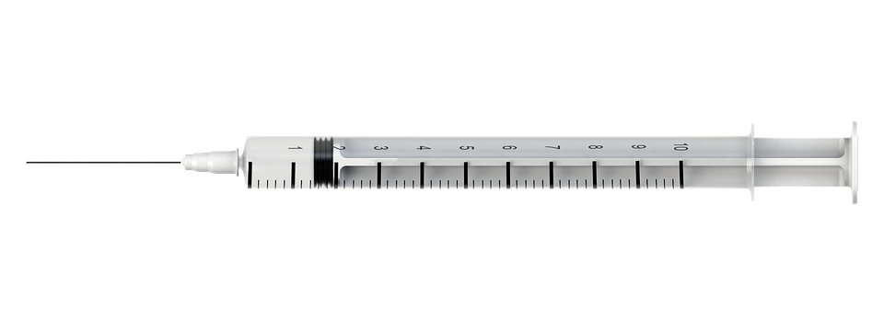
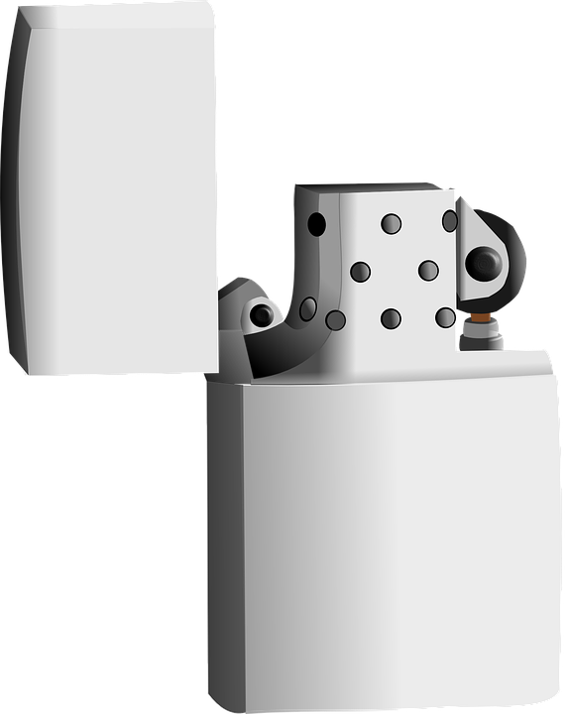
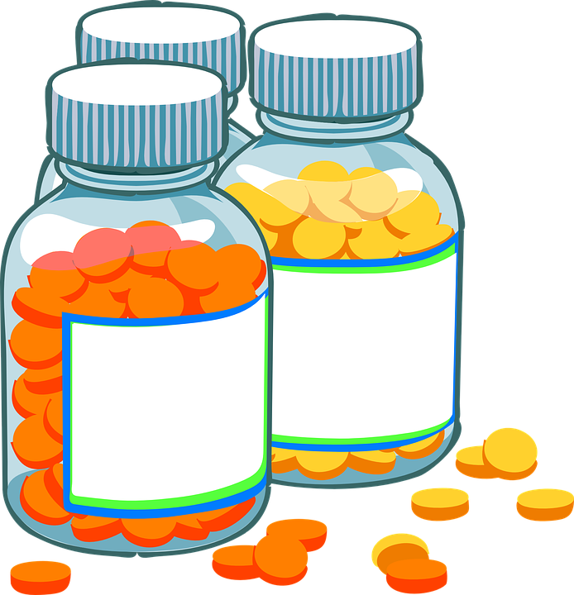
What Should I Do?
When I spend the night at grandpa’s house, he keeps an extra toothbrush for me in his medicine cabinet. Look at the medicine cabinet and help me stay safe as I find my toothbrush.
What could hurt me in here and what could I do to prevent injury?

Slide 15
It’s Your Turn...

Slide 16
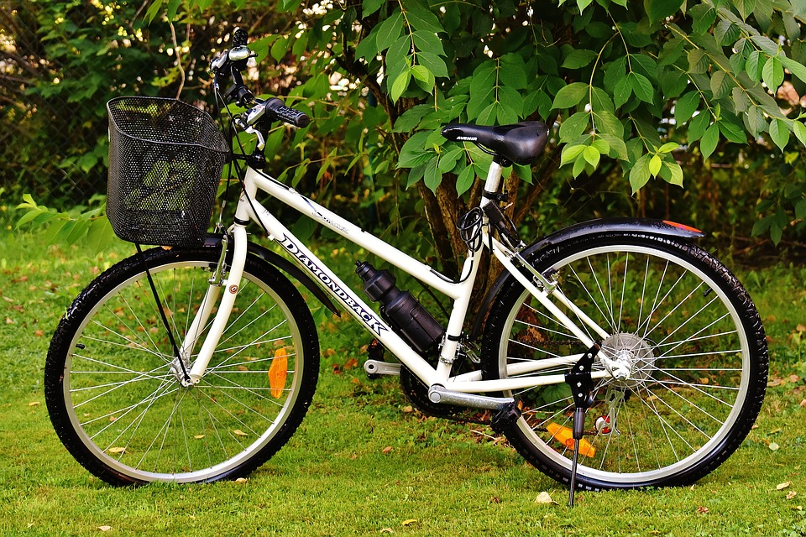
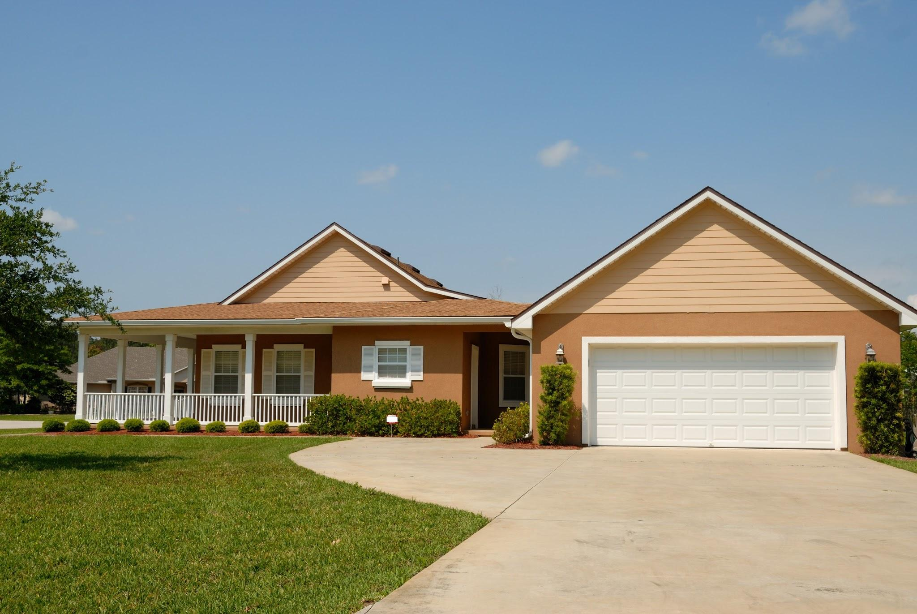
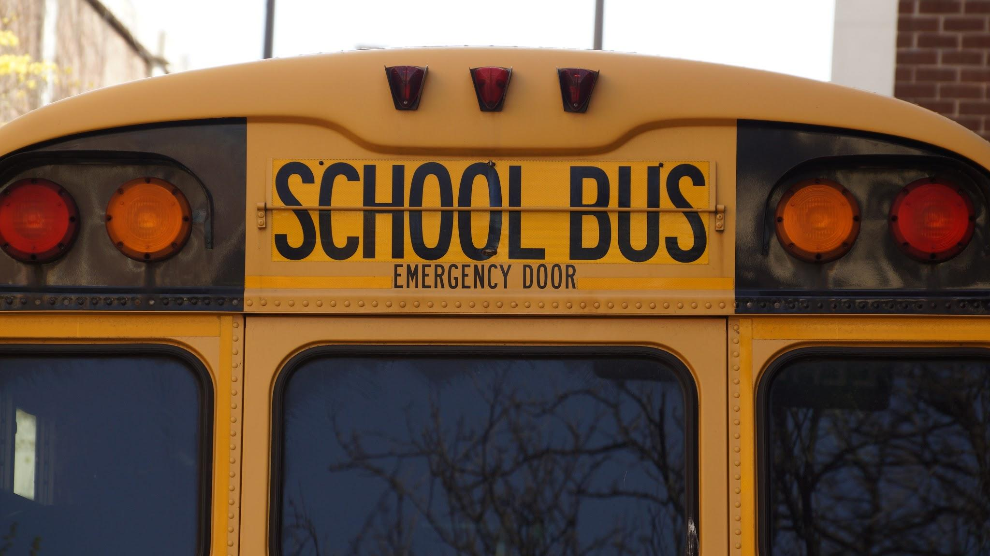
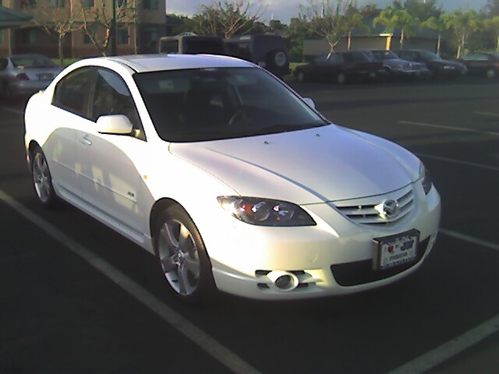
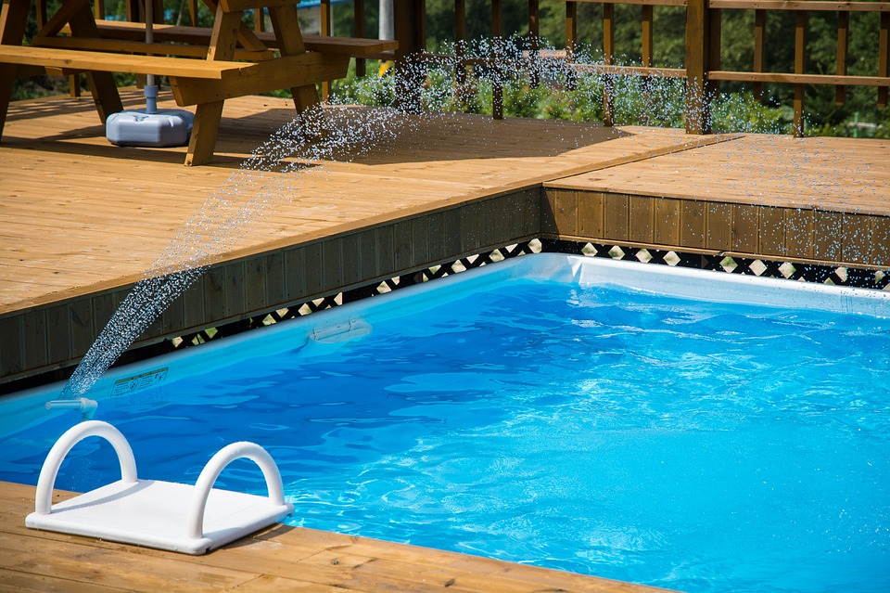
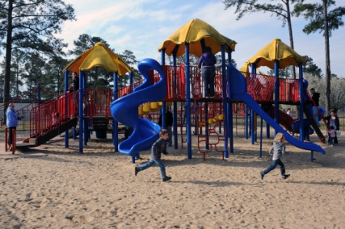
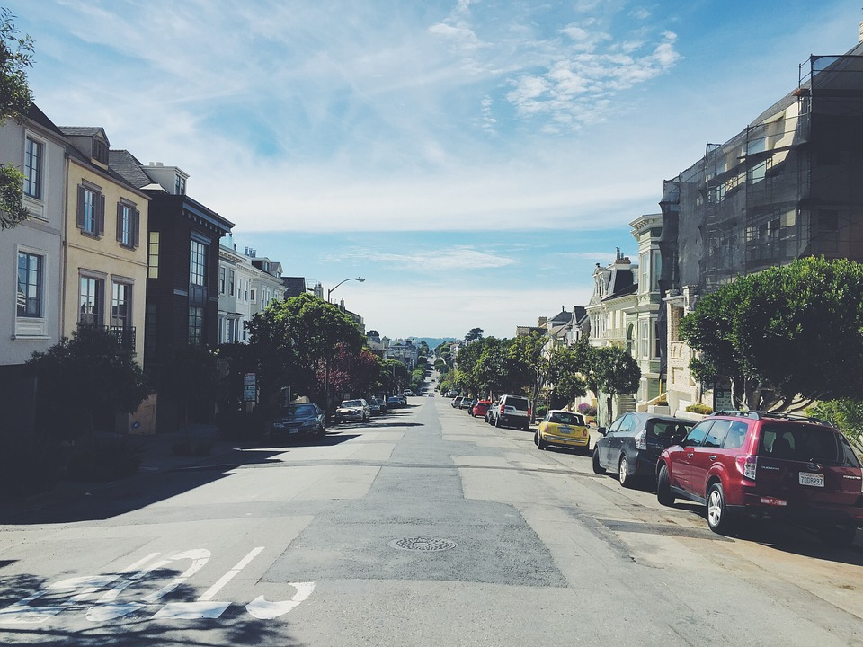
Staying Safe Pledge
Look at the following pictures below and decide how you could be safe in the environment or doing the activity. Create a personal pledge to be safe. A pledge is a promise. Include at least 5 ways to protect your personal safety in your pledge. See the next slide for an example of a pledge.

Slide 17
Personal Safety Pledge
I pledge to:
1. Wear my helmet when riding my bike.
2.
3.
4.
5.
_________ (write your name)____________
Don’t forget to add pictures and color to your pledge.

Slide 18
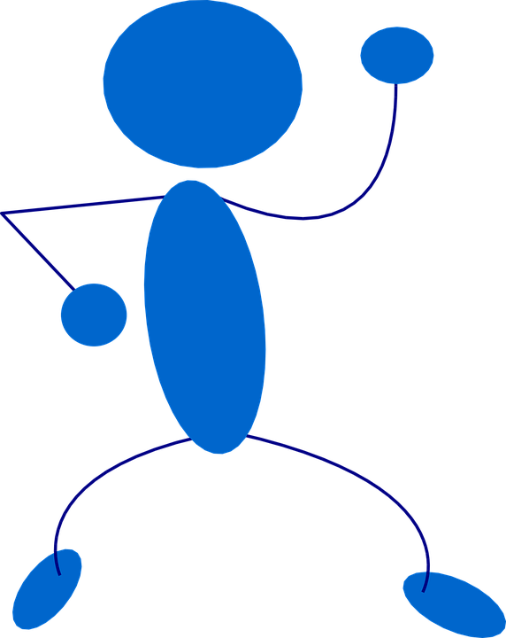
Let’s Move!
https://www.youtube.com/watch?v=9ccFDG4WY8Y

Slide 19
The End
Take Care of Your Health

