Slide 1
All About Me
Nutrition
Let’s Learn About Health!
2nd Grade

Slide 2
Nutrition

Slide 3
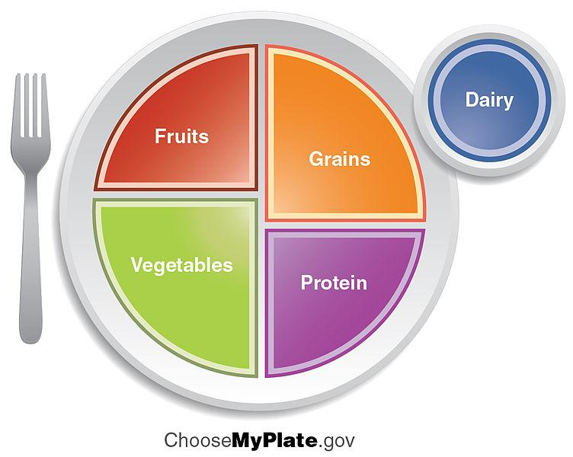
Choose brightly colored fruit
Choose low-fat dairy products
Choose whole grain as a healthier option
Choose brightly colored vegetables
Choose lean proteins such as baked or grilled chicken or fish and beans

Slide 4
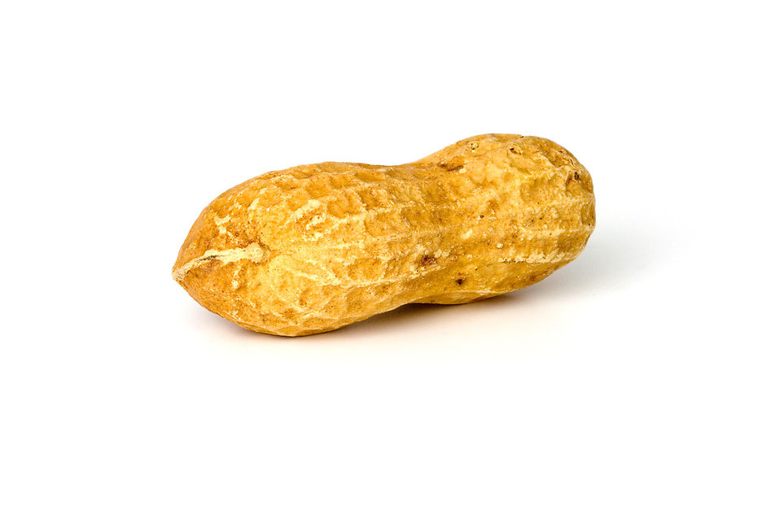
Where does food come from?
Watch the following video clip on where fruits and vegetables come from: https://www.youtube.com/watch?v=CdPRZ3wjCxA
Food will come from either a plant or an animal. Let’s practice deciding if the food is from a plant or an animal.

Slide 5
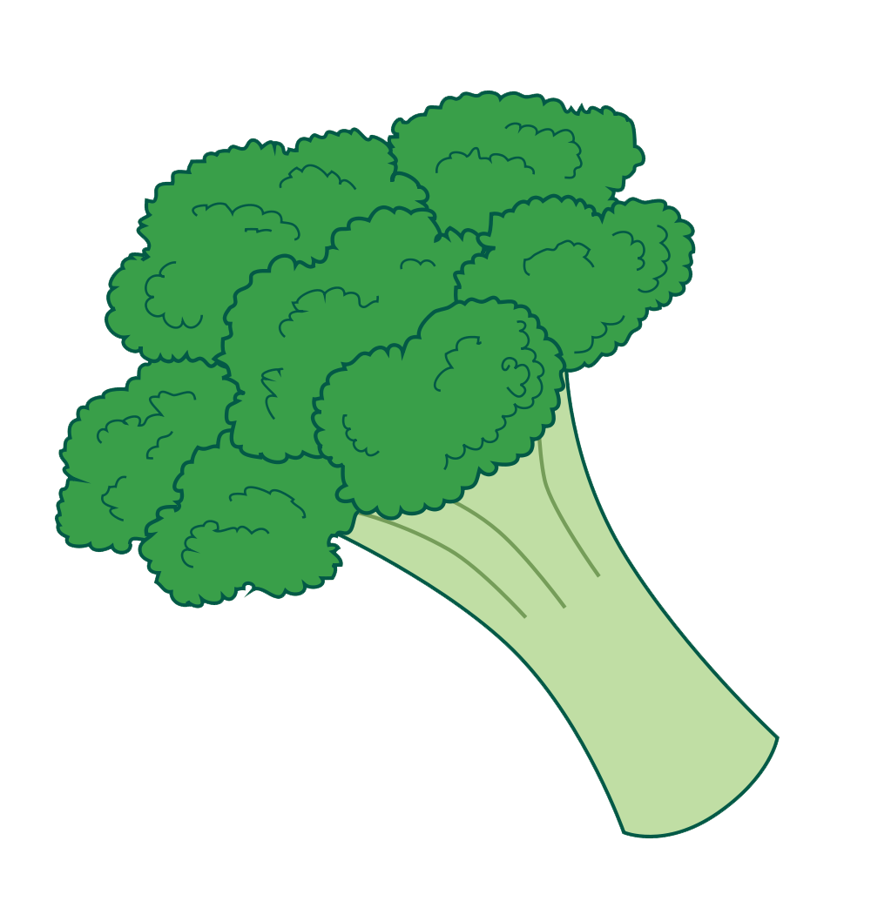
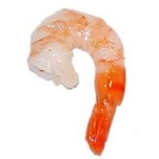
Plant or Animal?

Slide 6
Plant or Animal?
Icecream

Slide 7
Healthy Food
Give examples of healthy food you like to eat

Slide 8
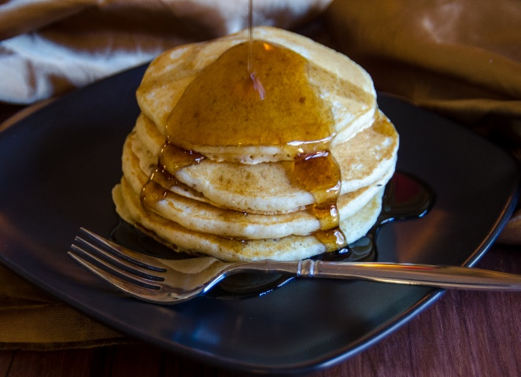
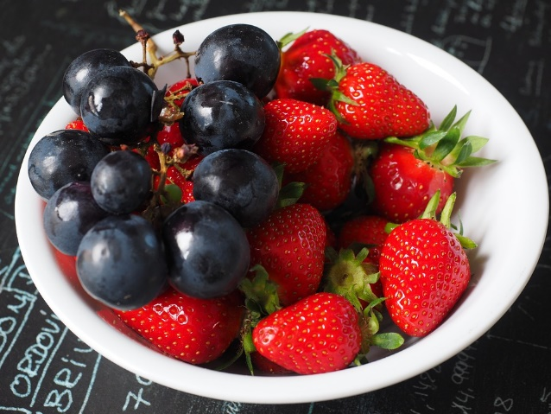
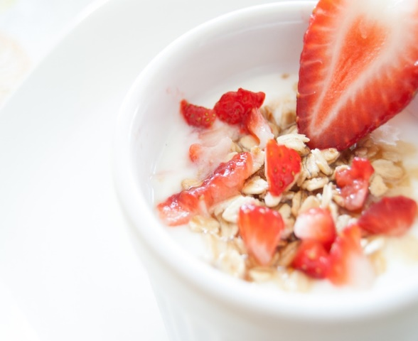
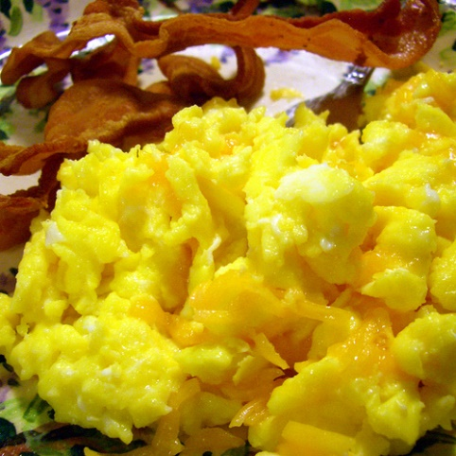
What Should I do?
Now that I’m in 2nd grade, my mom lets me choose whether I eat breakfast at home or school. Today, I’m going to eat at school. They are serving my favorite, pancakes. However, when I eat just pancakes, I notice that I’m really hungry before lunchtime and have a hard time focusing on my work. There are lots of breakfast foods to choose from. Can you help me pick out a breakfast that will give me energy, fill me up, and provide me will lots of important vitamins and minerals for my health?

Slide 9
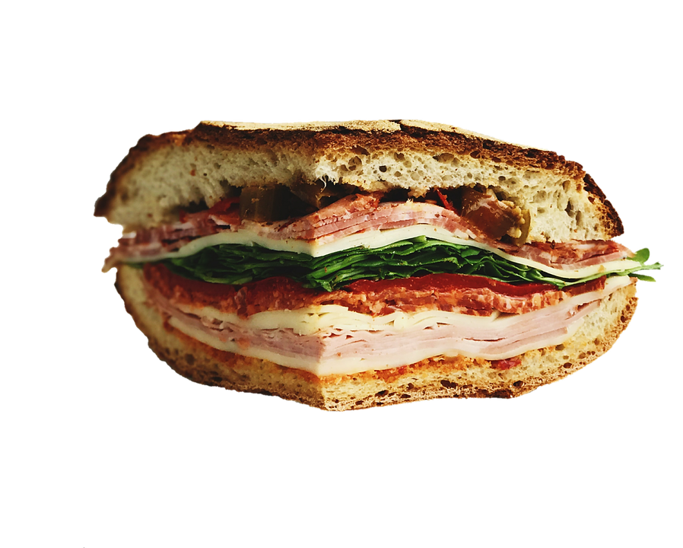
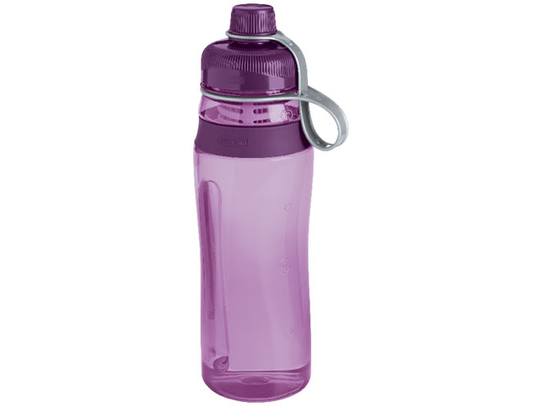
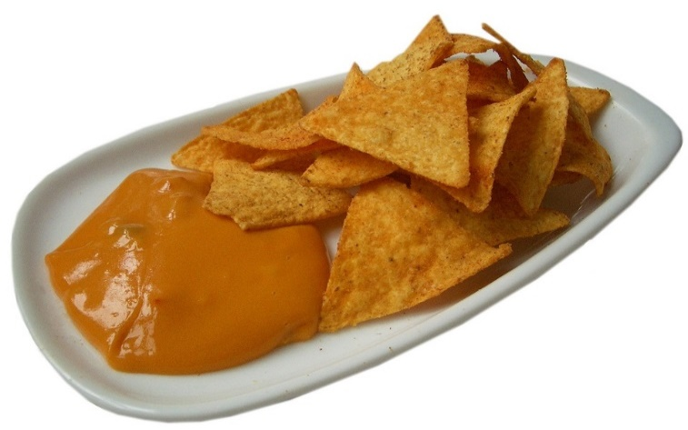
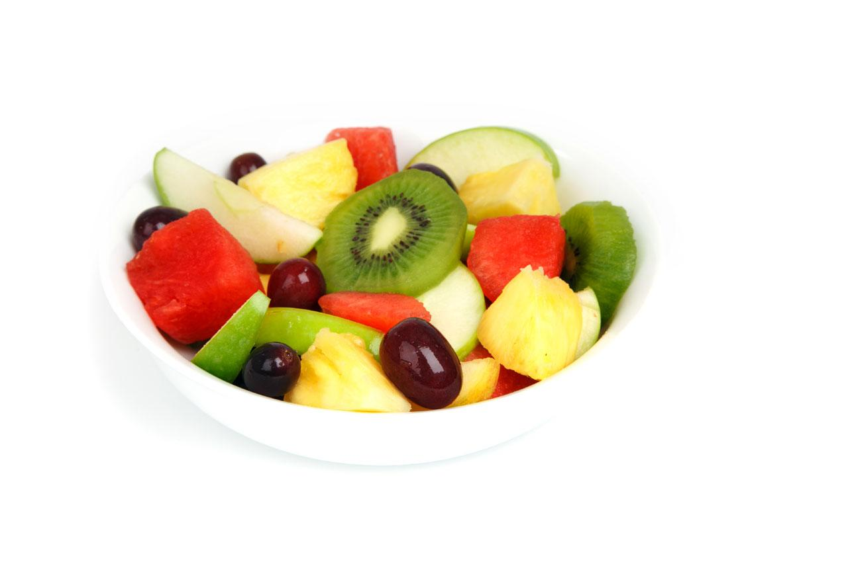
What Should I do?
Between school, soccer, gymnastics, and homework, I stay busy all day. It is important for me to have energy and feel good to participate in these activities. After school, I’m really hungry. I’m trying to decide what after school snack I should choose. Can you help pick a snack that will give me the energy I need?
OR
https://www.youtube.com/watch?v=krcJuxzXxWI

Slide 10
Unhealthy Food
Eat in moderation
Too much salt
Give examples of unhealthy food you like to eat.
Too much sugar
Fried Foods
Too much fat

Slide 11
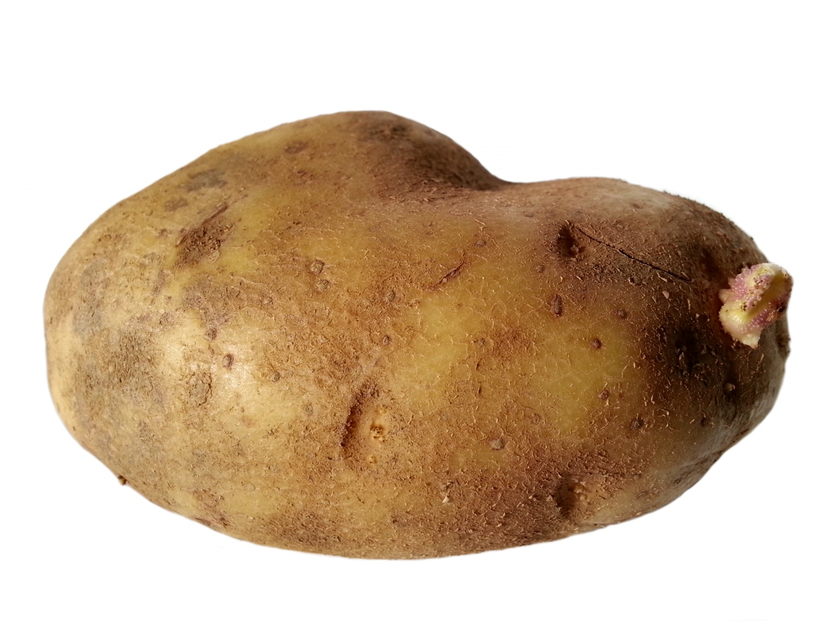
Pick the Healthier Food
Eating healthy food makes me feel good, helps me focus at school, and gives me more energy throughout the day. Can you help me pick which food is healthier?
Potato
Potato Chips
VS.

Slide 12
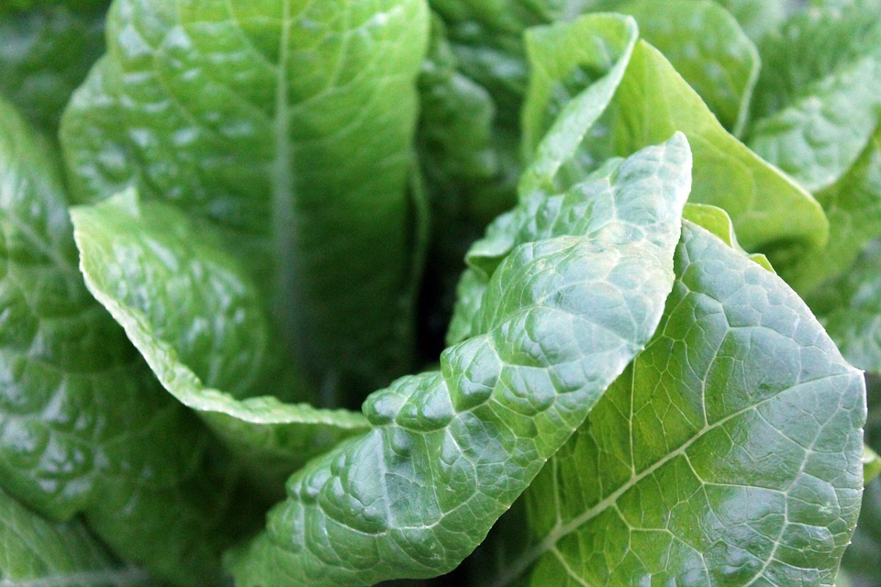
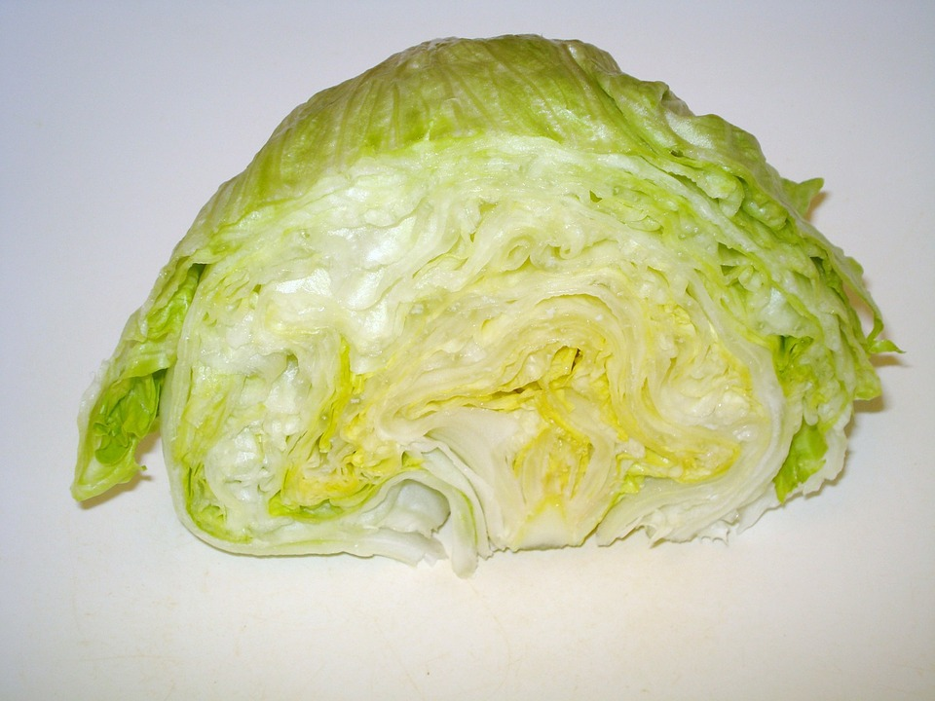
Pick the Healthier Food
Spinach
Iceburg Lettuce
VS.

Slide 13
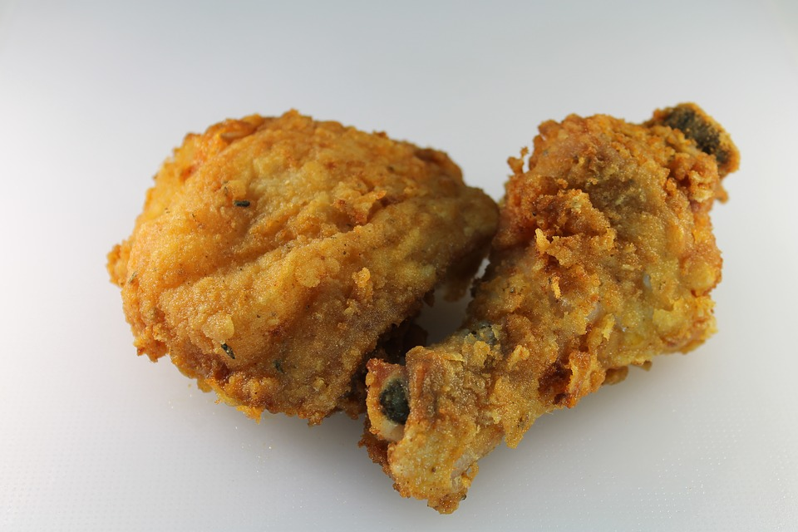
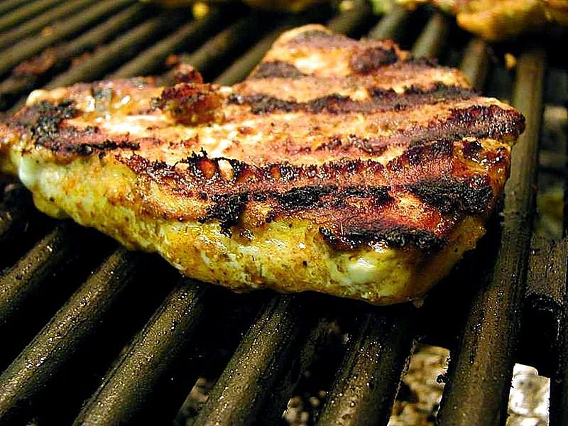
Pick the Healthier Food
Fried Chicken
Grilled Chicken
VS.

Slide 14
Pick the Healthier Option
Apple
Apple Juice
VS.

Slide 15
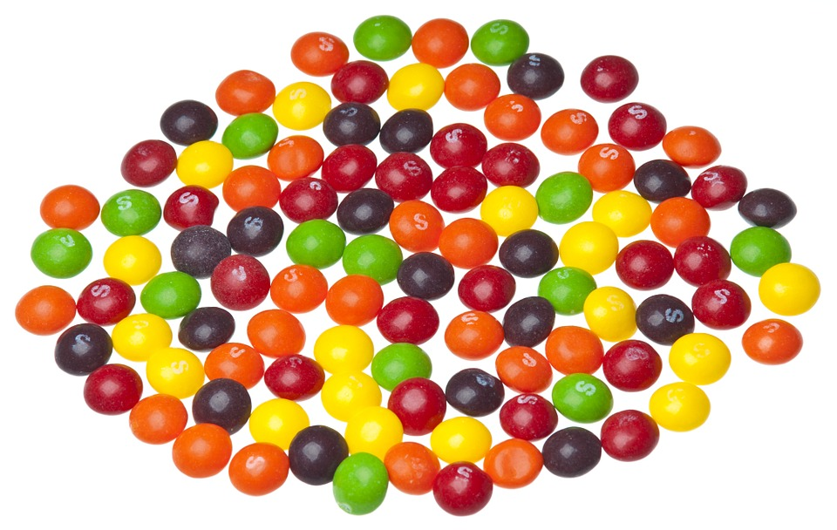
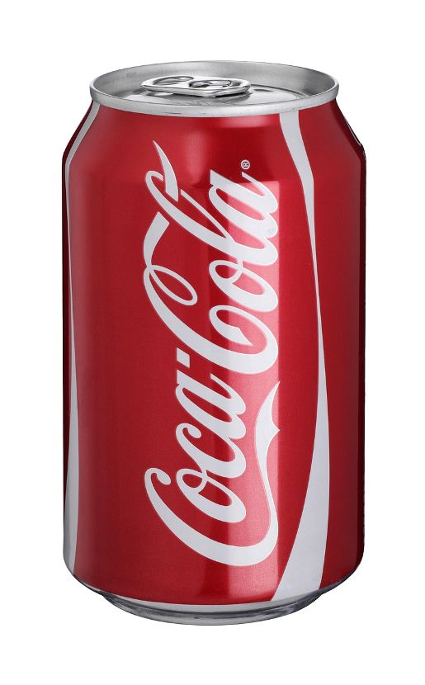
Eat or Drink This, Not That
Or in Moderation
Eating or drinking too much sugar is not healthy for me. Rather than drinking this coke, what could I have that tastes good but doesn’t have so much sugar?
Candy has lots of sugar in it. Rather than eating Skittles, what could I have for a treat?

Slide 16
Let’s Share…
Think of sugary foods and drinks that you love. What is a healthier alternative?
Caution: Most sodas contain caffeine

Slide 17
Make a Healthy Breakfast
The following items are in your kitchen. Using the guidelines from MyPlate, create a healthy breakfast to fuel your body for the day.
List of Available Food:
Yogurt
Shredded Cheese
Eggs
Bread
Granola
Cereal
Apple
Strawberry
Tomato
Spinach
Carrots
Milk
Oatmeal
Almond milk
Ham
Pepper

Slide 18
It’s Your Turn...
The following items are in your kitchen. Using the guidelines from MyPlate, create a healthy lunch to fuel your body.
Yogurt
Cheese
Milk
Almond milk
black beans
Ham
Turkey
Bread
Rice
Pasta
Apple
Strawberry
Spinach
Carrots
Sliced peppers
If you don’t see food options that you like, borrow a food item from a neighbor to make your meal.

Slide 19
Let’s Move!
https://www.youtube.com/watch?v=YDgVWIlFMac

Slide 20
The End
Take Care of Your Health

