Slide 1
Sun Safety
How can sunrays be harmful to us?
What can we do to protect ourselves from the sun?

Slide 2
Playing Outside is Good for Me
Being active is an important part of staying healthy
Our bodies make Vitamin D when we are exposed to sunlight
Only a short time in the sun is needed to get Vitamin D
We need to play outside every day!

Slide 3
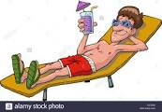
UV rays from the sun are harmful
UV rays cause sunburn
UV rays lead to skin wrinkling and aging quicker
UV rays increase the risk of skin cancer
Melanoma is the most dangerous type of skin cancer. Severe sun burns for kids increase the risk of melanoma
UV rays can also damage your eyes

Slide 4
All Sun Damage is Preventable!
Be sun safe and you can limit your risk

Slide 5
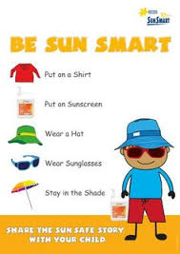
Tips for Being Sun Safe
Always Wear Sunscreen- SPF 30 or higher- make sure your sunscreen protects against both UVA and UVB rays
Wear sunglasses with UV protection
Wear a hat
Find Shade- If you are out in the sun for long periods, try to find shady areas as much as possible.

Slide 6
Always be Sun Safe!

