Slide 1
Sleep
Why is sleep important and how much sleep do we need?

Slide 2

Why do we need to sleep?
Sleep allows our bodies to rest
Sleep gives our brains a chance to reset. Your brain is busy organizing and processing information while you are sleeping
Elementary age children should get 10-11 hours of sleep every night

Slide 3
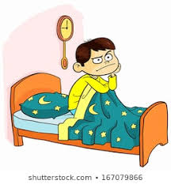
What are the affects of not getting enough sleep?
it is harder to concentrate in school
Makes you cranky and quick tempered
You are more likely to get sick
Makes it harder to remember things
You might feel clumsy or slow when you are trying to play
You are more likely to fall and get hurt
Over time, lack of sleep can affect your health too

Slide 4

Suggestions to Help You Get the Sleep You Need
Keep the same pattern. Regular bed time and wake up times are important.
Don’t argue with your parents when the say it is bed time!
Create a nighttime routine where you do the same things right before bedtime
Avoid screen time right before bed
Don’t worry about sleep. Staying calm and relaxed helps you sleep

Slide 5
Get 10-11 Hours of Sleep Every Night so You Can:
Do your best work in school
Treat your friends with kindness
Have energy to play during recess and P.E.
Stay healthy!

