Slide 1

All About Me
Body Systems
Let’s Learn About Health!
2nd Grade

Slide 2
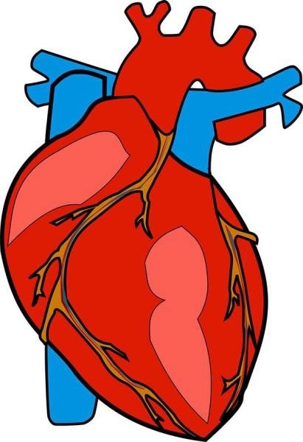

Can You Help Me?
During exercise the heart and ____________ work together to pump blood with oxygen to the muscles of the body.
+

Slide 3
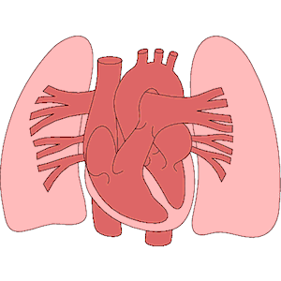
Heart & Lungs

Slide 4
Cardiorespiratory System

Slide 5
Heart & Lungs
The heart and lungs form the cardiorespiratory system
Watch the video to see how the heart and lung work together: https://www.youtube.com/watch?v=-s5iCoCaofc
(Exploring the Heart- The Circulatory System)

Slide 6
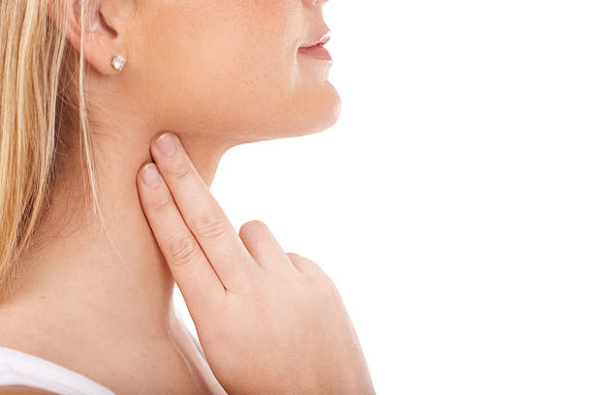
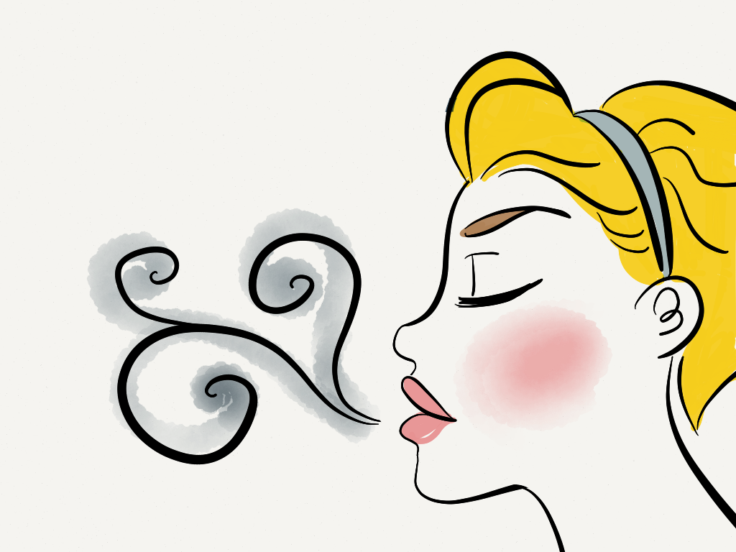
Heart and Lungs
Feel your heartbeat.
Put your hand on your chest and feel your lungs get bigger by taking a deep breath in. Now let it out and release air out of your mouth

Slide 7
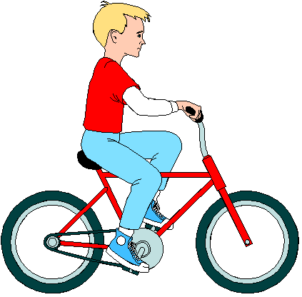
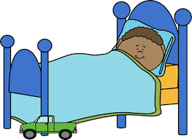
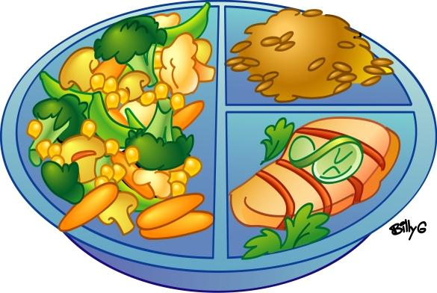
Healthy Heart & Lungs
Healthy eating keeps your arteries clean so blood can easily flow through
Sleep slows everything down and allows the body to recover
Exercise makes your heart and lungs stronger

Slide 8
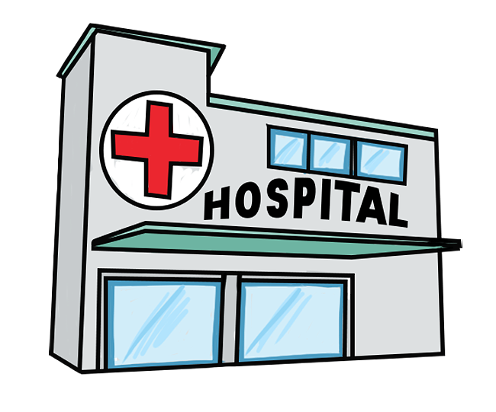
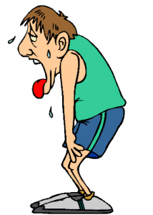
Consequences
If you don’t take care of your cardiorespiratory system, there may be consequences today and as you age.
Health problems later in life
Feel out of breath when exercise

Slide 9
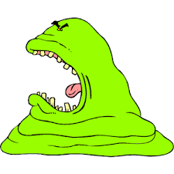
Can You Help Me?
What inside the body forms the framework or structure of the body, allows for movement, and protects the organs of the body? Without it, we would look like a blob.

Slide 10
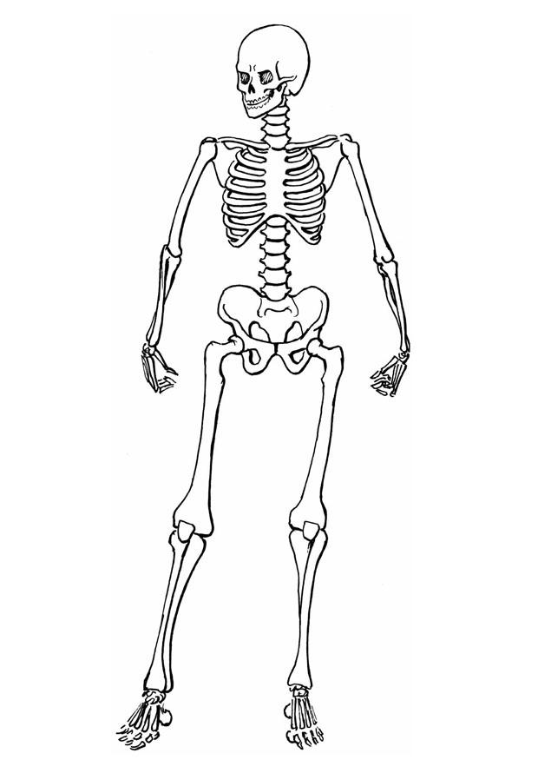
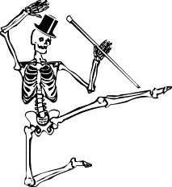
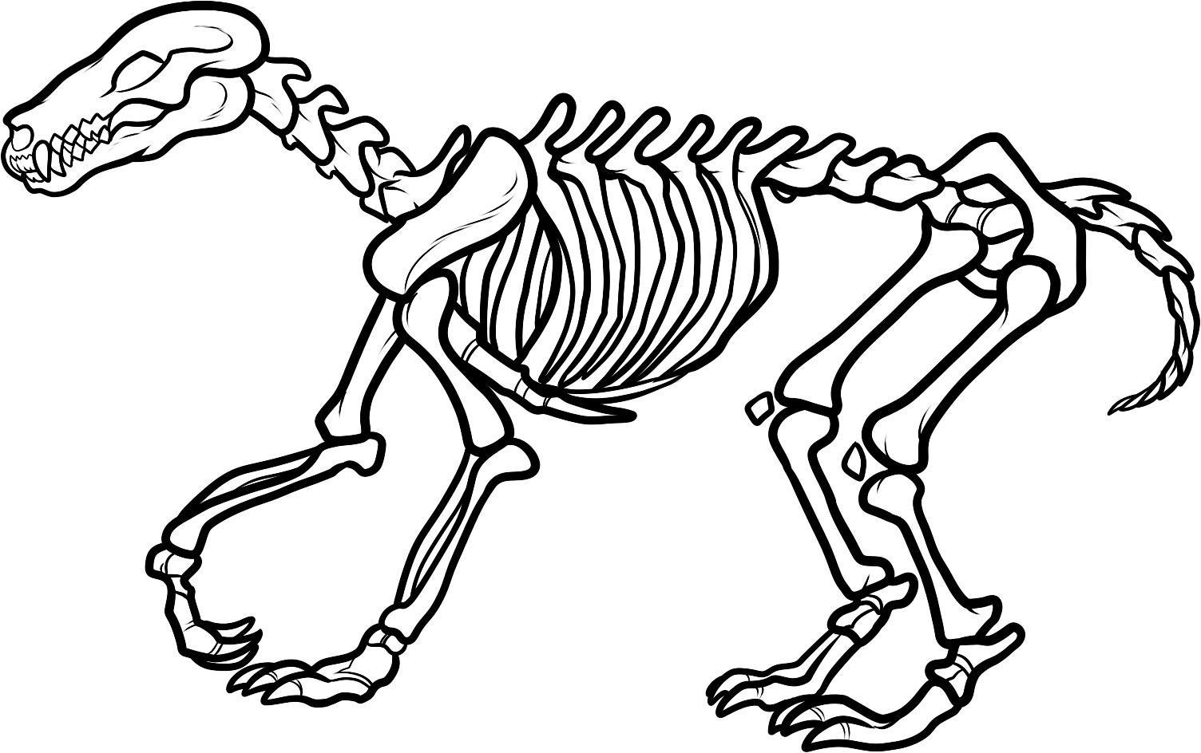
Bones

Slide 11
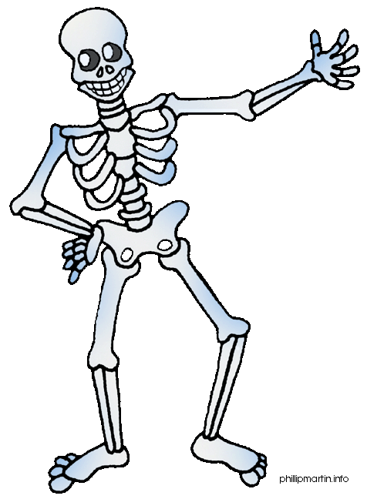
Skeletal System

Slide 12
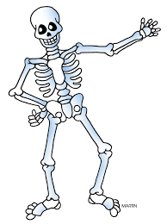
Bones
206 bones in the human body form the skeletal system.
Watch the video to see how your bones and skeleton works:
https://www.youtube.com/watch?v=i42FSNA9bAY (How your bones and skeleton works: KidsHealth.org)

Slide 13

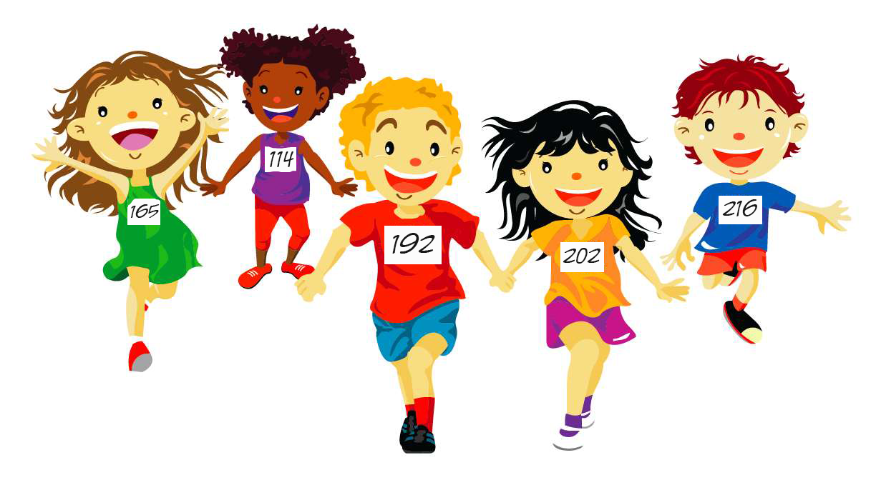
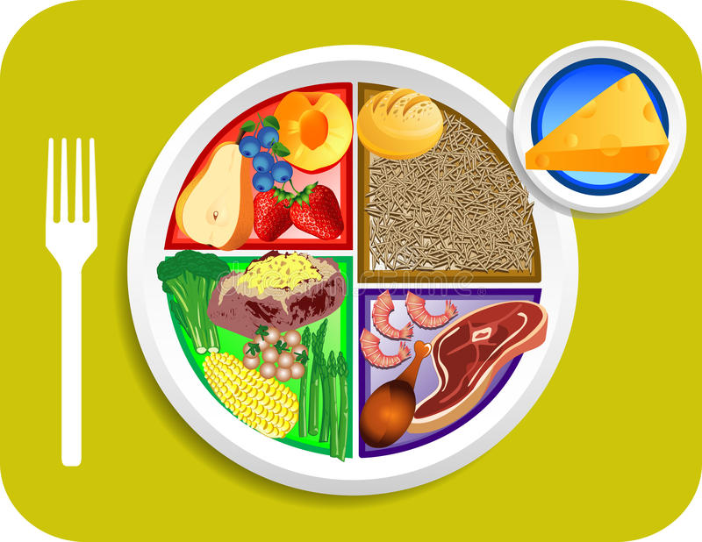
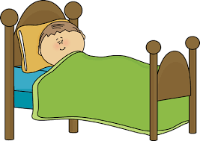
Healthy Bones and Skeletal System
Sun is a great source of Vitamin D which makes bones stronger.
Exercise makes bones stronger
Healthy diet builds strong bones especially foods high in Calcium and Vitamin D
During sleep, your bone cells regenerate and grow new bone

Slide 14
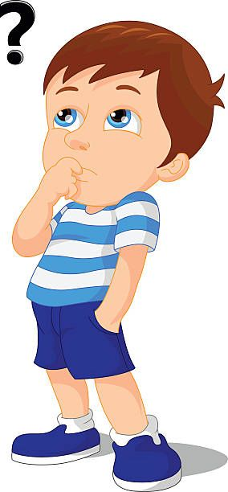
What Should I Do?
My grandma always tells me to keep my bones strong. I’m trying to decide on an afternoon snack. I could make a smoothie with fruit, vegetables, almond milk, and yogurt or have chips and a soda. Which would help strengthen my bones?
What should I do?

Slide 15
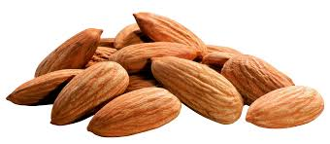
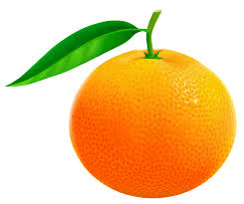

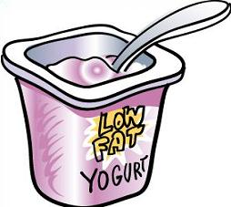
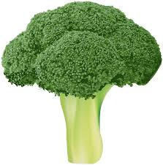
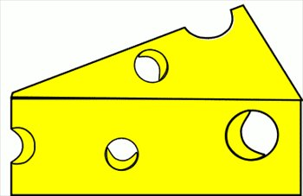
Strong bones = Foods high in Calcium

Slide 16
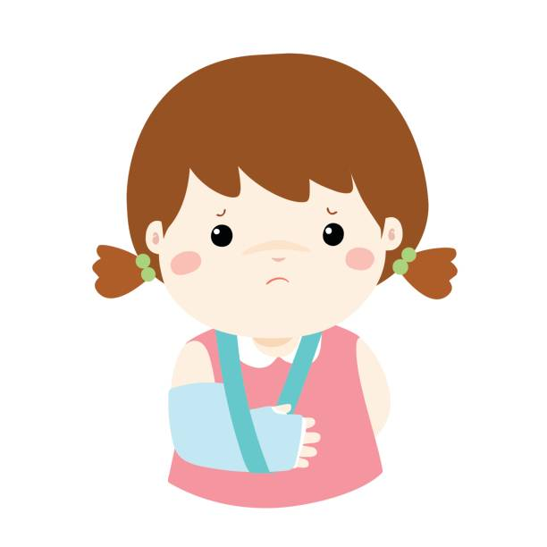
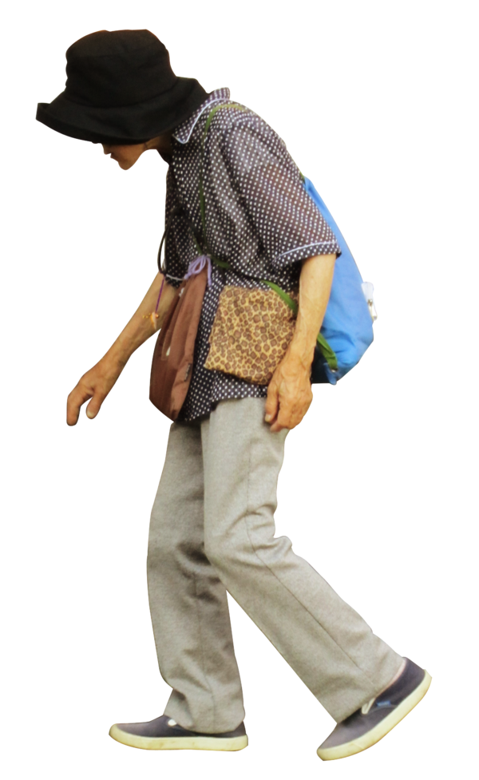
Consequences
If you don’t take care of your skeletal system, there may be consequences today and as you age.
Osteoporosis (weak bones) as an older adult
Weak bones break easier

Slide 17
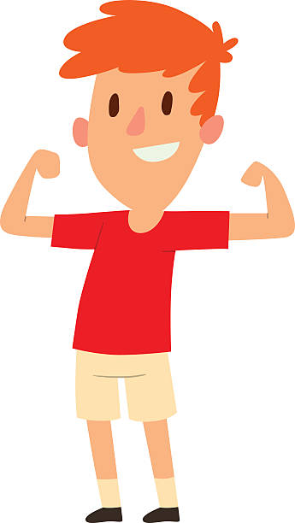
Can You Help Me?
Climbing, jumping, running, and going across the monkey bars requires strength. What inside the body makes me strong?

Slide 18
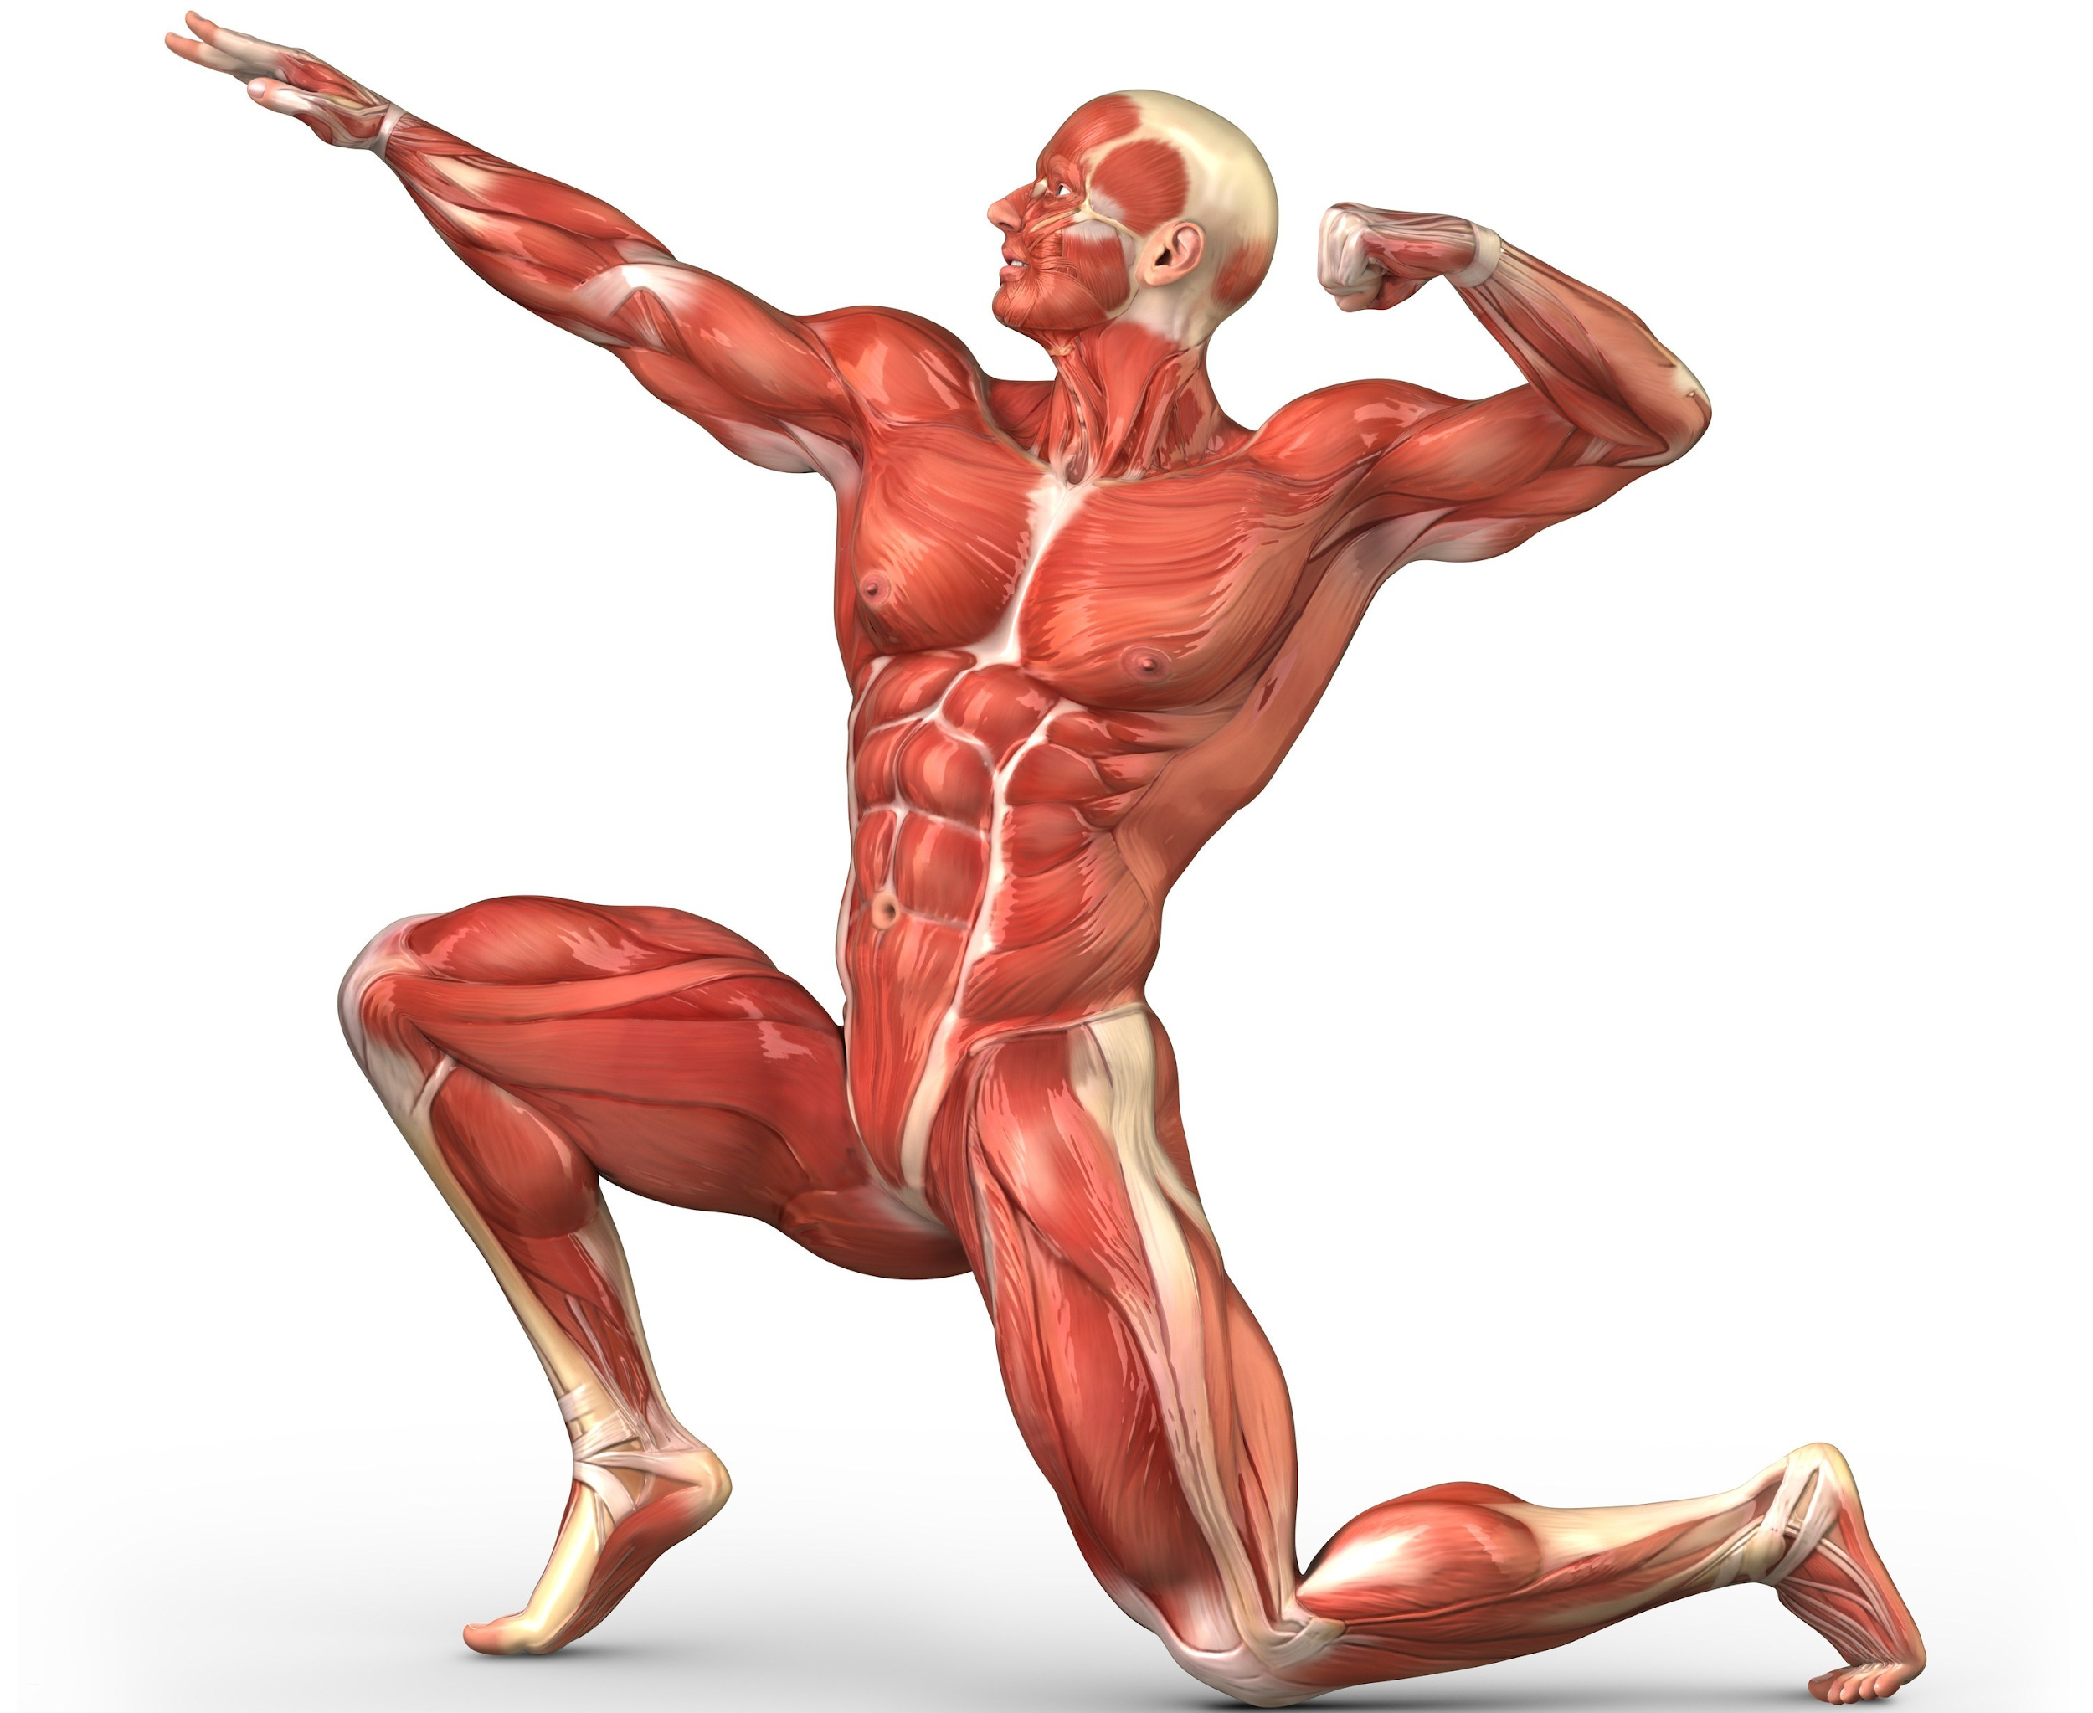
Muscles

Slide 19
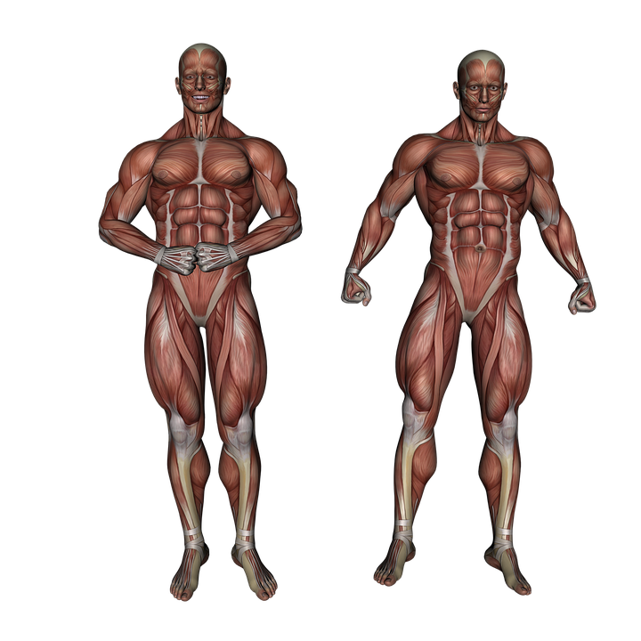
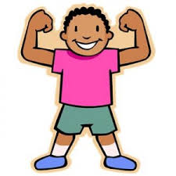
Muscular System
About 700 muscles form the human muscular system and are responsible for movement (with the bones).
Watch the video to see how your muscular system works:
https://www.youtube.com/watch?v=f_F5UwtdPOc (How your muscles work: KidsHealth.org)

Slide 20
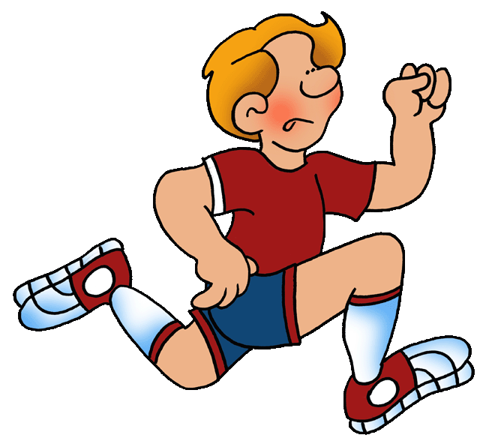
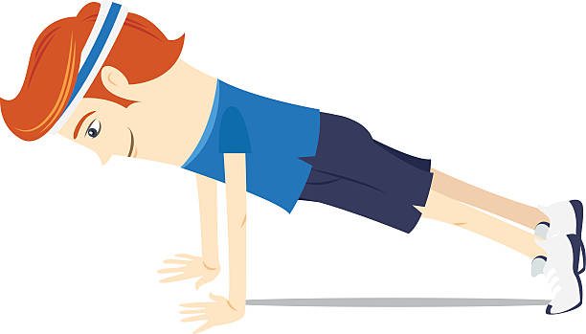
Healthy Muscles and Muscular System
Exercise makes muscles stronger
Healthy diet repairs muscles to make them stronger
During sleep, your muscles recover and repair

Slide 21
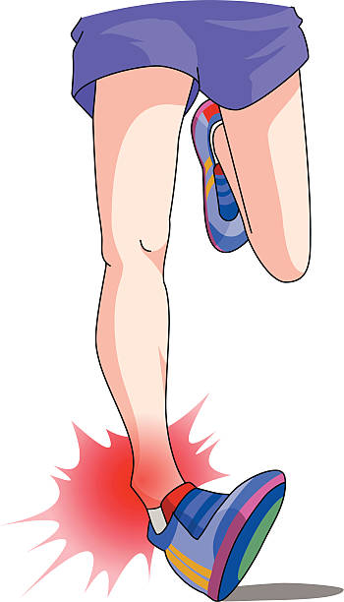
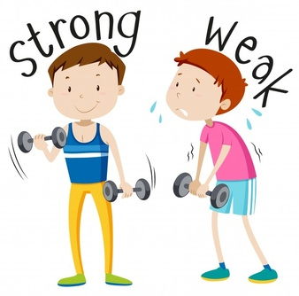
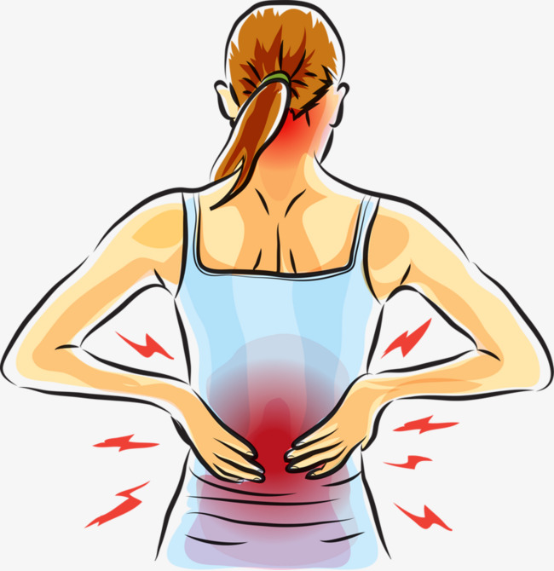
Consequences
If you don’t take care of your muscular system, there may be consequences today and as you age.
More likely to have an injury
Weak muscles
Muscle pain

Slide 22
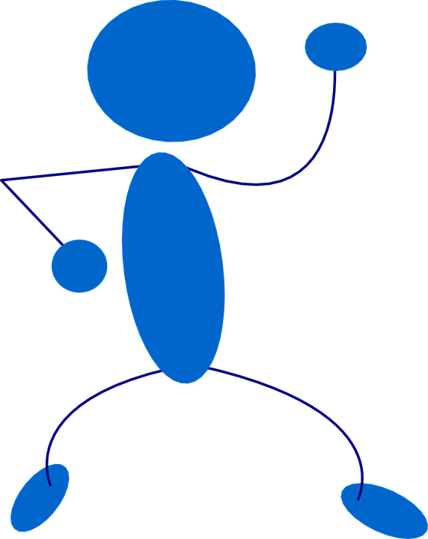
Let’s Move!
https://www.youtube.com/watch?v=9ccFDG4WY8Y

Slide 23
The End
Take Care of Your Health

