Slide 1
Love Shouldn’t hurt

Slide 2
Relationship spectrum:
Let’s Play
Kahoot.it
Decide whether each scenario is:
Healthy
Unhealthy
Abusive
Notes:
Click on this link here: https://play.kahoot.it/#/k/c329469e-58c8-4e92-89a1-8738c74c15b6 Students will log into kahoot.it
Kahoot.it will ask if you want to play individually or in a group. The individual setting is more fun. Kahoot will give a game pin# for the students to log into. Remind students to use their real name. You can delete bad names by scrolling your cursor over the name and clicking delete.

Slide 3
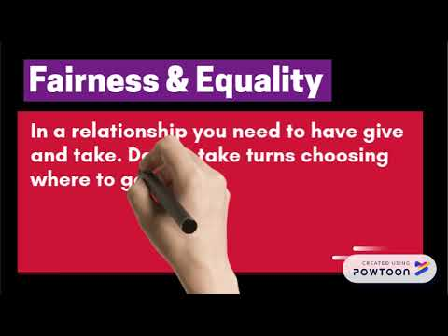
What makes a healthy relationship?
https://youtu.be/kwzzfN2gKtY

Slide 4
Teen Dating violence (TDV):
Is a pattern of behavior that includes, physical, emotional, verbal or sexual abuse used by one person in an intimate relationship to exert power and control over another.

Slide 5
1 in 3 teens will find themselves in an unhealthy relationship

Slide 6
But only 1 in 8 teens will be physically abused by a dating partner in the US every year (CDC, 2017)
Notes:
https://nccd.cdc.gov/youthonline/app/Results.aspx?LID=XX
YRBS Data 2017

Slide 7
“If you really love me...you will...”
Types of abuse:
Physical
Sexual
Verbal
Emotional/Mental
Digital
Financial
“Who are you with?”
“I called you 10 times. Why aren’t you answering my calls.”
“Why are you so sensitive? It was just a joke.”
“Why are you wearing that. Go change.”
Notes:
Types of Abuse - loveisrespect. (n.d.). Retrieved from http://www.loveisrespect.org/is-this-abuse/types-of-abuse/

Slide 8
2 out of 3 teens who experience
Teen dating violence will not tell anyone about it.
Remember: Abuse thrives in silence
Notes:
Types of Abuse - loveisrespect. (n.d.). Retrieved from http://www.loveisrespect.org/is-this-abuse/types-of-abuse/

Slide 9
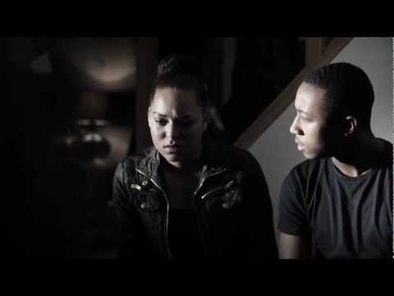
Pick out the unhealthy characteristics in this scenario
https://youtu.be/zOLAelTPs6c
Notes:
Ryan and Jade Teenage Relationship Abuse Advert [full version] (2013, March 4). Home Office Retrieved from https://youtu.be/zOLAelTPs6c.
Steiner, Leslie. (2013, Jan. 25). Why domestic violence victims don’t leave? TED Talk. Retrieved from https://www.youtube.com/watch?time_continue=1&v=V1yW5IsnSjo
The Line. (2008, October 19). Love is Respect. Retrieved June 18, 2018, from https://www.youtube.com/watch?time_continue=1&v=dNvt_zSiIkg
Types of Abuse - loveisrespect. (n.d.). Retrieved from http://www.loveisrespect.org/is-this-abuse/types-of-abuse

Slide 10
Abuse has no boundaries it affects all:
Races
Religions
Education levels
Income levels
Abuse can happen to anyone!

Slide 11
Understanding the cycle of violence
Honeymoon Phase
Tension Building Phase
This is when things are good. Your partner is treating you really kind. It can be the “I am sorry phase” where they apologize for their behavior.
This is when you sense tension.
“Walking on eggshells”
There may be verbal, emotional and/or mental abuse during this phase.
Explosion Phase
This is an act of violence:
Physical
Sexual
Verbal
Mental/Emotional
Digital
Stalking
Financial

Slide 12
cycle of violence in a long-term abusive relationship
Honeymoon Phase
Tension Building Phase
This is when things are good. Your partner is treating you really kind. It can be the “I am sorry phase” where they apologize for their behavior.
This is when you sense tension.
“Walking on eggshells”
There may be verbal, emotional and/or mental abuse during this phase.
Explosion Phase
This is an act of violence:
Physical
Sexual
Verbal
Emotional/Emotional
Digital
Stalking
Financial
Notes:
In a long-term abusive relationship the “Honeymoon phase” is eliminated and the cycle of violence consists of the “Tension Building Phase” and the “Explosion Phase”.

Slide 13
Pick out the unhealthy characteristics in this scenario
https://youtu.be/dNvt_zSiIkg
Notes:
The Line. Love is Respect (2008, October 19). Retrieved June 18, 2018, from https://www.youtube.com/watch?time_continue=1&v=dNvt_zSiIkg

Slide 14
early warning signs “Red flags” of abuse:
Not respecting your boundaries
Too serious too fast
Saying, “I love you” too quickly
Possessive
Extreme jealousy or controlling behavior
Attempts to manipulate or “guilt trip”
“If you really cared about me you would...
Constantly moody or agitated
Anger issues. Loses temper easily.
Disrespectful to others
Abuse to animals

Slide 15
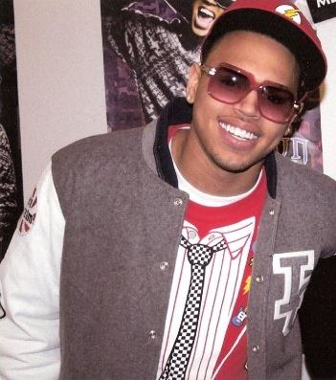
Prevalence of Abuse in pop culture
Emma Roberts & Evan Peters
Rihanna and Chris Brown
2009
2013
Notes:
https://www.washingtonpost.com/blogs/she-the-people/wp/2013/02/11/rihanna-and-chris-brown-are-proof-that-domestic-violence-is-everyones-business/?noredirect=on&utm_term=.5d9ba1d52a4c
https://people.com/crime/emma-roberts-and-evan-peters-share-emotional-embrace-after-domestic-violence-incident/

Slide 16
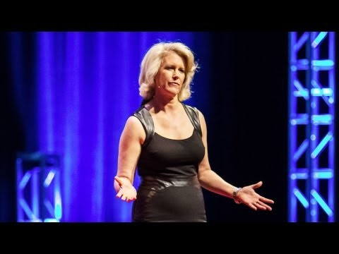
Watch this ted talk on Why Domestic Violence Victims Don’t leave?
https://youtu.be/V1yW5IsnSjo
Notes:
Steiner, Leslie. (2013, Jan. 25). Why domestic violence victims don’t leave? TED Talk. Retrieved from https://www.youtube.com/watch?time_continue=1&v=V1yW5IsnSjo

Slide 17
What were the early signs of abuse in leslie’s relationship?
Seduce and charm the victim
Isolation from friends and family
Partner “idolized her”
Put her on a pedestal.
Made her feel like she was the dominant partner in the relationship.
Saying, “I love you too quickly”

Slide 18
What were some risk factors of Leslie’s partner:
Partner was abused by stepfather
Introduced the threat of violence
Bought guns
Weapons in the house
Quit job to move to the country with Leslie

Slide 19
Victim blaming is common:
Examples:
“They are so stupid to stay with someone who abuses them.”
“Why don’t they just leave?”
Victim blaming further silences the victim and they are less likely to reach out for help!

Slide 20
Why do victims they stay?
Victims know it is very dangerous to leave the relationship
70% of violence happens after the relationship has ended
Once the relationship has ended there is a huge risk of violence, long-term stalking, threats and manipulation of the children’s court system.

Slide 21
How did Leslie leave her partner:
Made a safety plan
She broke the silence. Once the safety plan was in place she told everyone she was being abused. Her neighbors, co-workers, strangers, family and friends.

Slide 22
Abuse is about
Power & control
#BreaktheSilence on Abuse

Slide 23
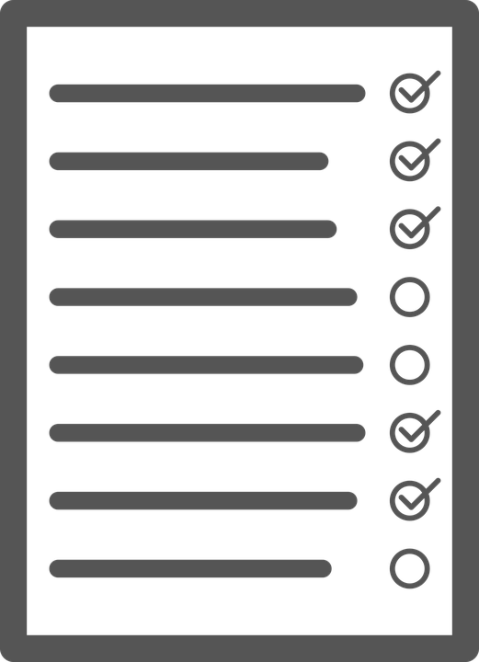
What is a safety plan?
A plan of action for the victim to help reduce the risk of being hurt by their abuser. Each plan is specific to the victim and their situation.
How to Help a Friend Stay Safe @:
School/Home
Online

Slide 24
Click here to view safety plan.
Notes:
https://www.canva.com/design/DAC7CwKcUFM/Hoe0QdK6WcEXHfMo_-9APA/view?utm_content=DAC7CwKcUFM&utm_campaign=designshare&utm_medium=link&utm_source=sharebutton

Slide 25
Tips for safety plan:
School/Home
Change your routine
Change your school schedule
Visit new places your abuser doesn’t go to
Only let those you trust know your schedule/routine

Slide 26
Tips for safety plan:
Online Safety:
Social media
Change passwords
Make accounts private or delete them
Block your abuser
Change your privacy settings
Avoid checking-in to places

Slide 27
REferences:
Ryan and Jade Teenage Relationship Abuse Advert [full version] (2013, March 4). Home Office Retrieved from https://youtu.be/zOLAelTPs6c.
Steiner, Leslie. (2013, Jan. 25). Why domestic violence victims don’t leave? TED Talk. Retrieved from https://www.youtube.com/watch?time_continue=1&v=V1yW5IsnSjo
The Line. (2008, October 19). Love is Respect. Retrieved June 18, 2018, from https://www.youtube.com/watch?time_continue=1&v=dNvt_zSiIkg
Types of Abuse - loveisrespect. (n.d.). Retrieved from http://www.loveisrespect.org/is-this-abuse/types-of-abuse/

Slide 28
REsources:
Relationship Spectrum Kahoot.it https://play.kahoot.it/#/k/c329469e-58c8-4e92-89a1-8738c74c15b6
http://www.loveisrespect.org/
http://www.loveisrespect.org/educators-toolkits/

