Slide 1
Teen Dating

Slide 2
Pair / Share:
Discuss with your partner:
"What does a healthy relationship look like???"
List some traits:

Slide 3
Foundations
of Healthy
Relationships
A good relationship is more than something we want—it’s something we need to be our happiest, healthiest, most productive selves.
But at home or work, supportive, fulfilling relationships don’t come automatically.
They take an investment in time and energy as well as social skills that can be learned.

Slide 4
What Makes a Healthy Relationship?
Mutual Respect- Each person values who the other person is and understands them. You will not challenge the other person’s boundaries.
Trust- A little jealousy is okay - jealousy is a natural emotion. It is how you react that is what matters. Trust is essential to a healthy relationship.
Honesty- Goes hand in hand with trust, if you are caught in a lie once, how can you expect to be trusted the next time?
Safety- You feel safe when with your significant other and you respect each other’s personal boundaries and beliefs.

Slide 5
What Makes a Healthy Relationship?
Fairness/Equality- Give and take relationship. Things need to be even, decisions and power need to be equal.
Good Communication- Do not keep things “bottled up” - express your feelings and concerns. Essential to a healthy relationship.
Support- Your significant other should be your shoulder to cry on and a person to celebrate with together.
Separate Identities- You need to make compromises, however not by sacrificing who you are. Feel free to develop new things while staying “within yourself”.

Slide 6
What affects our relationships (pillars)
Physical-are you attracted
Intellectual-beliefs
Emotional-what makes you laugh, cry, inspires you
Social - people person, more to yourself
Spiritual - how do you answer life’s big questions
Financial - number one disagreement for couples

Slide 7
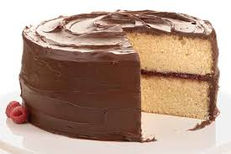
Cake Relationship Example
When baking a cake, do you follow a recipe, when do you ice the cake? Just like baking a cake there is a right way to build a relationship:
L1 = talking
L2 = dating
L3 = values and boundaries (understanding each other's)
L4 = trust (should take time)
L5 = commitment
L6 = The sex should be the icing, some cake may not be ready for or need icing.
Consequences of Sex; pregnancy, STD, get emotionally attached when physically intimate, chemical oxytocin release.

Slide 8
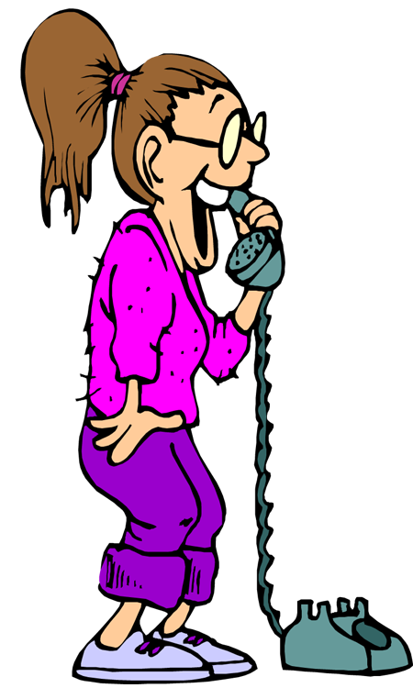
My Top 10

Slide 9
Healthy Relationships:
What are the 10 most important qualities for you to have in a future spouse? Make a list of your top 10 qualities (physical traits and personality traits)
Keep your expectations in mind as you date and look for your future spouse + don’t compromise!!
6
7
8
9
10

Slide 10
Building Healthy Relationships & Communication

Slide 11
Communication
COMMUNICATION: a process through which you send messages to and receive messages from others
Effective communication is a 2 way street
There are 3 basic skills necessary for effective communication
1. Speaking
2. Listening
3. Body Language

Slide 12
The 4 C’s to Building Healthy Relationships
For a relationship to succeed and be healthy, the people involved need certain skills.
4 C’s
1. Communication
2. Cooperation
3. Compromise
4. Character

Slide 13
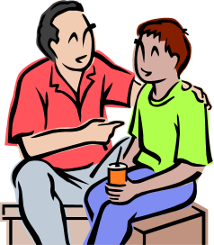
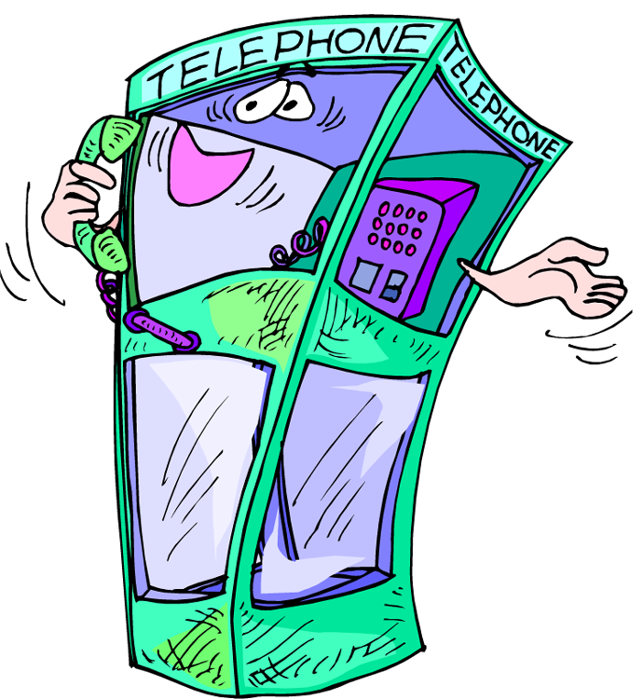
1. Communication
The way you send and receive messages from others
What are some ways we communicate?

Slide 14
Passive
Holding back your feelings and yielding to others

Slide 15
Aggressive
Communicating your ideas and feelings in a forceful or threatening way

Slide 16
Assertive
Able to stand up for yourself and express your feelings in a non-threatening way

Slide 17
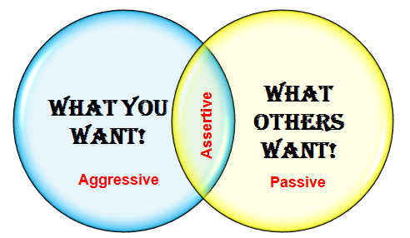

Slide 18
2. Cooperation
Working with others to accomplish a goal.
Relationship=Common goal=Cooperation

Slide 19
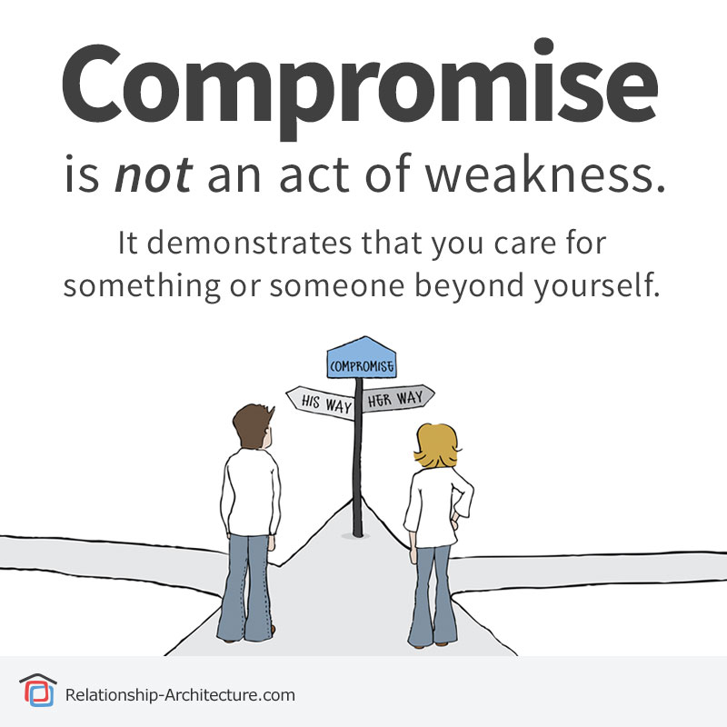
3. Compromise
Giving up something so that all can reach a satisfying solution
WIN-WIN SITUATION
Involves a “give and take” which can strengthen relationships
All must be satisfied with the solution
This does not include giving up your values or beliefs to compromise on a situation

Slide 20
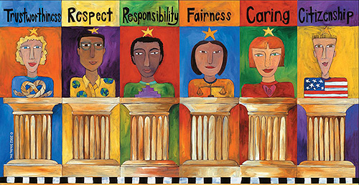
4. Character
There are 6 major character traits that are needed for relationships to be healthy
Trustworthiness – honesty, loyalty, courage to do what is right
Respect – good manners, consideration, tolerant
Responsibility – accountable for actions, self control, trying your best
Fairness – take turns, plays by rules, do not take advantage
Caring – demonstrates kindness, shows compassion
Citizenship – cooperation. Doing your share to help others, respect authority, obey laws, vote (learn about issues)

Slide 21
Dating Relationships
Important to remember that the teen years are a time of trying different relationships and roles
Breaking up, making up, and breaking up again can be painful, but it is part of a process of becoming emotionally mature
Honest and open communication are essential

Slide 22
Dating Relationships
Dating is a way that teenagers get to know people to whom they are attracted.
Dating gives you a chance to become more comfortable with others.
Dating provides the opportunity to practice GOOD decision making and communication skills.

Slide 23
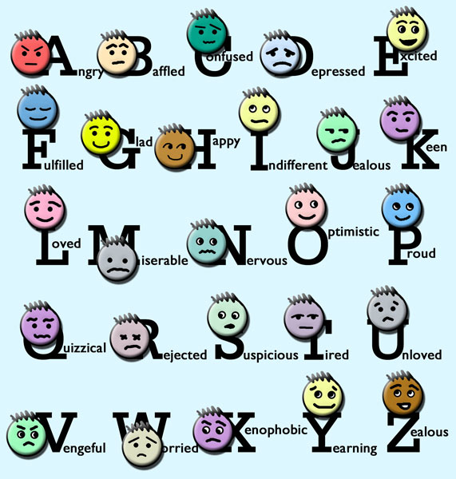
YOUR ASSIGNMENT:
H
E
A
L
T
H
Y
Write the words “Healthy Relationship” down the left side of your paper in a creative font on a computer, or in nice lettering by hand.
2. Read the given worksheet on “healthy relationships,” then…

Slide 24
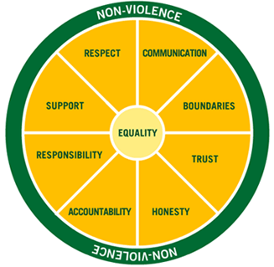
R
E
L
A
T
I
O
N
S
H
I
P
3. Use each letter as the start of a word or phrase that describes one component of a healthy relationship.

Slide 25
Respects your opinion
E
L
A
T
I
O
Never resorts to violence
S
H
I
P
Example:

Slide 26
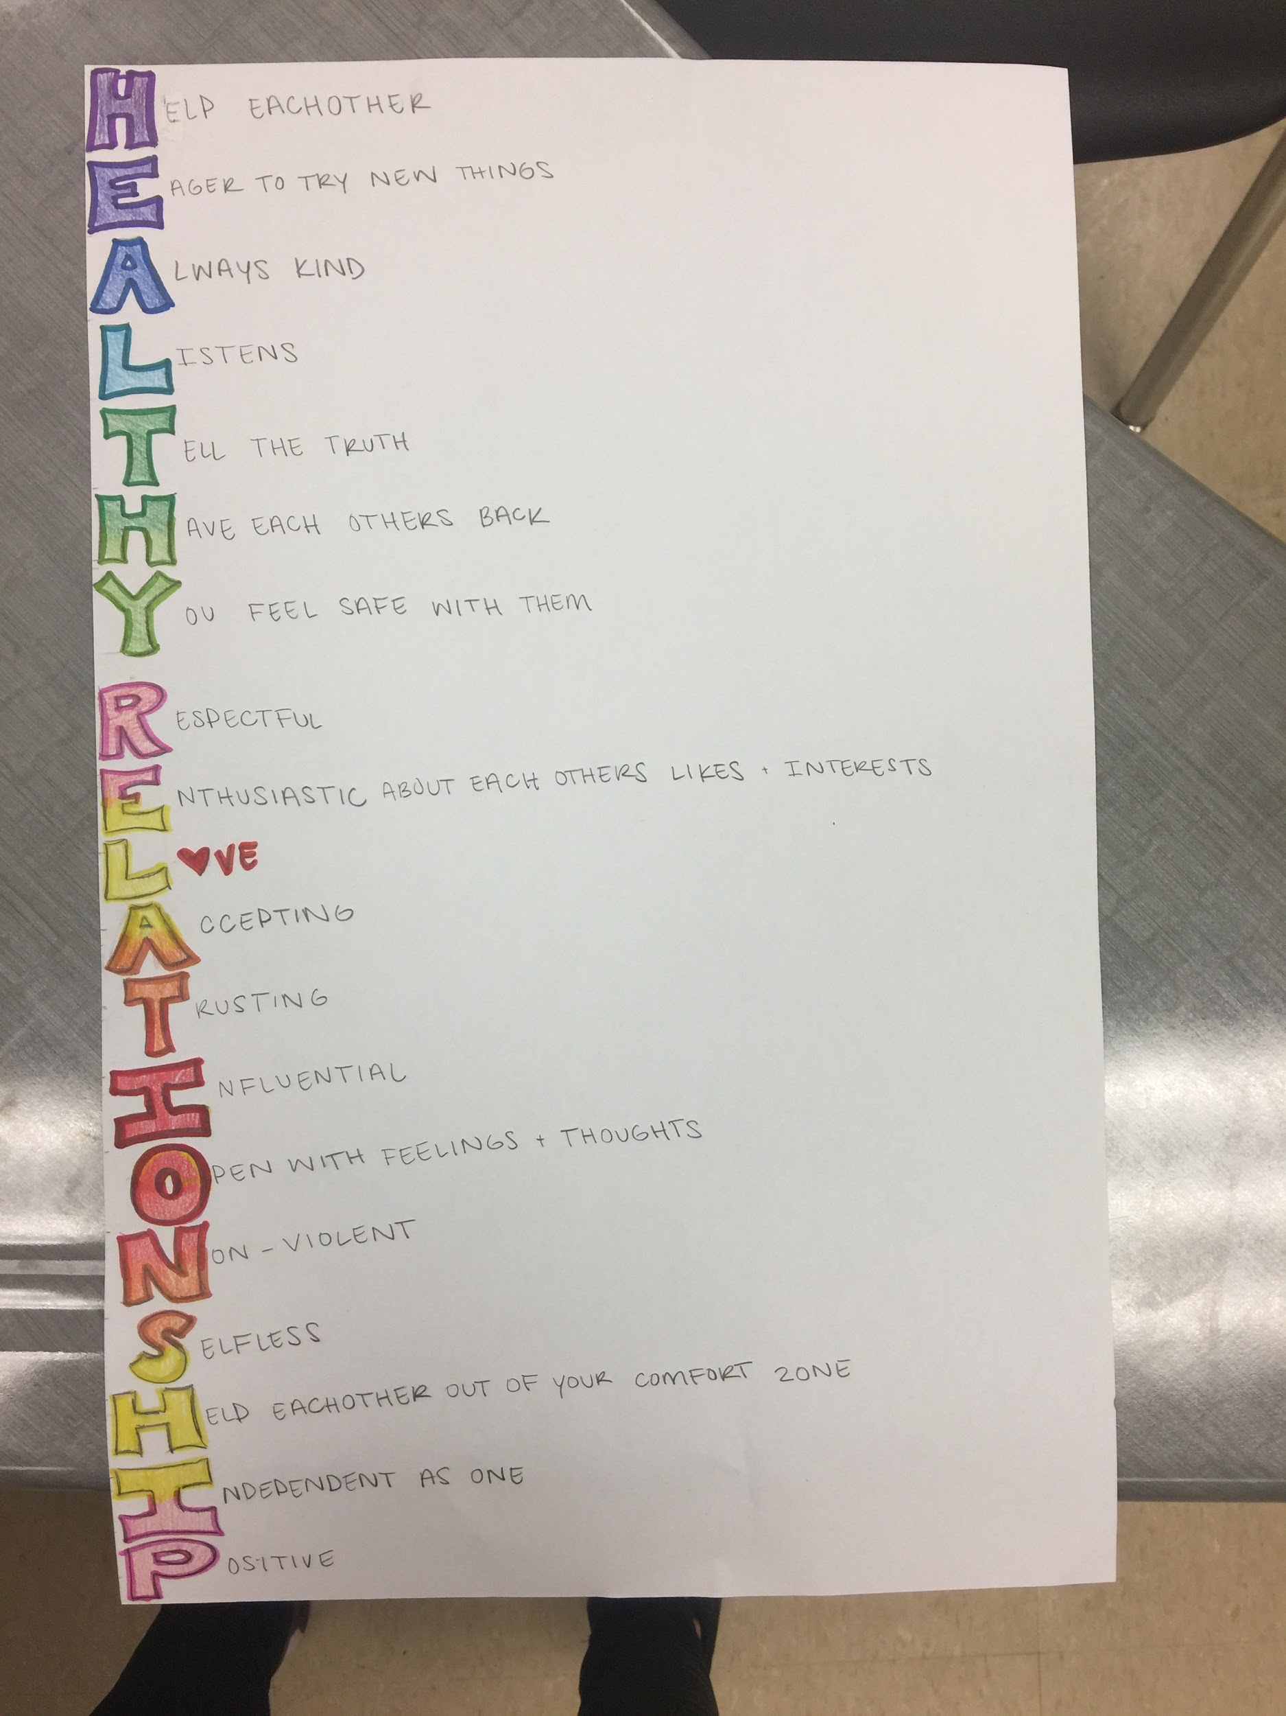
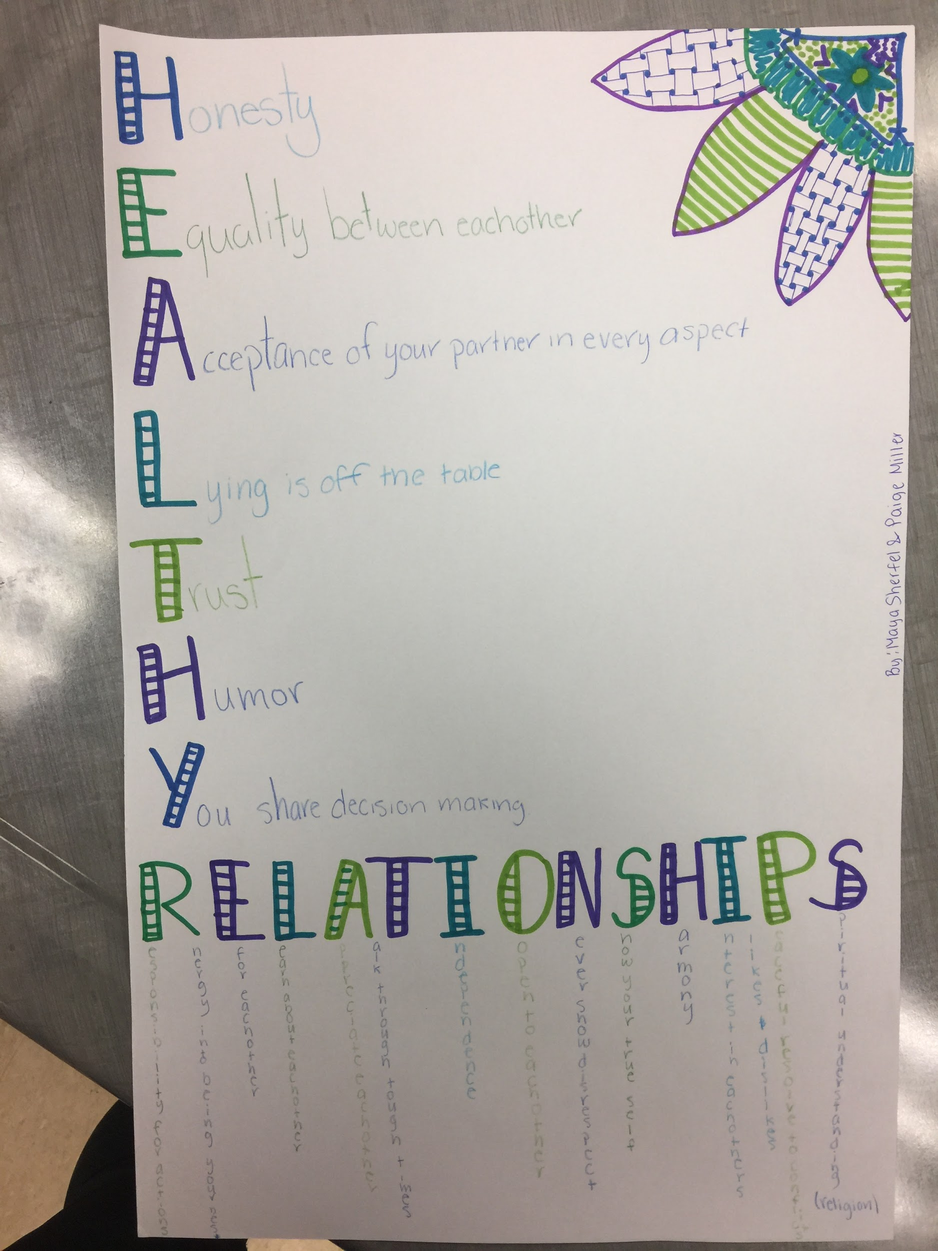
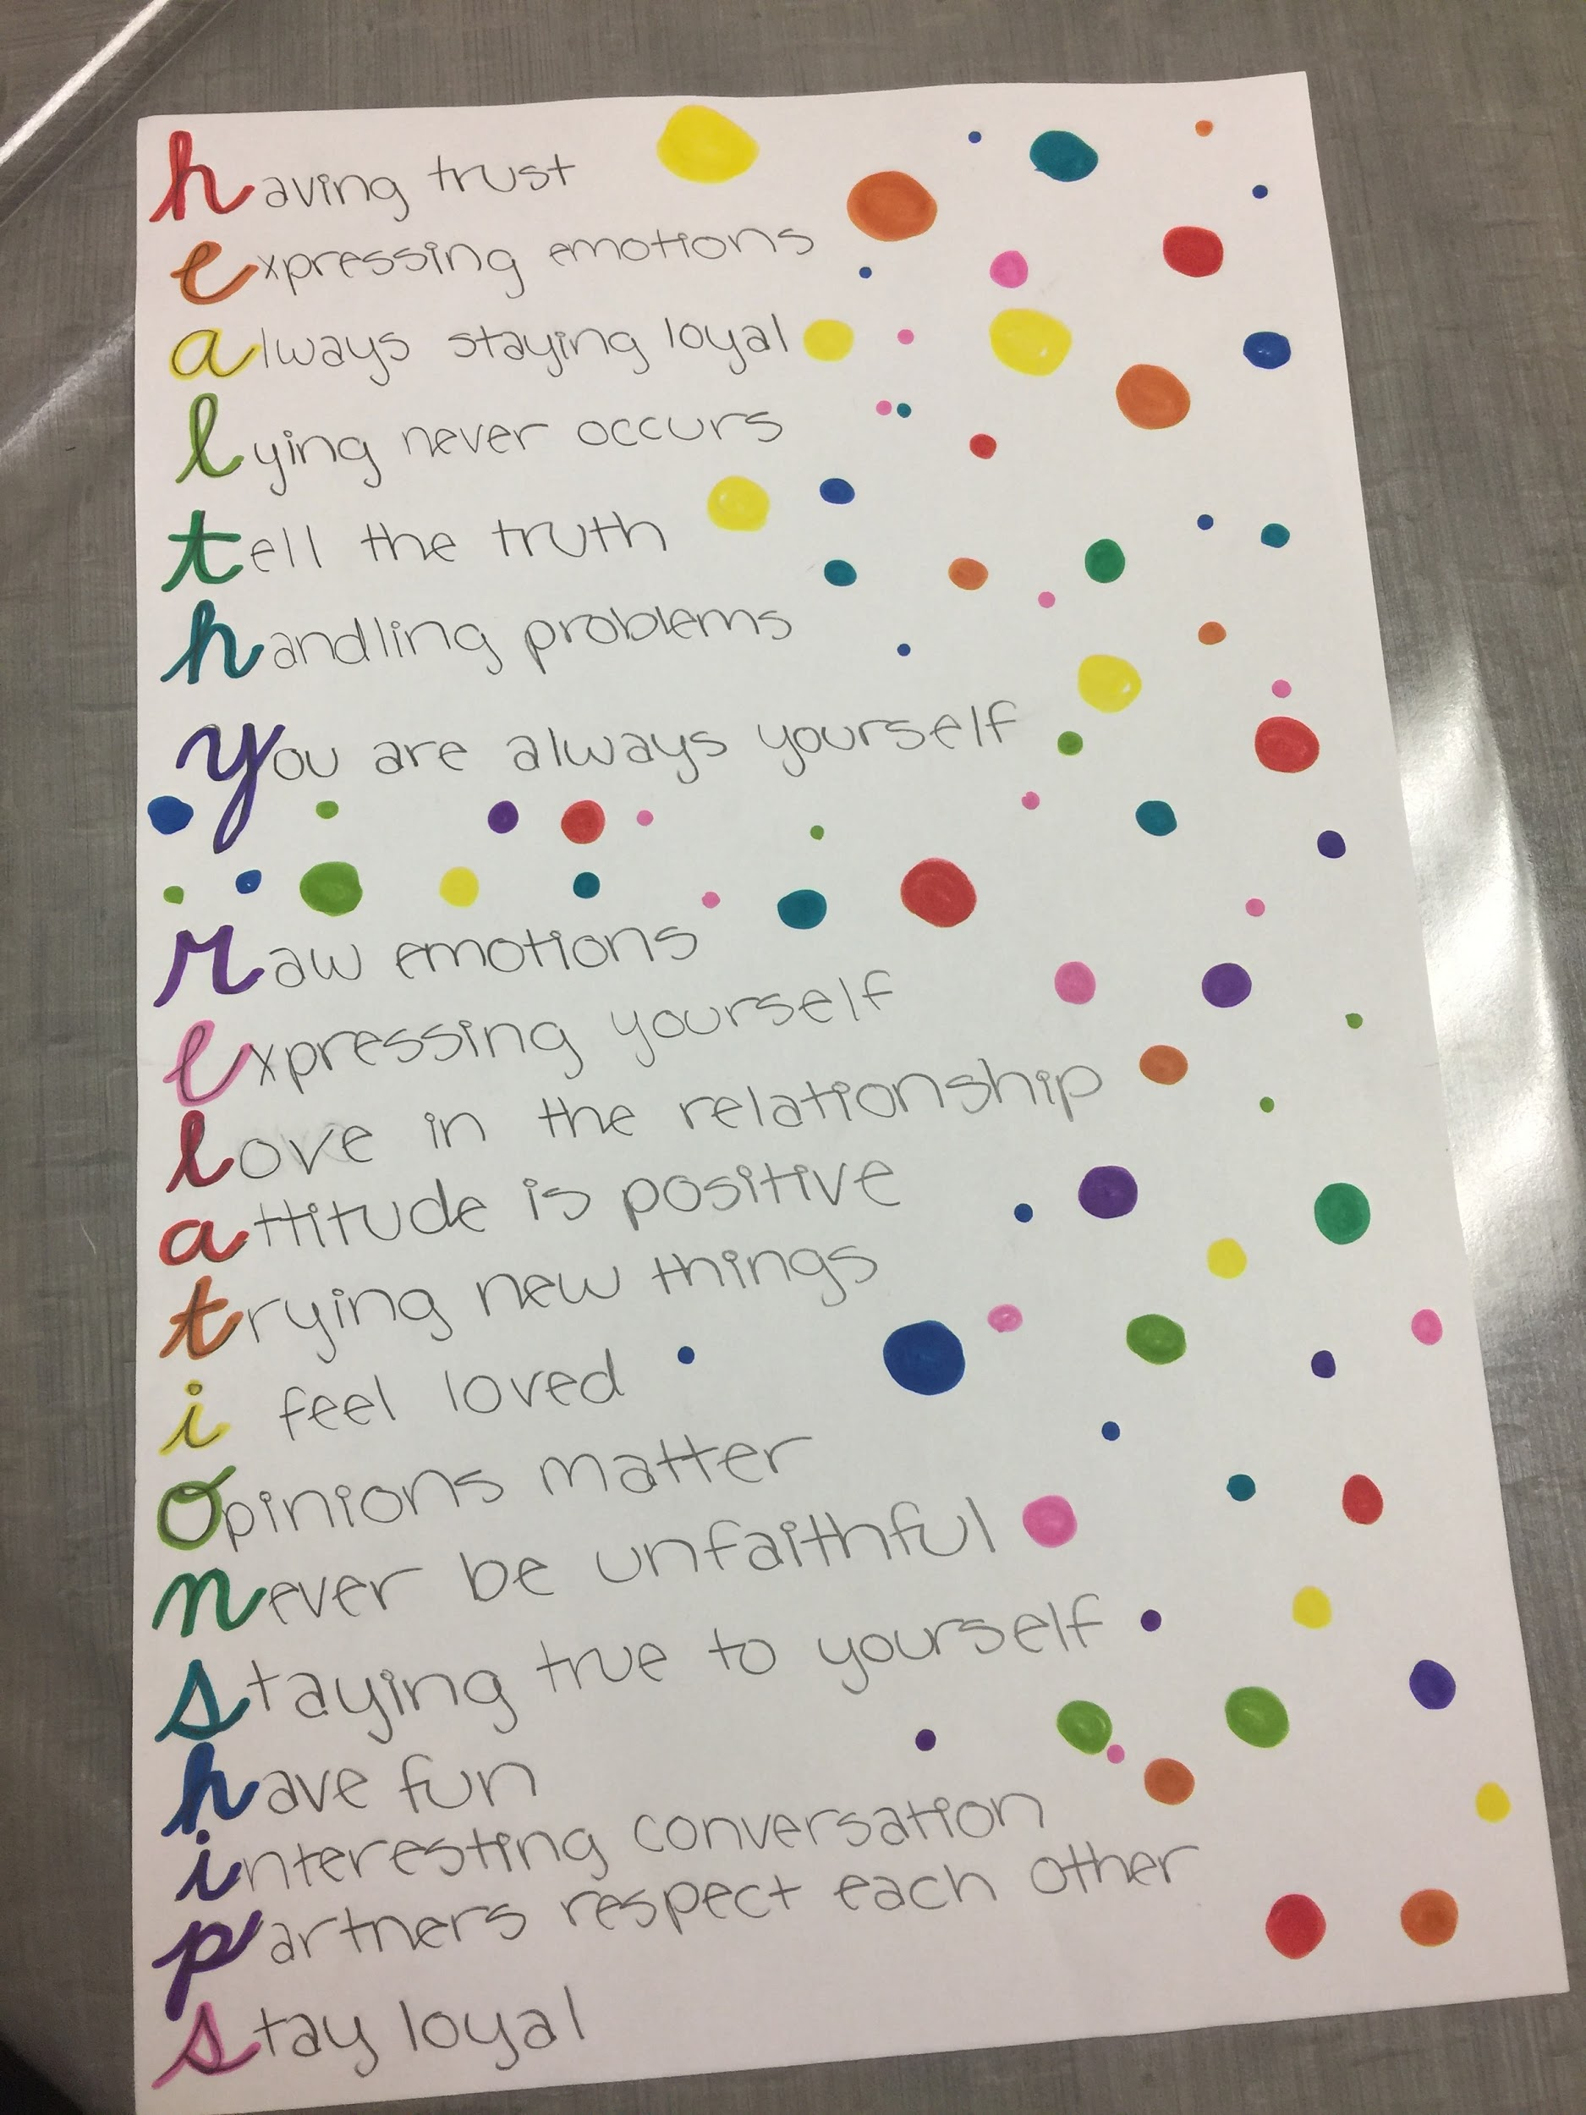
HEALTHY RELATIONSHIPS POSTERS:

