Slide 1
What makes a healthy relationship?

Slide 2
1.
Do now activity:
What characteristics make up a healthy relationship?
Notes:
As students walk into the classroom have them pair up with a partner and discuss, “What characteristics make up a healthy relationship”?
Students can write down their answers and share with each other. On the main whiteboard students can come up and write at least one healthy characteristic they want in a healthy relationship.

Slide 3
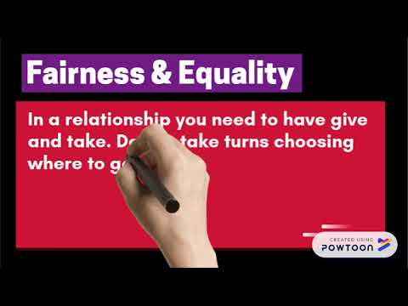
What makes a Healthy Relationship?
Place your screenshot here
Notes:
Show 2 minute video on,
What makes a healthy relationship?
Kimberly Ohara Published June 16, 2018
https://www.youtube.com/watch?v=kwzzfN2gKtY

Slide 4
Open communication
2. Mutual respect
3. Healthy boundaries
All Relationships are different but have these 3 things in common:

Slide 5

Boundaries
Help define what we are comfortable with and how you would like to be treated by others.

Slide 6




Different types of boundaries:
Emotional:
The “L” word:
Saying, “I love you,” happens at different times in a relationship. Just because your partner says it doesn’t mean you have to say it.
Time Apart:
It’s good to spend time with family, friends and have time along. It is good to have separate identities.
Physical:
Take your time:
Don’t rush to be physical if you are not ready. Both partners communicate how far each other wants to go.
Sex isn’t currency:
You don’t owe your partner anything. Even if they take you to an expensive dinner & concert.
Digital:
When it comes to a digital relationship. Where do you draw the boundaries?
Passwords are private:
Even if your partner has trust.
Photos and sexting:
One you hit send you lose control of who sees the photos.
Notes:
Setting Boundaries. (n.d.). Retrieved from http://www.loveisrespect.org/healthy-relationships/setting-boundaries/

Slide 7

Notes:
After watching the 40 second video. Students will identify all the unhealthy warning signs of this relationship. Warning Signs: Who is Nicole? Partner is checking up on her and reading text messages. Tells her he doesn’t want her hangout with Nicole. Partner says “Why do you have to be like that?” Partner gets angry raises voice and says, be like what?” Partner is suspicious of partner sneaking behind their back. Partner says, “If I find out your are lying to me you will see what happens.” This is a threat.
Ryan & Jade Teenage Relationship Abuse Advert (full version)
Home Office Published on March 4 2013
https://youtu.be/zOLAelTPs6c

Slide 8
Digital boundaries (think about these)?
Is it okay to tag or check in?
Do we post our relationship status?
Is it okay to friend or follow my friends?
When is it okay to text me and what is the expectation for when we return it?
Is it okay to use each other’s devices?
Is it okay to post, tweet or comment about our relationship?
Notes:
Setting Boundaries. (n.d.). Retrieved from http://www.loveisrespect.org/healthy-relationships/setting-boundaries/

Slide 9

Can boundaries change?
Yes, as you become more comfortable in a relationship or gain more life experience your boundaries might change. Make sure you communicate with your partner.
Notes:
Setting Boundaries. (n.d.). Retrieved from http://www.loveisrespect.org/healthy-relationships/setting-boundaries/

Slide 10
Consent is...
Permission. Talking openly with your partner(s) on what you agree on. It doesn’t always have to be physical or sexual.
Examples:
Can I help you?
Can I call you?
Can I post this picture on Snapchat of you?
Can I hold your hand?
Do you mind if I kiss you?
“To have consent means you have an enthusiastic “yes”.

Slide 11

Notes:
What is consent?
CampusClarity
Published on Mar 5, 2014
https://youtu.be/kJOKRYbgDh8

Slide 12
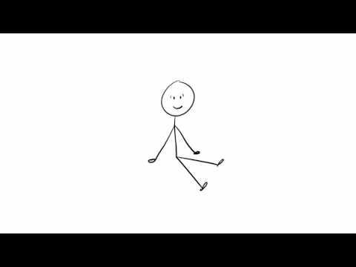
Notes:
Tea Consent (Clean)
Juno Beach Squadron Published on Nov 2, 2015
https://youtu.be/eS5wYFtfaeU

Slide 13
Video References:
Ryan & Jade Teenage Relationship Abuse Advert (full version)
Home Office Published on March 4 2013
YouTube. https://youtu.be/zOLAelTPs6c
Tea Consent (Clean)
Juno Beach Squadron Published on Nov 2, 2015
https://youtu.be/eS5wYFtfaeU
What is Consent?
CampusClarity
Published on Mar 5, 2014
https://youtu.be/kJOKRYbgDh8
What Makes a Healthy Relationship?
Kimberly Ohara Published on June 18, 2018
https://www.youtube.com/watch?v=kwzzfN2gKtY

Slide 14
References:
Setting Boundaries. (n.d.). Retrieved from http://www.loveisrespect.org/healthy-relationships/setting-boundaries/

