Slide 1
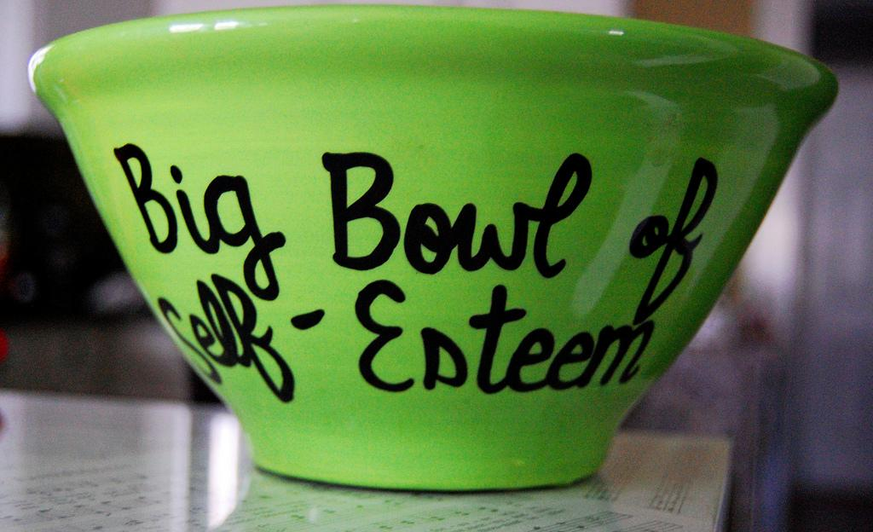
Building One’s
Self-Esteem and Self-Image
Notes:
‹#›

Slide 2
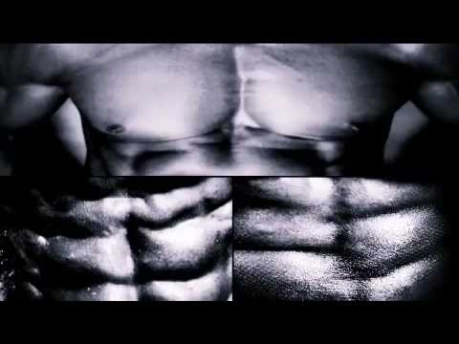
Notes:
Show this video clip from Teen Truth - Body Image to hook the class into the topic of the day. - https://www.youtube.com/watch?v=PpFBKeuKf7M

Slide 3
What does the term
“body image” mean to you?

Slide 4
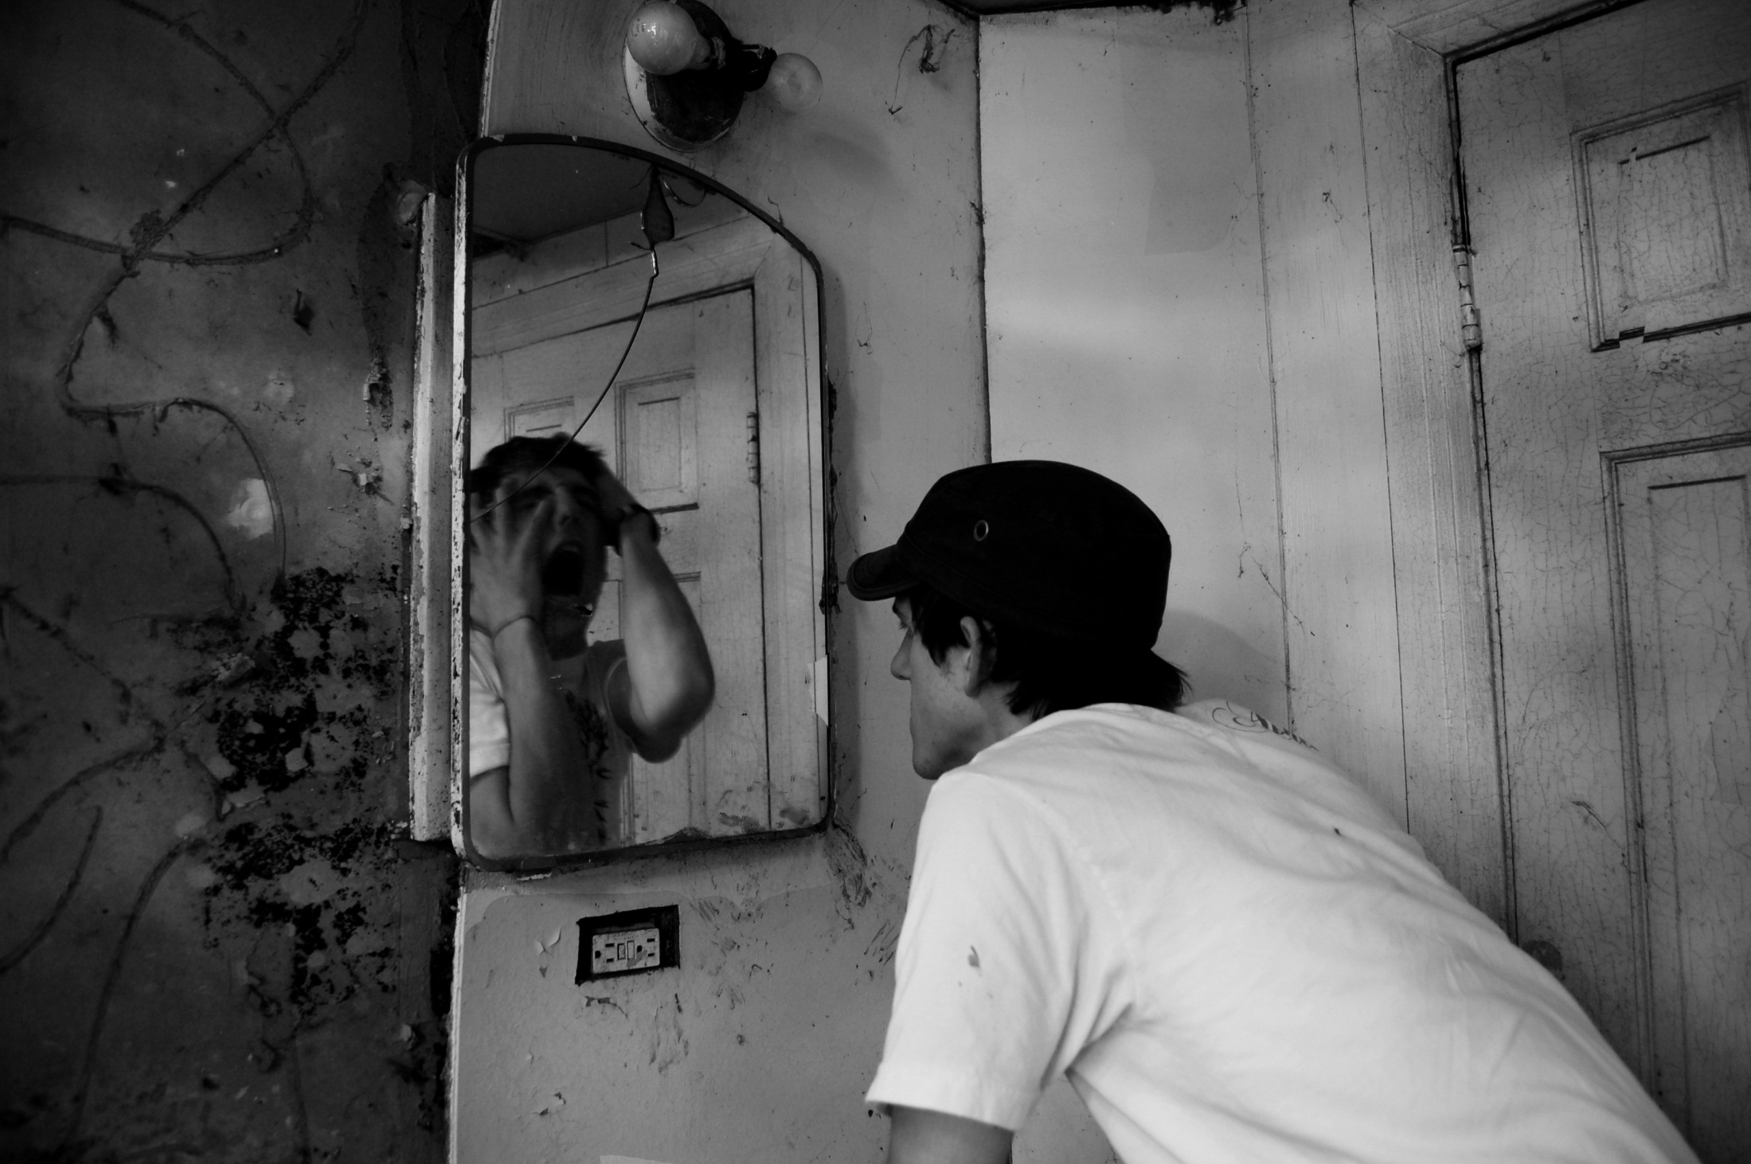
“Ever-changing, descriptive and evaluative beliefs about one’s appearance”
“learned through one’s environment”
Notes:
here are some possible definitions of body image

Slide 5
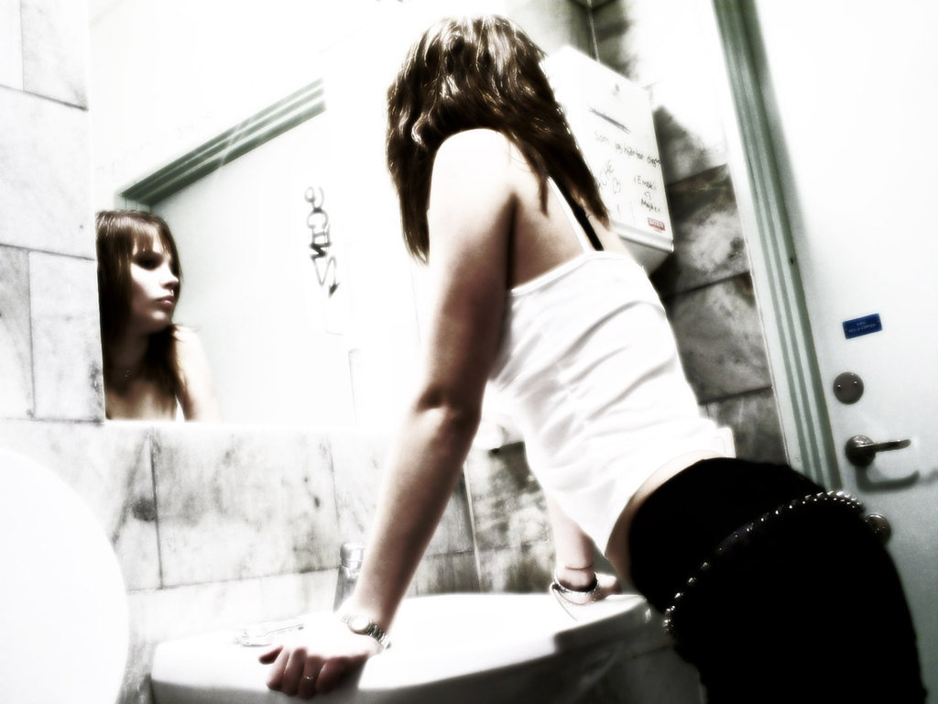
“A picture of the body seen through the mind’s eye.”
Notes:
here are some possible definitions of body image

Slide 6
On a scale of 1-10, 10 being very positive…
Where do you stand when it comes to your own body image?
Notes:
this is meant to be a rhetorical question

Slide 7
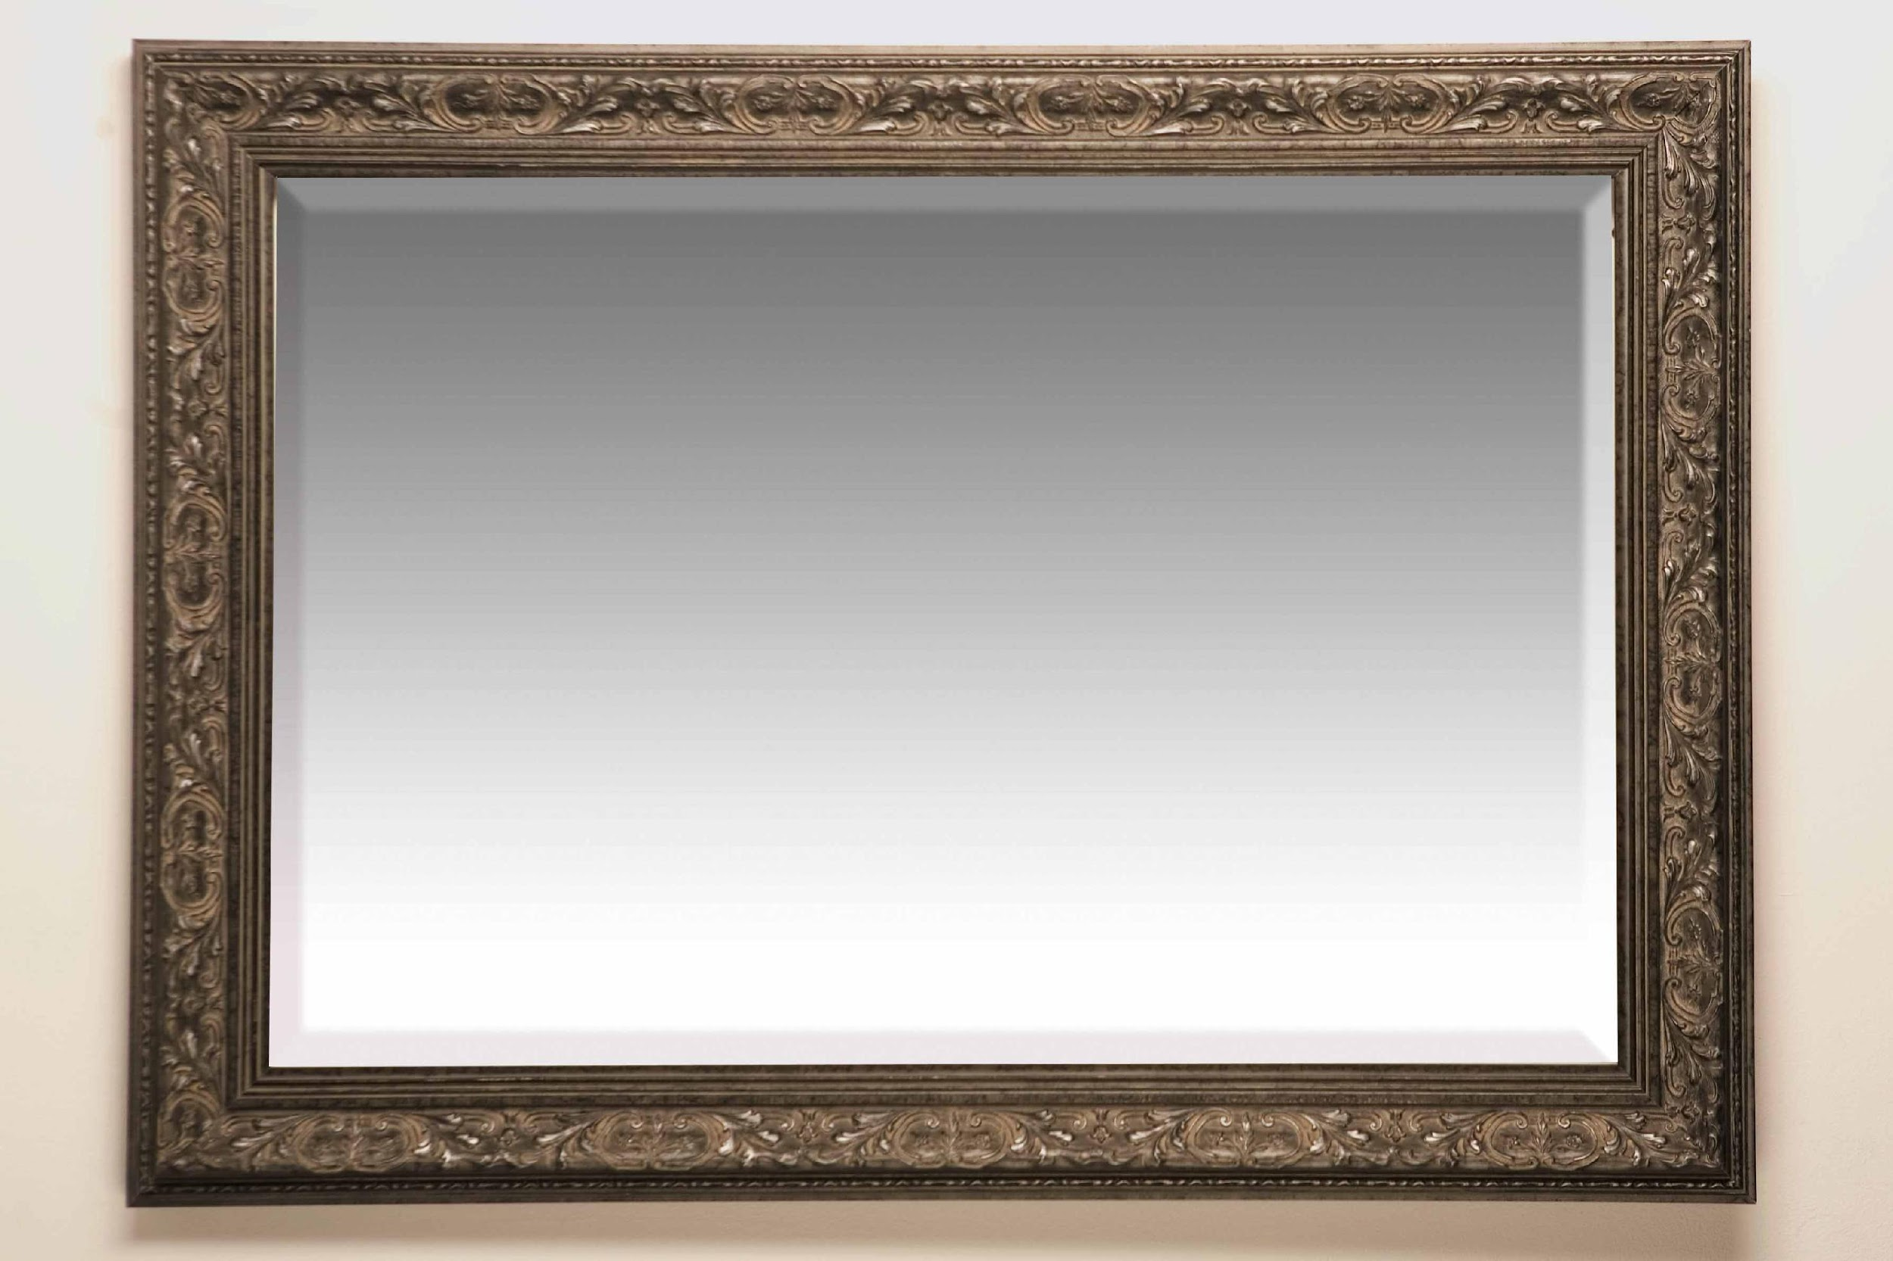
The Body Image Spectrum
Negative
Positive
Most of Us
Notes:
most of us fall somewhere in the middle but it is a continuum that is always shifting.

Slide 8
Body Image Walk & Talk
You and a partner will go on a 5 minute walk discussing the following questions/statements. Make sure you stay on topic with your conversations. There is plenty to talk about!

Slide 9
AGREE or DISAGREE - Boys and girls are equally affected when it comes to body image.
AGREE or DISAGREE - Students at our school care about their image. If so, what do they care about? Is there a difference for boys and girls?
AGREE or DISAGREE - When posting pictures on social media I try to make myself “look good”.
AGREE or DISAGREE - Selfies and other flattering photos of myself boost my self-confidence.
AGREE or DISAGREE - Getting “likes” or positive comments on social media boosts my self-confidence.
What factors or influences impact you when it comes to body image and self-concept?
What are three things someone can do to improve their self-esteem and create a more positive body image?
Notes:
It is a good idea to print this slide and hand to each group to help frame the conversation as they walk and talk.

Slide 10
What does the term
“self-image” mean to you?

Slide 11
Self-image is a mental picture of yourself
It includes:
how you look (body image)
your skills and abilities
and your weaknesses
This is something that forms over time and is influenced by your life experiences and interactions with others.

Slide 12
What does the term
“self-esteem” mean to you?

Slide 13
Self-esteem describes how you feel about yourself.
It is related to self-image.

Slide 14
Why is self-esteem important? Why does it matter?

Slide 15
Yourself-esteem has a major impact on many aspects of your life. It affects how well you…
do in school
make friends
manage disappointments
cope with stress

Slide 16
People with high self-esteem...
better cope with mistakes and disappointments
view negative events and failures as learning experiences
are more comfortable asking other people for help
have better decision-making skills
feel good about themselves
trust their own judgement
follow their own values
when pressured to go along with the crowd, have more courage to make the right decision

Slide 17
People with low self-esteem...
The good news is...Building self-esteem is not easy, but it can happen as people learn to work through issues and accept who they are.
often worry about what other people think of them
are more vulnerable to peer pressure
feel unable to resist pressure to engage in unhealthy behaviors

Slide 18
What are some
factors that affect self-esteem ?

Slide 19
Contributing Factors to Self-Image & Self-Esteem
Life Events
(Physical Experiences)
Environments
(Home, school, community, culture)
Personal Perceptions
(Imagination)
Body Image
Media
(TV, movies, social media, etc.)
Self-Image & Self-Esteem
Social Interactions
(family, friends, others, etc.)

Slide 20
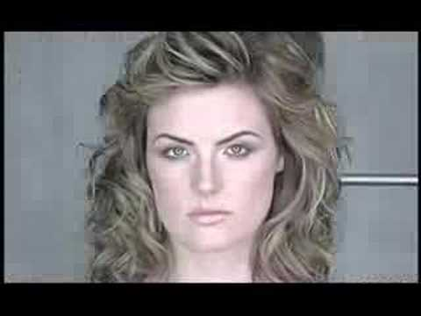
The media can have a significant impact on our own self-image and self-esteem
Notes:
Video - https://www.youtube.com/watch?v=iYhCn0jf46U

Slide 21
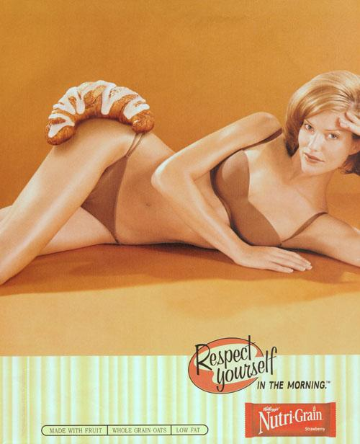
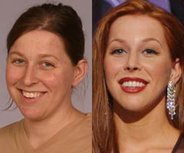
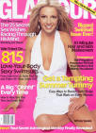

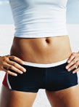



Sources of “Ideal” for women
Notes:
‹#›
Body image involves our perception, imagination, emotions, and physical sensations of and about our bodies.
This slide illustrates some of the many factors that contribute to your body image:
As you look at the factors you may notice that many of them are not static, in fact, they are ever-changing. In response, your body image can or will change along with them.
Mood – certainly your mood plays a major role in how you view yourself, when you are feeling down, you are less likely to look in the mirror and say “I really like and accept what I see!” Similarly, how you feel about your height, shape, and weight influences how you view yourself.
Imagination- How you picture yourself in your mind affects your body image – for example, often times people who used to be overweight, especially as children, still imagine themselves in that way even after they have lost weight.
Physical Experiences – how you sense and control your body as you move. How you feel in your body.
Environment –This includes the feedback that you get from others around you and the information you pick-up about what the ideals and expectations are.
Self-Esteem – Your self-esteem has a tremendous impact on your body image.

Slide 22
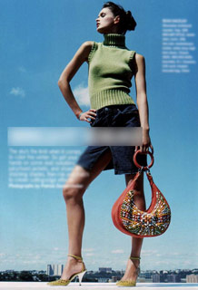
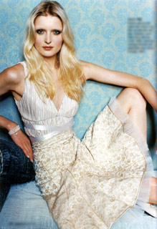
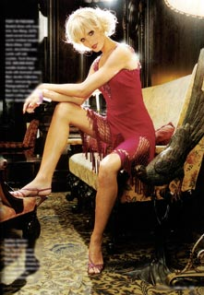
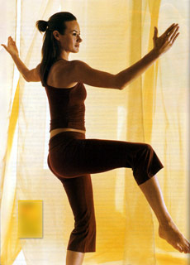
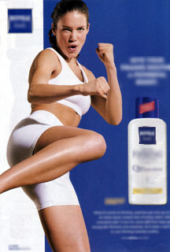
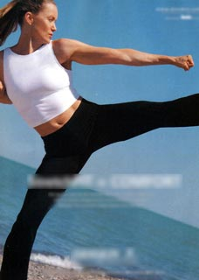
Notes:
‹#›
In response, many people are dissatisfied with their bodies because they don’t live up to the ideal. We generally think of this as an issue as people enter late adolescence or early adulthood, however, younger children already show evidence of body dissatisfaction.
In a national survey of 10-17 year olds – 7 out of 10 girls said they wanted to look like a television character. Almost a third of the girls said that they had changed something about their appearance to be more like the TV character. 16% of the girls said that they had dieted or exercised to look like a character.
According to a recent survey, over ½ the females between the ages of 18-25 would prefer to be run over by a truck than be fat, 2/3 surveyed would rather be mean or stupid.

Slide 23
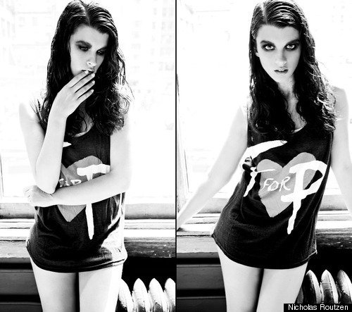
Digital Editing Tricks

Slide 24
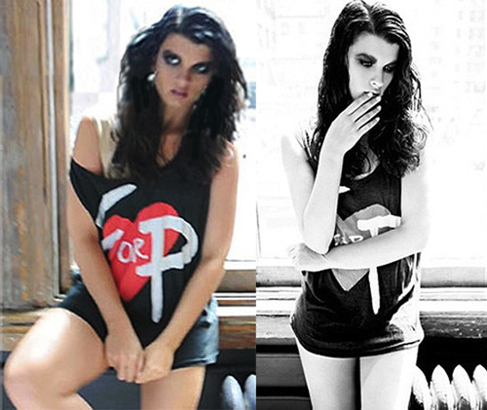
Digital Editing Tricks
What you see is probably not real

Slide 25








Men are Affected Too!
Notes:
‹#›
We are confronted by the images of “Ideal” bodies in social media,magazines, TV, movies, and billboards, etc.

Slide 26
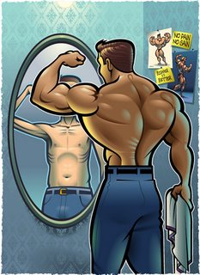
A New Boys Club
“Bigorexia”
Notes:
You can view more info here - https://www.cosmosclinic.com.au/blog/bigorexia-growing-issue-among-men-experts-concerned/

Slide 27
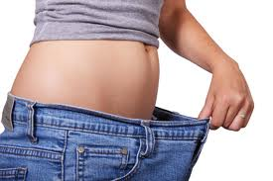
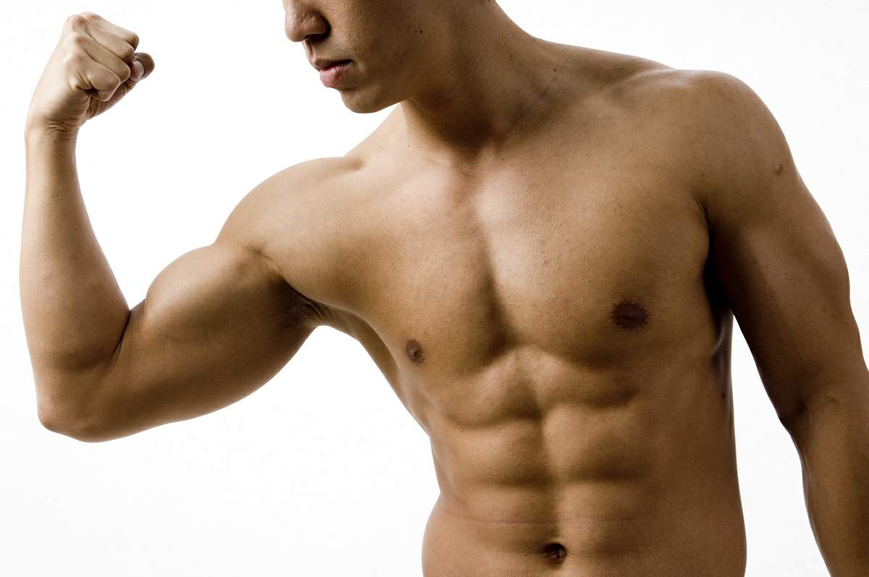

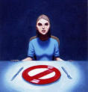

"We are bombarded with weight-loss ads every single day, multiple times a day because it's a multi-billion dollar industry that preys on the fear of being fat.”
DISSATISFACTION
BODY

Slide 28
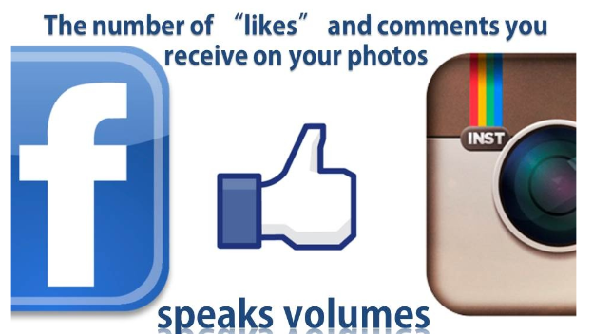

Slide 29
Research shows there is a strong relationship between social media and self-esteem. Increase in social media usage causes the self-esteem of individuals to decrease.
One study showed that one hour spent on social media daily results in a 5.5% decrease in the self-esteem score of an individual.
Notes:
Source: European Scientific Journal - https://eujournal.org/index.php/esj/article/viewFile/9815/9318

Slide 30
Upward social comparison occurs when comparing oneself to superior others who have positive characteristics.
As people use social media sites in their everyday life, they risk overexposure to upward social comparison information that can have a cumulative negative effect on their well-being.
Notes:
Source: Forest, A. L., & Wood, J. V. (2012). When social networking is not working: Individuals with low self-esteem recognize but do not reap the benefits of self-disclosure on Facebook. Psychological Science, 23, 295–302.

Slide 31
Downward social comparison means comparing oneself with inferior others with negative characteristics.
When people with low self-esteem use social media sites to express themselves in what seems like a safe environment, they could get into a vicious cycle of receiving some social support but also being exposed to constant upward social comparison, which may impair their self-esteem further.
Notes:
Source: Forest, A. L., & Wood, J. V. (2012). When social networking is not working: Individuals with low self-esteem recognize but do not reap the benefits of self-disclosure on Facebook. Psychological Science, 23, 295–302.

Slide 32
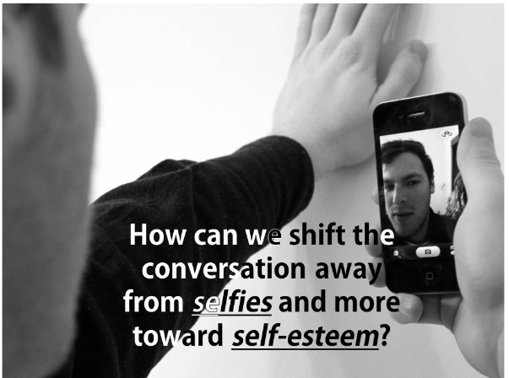

Slide 33
Ten Steps to Positive Self-Image
Appreciate all that your body can do.
Keep a top-10 list of things you like about yourself.
Remind yourself that a “true beauty” is not simply skin-deep. Beauty is a state of mind, not a state of you.
Look at yourself as a whole person.
Surround yourself with positive people.
Notes:
‹#›

Slide 34
6. Squelch the voices in your head that tell you that your body is not “right” or that you are a bad person.
7. Wear clothes that are comfortable and that make you feel good about your body.
Become a critical viewer of social and media messages.
Do something nice for yourself.
Use the time and energy that you might have spent worrying about food, calories, or your weight to do something to help others.
Notes:
‹#›

Slide 35
Now it’s your turn to continue your journey towards a positive self image by completing one of the following assignments. Pick one!
Analyzing Influences Web
Body Biography
Thinking Outside the (Crop) Box
I am Awesome

