Slide 1
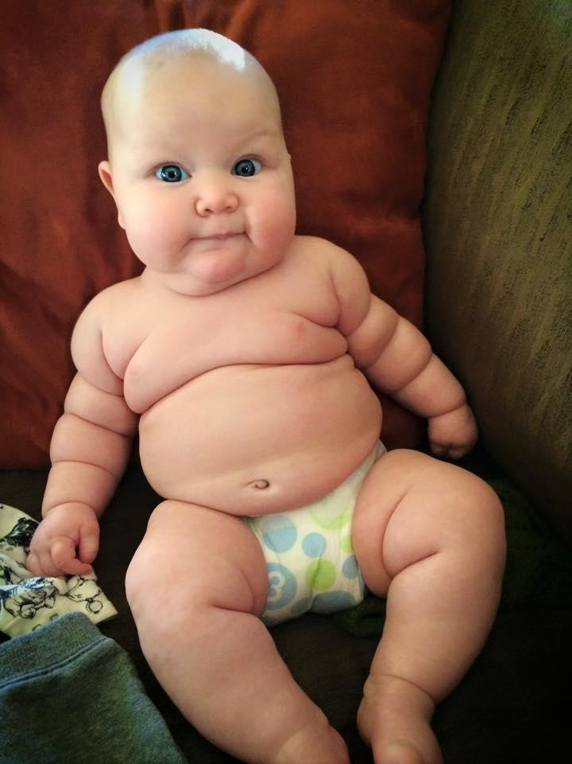
Body Image
Be HONEST, does this diaper make me look fat?

Slide 2


Society's Standard of Beauty

Slide 3
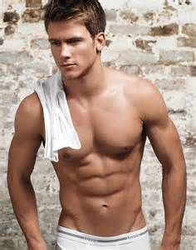
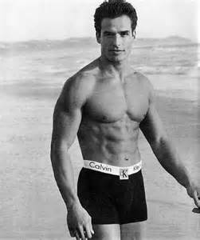
Society's Standard of Beauty

Slide 4
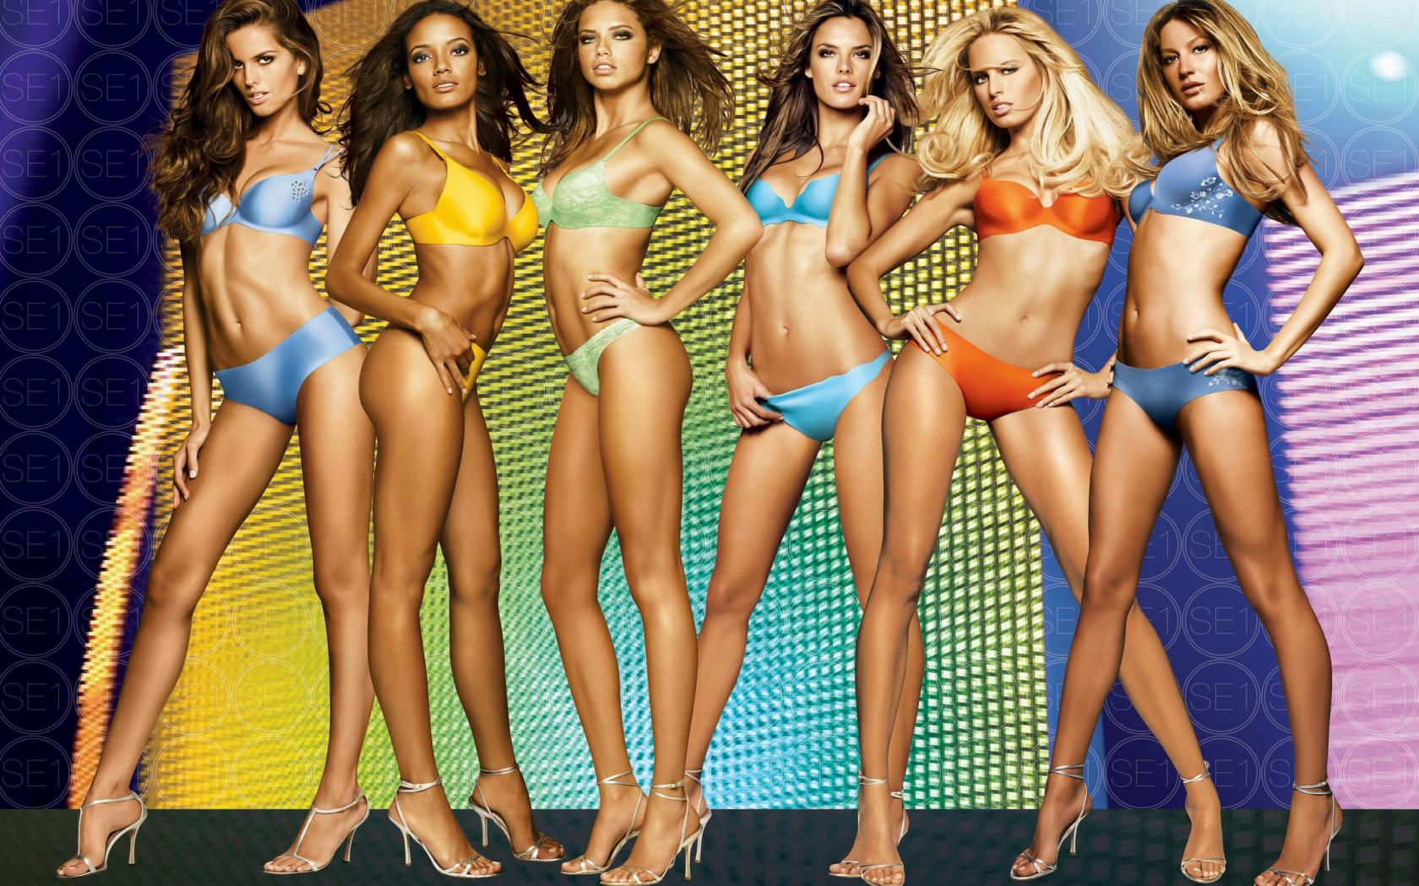
Society's Standard of Beauty

Slide 5
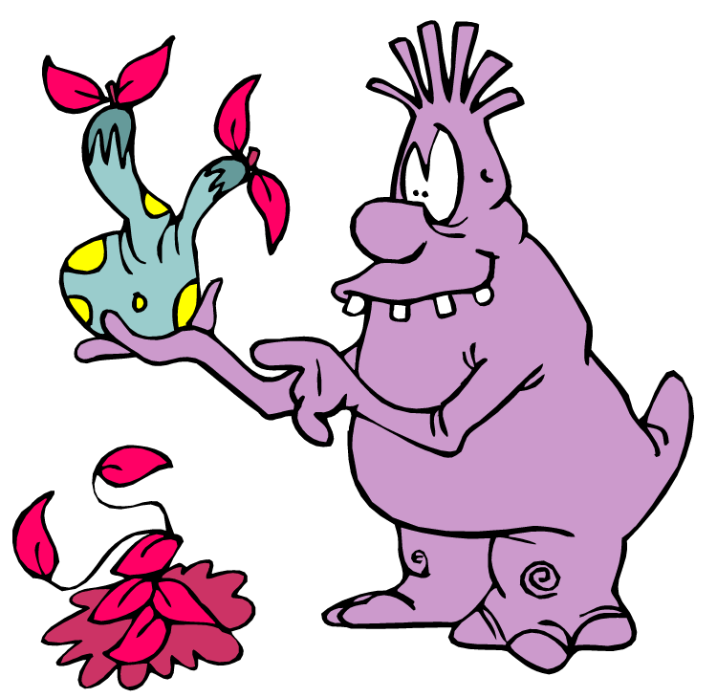
Namuhs

Slide 6
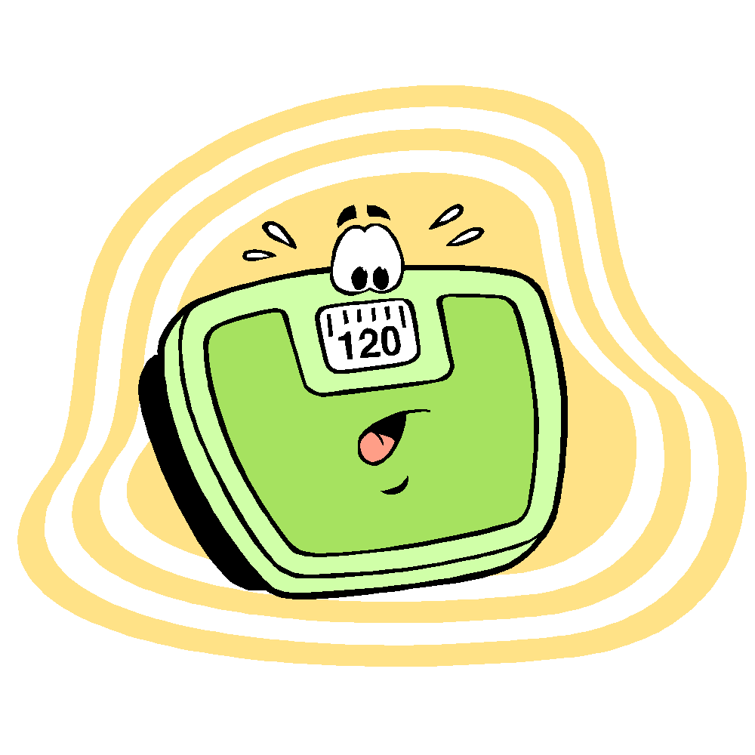
Scale Creed
Through my life, it took its toll
this scale you see, took too much control
it told me often how my day would go
can I eat! this told me no!
if I did have the urge
then to the bathroom, I would purge
there he stood looking so grim
as he told me I want to be trim
then one day, I came to see
without him, I could be free
so on this day, I’m giving him up
no longer is he allowed in my life to corrupt
I challenge you all to look down within
as like me, you too can win
NO LONGER WILL I LET THIS DETERMINE MY WORTH

Slide 7
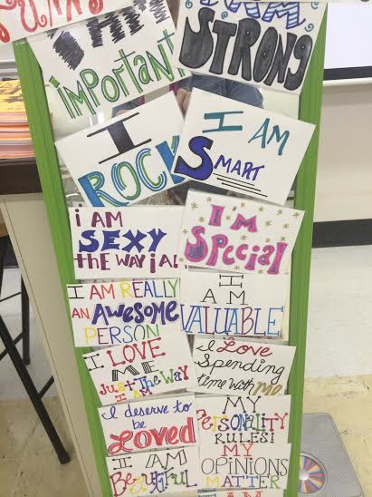
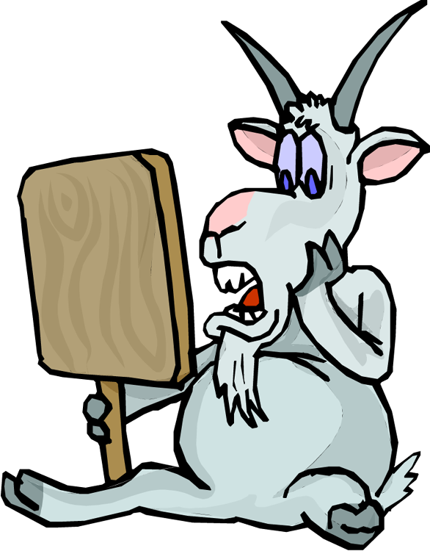
Mirror Mirror

Slide 8
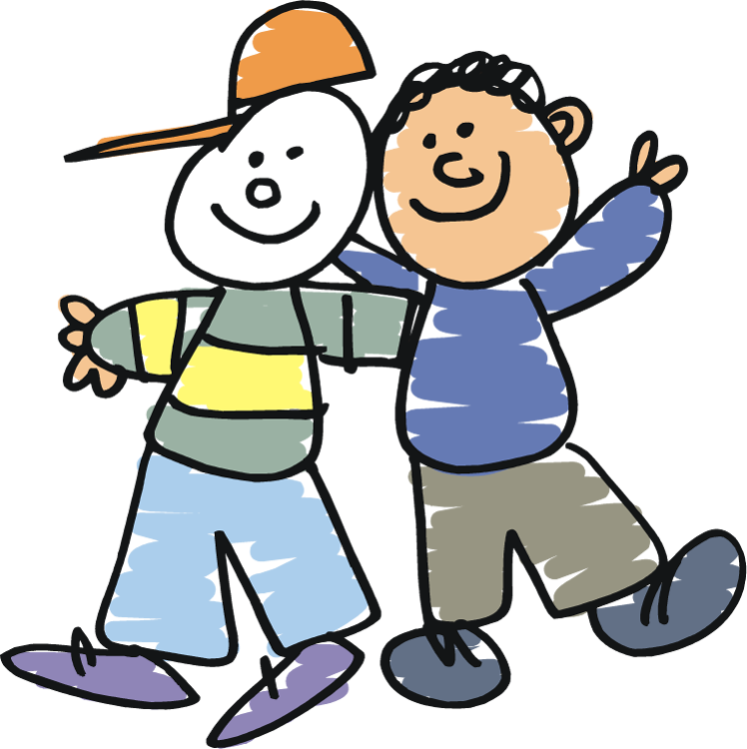
Who is your favorite person and why?
Favorite Person

Slide 9
The things you value in your favorite person are most likely the things that they also value in you
Favorite Person

Slide 10

Favorite Person

Slide 11
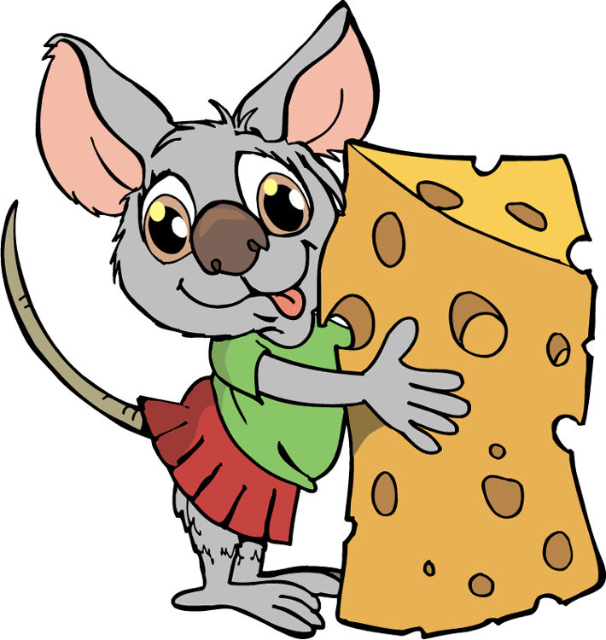
Summary
Move your body every day.
Eat as healthy as you can
Celebrate the body that you have

Slide 12
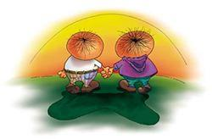
The End

