Slide 1

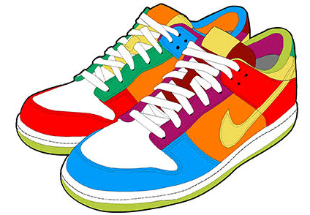
Walk a mile in their shoes

Slide 2


Slide 3

What is Empathy?

Slide 4
What is Empathy?
The ability to understand and share the feelings of another.

Slide 5
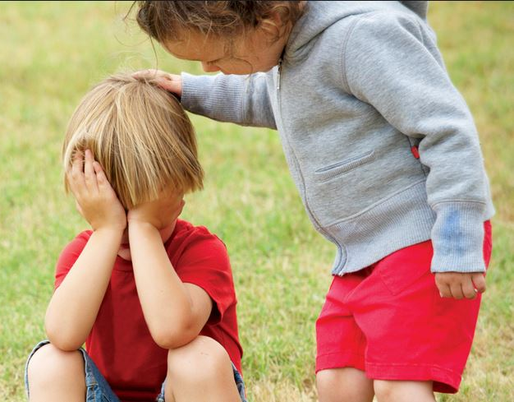
What is sympathy?

Slide 6
What is sympathy?
Feelings of pity and sorrow for someone else’s misfortune.

Slide 8


Slide 9

Notes:
Engage

Slide 10

Connection
Notes:
Engage

Slide 11
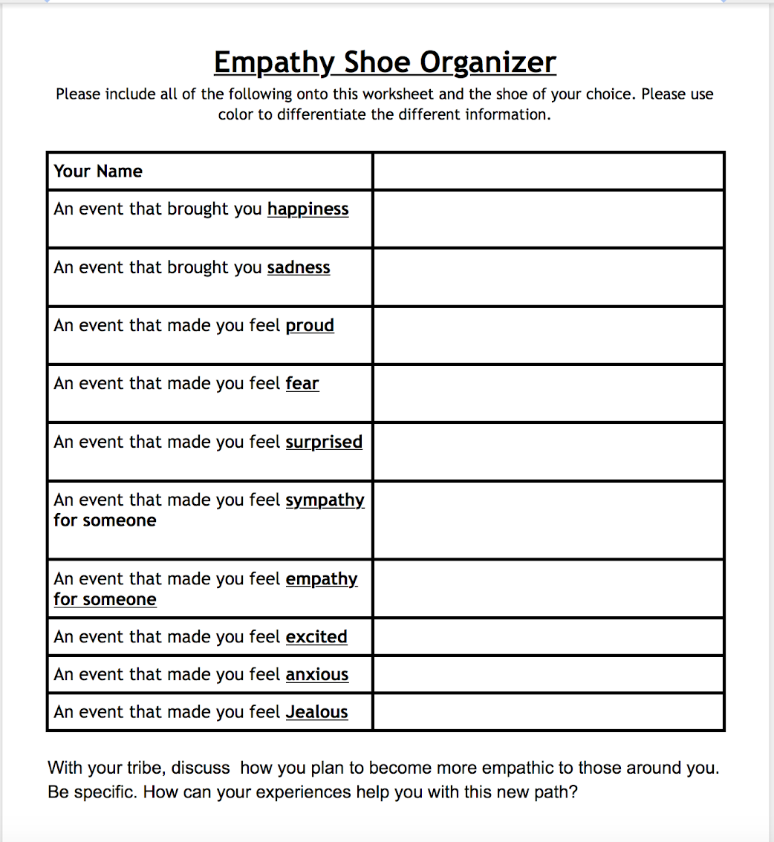
Building Empathy

Slide 12
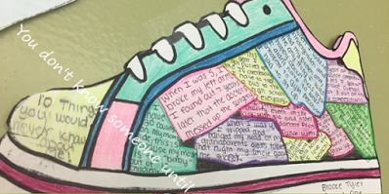
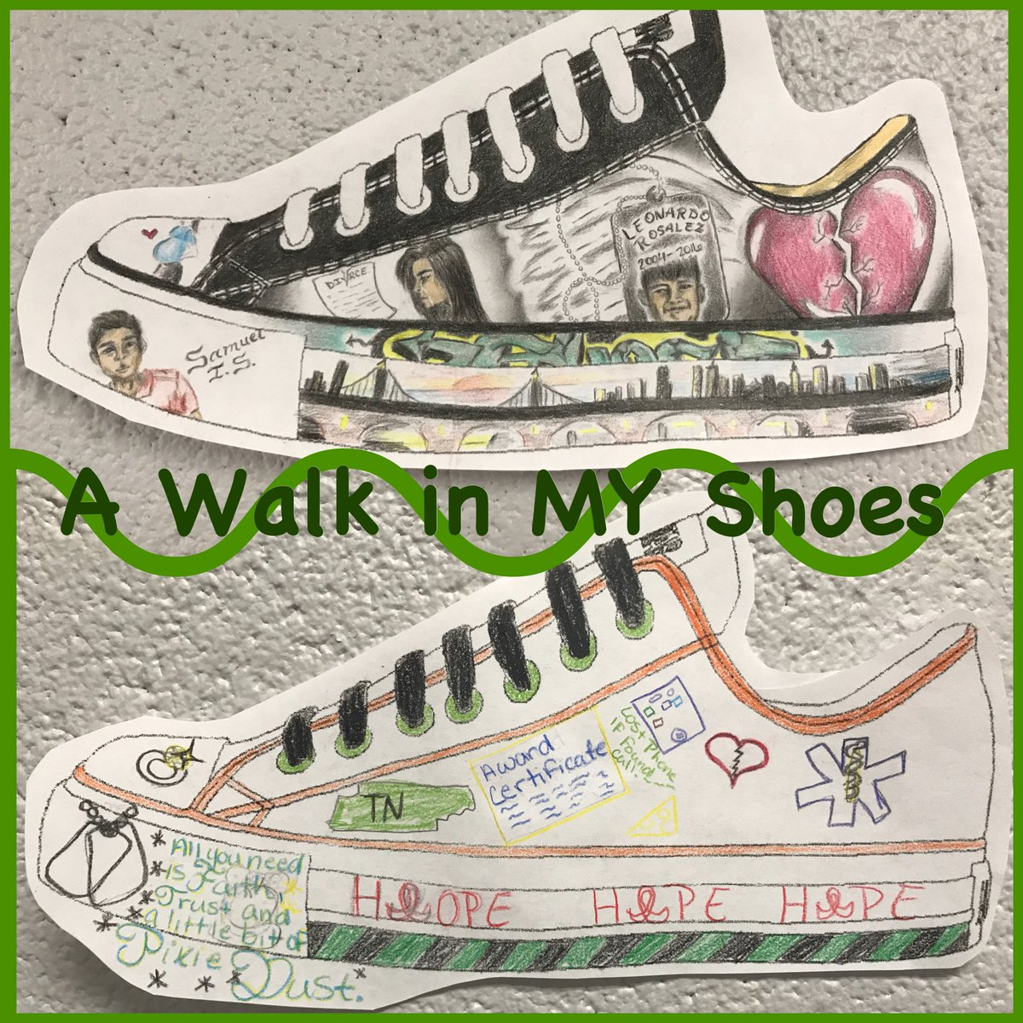
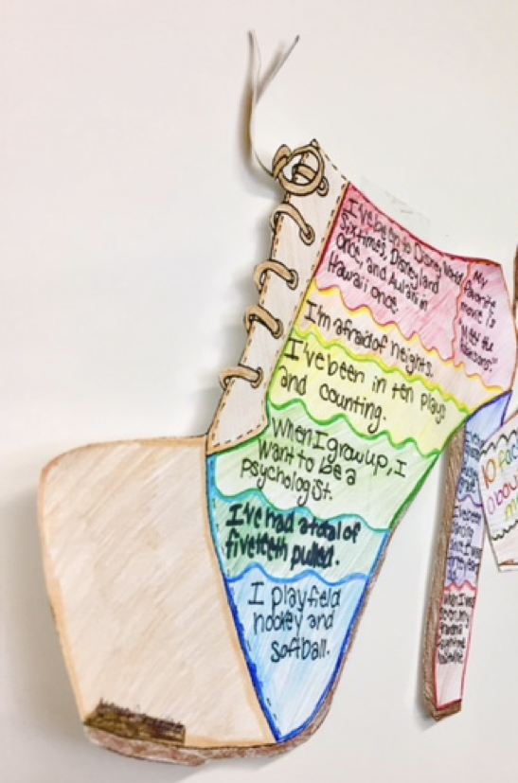

Slide 13
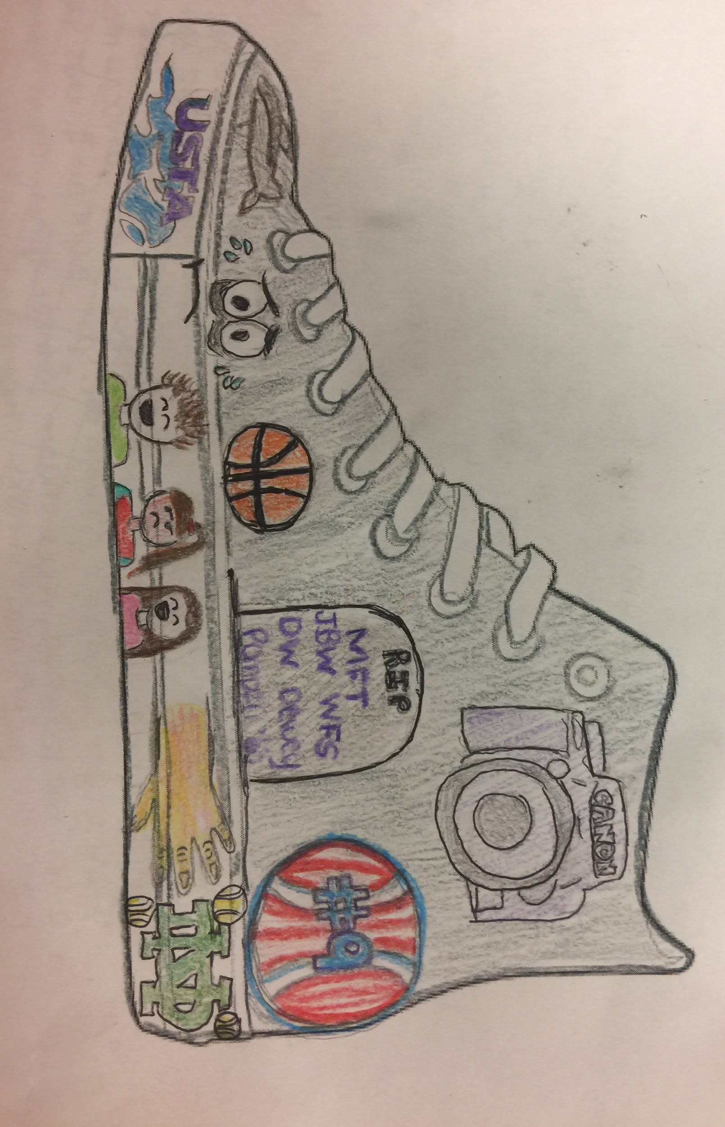
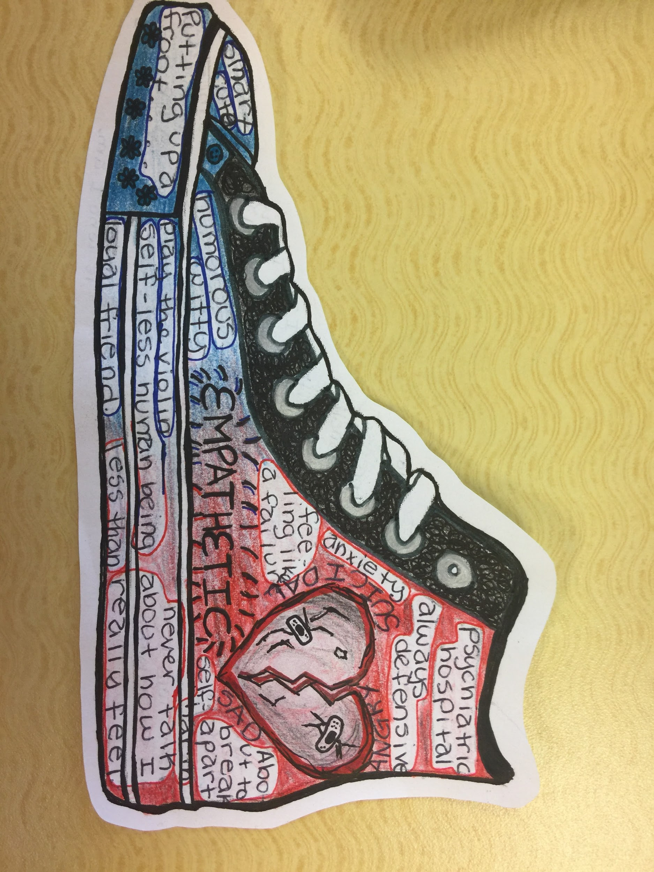
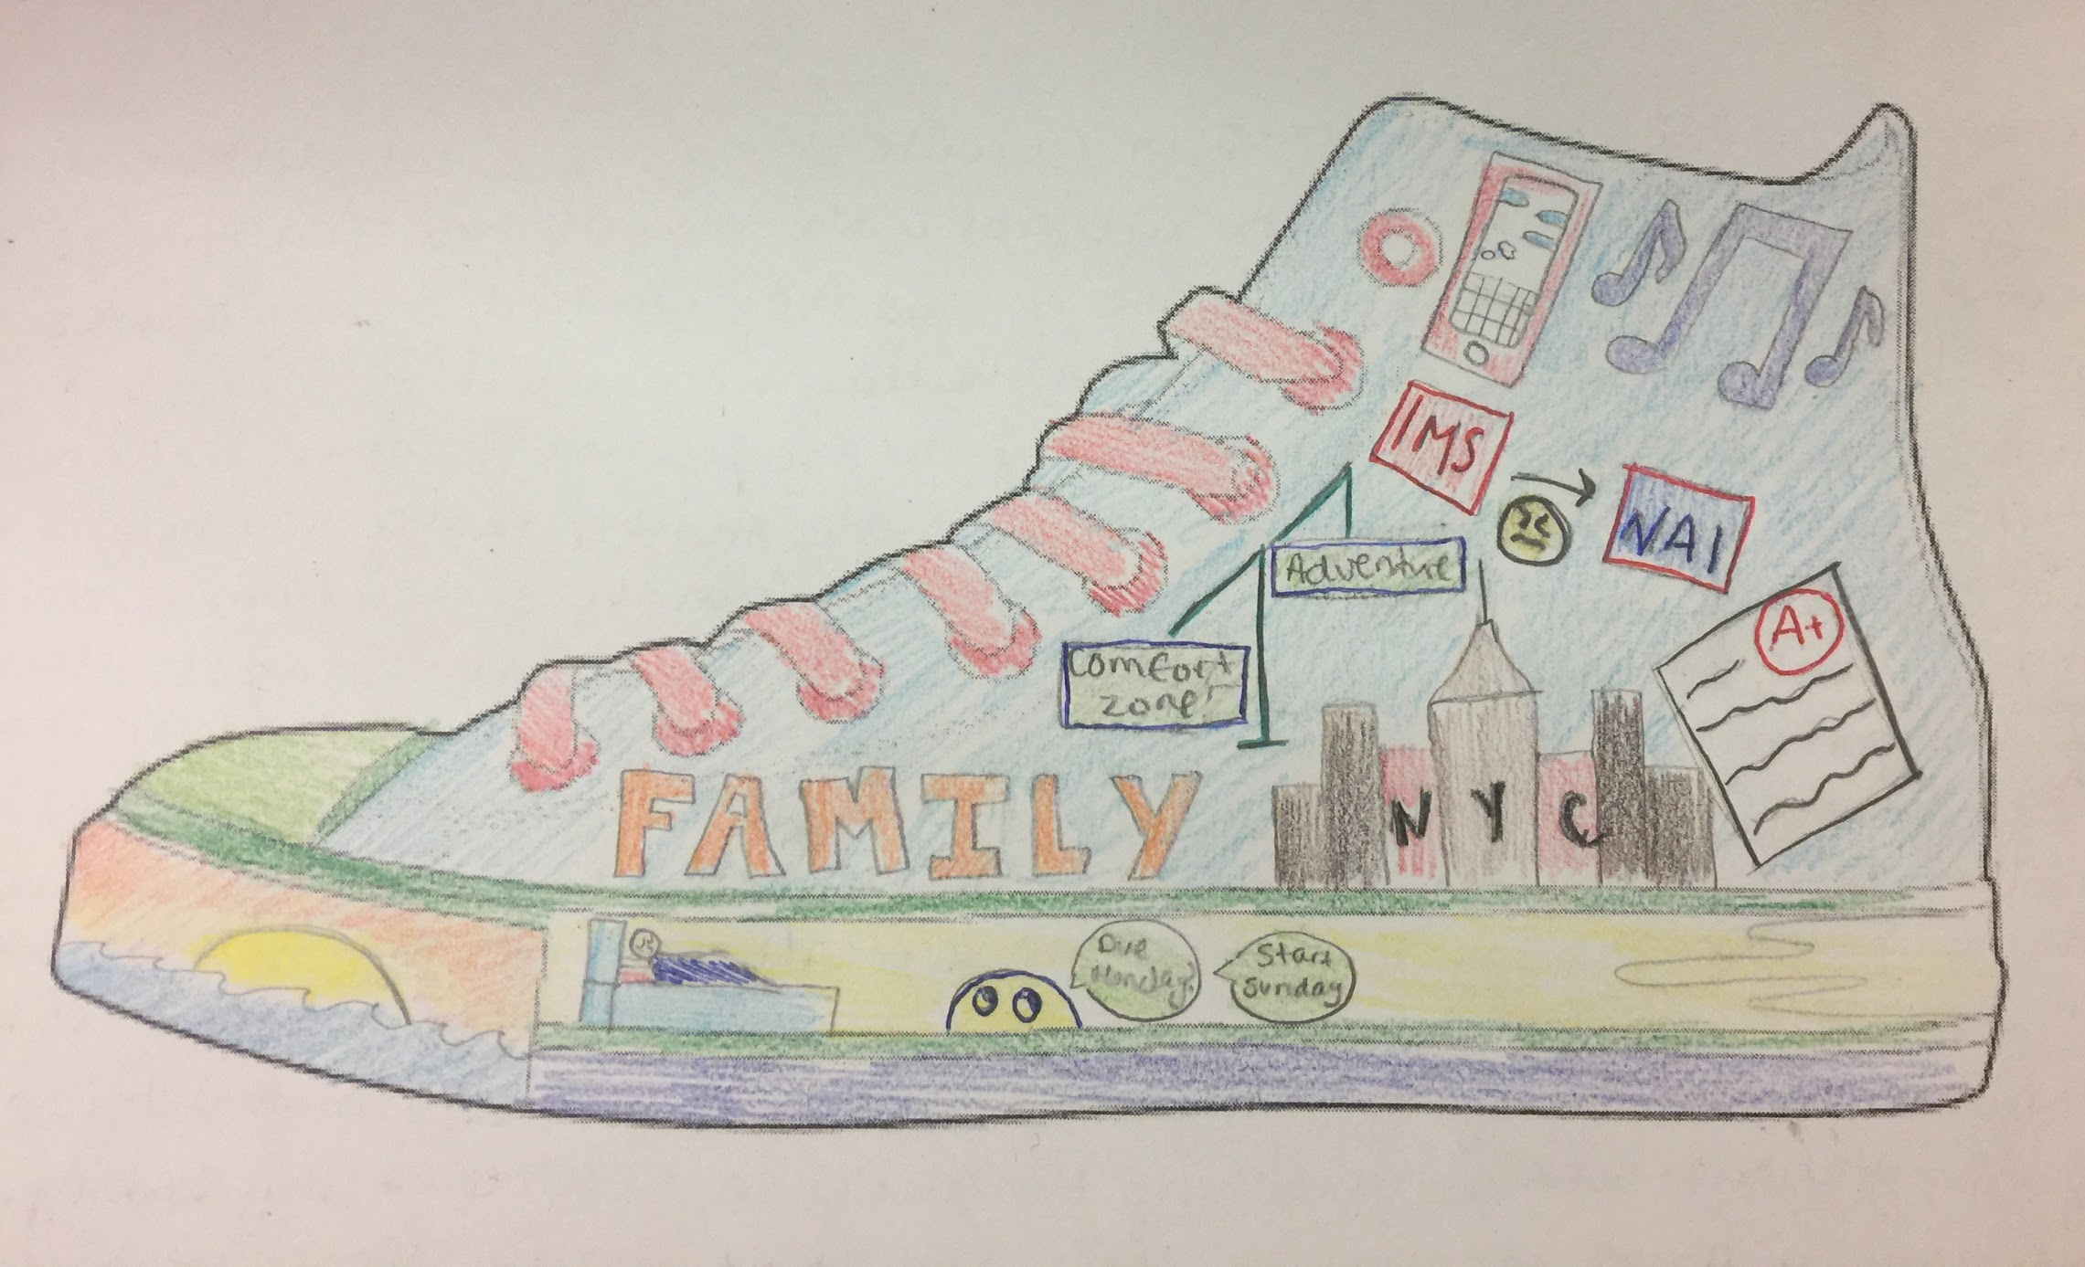

Slide 14
10 Facts on the shoe, it does not have to be from your worksheet
  Can be in pictures or words
  Back of shoe, you must write what it is like to walk in your shoes in a paragraph form.

Slide 15

When we put ourselves in another person’s shoes, we are often more sensitive to what that person is experiencing and are less likely to tease or bully them. By explicitly teaching students to be more conscious of other people’s feelings, we can create a more accepting and respectful school community.

