Slide 1
Building Healthy Relationships
“Things are never quite as scary when you’ve got a best friend”
-Bill Watterson

Slide 2
What Makes A Strong Relationship?
Pause for Discussion
Notes:
Ways to say no

Slide 3
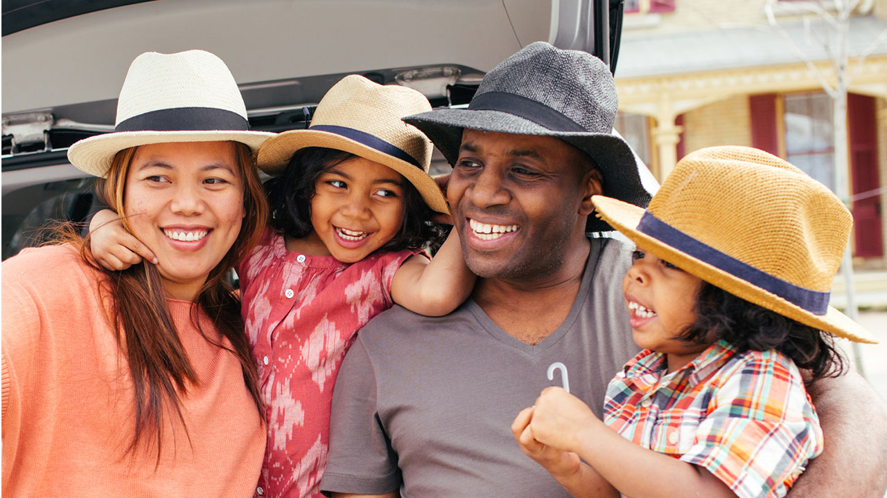
Family Relationships
People with strong family relationships feel connected to others
Qualities of strong relationships
Support each other
Show appreciation for each other
Spend quality time together
Use good communication skills
Show responsibility
Show respect
Source: Pixbay

Slide 4
Peer Relationships
Peer friendships are relationships with people around your age that you enjoy spending time with
Making new friends
Be yourself
Seek out teens who share your interests
Spend time together
Respect each other's differences
Friendships grow stronger with time as peers build trust
Source: Pixbay

Slide 5
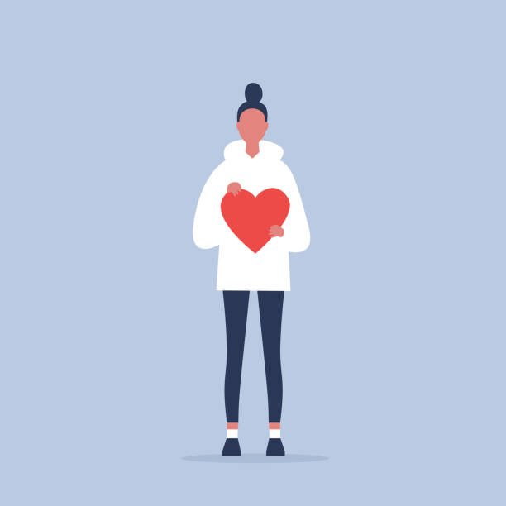
Dating Relationships
During teen years people may develop feelings of attraction to their friends or acquaintances
These feelings cause some teens to begin thinking about dating
Dating is a way to get to know people better
Group Dating-Spending time with groups of peers
Less pressure, easy to keep conversation going, less expensive
Individual Dating-Going out with just one person
A big step taken only for the right reasons
Parents will have input no when they feel you are ready for individual dating
Healthy relationships are built on caring, honest and respect
Source: Pixbay

Slide 6
Healthy Dating Relationships
Healthy relationships are built on mutual respect, caring, honesty and commitment
Set healthy boundaries-limits that protect you
Understand the consequences of your actions, places you go and people you spend time with can affect your safety, health and plans for the future
Dating Violence-When another person in a dating relationship tries to control their partner
Can be physical, emotional or psychological abuse
Ending relationships
Breakups can be difficult and may result in stress and depression. It is normal to feel lonely and hurt after a relationship ends but eventually these feelings fade with time

Slide 7
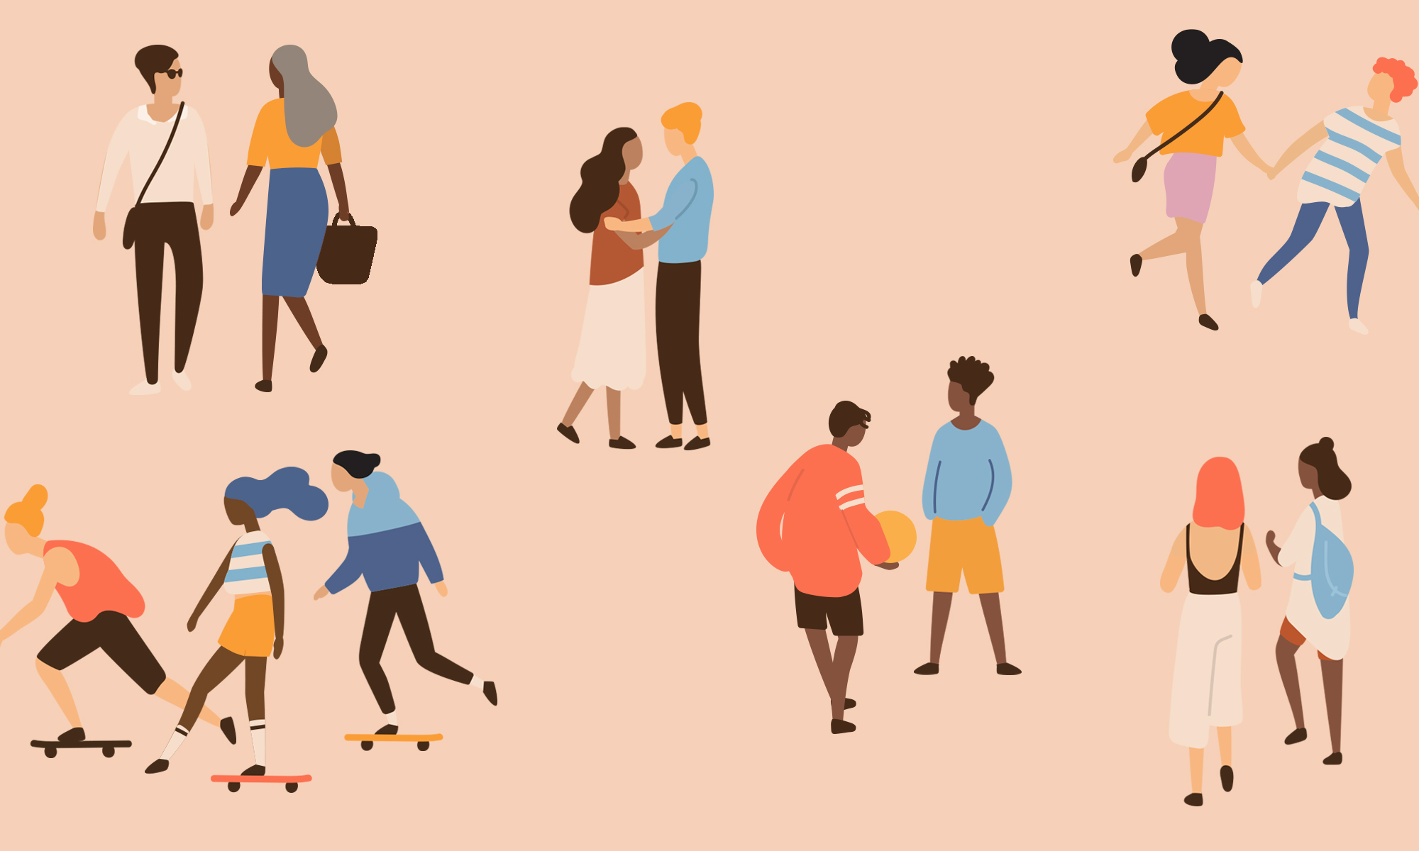
Relationship Reminders
Family Relationships
Guide for future interactions
Can become strained in adolescence
Peer Relationships
Build trust
Be authentic
Peer pressure
Know when to “go”
Romantic Relationships
Find someone you are comfortable with
Be yourself
Don’t forget your friends/family
Know the signs of abusive relationships
Communicate with adults in your life who have healthy relationships
Source: Pixbay

Slide 8
Application: Relationship Walkabout
Students will be divided into groups and travel throughout the room to write characteristics or examples of the following:
Healthy Family Relationships
Unhealthy Family Relationships
Healthy Peer Relationships
Unhealthy Peer Relationships
Healthy Dating Relationships
Unhealthy Dating Relationships

Slide 9
Exit Ticket
How do family relationships build the foundation for peer and dating relationships?
Source: giphy.com

